Slide 1
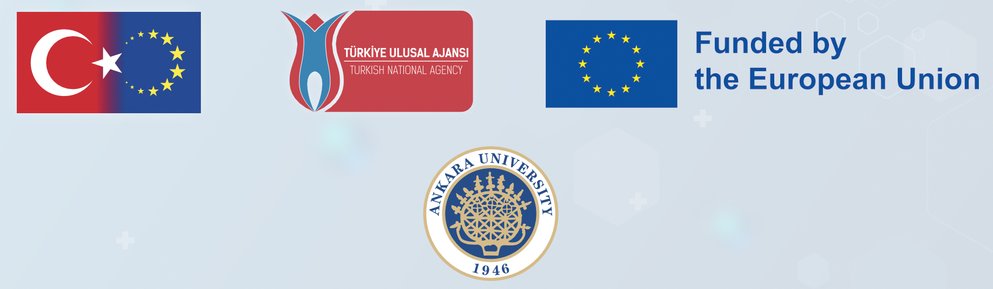

A UNIVERSAL STRATEGIC NECESSITY:
FROM MOLECULE TO DRUG
2022-1-TR01-KA220-VET-000088373

Slide 2
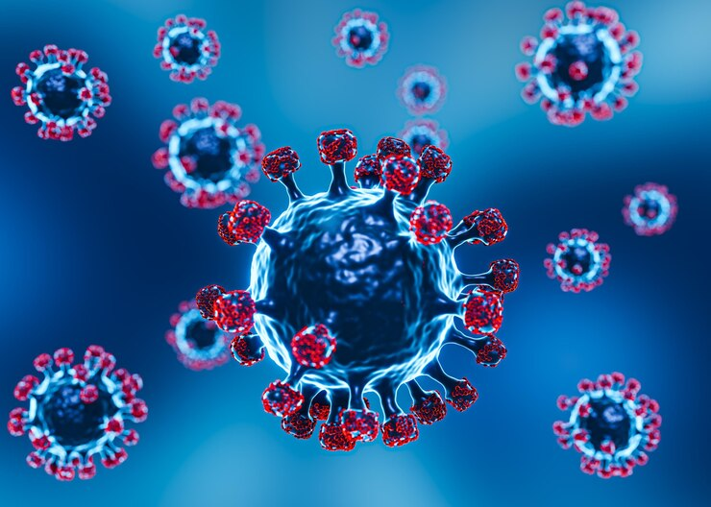
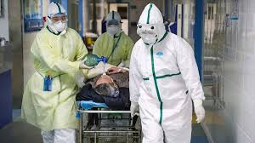
Rationale
Covid-19 pandemic (2020)
Preparedness for sudden and unexpected events
Ability to carry out drug and vaccine production activities
Need for trained personnel - proficient in professional standards and applied skills
Notes:
With the sudden and unexpected impact of the Covid-19 outbreak in 2020, it became clear that there was a great need for trained personnel who are experienced in practical applications and who are proficient in standard working methods to carry out drug and vaccine production studies to be developed against diseases.

Slide 3
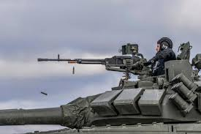
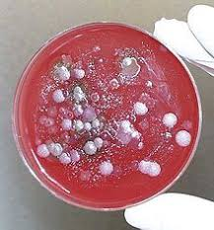

Rationale
Prediction: pandemics will occur more frequently
Combating biological agents = strategic importance
Strategies to increase drug production facilities in countries with increasing awareness
Notes:
It is predicted that pandemics will occur more frequently in the changing world after the Covid-19 outbreak. The fight against biological agents is of strategic importance. From time to time, such agents can also be used as weapons or economic attacks. Countries with increasing awareness on this issue are developing strategies to increase the number of drug production facilities.

Slide 4
Aims
To provide specialized workforce in the pharmaceutical sector with innovative theoretical and practical training applications
To prepare professional surge capacity in case of emergency drug demand To conduct R&D studies based on innovative drug research methods
To contribute to the sustainability of drug research and production processes of countries
Notes:
The aim of the project is;
To provide a specialized workforce in the strategically important pharmaceutical sector by training personnel with international experience through innovative theoretical and practical training practices
To make personnel experienced in pharmaceutical production ready to meet the need on an international scale in case of an emergency demand for medicines that may arise in extraordinary circumstances
To conduct R&D studies based on innovative pharmaceutical research methods
To contribute to the sustainability of countries' pharmaceutical research and production processes.

Slide 5




Project Partners
Project Coordination
ANKARA UNIVERSITY, Türkiye
TOBB ECONOMICS AND TECHNOLOGY UNIVERSITY, Türkiye
ANKARA HACI BAYRAM VELI UNIVERSITY, Türkiye
Partners
DOKUZ EYLUL UNIVERSITY, Türkiye
KOBAY INC., Türkiye
UNIVERSITA DEGLI STUDI DI PADOVA, ITALY
TRANSMISSIBLE BV, NETHERLANDS
UNIVERSIDADE DO MINHO, PORTUGAL
Notes:
The project is coordinated by Ankara University. Project partners include TOBB University of Economics and Technology, Ankara Hacı Bayram Veli University, Dokuz Eylül University and Kobay Joint Stock Company from Turkey. Partners in Europe are Universidade Do Minho from Portugal, Universita Degli Studi Di Padova from Italy and Transmissible Bv from the Netherlands.

Slide 6

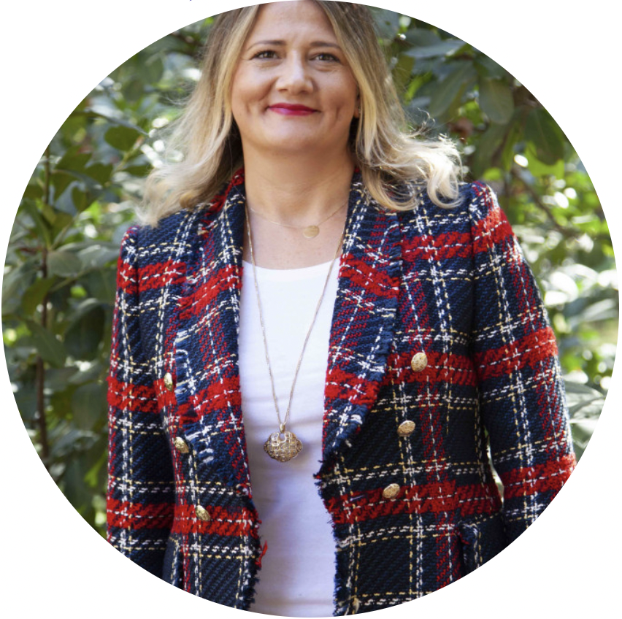
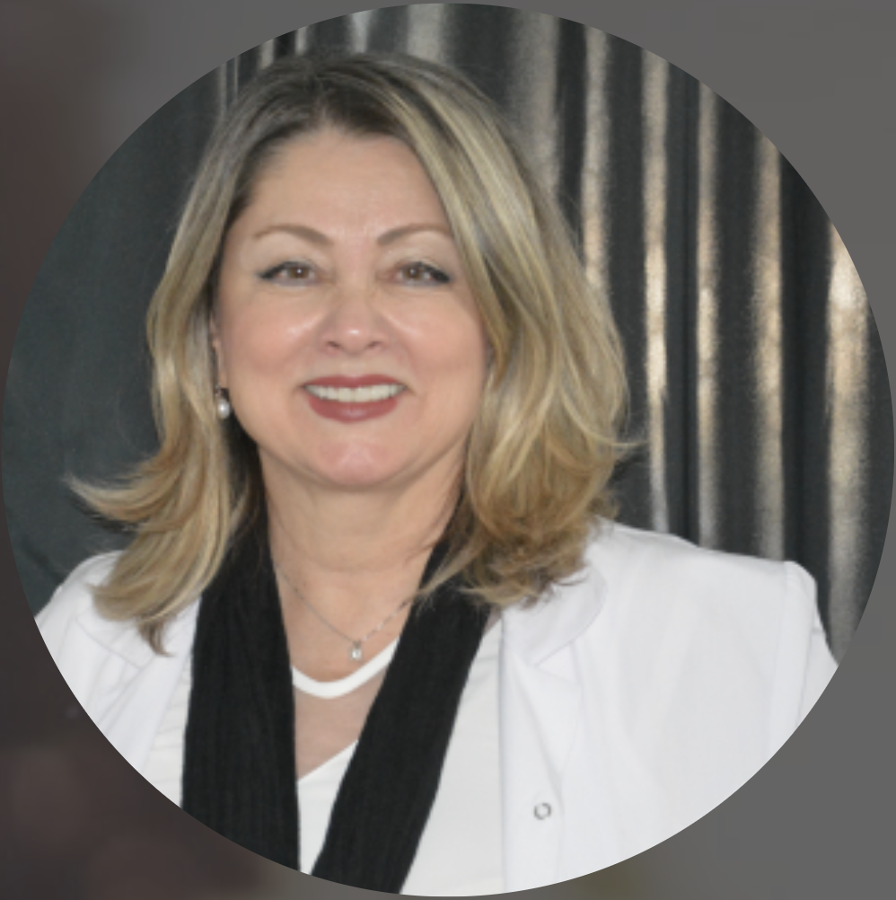
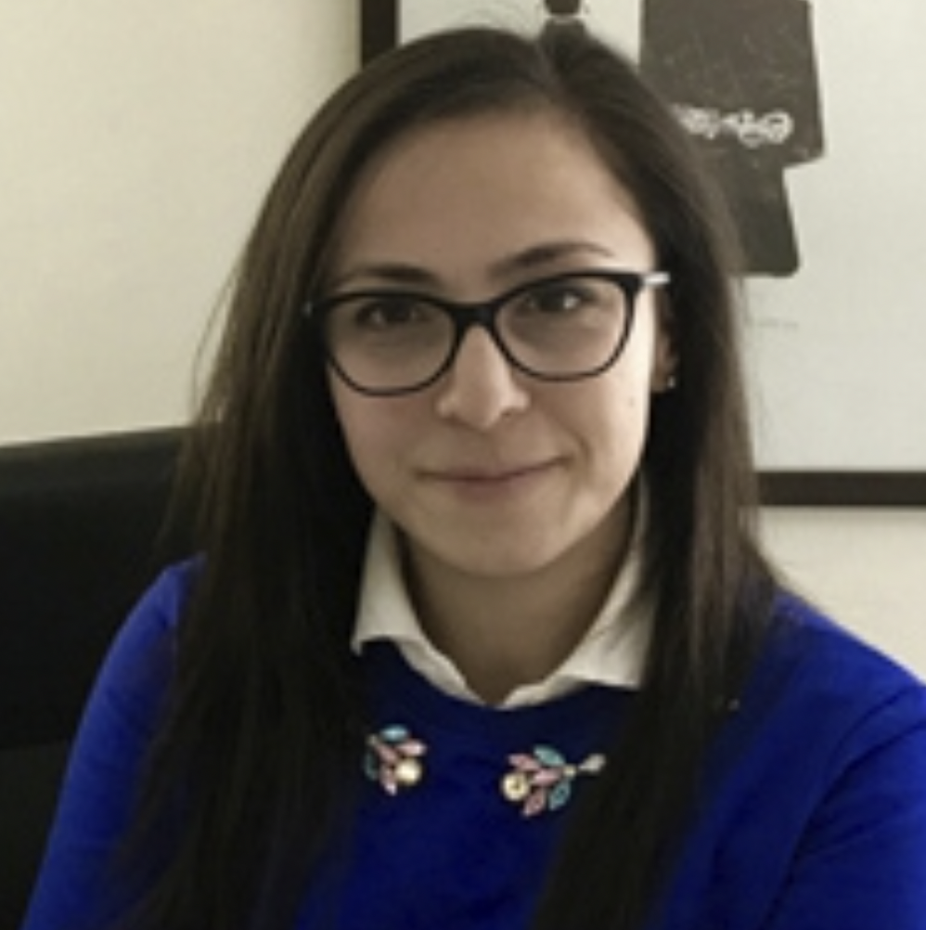
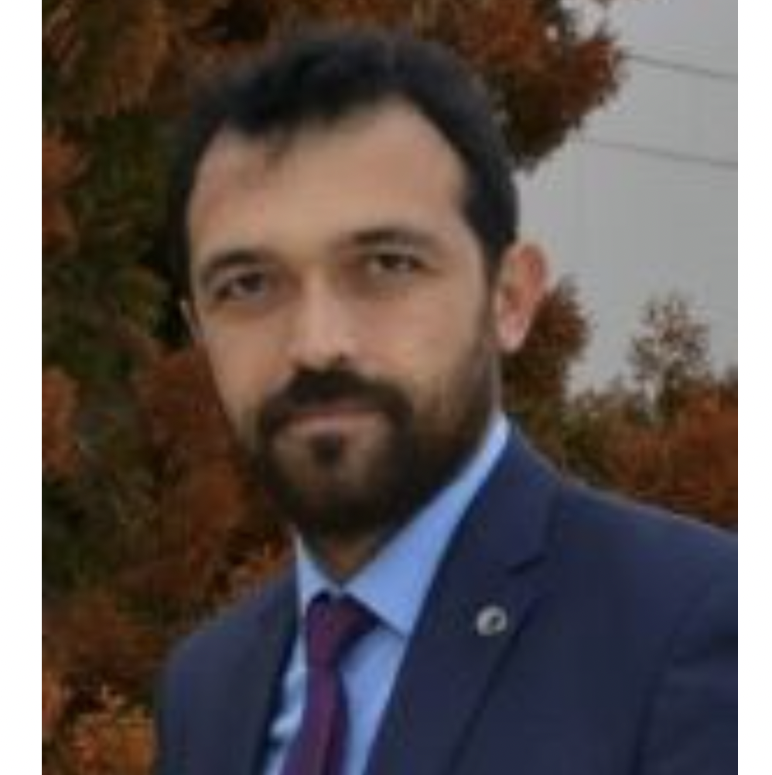
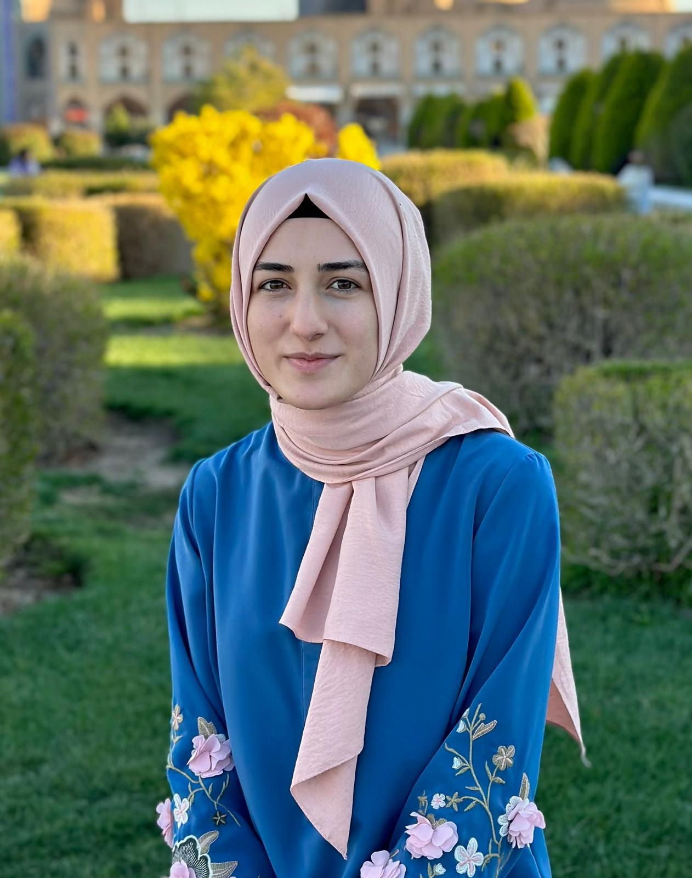
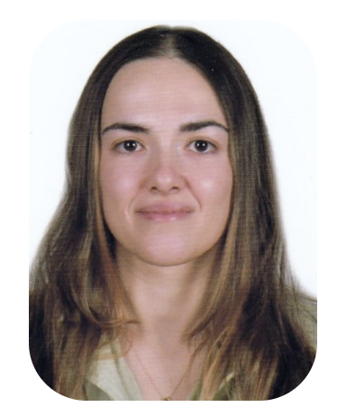
Project Team
ANKARA UNIVERSITY
Prof. Dr. Demet CANSARAN DUMAN (Molecular Biologist, Biotechnologist)
Prof. Dr. Gülçin SALTAN İŞCAN (Pharmacist)
Assoc. Prof. Dr. Açelya YILMAZER AKTUNA (Molecular Biologist, Nanotechnologist)
Dr. Mehmet ÖZDEMİR (Corporate Communications Coordinator)
Mine ENSOY (Molecular Biologist, Biotechnologist)
Res. Asst. Hale ALKAN (Molecular Biologist, Biotechnologist)
Notes:
Ankara University is the executive organization. Professor Doctor Demet CANSARAN DUMAN is the coordinator of the project. Ankara University team includes Professor Doctor Gülçin SALTAN İŞCAN, Associate Professor Doctor Açelya YILMAZER AKTUNA, Doctor Mehmet ÖZDEMİR, Mine ENSOY and Research Assistant Hale ALKAN.

Slide 7
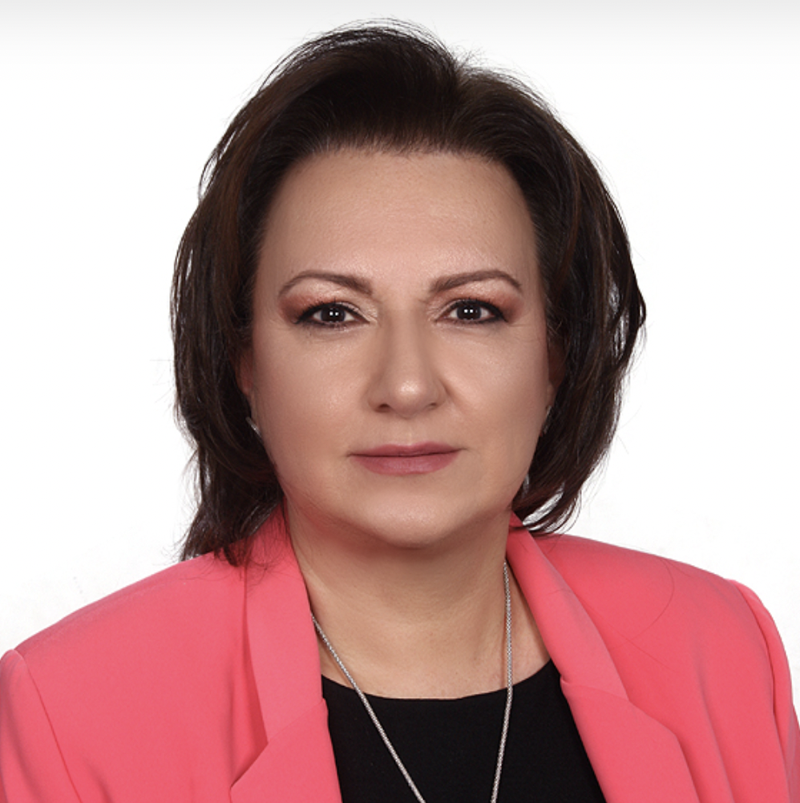

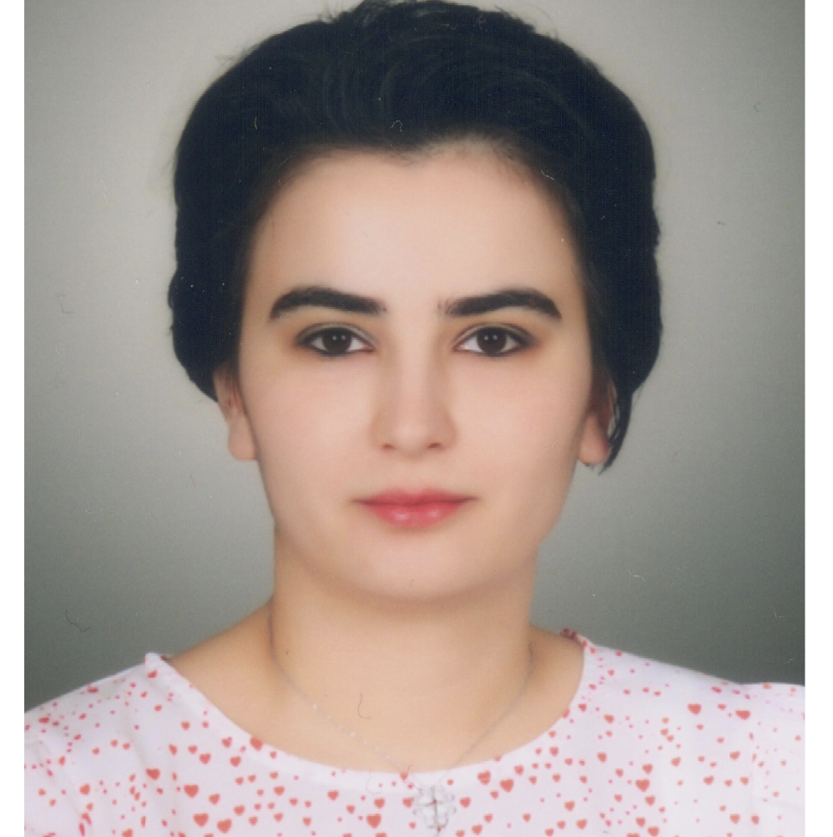


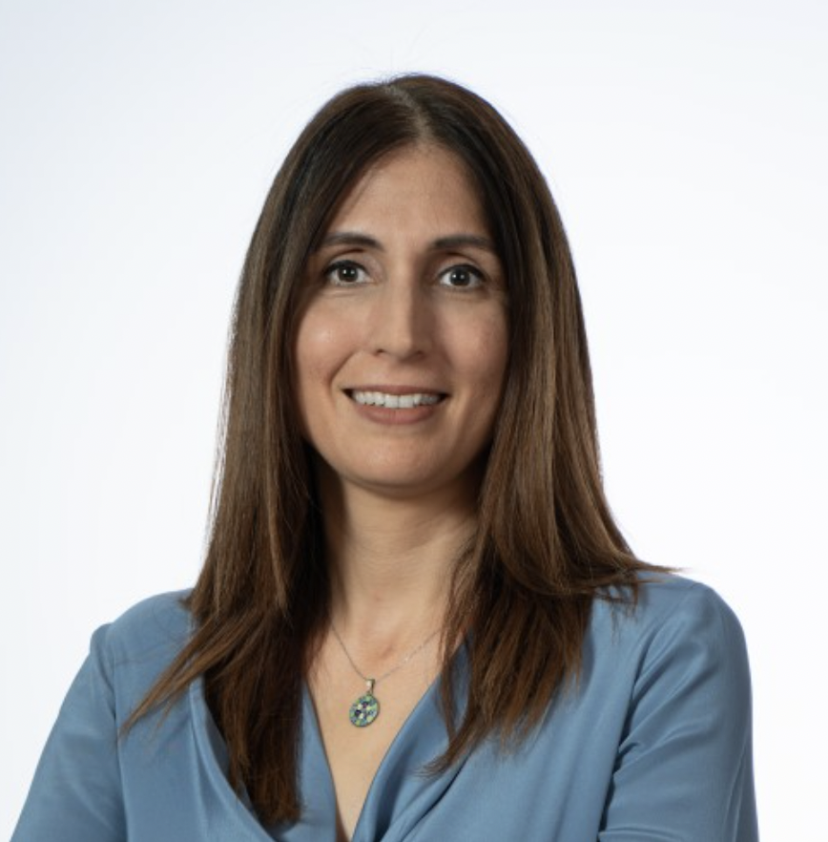
Project Team
TOBB ECONOMY AND TECHNOLOGY UNIVERSITY
Prof. Dr. Ayşegül TAYLAN ÖZKAN (Med. Doctor, Lab. Safety, Quality)
ANKARA HACI BAYRAM VELI UNIVERSITY
Prof. Dr. Emine ÖNER KAYA (Banking-Finance)
DOKUZ EYLÜL UNIVERSITY
Prof. Dr. Hülya AYAR KAYALI (Chemist, Biotechnologist)
Notes:
Professor Doctor Gülçin Ayşegül TAYLAN ÖZKAN from TOBB University of Economics and Technology, Professor Doctor Emine ÖNER KAYA from Ankara Hacı Bayram Veli University and Professor Doctor Hülya AYAR KAYALI from Dokuz Eylül University are in the project team.

Slide 8
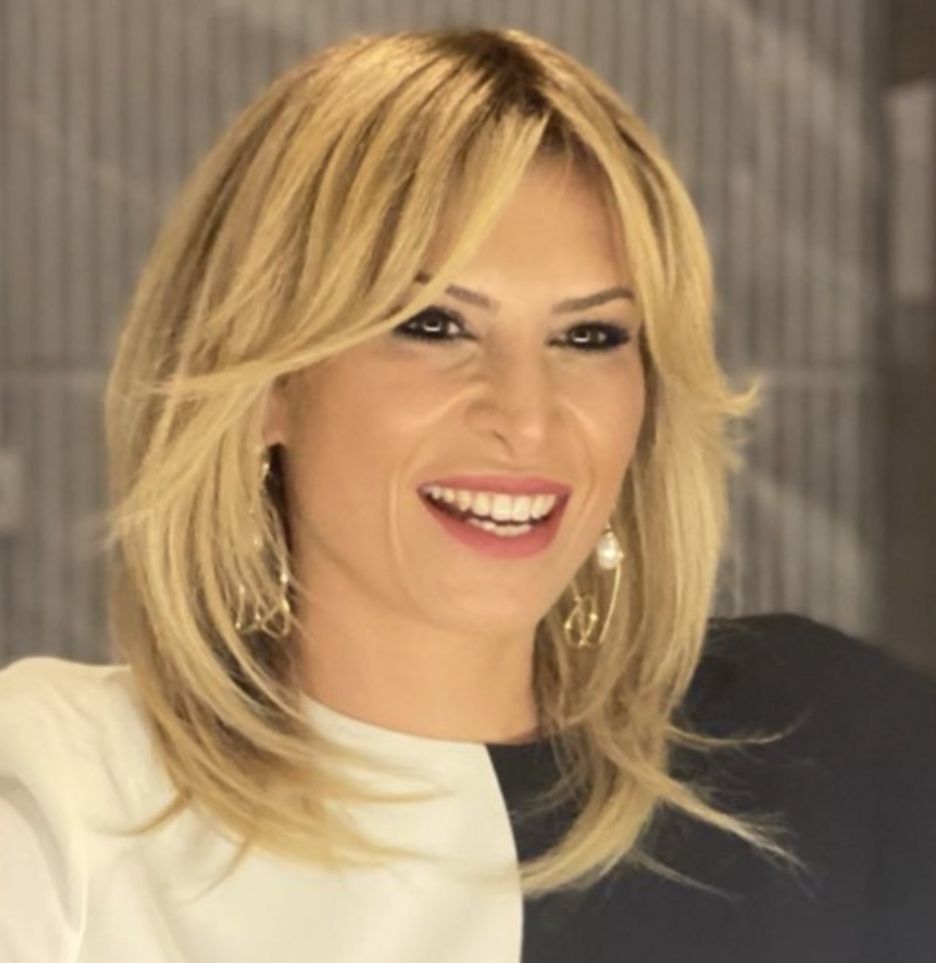
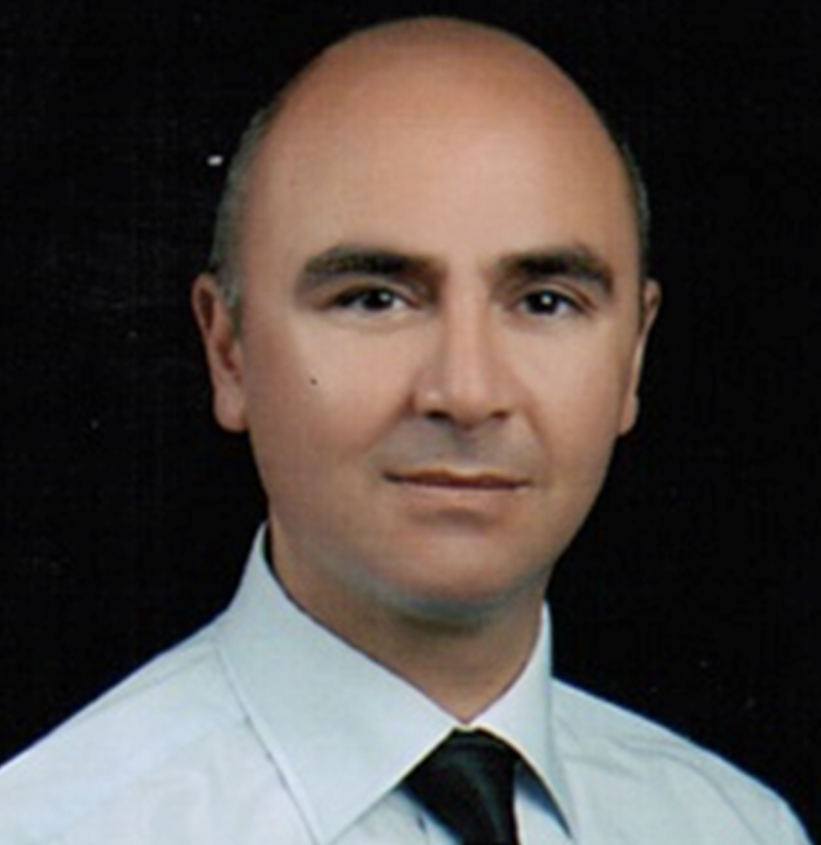


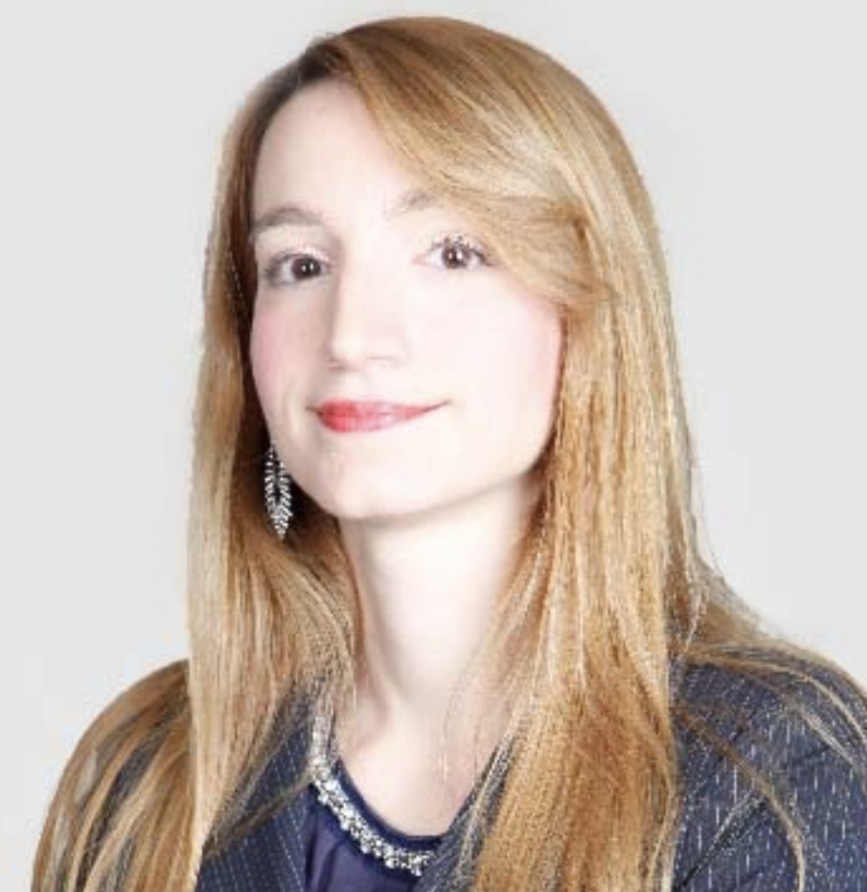
PROJE EKİBİ
KOBAY A.Ş.
Begüm BUĞDAYCI (Veterinarian)
Assoc. Prof. Dr. Kürşat DERiCi (Medical Doctor, Pharmacologist)
UNIVERSITA DEGLI STUDI DI PADOVA
Assoc. Dr. Lucia GEMMA DELOGU (Nanotechnologist)
Notes:
On behalf of Kobay Anonim Şirketi, Veterinarian Begüm BUĞDAYCI and Assoc. Prof. Dr. Kürşat DERiCi are in the project team.
Representing our international partner Universita Degli Studi Di Padova, Associate Professor Lucia GEMMA DELOGU is in the team.

Slide 9

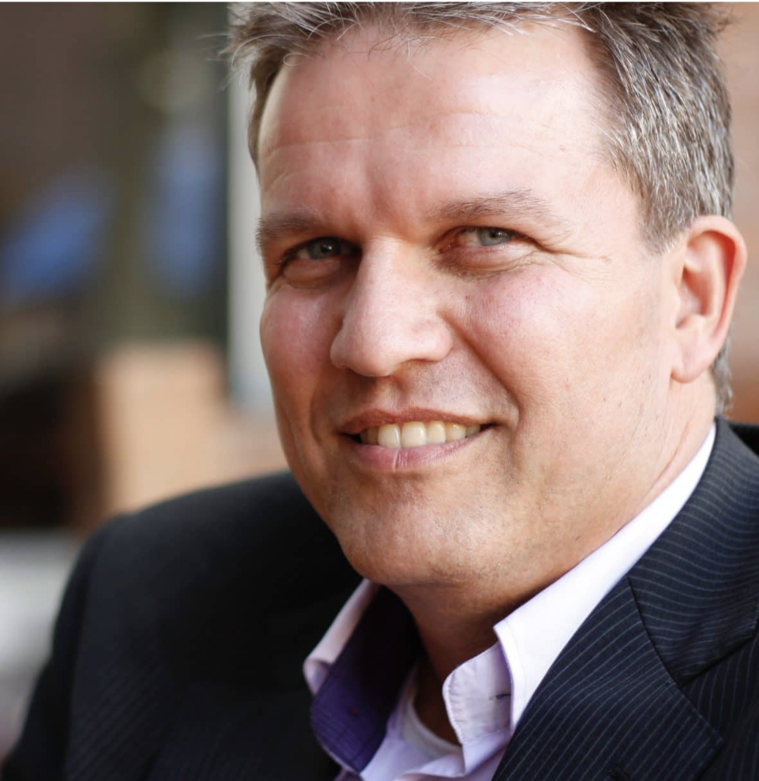

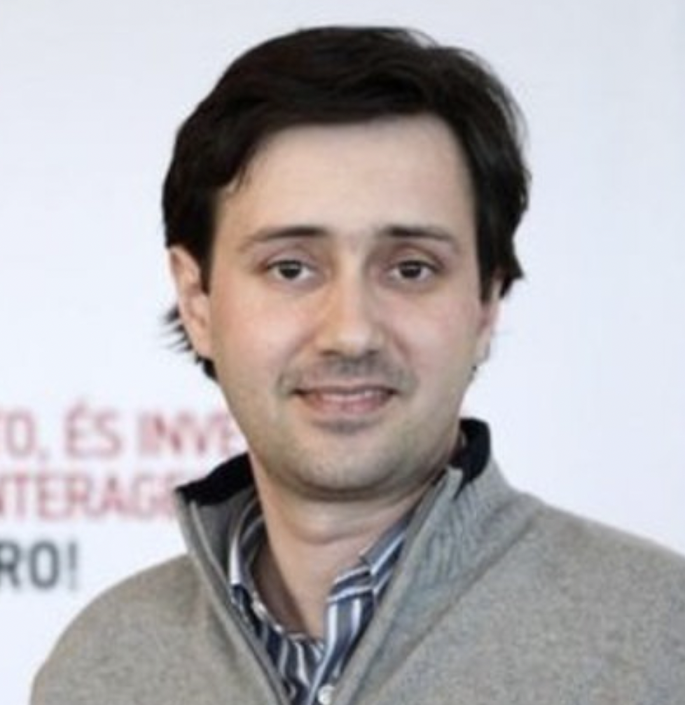
PROJE EKİBİ
TRANSMISSIBLE BV
Dr. Arnold BOSMAN (Director; public health specialist)
UNIVERSIDADE DO MINHO
Prof. Dr. Nuno S. OSÓRIO (Bioinformatics Expert)
Notes:
Our international project partners include Dr. Arnold BOSMAN from Transmıssıble Bv and Professor Dr. Nuno S. OSÓRIO from Universidade Do Minho.

Slide 10



PROJECT TARGET AUDIENCE
Biology
Medicine
Pharmacology
Bioengineering
Biotechnology
Bioinformatics
Pharmacy
Chemistry
Chemical Engineering
Veterinary Medicine
……….
Post Graduate Degree
Notes:
Our project is multidisciplinary and multisectoral in nature as it sheds light on the entire process from drug discovery to launch and follow-up. Therefore, our target audience covers many professional groups. These include Biology, Medicine, Pharmacology, Bioengineering, Biotechnology, Bioinformatics, Pharmacy, Chemistry, Chemical Engineering, Veterinary Medicine.

Slide 11
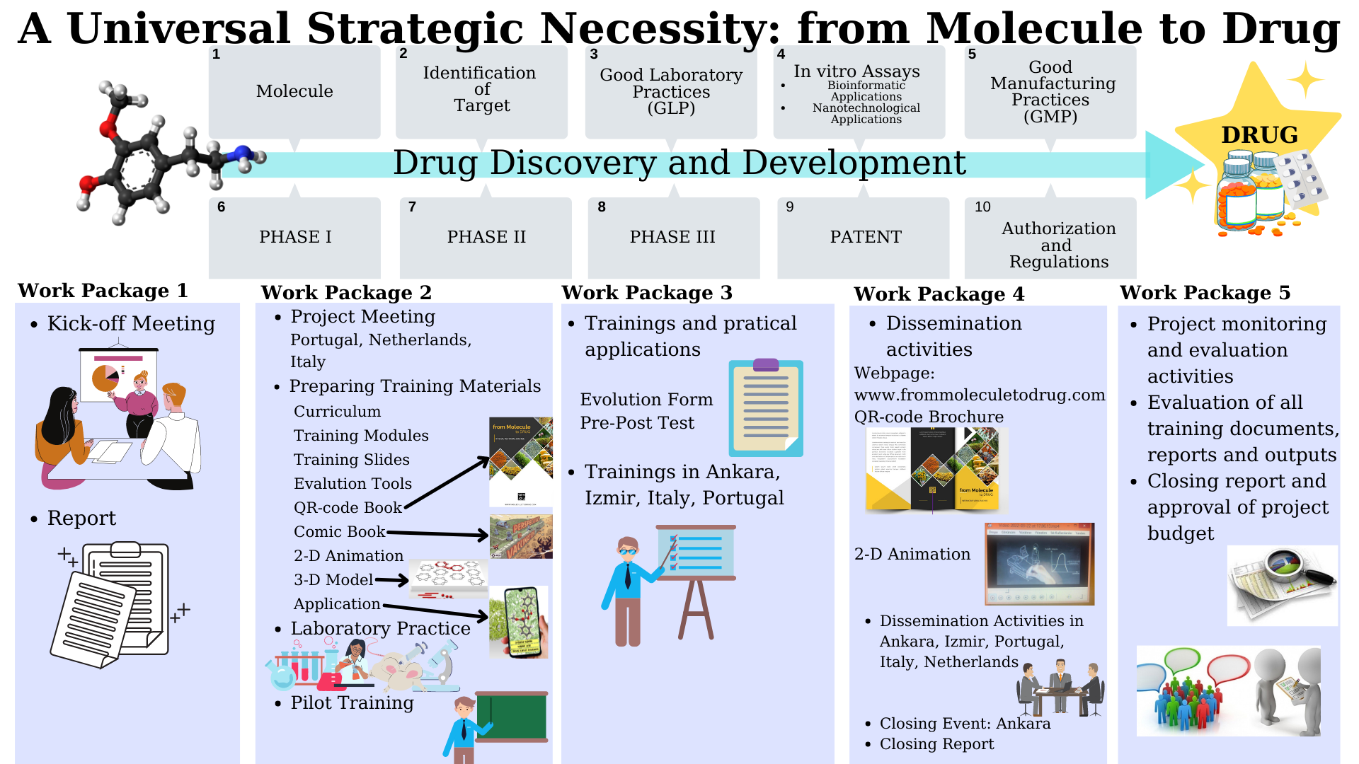
Notes:
Here is a visual of the stages of our project from a molecule to being monitored in the market. Our project aims to provide a holistic perspective on these stages. 5 work packages are envisaged for the execution of our project.

Slide 12
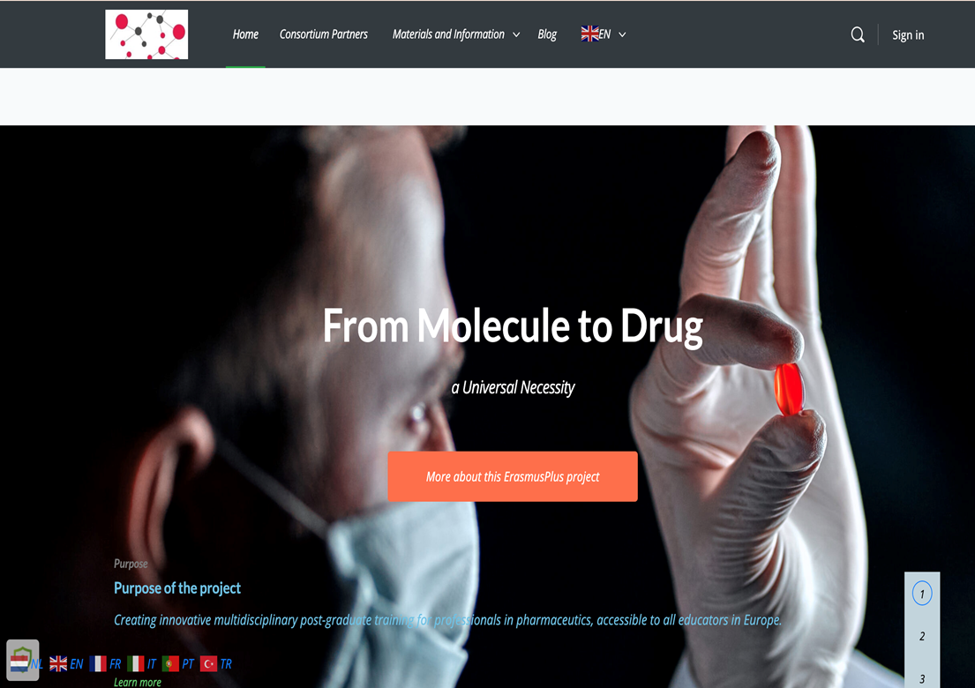
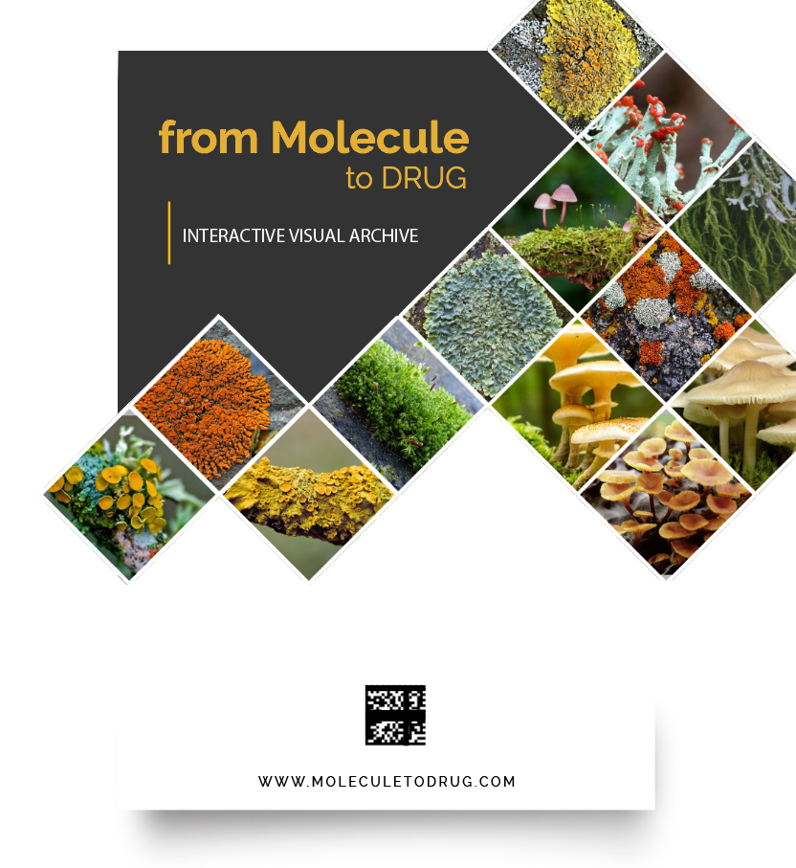
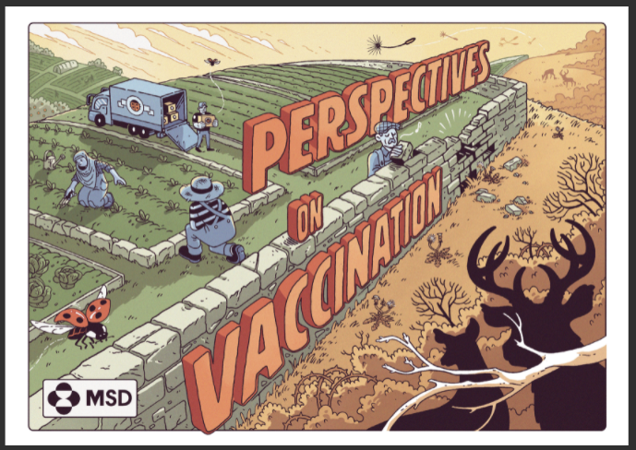
PROJECT MATERIALS
Webpage
Standardized Curriculum
Standardized Training Module
Standardized Training Slides
Online Assessment Tools
QR Code Book
Educational Comic Book
Lab Manual
Notes:
There are some materials among the project outputs. It has been committed to produce a web page, Standardized Education Curriculum, Standardized Education Module, Standardized Education Slides, Online Assessment Tools, QR code book, Funny book and Laboratory guide.

Slide 13
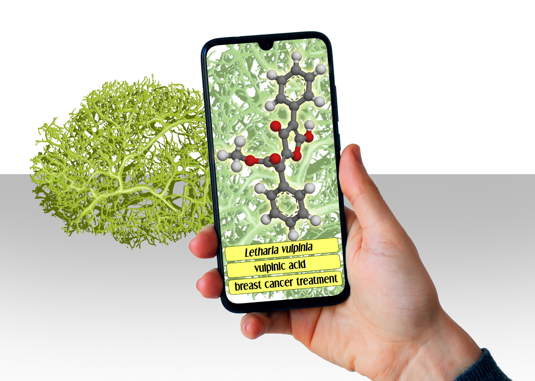
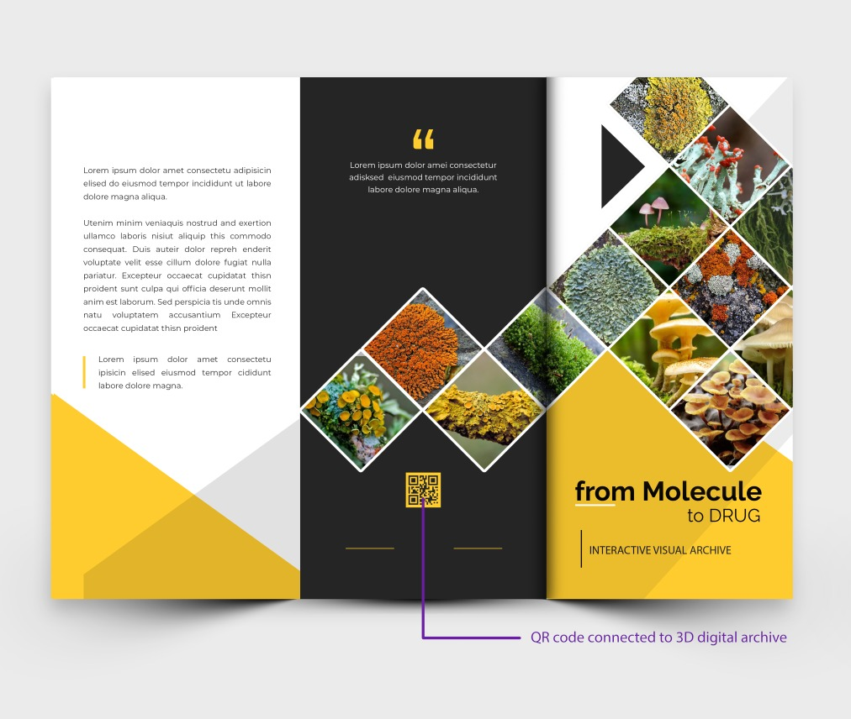
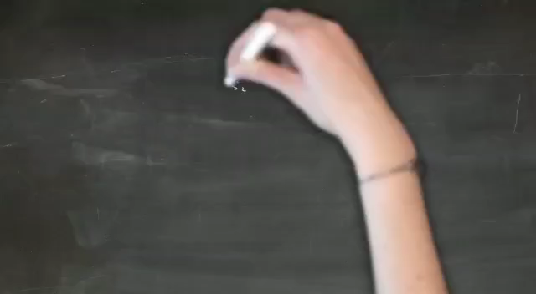
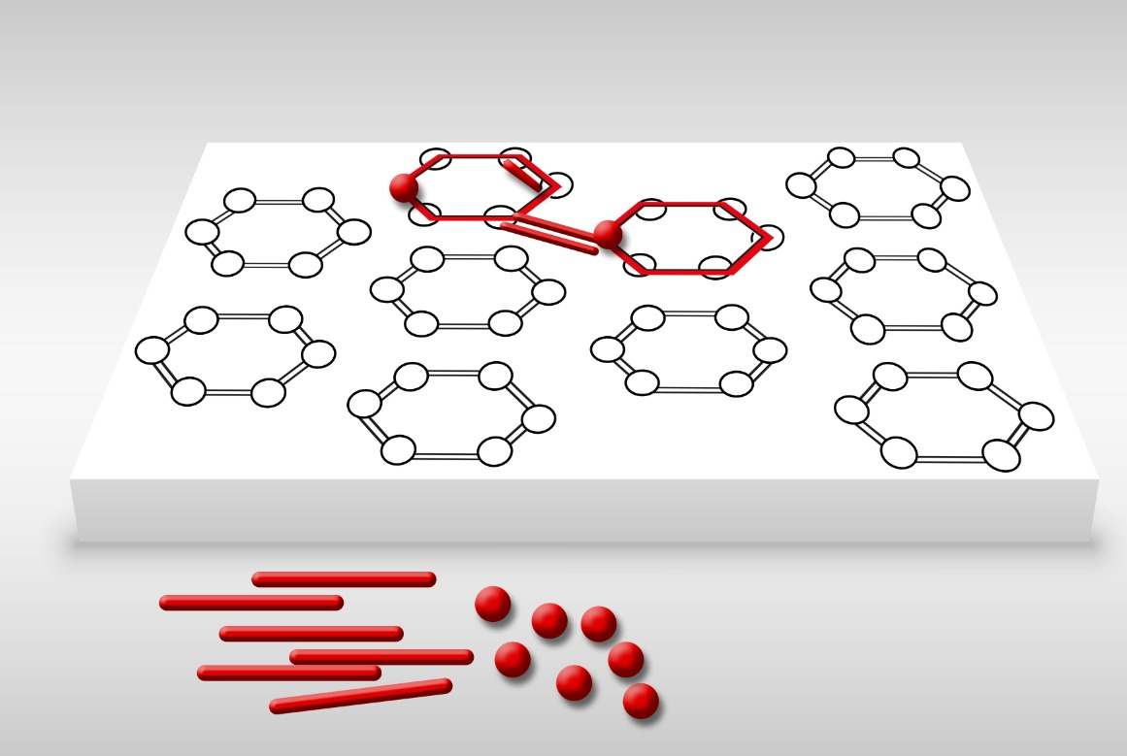
PROJECT MATERIALS
QR code brochure
2D short film
3D interactive model educational models created with 3D printing
Mobile application: Augmented reality and molecule recognition application
Scientific studies using innovative drug research methods
Notes:
These materials also include a brochure with a QR code, a 2D short film, 3D interactive model training models created with 3D printing, and a mobile application with augmented reality and molecule recognition application. The project also aims to increase human power in this field by conducting scientific studies using innovative drug research methods.

Slide 14
Day 1
Main Title | Subject
Registration and Login | Pretest, introductory activity and expectations
Introduction of the Training Program | Why M2D?
Discovery | Molecules
 | Bioinformatics in discovery
Innovative Drug Research Techniques | Preclinical studies overview
 | Bioinformatics in research
 | Recombinant DNA technology
 | Nanotechnology
 | Cell culture and xCELLgience
 | In vivo testing and GLP
End of day evaluation | What do we remember?
Notes:
Proje kapsamındaki eğitimler sahada çalışan kişilerin işlerinden uzun süre ayrılamayacakları da göz önüne alınarak iki günde yoğun bir programla gerçekle ştirilmektedir. Yüz yüze yapılan eğitimler yetişkin eğitimi uygulamaları doğrultusunda interaktif ve katılımcı bir yaklaşımla yürütülmektedir. Eğitimin etkinliğini değerlendirmek amacıyla ön test uygulanarak katılımcıların hazır bulunuşlukları değerlendirilmektedir. Akabinde molekül keşfinden itibaren süreçle ilgili bilgilendirmeye devam edilmektedir.

Slide 15
2. GÜN
Main Title | Subject
Development | Clinical phase studies and GCP
Production and Quality | Laboratory safety and security
 | Good manufacturing practices (GMP)
Registration | Technical requirements, pharmacopoeia, licensing and patenting process
Distribution | Compatibility, pharmacovigilance
Overview | Case study: Thalidomide disaster
 | Success story: Gilurubin
 | Presentation of project outcomes
Closing | Posttest, comparison of expectations, overall evaluation of the training
 | Certification ceremony
Notes:
The training program continues intensively on the second day, and in this context, the process of drug development and the process afterwards is discussed. Finally, the entire process is reviewed with a case study and the effect of the training on the knowledge level is evaluated by conducting a post-test. After the feedback from the participants about the training is received, a "certificate of participation" is presented to the individuals who attend the training full-time.

Slide 16
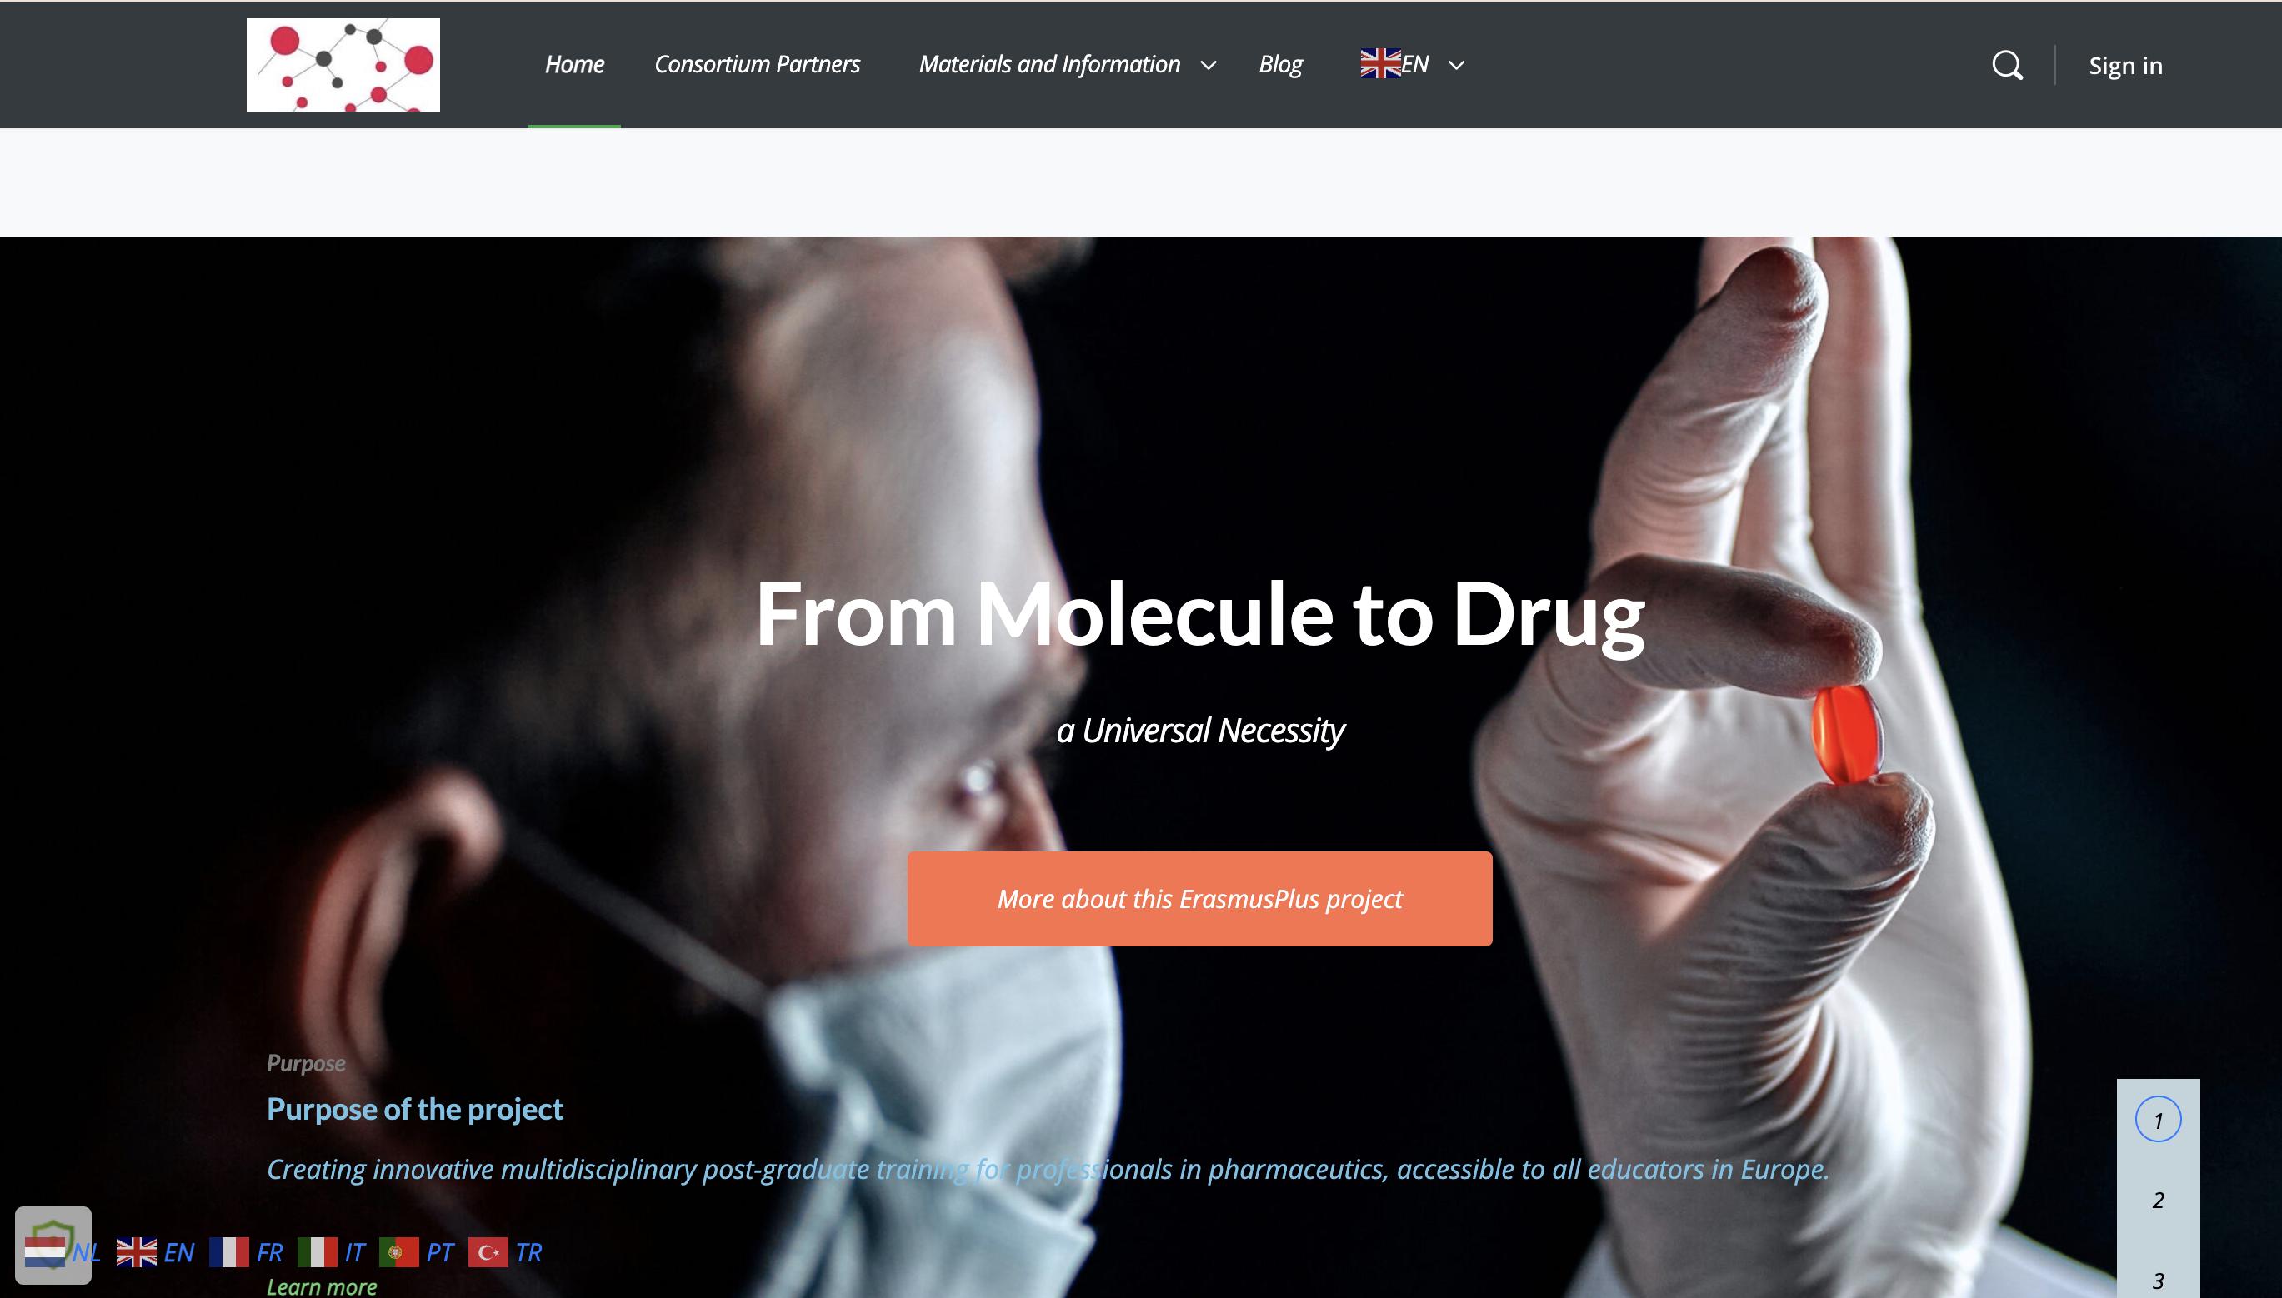
PROJECT SOCIAL MEDIA ACCOUNTS
https://frommoleculetodrug.com/
Linkedin
  From Molecule to Drug
Instagram
  Frommoleculetodrug
Twitter
  @moleculetodrug
Notes:
Projenin ilerlemesine ilişkin duyurular sosyal medya hesaplarından takip edilebilir. Oluşturulan web sayfasında projeye ilişkin tüm çıktılar yer almaktadır. Projenin daha geniş kitlelere ulaşabilmesi için eğitimlere online olarak ulaşılabilmektedir.

Slide 17




This document was prepared for the Erasmus Project
"2022-1-TR01-KA220-VET-000088373
A UNIVERSAL STRATEGIC NECESSITY: FROM MOLECULE TO DRUG»
Supported by the European Commission within the scope of the Erasmus+ Program. However, the European Commission and the Turkish National Agency cannot be held responsible for the opinions expressed here.
Notes:
A universal necessity: From Molecule to Medicine Project is supported by the European Commission within the Erasmus+ / European Solidarity Programme. The content herein reflects the author's views, for which the European Commission and the Turkish National Agency cannot be held responsible.«

Slide 18
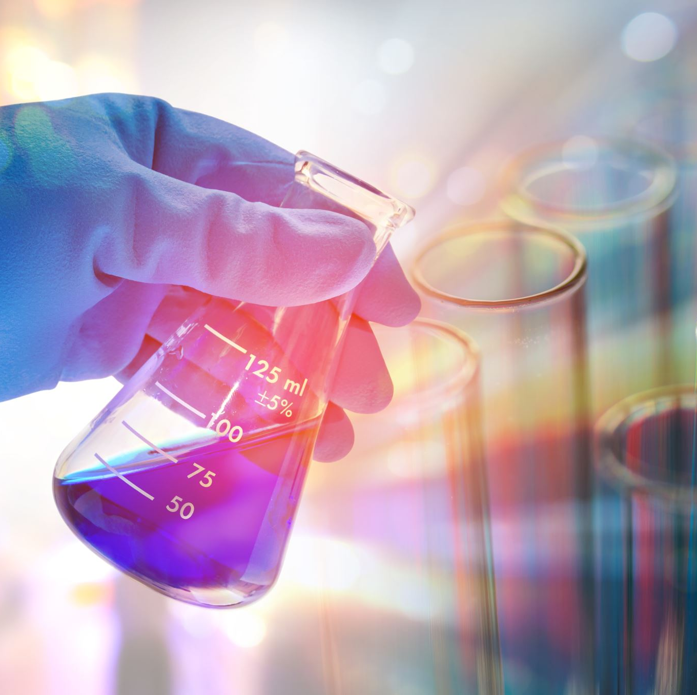
Thank You
Notes:
We would like to thank the European Commission for their support of our project, all our members who contributed to the project team, and everyone who participated in the activities within the scope of the project.

