Slide 1
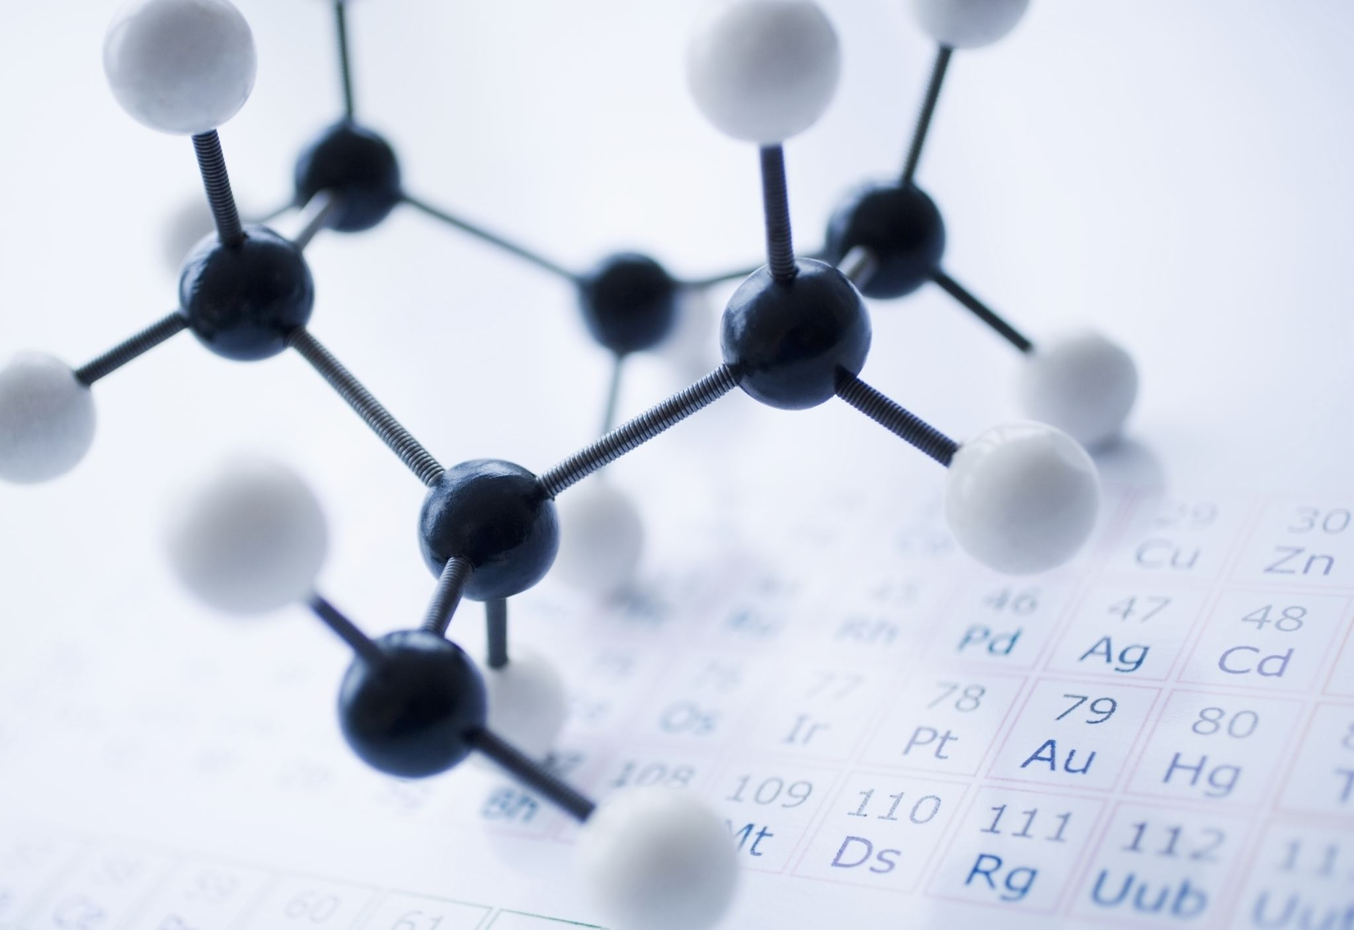
DISCOVERY 1: MOLECULES
From Molecule to Drug
Prof. Dr. Demet CANSARAN DUMAN
Notes:
In this session, the first stage of drug discovery, the molecule, will be discussed.

Slide 2
Learning Objectives
Identify
the importance of molecules
Recall
Explain
the first step of the drug production phase in drug research and revealing the potential to become a drug candidate.
Interpret
the importance of mechanism of action of drug candidate molecules
the key principle of discovery of molecules
Notes:
In this session, your learning objectives are structured into four key areas: defining, remembering, explaining, and interpreting. By the end of our time together, you will be able to define the critical role of molecule discovery in drug research and recall the structures of essential molecules and their importance in this field. Additionally, you will explain the structure and potential activity of molecules that mark the beginning of the drug production process and show promise as drug candidates. Finally, you will interpret the structural and functional characteristics of these potential drug molecules.

Slide 3
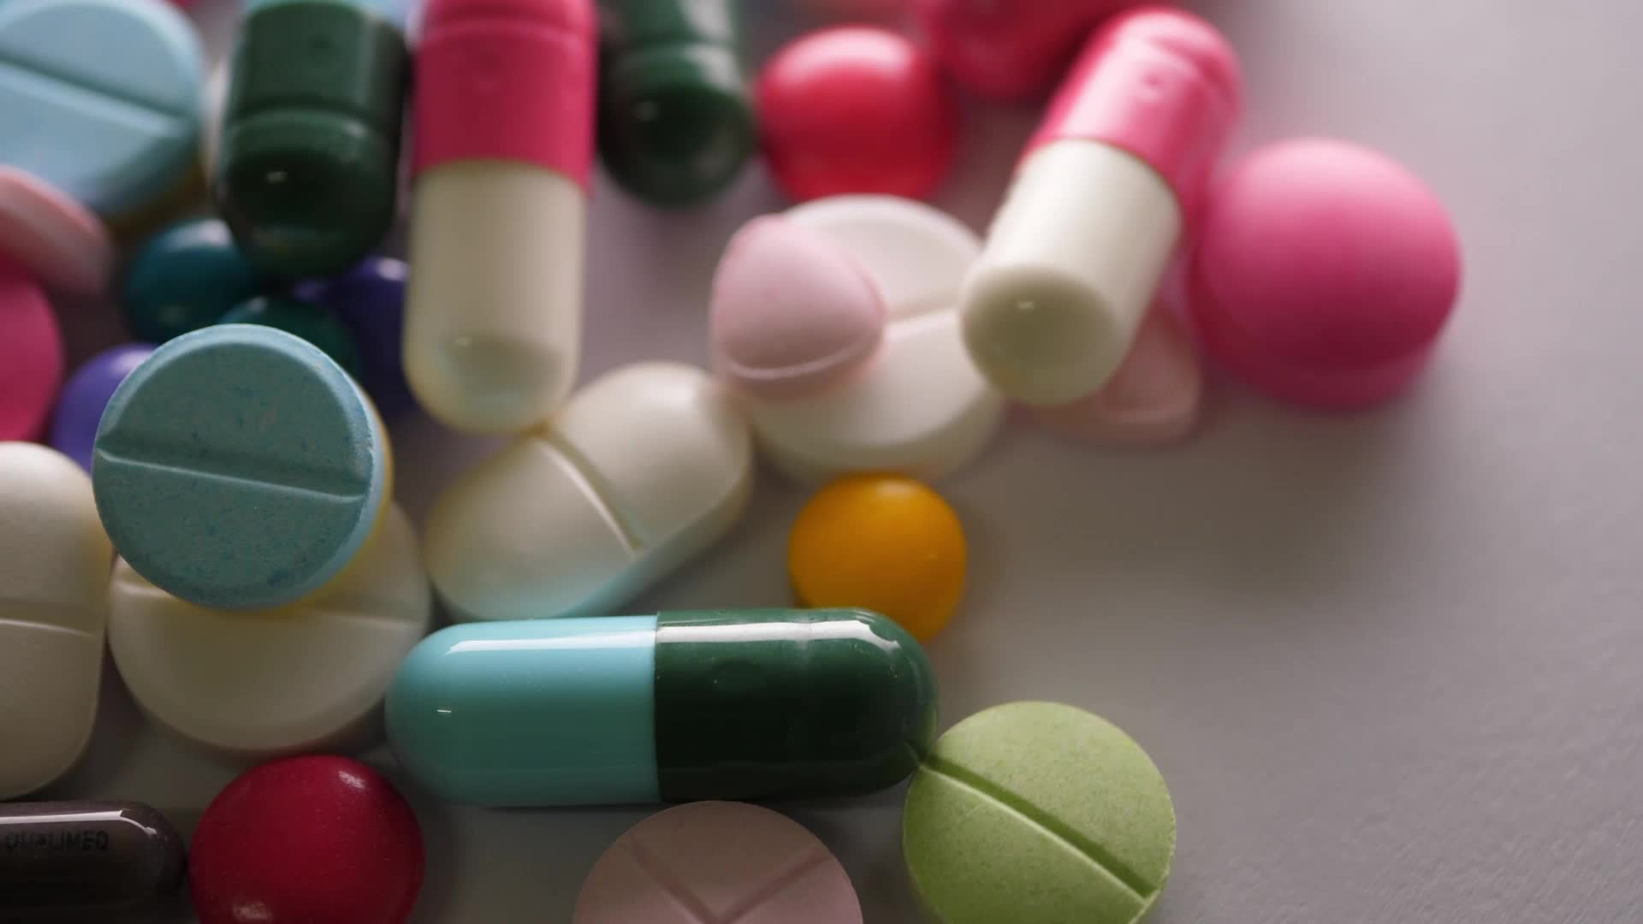
Agenda
Importance of Drug Development in Healthcare
Discovery Phase
The Diversity of Drug Candidate Molecules
Drug Candidate Criteria
Challenges in Drug Development
Notes:
In the opening presentation of our program, we'll delve into the overall process together. Initially, we'll underscore the significance of drug development in healthcare services and consider key aspects of the molecule discovery phase. Following this, we'll explore how the structural variations in drug candidate molecules can influence drug development positively or negatively. Additionally, we'll discuss the criteria for a molecule to qualify as a drug candidate and the challenges commonly faced in drug development. This session aims to provide you with a comprehensive understanding of these foundational elements.

Slide 4
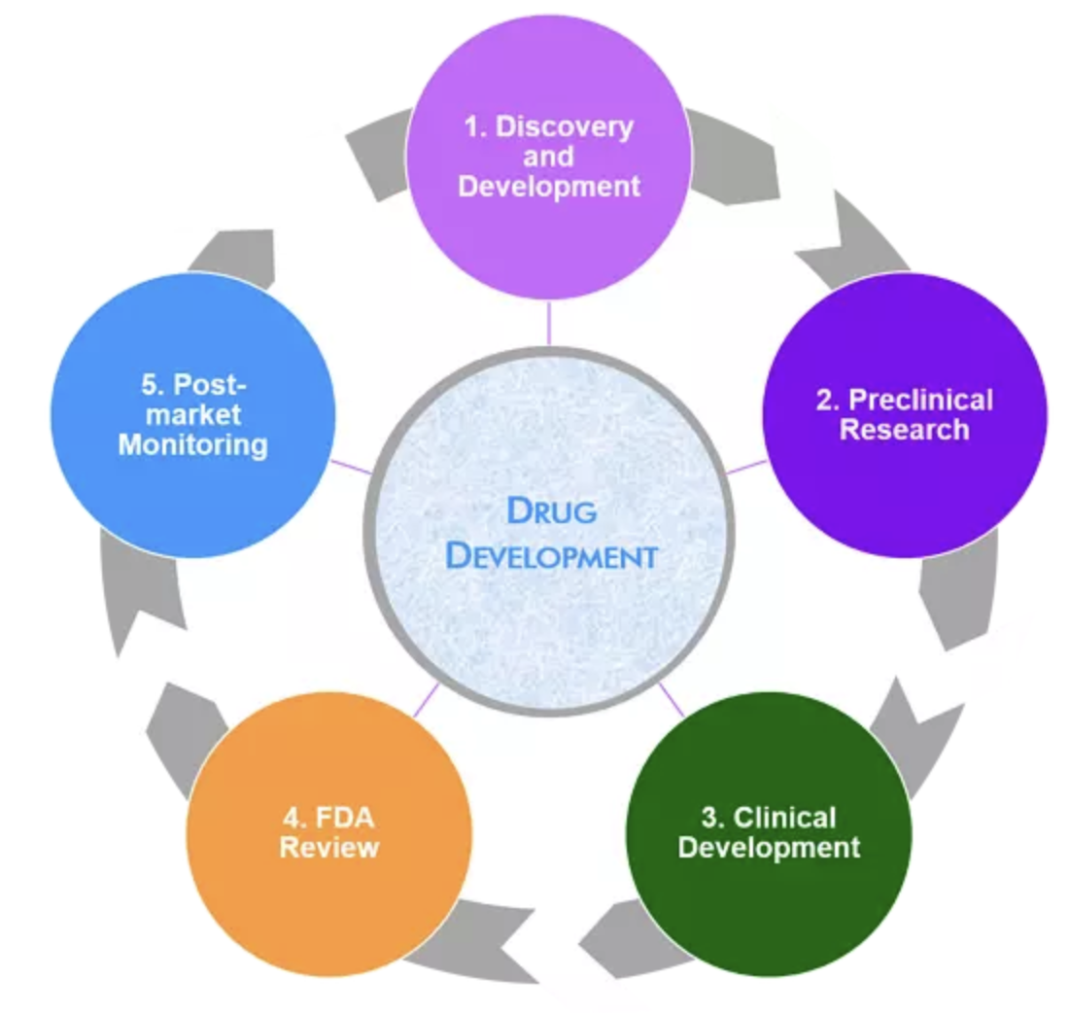
Brief Overview of Drug Discovery Process
Treatment of Diseases
Improved Patient Outcomes
Innovation and Scientific Advancements
Public Health Impact
Economic Growth
Prolonged Life Expectancy
Personalized Medicine
Addressing Unmet Medical Needs
Clinical Trials and Evidence-Based Medicine
https://www.nebiolab.com/drug-discovery-and-development-process/
Notes:
Drug development plays a pivotal role in healthcare, significantly enhancing treatment options and improving patient care.
Today, we will explore the importance of drug development across several key areas: Disease Treatment, Improved Patient Outcomes, Innovation and Scientific Developments (Personalized Treatment), Public Health Impact, Economic and Social Impact, Meeting Medical Needs in Chronic and Rare Diseases, and Encouraging Scientific Collaboration.
**Disease Treatment:** We will delve into how the discovery and development of new and improved drugs are essential for managing various diseases and medical conditions, including infectious diseases, chronic conditions, and rare genetic disorders.
**Improvement in Patient Prognosis:** You'll learn how new drugs often offer more effective and targeted treatments, which enhance patient prognosis. We'll discuss the benefits of newly discovered or redeveloped drugs, such as greater efficacy, fewer side effects, and enhanced quality of life, particularly for those with chronic diseases.
**Innovation and Scientific Developments:** Understand how the drug development process fosters scientific innovation, with researchers and pharmaceutical companies investing in advanced technologies and methodologies to create new drugs.
**Public Health Impact:** We'll examine the significant impact of successful drug development on public health, including how vaccines, antibiotics, and antiviral drugs have improved global health by preventing and treating infectious diseases.
**Economic Growth:** Discover how the pharmaceutical industry contributes to the economy by generating jobs, stimulating economic growth, and promoting research and development in related sectors.
**Increased Life Expectancy:** Reflect on the role of life-saving drugs and treatments in increasing life expectancy, allowing for better management and control of various health conditions.
**Personalized Medicine:** Learn about advances in drug development that enable personalized medicine, tailoring treatments to an individual’s genetic profile, lifestyle, and specific disease characteristics for more precise and effective interventions.
**Addressing Unmet Medical Needs:** We'll discuss the critical importance of drug development in addressing unmet medical needs, particularly for rare diseases or conditions with limited treatment options.
**Clinical Trials and Evidence-Based Medicine:** Finally, gain insight into how the drug development process, conducted through clinical trials, supports evidence-based practices, ensuring that new drugs are safe, effective, and scientifically validated before reaching the public.
This session is designed to give you a comprehensive understanding of the multifaceted impact of drug development on society and public health.

Slide 5
Drug discovery process
Target determination
Target verification
Target selection
1-3 mnd
Lead compound identification
1y
Lead compound optimisation
Pre clinical studies
Phase I
Phase II
Phase III
Licensing
Post marketing Phase IV
Notes:
The process of developing drug candidates, from identifying promising molecules to developing effective drugs, is a complex and multifaceted journey.
The process from molecule to drug is an example of scientific creativity and dedication coming together.
This comprehensive approach ensures that potential drug candidates undergo detailed testing and evaluation before reaching the market, with the ultimate goal of providing safe and effective treatments for a variety of diseases.
At the beginning of this long process, we would like to briefly provide information about the roadmap to be followed on the path from molecule to drug.

Slide 6
Drug development steps
Pre-clinical development
Safety and Toxicity Assessment
Pharmacokinetics (PK) and Pharmacodynamics (PD)
Structure-Activity Relationship (SAR)
Clinical development
Phase I: Safety and Dosage
Phase II: Efficacy and Side Effects
Phase III: Large-Scale Trials
Regulatory approval
Post-marketing surveillance
Notes:
The identification and development of molecules with therapeutic potential is a key phase of drug discovery and development.
This process involves extensive research, preclinical testing, and clinical trials to assess the safety and efficacy of a therapeutic molecule before it becomes an approved drug.
Drug development involves important steps that must be followed.
PRECLINICAL DEVELOPMENT includes:
Safety and Toxicity Assessment:
Ensuring the safety of a drug candidate is crucial. Toxicity studies must be conducted meticulously to determine adverse effects on vital organs or physiological systems. This step helps eliminate drug candidates with unacceptable safety profiles.
Pharmacokinetics and Pharmacodynamics:
Characterization of drug candidates involves understanding their pharmacokinetic and pharmacodynamic properties. Pharmacokinetics is the study of how the body absorbs, distributes, metabolizes, and disseminates a drug. Pharmacodynamics is the study of the effects of a drug on the body.
Structure-Activity Relationship:
Analyzing the structure-activity relationship of a lead drug compound helps to understand how different structural modifications affect its biological activity. This method will allow the compound to be optimized to increase efficacy and reduce side effects.
The criteria for selecting the appropriate molecule include
High specificity and selectivity
Suitable pharmacokinetic and pharmacodynamic potential
Low toxicity and minimal side effects
Formulation and release profile.
CLINICAL DEVELOPMENT consists of three phases.
Phase I addresses Safety and Dosage. Candidate drugs are tested on a small group of healthy volunteers to assess their safety profile and determine the appropriate dosage.
Phase II evaluates Efficacy and Side Effects. The drug is administered to a larger group of patients to assess its efficacy and monitor side effects.
Phase III moves on to Large-Scale Trials. Large-scale trials confirm the efficacy and safety of the drug in various patient populations.
Drugs that have passed the clinical development stage must receive regulatory approval.
In order for a molecule to become a therapeutic drug, it must undergo regulatory approval through rigorous testing and evaluation to ensure compliance with standards. Regulatory bodies such as the US Food and Drug Administration (FDA), the European Medicines Agency (EMA), and the Turkish Medical Drugs and Medical Devices Agency (TİTCK) evaluate the safety and efficacy of therapeutic molecules before granting approval for clinical use.
POST-MARKETING SURVEILLANCE
Following approval, continuous monitoring is carried out worldwide to identify and address emerging safety concerns.

Slide 7
DISCOVERY PHASE
Target identification and validation
Understanding Disease Mechanisms:
Genomic and Proteomic Analysis:
Bioinformatics and Systems Biology:
Target selection (High-throughput screening)
Cellular and Molecular Studies
Animal Models
Human Tissue Studies
Genetic Validation:
Target (Hit molecules) Selection (High-Throughput Screening)
Lead Molecule Selection
Notes:
Drug discovery consists of four stages: Target identification and validation, Selection of lead molecules and selection of lead molecules.
1. Target Identification
Many therapeutic molecules are designed to interact with specific biological targets such as proteins, enzymes, receptors or genetic material. This specificity is important in achieving the desired therapeutic effect while minimizing side effects. The mode of action of therapeutic molecules varies greatly.
Some molecules can modulate biochemical pathways, some can inhibit or activate specific proteins, and some can affect gene expression.
Understanding the pathway of action of the molecule is crucial to optimizing therapeutic outcomes. Drug targets must be effective, safe, usable, and meet clinical and commercial requirements.
The first step in target identification and validation is to Understand Disease Mechanisms. Researchers aim to understand the molecular and cellular mechanisms underlying a particular disease. Genetic studies, epidemiological data and biomarker analyses help identify potential targets.
The second step in this phase is Genomic and Proteomic Analysis. Advances in genomic and proteomic analyses allow researchers to explore the entire genome and proteome profile for potential drug targets. Identification of genes or proteins associated with disease pathogenesis is a key focus.
Another stage is Bioinformatics and Systems Biology analyses. Using computational tools to analyze biological data helps identify potential targets and their interactions. Systems biology approaches consider the molecular interaction network within cells.
2. Target Validation
At this stage, cellular and molecular-based studies must be conducted first. Experimental techniques such as gene silencing or knockout models help confirm the functional relevance of a potential target. Investigating the target’s role in disease-related pathways strengthens the molecule’s potential as a candidate.
Another analysis method for target validation is using Animal Models: Using animal models to simulate disease states and evaluate the effect of target modulation, animal models are used to demonstrate the correlation between target modulation and disease outcome.
Human Tissue Studies are also used for target validation purposes: By analyzing human tissue samples to verify the presence and importance of the target in diseased tissues, it is possible to establish a direct link between the target and the disease symptom.
Genetic Validation analyses also help in target validation. The main goal of these analyses is to examine genetic variations in human populations to associate a specific genetic change with disease susceptibility. Genetic validation analyses help to prioritize targets according to their association with disease.
Researchers use modern tools and techniques such as disease association, bioactive molecules, cell-based models, protein interactions, signaling pathway analyses, functional analysis of genes, in vitro genetic manipulation, antibodies to validate drug targets. For example, Next Generation Sequencing (NGS) analysis, CRISPIR, etc. methods are excellent sources for drug discovery targets.
3. Selection of Lead Molecules (High-Throughput Screening)
After the target that the drug will affect is validated, high-throughput screening techniques are used to identify lead drug candidates. These screenings involve testing thousands of compounds to identify molecules that exhibit the desired biological activity. At this stage, promising compounds are called target/lead molecules. Many therapeutic molecules are designed to interact with specific biological targets such as proteins, enzymes, receptors or genetic material. This specificity is extremely important to achieve the desired therapeutic effect while minimizing side effects. This stage is very important to ensure that drug development processes are based on solid foundations after a correct target identification and validation stages.
4. Lead Molecule Selection
Lead molecules are selected from the target molecule pool according to their activity, safety profiles and other relevant criteria. These lead molecules serve as the starting point for further processes in drug development.

Slide 8
DISCOVERY PHASE
1. Target Identification and Validation
Literature Review
Genomic and Proteomic Analysis
Bioinformatics Tools
Network Analysis
Functional Annotation
Expression Profiling
Clinical Data Analysis
Experimental Validation
Notes:
The first step in drug development is Target Identification and Validation.
To identify a target, it is necessary to understand the biological target or pathway that may play a role in the disease. Validation of the target means showing that modulation of the target has a therapeutic effect.
In this context, the following steps should be followed.
Literature Review: A comprehensive literature review is required to understand the current state of knowledge about the disease. Studies that identify potential biomarkers, proteins or genes associated with the disease should be found and examined.
Genomic and Proteomic Analysis: Genomic and proteomic data should be used to identify potential genes and proteins associated with the disease. High-throughput technologies such as microarray analysis and next-generation sequencing provide important information in this context.
Bioinformatics Tools: Bioinformatics tools and databases should be used to analyze genomic and proteomic data. Tools such as BLAST, NCBI Gene and UniProt can help identify homologous genes and proteins.
Pathway Analysis: Network analysis tools are used to explore interactions between genes and proteins. Biological network databases and software such as STRING or Cytoscape can help visualize and analyze protein-protein interactions.
Functional Analysis: Functional analysis is performed to understand the biological roles and pathways associated with potential targets. Gene Ontology (GO) analysis and pathway analysis tools such as DAVID or Reactome can provide information about the functions of genes and proteins.
Expression Profile Analysis: Gene expression profiles are examined in diseased tissues compared to healthy tissues. Microarray or RNA-sequencing data analysis can reveal regulated genes with increased and decreased expression levels specific to the disease.
Clinical Data Analysis: Clinical data is integrated with genomic and proteomic data to identify correlations between specific genes or proteins and clinical outcomes, which can help prioritize potential targets of clinical importance.
Experimental Validation: Validation experiments should be performed to validate potential targets identified through computational analysis. Techniques such as PCR, qRT-PCR, western blot, and immunohistochemistry can confirm the expression level of genes and proteins in relevant tissues.
Genetic Association Studies: Genetic association studies are performed to investigate the relationship between genetic variations and disease. Genome-wide association studies (GWAS) and case-control studies can identify genetic markers associated with disease.
Drug Target Databases:
Databases focused on drug targets and pharmacology such as DrugBank or Therapeutic Target Database should be examined to identify existing drugs or compounds that target the identified biological targets.
Collaboration and Data Sharing: Collaboration should be done with researchers and institutions working on similar diseases. Data sharing and integration can improve the understanding of disease mechanisms and identify common biological targets.

Slide 9
DISCOVERY PHASE
2. High-Throughput Screening (HTS):
Library Screening
Hit Identification
3. Hit Confirmation:
Repeat Testing
Selectivity Assessment
4. Lead Optimization:
Chemical Structure Modification
Structure-Activity Relationship (SAR) Studies
ADME/T Properties Optimization
Pharmacokinetics/Pharmacodynamics (PK/PD) Optimization
Notes:
After the Target Identification and Validation phase, which is the first step of drug development, is completed, the Lead Molecule Selection phase begins.
At this stage, High Throughput Screening (HTS) tests are used to select lead molecules suitable for the target from tens of thousands of molecules. At this stage, bioinformatics tools can also be used to support HTS tests.
For example, to give a few examples of Drug Target Databases;
In order to identify existing drugs or molecules that target the identified biological targets, databases focusing on drug targets and pharmacology, such as DrugBank or Therapeutic Target Database, should be examined.
After the Lead Molecule selection is completed, the Lead Molecule Selection phase begins. At this stage, studies such as
Chemical Structure Change
Structure-Activity Relationship (SAR) Studies
ADME/T (Adsorption, Distribution, Metabolism, Excretion, Toxicity) Properties Optimization
Pharmacokinetic/Pharmacodynamic (PK/PD) Optimization
should be performed carefully to verify the potential of the molecule to become a lead molecule.

Slide 10
DISCOVERY PHASE
5. Biochemical and Cellular Assays:
Evaluate Mechanism of Action
Cellular Activity
6. In Vivo Studies:
Animal Models
Toxicity Studies
7. Iterative Process:
Feedback Loop
Balancing Efficacy and Safety
8. Preclinical Development:
Regulatory Considerations
Scale-up Production
Notes:
After the Lead Molecule is determined, in vitro pre-clinical experiments, in vivo studies, holistic evaluation of all data and the creation of work plans appropriate to the production conditions of pre-clinical stage regulators are provided.

Slide 11
The Diversity of Drug Candidate Molecules
Traditional Drugs
The unconventional Molecules
Small Molecules / Natural Compounds
Extracts from plants and fungi
Marine-derived compounds
Beyond Small Molecules
Biologics (proteins, antibodies, nucleic acids)
Gene therapies as potential drug candidates
Cell therapies
Nanoparticles and Nanomedicine
Targeted drug delivery
Theranostic applications
Peptides and Aptamers
Peptides as emerging drug candidates
Aptamers for targeted therapy
Notes:
There are different types of candidate molecules to obtain molecules that interact with the target. The project will focus on unconventional molecule candidates outside of traditional drugs.
Unconventional molecules are divided into two groups: small molecules and drug candidates outside of small molecules.
In small molecules, apart from those of chemical and synthetic origin, the project will focus on candidate small molecules obtained from natural organisms. Examples of these are drug candidate molecules obtained from fungi, lichens and plant species and from marine biological organisms.
Among the therapeutics outside of small molecules, many innovative therapeutic methods such as monoclonal antibodies, peptides, cellular treatment methods, nanoparticle systems, peptides, aptamers can be given as candidate methods used in the treatment of diseases.

Slide 12
The Importance of Molecular Structure in the Pharmaceutical Industry
While precursor molecules with similar molecular structures have some biological effects in common, small differences in their structures can lead to significant changes in their pharmacological properties.
Many pharmaceutical and chemical compounds used in disease treatment are composed of chiral enantiomers (having the same physical and chemical properties) in racemic structure.
Notes:
While some biological effects of lead molecules with similar molecular structures are common, small differences in their structures can lead to significant changes in their pharmacological properties.
Pharmaceutical companies conduct meticulous studies to optimize the molecular structure to minimize adverse reactions and achieve specific therapeutic effects.

Slide 13
Three-dimensional structure of molecules
Covalent bonds and functional groups are important for the function of a molecule.
Stereochemistry: It is the arrangement of the atoms that make up the molecule in three-dimensional space.
Stereoisomers: In a carbon-containing compound, the molecules contain the same chemical bonds but have different configurations.
Notes:
We have previously emphasized that knowing stereochemistry is very important in drug development. Stereoisomers have different effects on people. If a binding site on a protein is complementary to one isomer of a chiral molecule, it cannot be complementary to the other. This situation is similar to not being able to put the left side of a glove on the right hand. Let's try to explain this situation with some examples.
For example, there are two isomers of carvone. (R)-carvone: mint; (S)-carvone is cumin.
The artificial sweetener aspartame is sweet, while isoproterenol is bitter. Aspartame The difference in the configuration of one of the two chiral carbon atoms leads to this result.
Citalopram It is found as a racemic mixture of two stereoisomers. However, only (S)-citalopram has a therapeutic effect as an antidepressant.

Slide 14
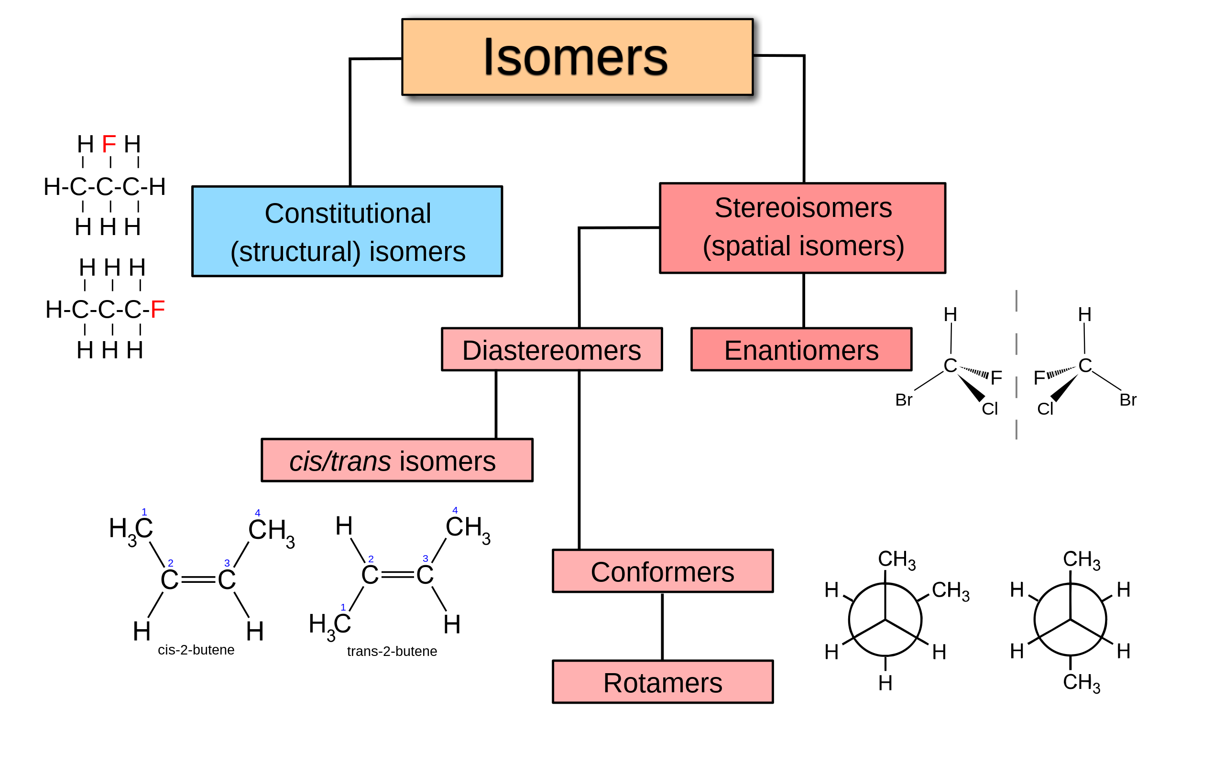
The potential of the molecule's structure on Traditional drug
Stereoisomer
Subsituent
Enantiomer
Racemic mixture
Chiral compound
Notes:
In this session, we're going to demystify the structure of a molecule by breaking down some crucial terms like functional groups, stereoisomers, substituents, enantiomers, racemic mixtures, chiral centers, and chiral compounds.
Isomers are molecules that share the same molecular formula but differ in structure and properties. For instance, glucose, mannose, and fructose all have the formula C6H12O6, featuring six carbons, twelve hydrogens, and six oxygens, yet they exhibit distinct properties. Isomers are classified into two types:
Structural Isomers: These are compounds with the same types and numbers of atoms but different structural arrangements.
Stereoisomers: These have the same bonding sequence of atoms but differ in the spatial arrangement of these atoms.
Stereoisomers further divide into:
Enantiomers: Non-superimposable mirror images of each other.
Diastereomers: Stereoisomers that are not mirror images of each other.
A Substituent (R) refers to a group that replaces another part of the molecule.
A Racemic Mixture is an equal mix of D- and L- stereoisomers of optically active compounds, where D- and L- refer to the right and left placement of an asymmetric carbon, respectively.

Slide 15
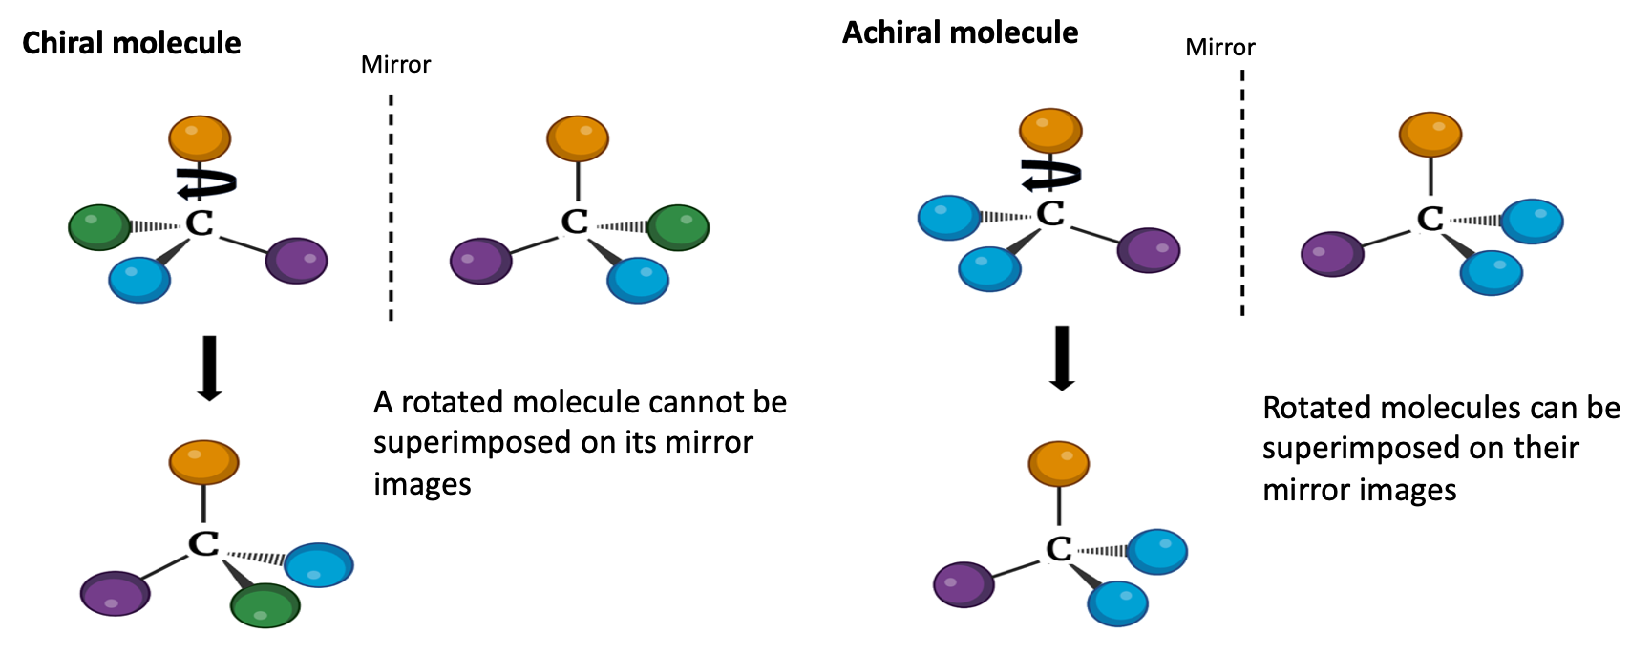
Chiral and Achiral molecules
Nelson ve ark., 2024
Notes:
Chiral and Achiral molecules
A carbon atom contains four different substituent groups (A, B, X, Y) and these groups can be arranged in two different ways. These two structures are non-superimposable mirror images of each other (enantiomers). This asymmetric carbon atom is called a chiral atom or chiral center
A chiral center is an atom that is not symmetrical in the mirror image of the molecule as a result of the arrangement in which the atoms in the original composition are replaced by other atoms.
Chiral compound: A compound that contains an asymmetric center (chiral atom-chiral center) and therefore appears as two unsymmetrical mirror images.
When a tetrahedral carbon atom contains only three different substituents (for example, if there are two from the same group), only one configuration is possible and the molecule it forms is asymmetric or achiral. In this case, the molecule can be superimposed on its mirror image: when the molecule on the left is rotated counterclockwise (so that the bond between A and C remains vertical), the mirror image of the molecule is obtained.
Chiral centers and stereoisomerism can have a profound effect on the activity of a drug. For example, enantiomers of molecules may exhibit different pharmacological properties due to their interactions with chiral receptors. Therefore, understanding and controlling stereochemistry is vital to drug design.

Slide 16
Geometric isomers or cis-trans isomers
Nelson ve ark., 2024
Notes:
Let's examine the examples of maleic acid and fumaric acid for the configurations of geometric isomers.
Isomers such as maleic acid (malate at pH 7) and fumaric acid (fumarate) seen in Figure a cannot be converted into each other without breaking their covalent bonds.
For this, much more energy must be given than the average kinetic energy of the molecules at physiological temperatures.
For cis-trans isomers, the example of retinal in the vertebrate retina can be given. As seen in Figure b, the first event during the perception of light is the absorption of light in the visible region by 11-cis-retinal. The energy of the absorbed light (approximately 250 kJ/mol) converts 11-cis-retinal into trans-retinal. This event causes electrical changes in the retinal cell and a nerve impulse is generated.

Slide 17
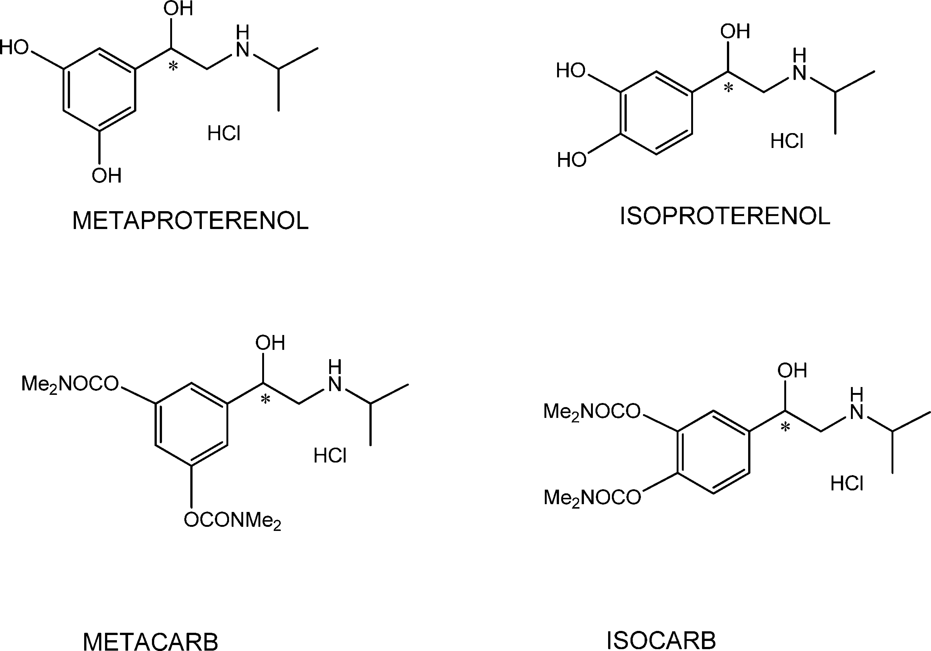
Structure vs Effect
Even if the drugs have the same molecular structure, do they have similar biological effects?
Notes:
Even though two drugs with the same molecular structure may appear identical, small differences in their chemical structure can lead to significant changes in their biological effects.
Even small changes in the arrangement of atoms or functional groups can affect the pharmacokinetic and pharmacodynamic parameters of a drug. These pharmacokinetic parameters include how the body absorbs, distributes, metabolizes, and excretes the drug, and pharmacodynamic effects include how the drug interacts with target receptors or enzymes.
A drug's biological effect is often determined by its interaction with specific receptors, enzymes, or other molecular targets in the body. Even small changes in a drug's structure can change its binding affinity for these targets, potentially leading to differences in efficacy, efficacy, and side effects.

Slide 18
Drug Activity and Stereochemistry
The quantitative difference between the biological activities of two enantiomers of a compound is sometimes quite large.
For example, the D isomer of the drug isoproterenol, used in the treatment of mild asthma, is 50-80 times more effective as a bronchodilator than the L isomer.
Notes:
Stereoisomers have different effects on humans.
If the binding site on a protein is complementary to one isomer of a chiral molecule, it cannot be complementary to the other.
For example; It is similar to not wearing the left side of a glove on the right hand.
Two isomers of carvone: (R)-carvone: spearmint; (S)-carvone caraway
(b) Aspartame (Artificial sweetener) It is the difference in the configuration of one of the two chiral Carbon atoms.
(c) Citalopram (antidepressant): exists as a racemic mixture of two stereoisomers. However, only (S)-citaloplam has a therapeutic effect.

Slide 19
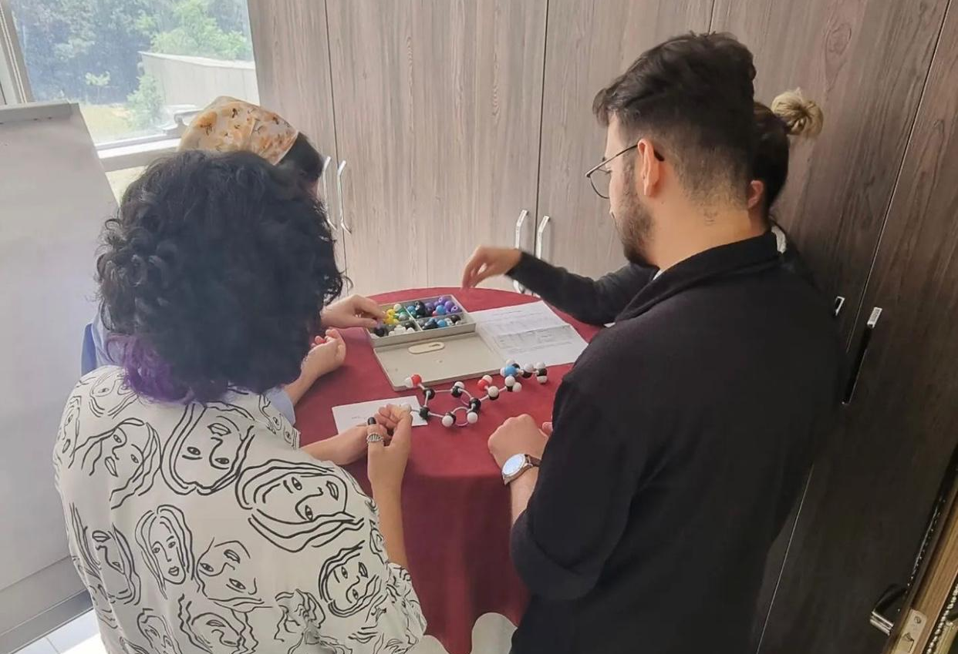
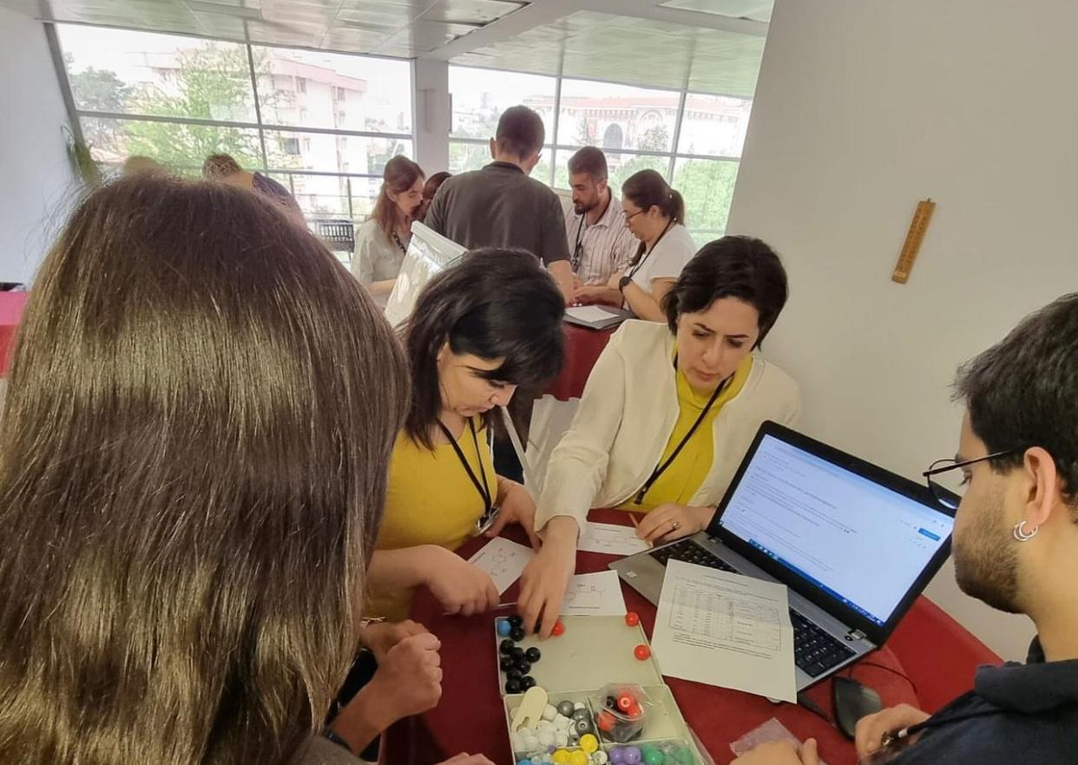
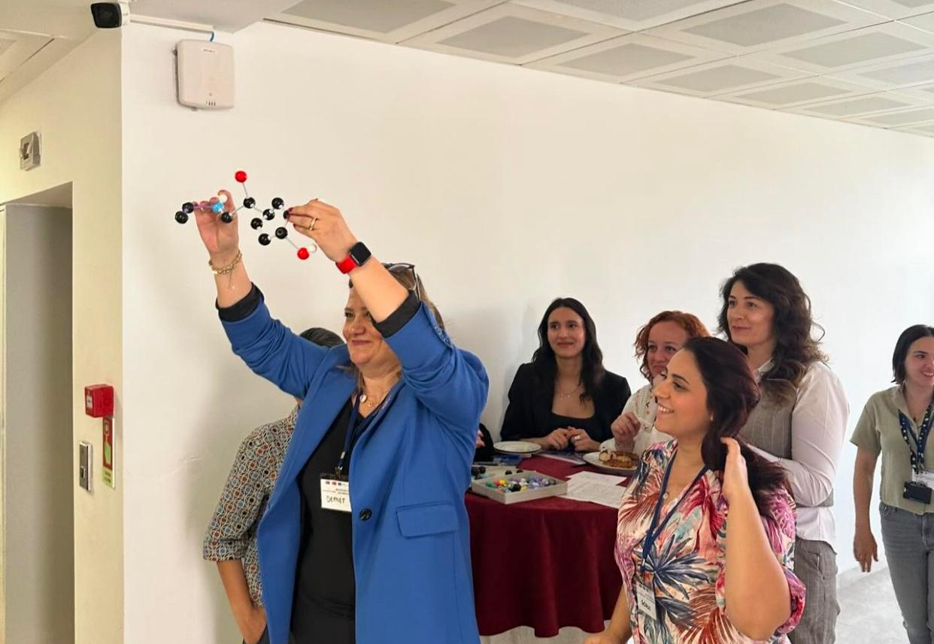
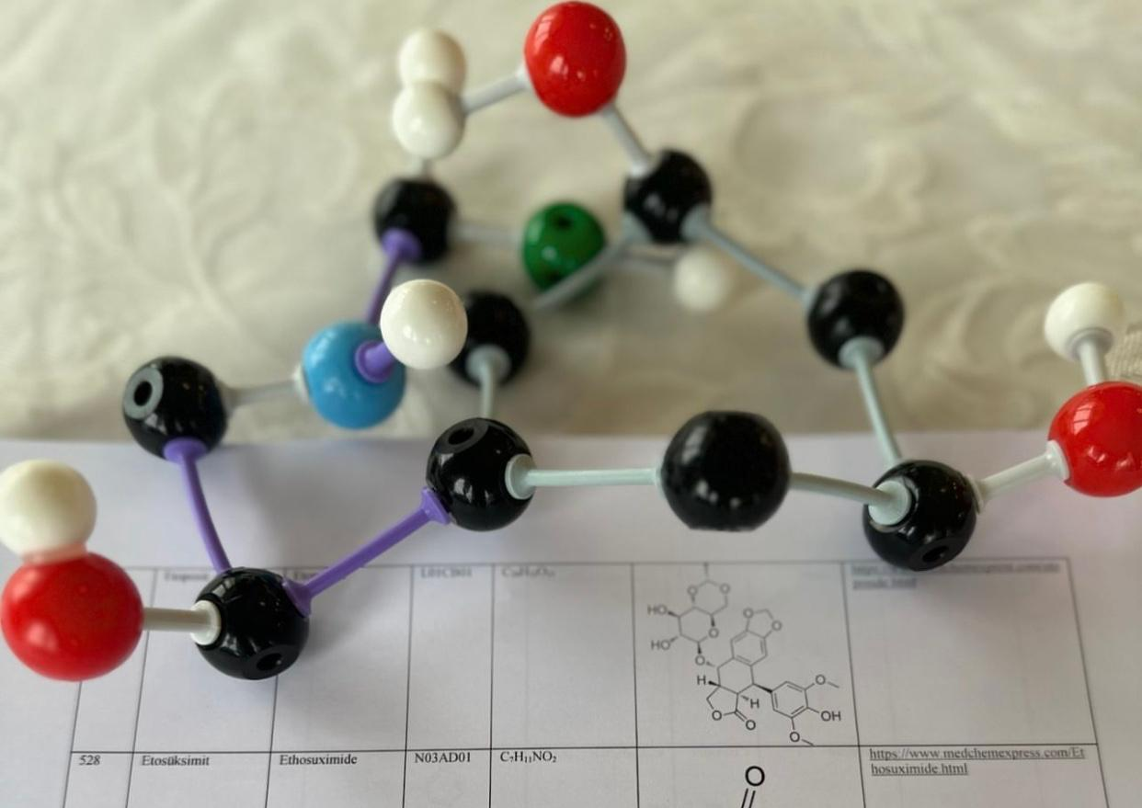
2-D model application
Notes:
Within the scope of our project, in order to answer the question ‘Do drugs with similar molecular structures have similar biological effects?’, participants were divided into groups and given time to create their own Metaproterenol and Isoproterenol molecular structures. Thus, the profile that could be formed in the structure and activity of the molecule by changing the location of even one functional group was discussed.

Slide 20
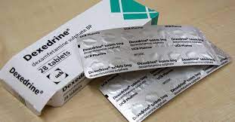
Dexedrine and Benzedrine
A few years ago, two pharmaceutical companies marketed a drug under the trade names «Dexedrine» and «Benzedrine».
Nelson ve ark., 2024
Notes:
Dexedrine and Benzedrine had the same physical properties (C, H, and N analysis, melting point, solubility, etc.). The recommended oral dose of Dexedrine (still available) is 5 mg/day, while the recommended dose of Benzedrine (no longer available) was twice that. Apparently, much more Benzedrine than Dexedrine was required to produce the same physiological response. However, only one enantiomer of the drug was physiologically active. Dexedrine was a single enantiomer, while Benzedrine was a racemic mixture.

Slide 21
Drug Candidate Criteria
Safety and Toxicity Profiles
Pharmacokinetics and Bioavailability
Mechanism of Action and Pathway Analysis
Disease-Relevant Models
Formulation and Manufacturing Considerations
Intellectual Property and Market Differentiation
Notes:
Drug discovery is a complex and lengthy process that involves identifying and developing molecules with the potential to become therapeutic agents. The journey from a promising molecule to a marketable drug is fraught with challenges, and selecting the right drug candidates is a crucial step in this process. The parameters included in this scope are the fundamental criteria that guide the selection of drug candidates and ensure that they have the best chance of success in preclinical and clinical development.
Safety and Toxicity Profiles
Safety is very important in drug development. A promising drug candidate must not only demonstrate efficacy, but also have a favorable safety profile.
Preclinical studies evaluate the toxicity levels of the molecule and its effects on various organs and systems. Predicting and reducing potential adverse effects in the early stages of development is crucial to avoid safety concerns in later stages.
Pharmacokinetics and Bioavailability
A successful drug must be absorbed, distributed, metabolized, and eliminated in a way that provides optimal therapeutic effects. Pharmacokinetic studies evaluate how the body metabolizes a compound by determining factors such as bioavailability, half-life, and excretion. Understanding these properties is important for establishing appropriate dosing regimens and predicting how the drug will behave in humans.
Mechanism of Action and Pathway Analysis
A complete elucidation of the mechanism of action provides insight into a drug’s therapeutic efficacy. Comprehensive pathway analysis helps researchers understand the broader impact of the drug on cellular processes. This information not only helps improve drug design, but also provides valuable information for predicting potential side effects or interactions.
Disease-Relevant Models
Relevance to the target disease is critical for a drug candidate. Testing the molecule in disease-relevant models, such as cell/tissue culture and animal models, helps confirm its efficacy in an environment that mimics the human condition. The closer these models are to the human disease, the more confident researchers can be in predicting the potential clinical success of the drug.
Formulation and Manufacturing
A drug candidate must be capable of being manufactured at scale and its final formulation must be stable. Early attention to formulation and manufacturing is crucial to avoiding potential problems in later stages of development. Factors such as solubility, stability, and scalability are addressed to ensure a smooth transition from lab-scale production to commercial production.
Intellectual Property and Market Differentiation
Protecting intellectual property is vital to a drug’s commercial success. Assessing patent status ensures that the drug candidate has a unique selling proposition and reduces the risk of infringement. Additionally, market differentiation is assessed by assessing how the drug candidate molecule stands out among existing and potential future therapies.​

Slide 22
Challenges in Drug Development
High Costs
Time-Consuming Process
Low Success Rates
Complex Biology
Drug Resistance
Regulatory Hurdles
Ethical Considerations
Target Validation and Identification
Technological Complexity
Diversity of Diseases
Notes:
Drug discovery is a complex and challenging process that involves the identification and development of new therapeutic agents. There are several challenges inherent in this field, and addressing them is crucial for the successful development of new drugs. Some of the key challenges in drug discovery are:
High Costs: Drug development is an expensive process, often costing billions of dollars. This includes research and development, preclinical testing, and extensive clinical trials. The high financial investment poses a significant risk to pharmaceutical companies.
Time-consuming Process: Drug discovery and development can take more than a decade from initial research to market approval. Delays at any stage can further extend the timeline. This can be challenging when it comes to addressing certain diseases.
Low Success Rates: The success rates from drug candidate identification to market approval are extremely low. Many molecules that show promise in the early stages fail during preclinical and clinical trials due to efficacy, safety, or other reasons.
Complex Biological Mechanisms: It is difficult to understand the complex biological mechanisms underlying diseases. Identifying appropriate drug targets and designing molecules that effectively modulate these targets while minimizing side effects is a complex task.
Drug Resistance: The emergence of drug-resistant pathogens or cancer cells is a major concern. Over time, some drugs lose their effectiveness as organisms or cancer cells develop mechanisms to evade the effects of the drug.
Regulatory Barriers: Strict regulatory requirements for drug approval can slow down the development process. Complying with regulations and safety standards across multiple regulatory agencies, as well as meeting documentation requirements, can be time-consuming.
Ethical Considerations: Ensuring ethical conduct in clinical trials, obtaining informed consent, and addressing patient privacy issues are critical yet challenging aspects of drug development. Balancing potential benefits and risks creates a constant ethical dilemma.
Target Identification and Validation: Identifying suitable biological targets for drug production is an important early step. However, understanding the role of these targets in disease and validating their suitability for drug development can be challenging.
Technological Complexity: Rapid advances in technologies such as genomics, proteomics, and computational biology present challenges as well as opportunities. Integrating these technologies into the drug discovery process and using them effectively requires ongoing adaptation and expertise.
Disease Diversity: Different diseases have their own unique challenges. For example, neurological disorders present challenges related to blood-brain barrier penetration, while infectious diseases face challenges related to rapidly changing pathogens.
To overcome these challenges, collaboration between researchers, pharmaceutical companies, regulatory agencies, and other stakeholders is necessary. Advances in technology, data analysis, and a better understanding of disease mechanisms are continually helping to overcome some of these barriers to drug discovery.

Slide 23
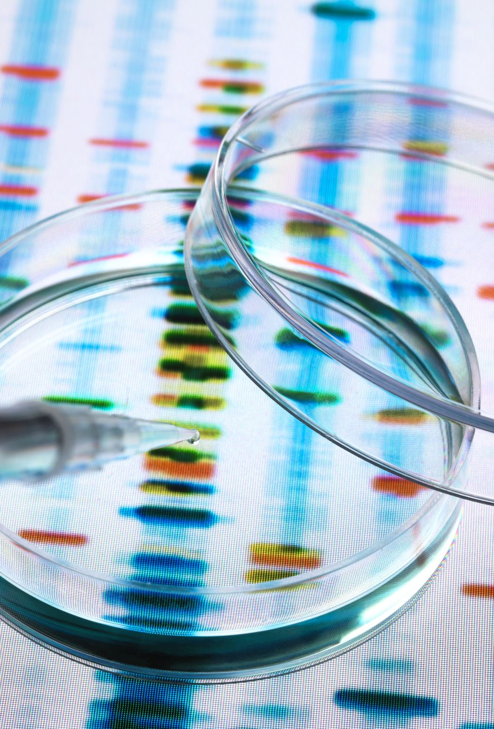
Future Trends in Drug Development
Advances in personalized medicine, where treatments are tailored to individual patients, and the integration of artificial intelligence and machine learning to streamline drug discovery, advances in genomics and proteomics, targeting novel pathways are transforming the landscape.
Notes:
Advances in personalized medicine, where treatments are tailored to individual patients, and the integration of next-generation sequencing, artificial intelligence and machine learning to facilitate drug discovery, along with advances in genomics and proteomics targeting new pathways, are changing the profile of drug development.

Slide 24
Questions and Discussion
QUESTION AND ANSWER
SHARING EXPERIENCES
LET'S SUMMARIZE
Notes:
Please review the books and other documents on our website to obtain more detailed information on the subject. You can use our social media accounts for any questions or concerns you may have.

Slide 25
Conclusion
Selecting the right drug candidates is a meticulous and multidimensional process.
Balancing efficacy, safety, and feasibility requires collaboration across scientific disciplines.
Rigorous evaluation increases the likelihood of identifying compounds that may provide meaningful therapeutic benefits to patients.
Notes:
Selecting the right drug candidates is a meticulous and multidimensional process.
Balancing efficacy, safety, and feasibility is a delicate task that requires collaboration across various scientific disciplines.
Rigorous evaluation based on the criteria increases the likelihood of identifying compounds that can progress through the complex stages of drug development and ultimately provide meaningful therapeutic benefits to patients.

Slide 26
Additional Resources
Annett, S. (2021). Pharmaceutical drug development: high drug prices and the hidden role of public funding. Biologia Futura, 72 (2), 129–138. https://doi.org/10.1007/s42977-020-00025-5
Aronson, J. K. (2010). Clinical pharmacology and therapeutics in the UK – a great instauration. British Journal of Clinical Pharmacology, 69 (2), 111–117.
Bergkessel, M., Forte, B., & Gilbert, I. H. (2023). Small-Molecule Antibiotic Drug Development: Need and Challenges. ACS Infectious Diseases, 9 (11), 2062–2071.
Nelson, D. L., Cox, M. M. Lehninger principles of biochemistry 7. baskıW.H. Freeman, New York, NY (2024)

Slide 27
Project Partners

Slide 28
This document was prepared for the Erasmus Project "2022-1-TR01-KA220-VET-000088373
A UNIVERSAL STRATEGIC NECESSITY: FROM MOLECULE TO DRUG»
"”Supported by the European Commission within the scope of the Erasmus+ Programme. However, the European Commission and the Turkish National Agency cannot be held responsible for the opinions expressed here."
Notes:
A universal necessity: From Molecule to Drug Project
"Supported by the European Commission within the Erasmus+ Programme.
However, the European Commission and the Turkish National Agency cannot be held responsible for the views expressed here."

Slide 29
THANK YOU
Notes:
Projemize desteklerinden ötürü Avrupa Komisyonu’na ve proje ekibinde yer alarak katkıda bulunan tüm üyelerimize ve proje kapsamındaki etkinliklere katılan herkese teşekkür ederiz.

