Slide 1
DEVELOPMENT: Basic Principles of Clinical Research
From Molecule to Drug
Dr. Mehmet Kürşat DERİCİ
Notes:
Hello
The topic of this session is Clinical trials and good clinical research practices
Clinical trials play a very important role in the drug development and licensing process. These trials are research studies that involve human participants and are designed to evaluate the safety, effectiveness, and sometimes dosage or side effects of a new drug or treatment. The entire drug development and licensing process typically consists of several stages, and clinical trials are a key component of each stage.

Slide 2
Learning Objectives
Identify
Recall
Interpret
Explain
the drug development stages and the basic principles of clinical research
the main duties and the fields of the Ethics Committees
the clinical research phases
the concept of Good Clinical Practice (GCP)
Notes:
This chapter provides a brief overview of these learning objectives in Clinical Trials and Good Clinical Practice. At the end of this session, you will be able to describe the stages of drug development and the basic principles of clinical research, recall the main tasks and areas of Ethics Committees, interpret the stages of clinical research and explain the concept of Good Clinical Practice (GCP).

Slide 3
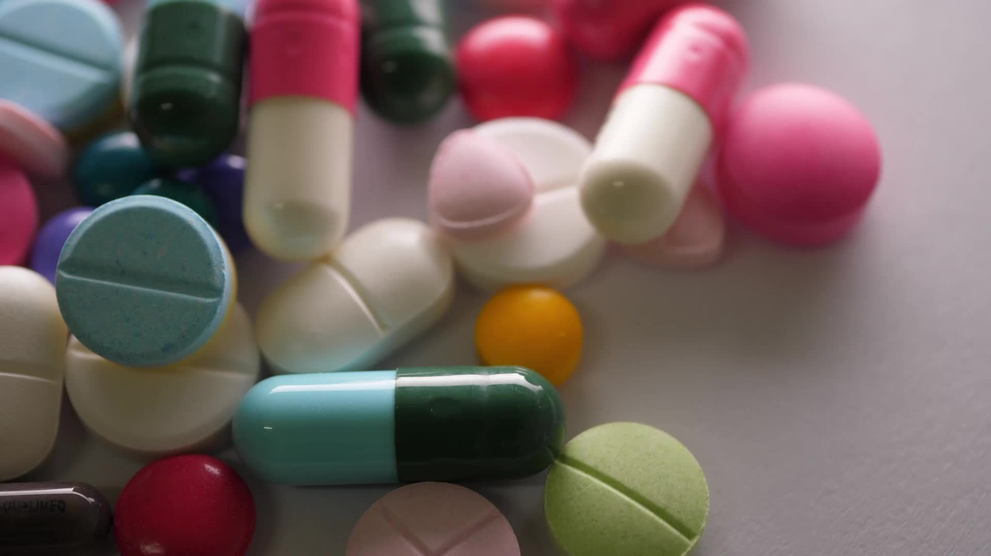
Agenda
Overview of drug development stages
Basic principles of clinical research
Stages of clinical research
Ethics Committees
Good Clinical Practice (GCP)
Notes:
In this presentation, after an overview of the drug development stages, we will cover the basic principles of clinical research, clinical research stages, Ethics Committees and Good Clinical Practices.

Slide 4
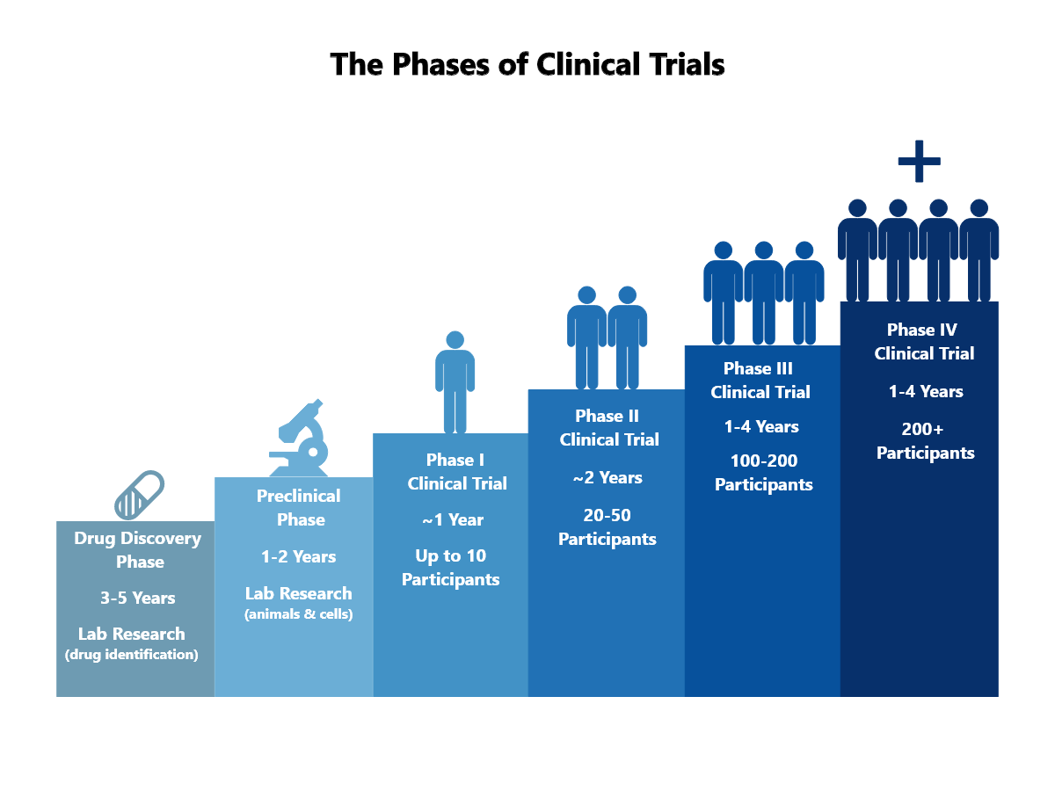
I. Overview of the drug development stages
Preclinical Research
Phase 1 Clinical Trials
Phase 2 Clinical Trials
Phase 3 Clinical Trials
Regulatory Review
Phase 4 Clinical Trials (Post-Marketing Surveillance)
Notes:
Preclinical Research:
Before a drug reaches clinical trials, it undergoes extensive preclinical research using laboratory and animal studies.
Researchers identify potential drug candidates and evaluate their safety, pharmacokinetics, and efficacy in preclinical models.
Phase 1 Clinical Trials:
These trials involve a small number of healthy volunteers and aim to determine the safety, dosage range, and potential side effects of the drug.
The primary focus is to understand how the drug is absorbed, metabolized, and excreted in the body.
Phase 2 Clinical Trials:
In this phase, the drug is administered to a larger group of patients who have the condition the drug is intended to treat.
The goal is to evaluate the drug’s effectiveness, optimal dosage, and continue to evaluate its safety.
Phase 3 Clinical Trials:
These are large-scale trials that include a larger patient population to further evaluate the drug’s effectiveness and monitor side effects.
Comparisons are often made with current standard treatments or placebos.
The results from Phase 3 trials provide critical data for regulatory filings.
After completion of Phase 3 trials, the drug developer submits a New Drug Application to regulatory authorities such as the U.S. Food and Drug Administration (FDA) or the European Medicines Agency (EMA).
Regulatory agencies review data from clinical trials and other relevant information to determine whether the drug is safe and effective for its intended use.
Phase 4 Clinical Trials (Post-Marketing Surveillance):
These trials occur after a drug has been approved and is on the market.
They monitor the long-term safety and effectiveness of the drug in a larger, more diverse patient population.

Slide 5
II. Key objectives of Clinical Trials
Assessing Safety
Evaluating Efficacy
Optimizing Dosages
Comparing Interventions
Understanding Mechanisms
Informing Regulatory Decisions
Contributing to Evidence-Based Medicine
Advancing Medical Knowledge
Notes:
Clinical trials are studies with human participants aimed at evaluating medical interventions, such as drugs, treatments, and devices. These trials provide scientific data about the intervention's benefits and risks, and improve medical knowledge.
The main purposes of clinical trials are:
Assessing Safety: To determine an intervention's safety by tracking side effects and potential risks.
Evaluating Efficacy: To assess how well the intervention works for its intended purpose, like treating a condition or improving symptoms.
Optimizing Dosages: To find the best dosage that is both effective and has acceptable side effects.
Comparing Interventions: To see if a new treatment is better than existing standard treatments or a placebo.
Understanding Mechanisms: To investigate how the intervention works within the body.
Informing Regulatory Decisions: To provide data for regulatory bodies like the FDA or EMA on whether an intervention should be approved for use.
Contributing to Evidence-Based Medicine: To give clinicians information to make informed treatment decisions based on evidence.
Advancing Medical Knowledge: To expand our understanding of diseases and treatments, thereby improving patient care.
In essence, clinical trials are critical for applying scientific research to patient care, ensuring treatments are safe and effective, and guiding healthcare practice.

Slide 6
III. Phase 0 and Phase 1 Clinical Trial
Phase 0 Clinical Trial = "microdosing" or "exploratory investigational new drug" study
Phase 1 Clinical Trial: Phase 1 clinical trials are the first stage of traditional drug development involving human participants.
PHARMACOKINETICS
Understands how a drug is absorbed, distributed, metabolized, and excreted in the human body
Notes:
A Phase 0 trial, also called a microdosing study, is a preliminary step in drug development. It involves giving very low doses of a drug to a small group of people. The main aim is to gather early data on how the body processes the drug and responds to it. These trials are not for therapeutic purposes but to understand the drug's pharmacokinetics and pharmacodynamics in humans.
The goal of Phase 0 trials is to collect early information on the drug's dynamics in the body. This helps in deciding whether to move forward with more extensive testing. These trials assess if the drug engages the target, how the body metabolizes it, and its duration in the system, thus streamlining the drug development process.
Phase 1 trials mark the first stage of traditional testing in humans. They evaluate a drug's safety and dosage. Healthy volunteers or patients with the disease may be enrolled to receive escalating doses of the drug. The objectives are to determine the highest dose humans can take without serious side effects, to observe any adverse reactions, and to understand how the drug is processed by the body.
Phase 1 Clinical Trials aim to define a drug's safety profile and appropriate dosage for future studies. They provide essential information on absorption, distribution, metabolism, and excretion. While the focus is on safety, these studies may offer initial data on effectiveness. A successful Phase 1 trial is crucial for progressing to the more comprehensive Phase 2 trials.

Slide 7
Phase 2 and Phase 3 Clinical Trial
Phase 2:
Phase 3:
Expand testing to more patients with the targeted condition
Assess drug's safety profile in greater detail
Determine effectiveness at treating the condition
Identify optimal dosing levels
Purpose:
Provide deeper safety and efficacy data
Observe therapeutic effects in the intended patient population
Detect potential side effects early
Inform design and planning for Phase 3 trials
Support decision-making on progression to the next phase
Conduct large-scale studies across diverse participant groups
Confirm effectiveness and monitor for any side effects
Compare new treatment against standard treatments or placebos
Collect comprehensive evidence for regulatory review
Purpose:
Finalize safety and efficacy profile for regulatory submission
Establish the drug's therapeutic value in a real-world population
Determine the drug's place within current treatment standards
Lay groundwork for FDA, EMA, or other health authority approval
Notes:
Phase 2 Clinical Trial: Phase 2 clinical trials are the second phase of clinical testing for a new drug or treatment. These trials typically involve a larger group of participants, typically individuals with the specific medical condition for which the drug is intended. The primary goals of Phase 2 trials are to further evaluate the safety of the drug, determine its effectiveness in treating the targeted condition, and gather additional information about optimal dosage.
Phase 2 Clinical Trial Purpose: The primary goal of Phase 2 trials is to provide more comprehensive data on the safety and effectiveness of the drug in the targeted patient population. Researchers seek to improve understanding of the drug’s effectiveness, identify potential side effects, and gather additional information to inform the design of larger Phase 3 trials. Positive results from Phase 2 trials help inform decisions about whether to proceed to the next phase of testing.
Phase 3 Clinical Trial: Phase 3 clinical trials are large-scale studies that include a diverse and comprehensive population of participants with the targeted medical condition. These trials aim to confirm the effectiveness of the drug, monitor side effects, and compare the new treatment with standard treatments or placebos. Phase 3 trials are critical to providing the robust evidence needed for regulatory approval. Purpose of Phase 3 Clinical Trials: The primary goal of Phase 3 trials is to generate the evidence needed to support the safety and effectiveness of a drug for regulatory approval. These trials further investigate the benefits and risks of the drug in a real-world setting and help determine its place in the standard of care. Positive results from Phase 3 trials form the basis for a regulatory application to health authorities such as the U.S. Food and Drug Administration (FDA) or the European Medicines Agency (EMA). If the results are positive, regulatory approval allows the drug to be marketed and prescribed for the intended medical indication.

Slide 8
Phase 4 Clinical Trial
Purpose of Phase 4 Clinical Trials
Post-marketing surveillance or post-approval studies,
not a prerequisite for regulatory approval.
Long-term safety, effectiveness, and potential benefits or risks in a larger and more diverse population.
Detecting Rare Side Effects
Long-Term Safety
Comparative Effectiveness
Optimizing Use
Health Economics:
Labeling Updates
Notes:
Phase 4 Clinical Trial: Also known as post-marketing surveillance or post-approval studies, Phase 4 clinical trials occur after a drug has been approved for marketing and is available to the public. Unlike earlier phases, Phase 4 trials are not a prerequisite for regulatory approval. Instead, they are conducted to gather additional information about the long-term safety, effectiveness, and potential benefits or risks of a drug in a larger, more diverse population.
Purpose of Phase 4 Clinical Trials: The primary goal of Phase 4 trials is to continue to monitor the safety and effectiveness of a drug after it is on the market. Key goals include:
Detection of Uncommon Side Effects: Phase 4 trials help identify rare or long-term side effects that may not be apparent in earlier phases due to smaller sample sizes or shorter observation periods.
Long-Term Safety: Evaluation of the long-term safety profile of a drug in a real-world setting, including potential interactions with other drugs and the effect on various patient populations.
Comparative Effectiveness: Comparing the effectiveness of a drug to other available treatments and providing additional information to healthcare providers to make informed decisions about treatment options.
Optimizing Use: Understanding optimal dosages, administration schedules, and factors that may affect the effectiveness and safety of a drug in different patient groups.
Health Economics: Assessing the economic impact of a drug on the healthcare system and its cost-effectiveness compared to other treatments.
Labeling Updates: Providing data for updates to a drug’s label, including new warnings, precautions, or indications based on real-world experience.
Phase 4 trials supplement ongoing pharmacovigilance studies and help ensure that a drug’s benefits continue to outweigh potential risks in a broader patient population. Findings from these studies can lead to improvements in clinical guidelines and influence prescribing practices, ultimately improving patient care and safety.

Slide 9
Key Players in Clinical Trials
Sponsor
Principal Investigator (PI)
Clinical Research Coordinator (CRC)
Institutional Review Board (IRB) or Ethics Committee
Regulatory Authorities
Data and Safety Monitoring Board (DSMB)
Contract Research Organization (CRO)
Clinical Trial Monitors
Participants (Patients or Healthy Volunteers)
Notes:
Clinical trials are a collaborative effort, involving a network of individuals and entities committed to upholding the highest standards of ethics, science, and regulation.
The primary stakeholders include:
Sponsor: This is typically an organization, such as a pharmaceutical company, academic institution, or government body that initiates, finances, and oversees the trial.
Principal Investigator (PI): A qualified medical doctor or scientist who leads the trial, ensuring it runs smoothly, ethically, and safely, in line with the protocol.
Clinical Research Coordinator (CRC): Manages the trial's daily activities, oversees patient care, and maintains clear communication among all parties.
Institutional Review Board (IRB) or Ethics Committee: An independent body that evaluates the trial protocol to protect participant rights and welfare and monitors the trial’s ethical conduct.
Regulatory Authorities: Bodies like the FDA or EMA that regulate the trial process, review data, and can authorize the drug’s entry to the market.
Data and Safety Monitoring Board (DSMB): An independent committee that reviews trial data for participant safety and study validity, and can make recommendations on the trial’s course.
Contract Research Organization (CRO): Offers specialized services to sponsors, including trial design, data management, and regulatory adherence.
Clinical Trial Monitors: Ensure that the trial adheres to protocols and good clinical practice at the investigative sites.
Participants: The volunteers, either patients or healthy individuals, whose involvement and data are crucial to the trial’s success.
Effective interaction and clear communication between these parties are fundamental to a trial’s success, ensuring the integrity of data, the protection of participants, and the production of meaningful research outcomes.

Slide 10
Case: Tuskegee Syphilis Experiment
Background:
Study conducted from 1932 to 1972 in Tuskegee, Alabama.
Initiated by the U.S. Public Health Service and the Tuskegee Institute.
Aimed to track the natural course of untreated syphilis in African American men.
600 participants, 399 of whom had latent syphilis, and 201 healthy control.
Notes:
The Tuskegee Syphilis Experiment, which took place in Alabama from 1932 to 1972, is one of the most infamous examples of ethical misconduct in medical research. Conducted by the U.S. Public Health Service alongside the Tuskegee Institute, the study aimed to observe the natural history of untreated syphilis in African American men.
The study involved 600 men, 399 with syphilis and 201 without the disease. The men were not informed of their disease status, were misled about the purpose of the study, and were denied effective treatment even after it became available.

Slide 11
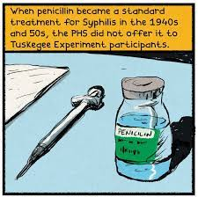
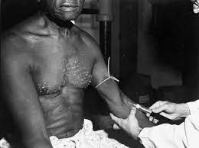
Ethical breaches and human impact
Participants believed they were receiving free healthcare, not part of a study.
Penicillin treatment was available but intentionally withheld from participants.
Resulted in unnecessary suffering, serious health complications, and deaths.
Demonstrated grave violations of informed consent and medical ethics.
Notes:
Participants were deceived into thinking they were receiving free health care from the federal government. Even after penicillin was recognized as an effective cure for syphilis post-World War II, the treatment was deliberately withheld.
The consequences of this deception were dire, leading to significant and unnecessary suffering, the progression of serious health conditions, and for some, premature death.

Slide 12
Aftermath and Changes in Research Ethics
Exposure of the study in 1972 prompted public outrage and a congressional investigation.
Immediate termination of the study following the exposure.
Establishment of the National Research Act and subsequent Belmont Report.
Introduction of ethical principles for research: respect for persons, beneficence, and justice.
The study emphasizes the critical need for ethical oversight in clinical research.
Notes:
The unethical nature of the Tuskegee Syphilis Study was publicly revealed in 1972, causing a national scandal that resulted in the study's termination and a comprehensive review of research ethics in the United States. This led to the enactment of the National Research Act and the establishment of the National Commission for the Protection of Human Subjects of Biomedical and Behavioral Research, which was responsible for creating the Belmont Report. This report laid down the ethical principles and guidelines for conducting research involving human participants.
The study's legacy underscores the critical need for informed consent and the protection of participants in medical research.
Additionally, 'Miss Evers' Boys' is a dramatized account of the Tuskegee study. While it offers a narrative on the events, it's important to approach dramatizations with an understanding of the artistic license taken and seek factual accounts for academic study.

Slide 13
IV. Ethics Committees (Institutional Review Boards - IRBs) and Ethical Guidelines
Functions of Ethical Committees
Protocol Review and Approval
Informed Consent Oversight
Risk-Benefit Assessment
Continuing Review
Privacy and Confidentiality Evaluation
Participant Selection and Inclusion
Emergency Unblinding and Adverse Event Oversight
Community and Cultural Considerations
Education and Guidance
Notes:
Clinical research must be grounded in ethics to protect the rights and welfare of participants. Ethical committees, known as Institutional Review Boards (IRBs) or Ethics Committees (ECs), are crucial in maintaining this standard. They are independent entities that oversee the ethical dimensions of clinical research.
These committees review research proposals to ensure that the rights, safety, and well-being of participants are a priority. They also make sure that research studies follow ethical principles, guidelines, and regulatory requirements.
Key Functions of Ethical Committees:
Protocol Review and Approval: Assess research plans for ethical integrity and participant protection.
Informed Consent Oversight: Ensure the informed consent process is clear, comprehensive, and truly voluntary.
Risk-Benefit Assessment: Weigh the potential benefits against the risks to determine if the research is justifiable.
Continuing Review: Monitor ongoing trials to ensure persistent adherence to ethical standards.
Privacy and Confidentiality: Safeguard participants' personal information.
Participant Selection and Inclusion: Review criteria for participation to avoid exploitation and ensure fair inclusion.
Emergency Procedures: Oversee procedures for emergency situations and adverse event reporting.
Community and Cultural Respect: Ensure research respects the cultural context and values of the population studied.
Education and Guidance: Offer researchers ongoing education on ethical conduct in research.
Ethical committees are integral in fostering ethically responsible research, ensuring that studies conducted not only advance scientific knowledge but also respect the dignity and rights of every participant.

Slide 14
Significance of Ethical Committees
Participant Protection
Public Trust
Regulatory Compliance
Scientific and Social Value
Composition of Ethical Committees;
Members
Chairperson
Community Representatives
Legal and Regulatory Experts
Notes:
Let’s look at the Significance of Ethical Committees through these four perspectives:
Participant Protection: These committees are crucial in protecting the rights, safety, and well-being of research participants, ensuring that individuals are not exploited and are fully informed of their involvement.
Public Trust: Ethical committees foster public confidence by ensuring that research is conducted ethically, reinforcing the notion that participant welfare is of paramount importance.
Regulatory Compliance: They help ensure that clinical trials are conducted in accordance with all applicable laws and guidelines, which is vital for the legitimacy and legality of research activities.
Scientific and Social Value: Ethical research overseen by these committees contributes valuable knowledge and has the potential for significant societal benefit.
The Composition of Ethical Committees usually includes the following groups:
Members: A diverse group from various disciplines—medicine, ethics, law, patient advocacy, and lay community members—to provide a well-rounded review.
Chairperson: Leads the committee, oversees the review process, and acts as a liaison with the research team and regulatory bodies.
Community Representatives: Offer perspectives to ensure the research is reflective of, and considerate towards, community interests and values.
Legal and Regulatory Experts: Provide insights into compliance with laws and regulations, ensuring the research adheres to all legal standards.
In conclusion, ethical committees are vital in clinical research, ensuring the integrity and ethical soundness of studies. They play a comprehensive role in safeguarding participant welfare, upholding public trust, ensuring compliance, and fostering ethically conducted scientific inquiry.

Slide 15
V. Good Clinical Practice (GCP)
International ethical and scientific standards.
Essential for credible clinical research.
Protects participants' safety and rights.
ICH promotes global GCP guidelines.
Harmonizes trial practices worldwide.
Ensures data integrity and trust.
Underpins rigorous and reliable findings.
Notes:
Good Clinical Practice, or GCP, is an international ethical and scientific standard for conducting clinical trials that involve human participants. This segment introduces what GCP is, outlines its core principles, and discusses why it's essential for the integrity of clinical research.
GCP provides a framework that assures trials are planned and executed to protect participant safety and rights, and that the data generated is credible. These guidelines are vital for gaining public trust and for the acceptance of clinical trial results globally.
The International Council for Harmonisation (ICH) plays a key role in shaping GCP standards, aiming to standardize practices across borders and ensure that the quality and efficacy of new treatments can be evaluated consistently, irrespective of where the trial is conducted.
GCP is not just a guideline but a cornerstone that upholds the rigor and reliability of clinical research. By adhering to GCP, researchers can confidently stand behind their findings and ultimately improve patient care and access to new therapies.

Slide 16
Principles of Good Clinical Practice
ethical conduct
scientific quality
protocol compliance.
informed consent.
data integrity.
monitoring and quality assurance.
investigator responsibilities.
safety reporting.
recordkeeping and documentation.
Notes:
Ethical Conduct: GCP emphasizes the need for ethical conduct in clinical research, ensuring that the rights, safety, and well-being of study participants are prioritized.
Scientific Quality: GCP mandates scientific quality in clinical research and requires rigorous study design, conduct, and analysis to generate reliable and meaningful data.
Protocol Compliance: Clinical trials must be conducted in strict accordance with the approved protocol to maintain consistency and reliability in data collection.
Informed Consent: GCP requires a robust informed consent process to ensure that participants are adequately informed and voluntarily agree to participate.
Data Integrity and Accuracy: GCP guidelines emphasize the importance of accurate and verifiable data collection, recording, and reporting to maintain the integrity of clinical research.
Monitoring and Quality Assurance: Regular monitoring of clinical research activities and adherence to quality assurance practices form the foundation of GCP and support the reliability of research results.
Investigator Responsibilities: GCP outlines the responsibilities of researchers, emphasizing their role in protecting participant rights, ensuring protocol compliance, and maintaining accurate and complete records.
Safety Reporting: GCP requires rapid and accurate reporting of adverse events and safety issues and prioritizes participant safety throughout the trial.
Record Keeping and Documentation: Comprehensive and well-maintained documentation is a core GCP principle that ensures traceability and reproducibility of study results.

Slide 17
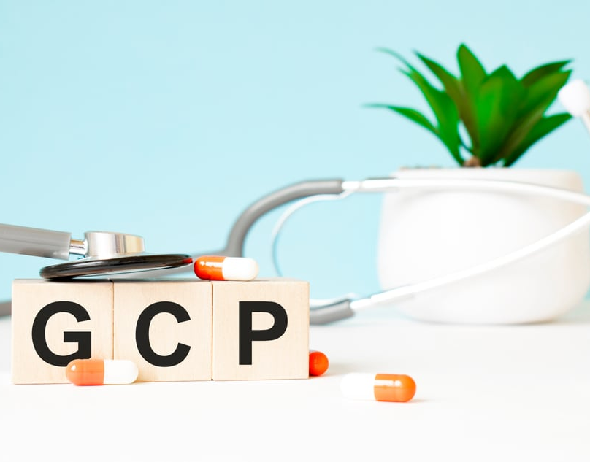
Importance of Good Clinical Practice
Participant Protection
Data Reliability
Regulatory Compliance
Global Acceptance
Public Trust
Notes:
Good Clinical Practice ensures:
Participant Safety: It secures participants' rights and health, making sure they are the primary concern.
Data Trustworthiness: Standardizes how studies are run and reported, making the data gathered trusted worldwide.
Regulatory Adherence: Following GCP is a must in many countries to get approval for new treatments.
Worldwide Recognition: GCP is known and respected globally, which helps in doing large studies across countries.
Maintains Public Trust: It helps people believe in clinical research, showing that the results are obtained responsibly.
In essence, Good Clinical Practice is vital for conducting high-quality, ethical research. It directs all involved in clinical trials, from planners to investigators, ensuring safety and scientific validity. Following GCP means meeting both ethical obligations and regulatory expectations, crucial for progress in healthcare

Slide 18
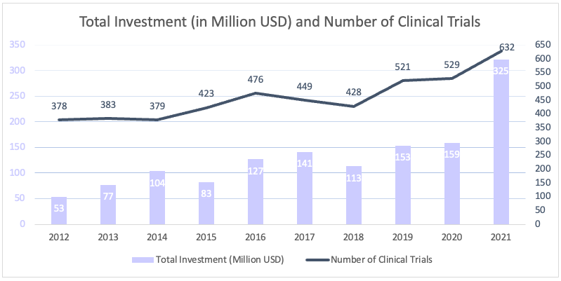
The Importance of Good Clinical Practices
Notes:
In this graph, we see that the budget allocated to clinical research worldwide is increasing and even there have been big leaps in recent years.

Slide 19
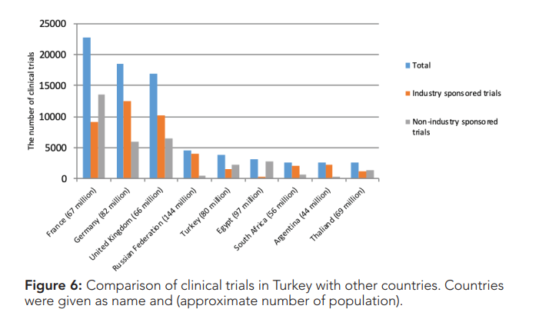
The Importance of Good Clinical Practices
Notes:
As can be seen, developed countries receive a significant budget from clinical studies. Clinical studies in LMIC are extremely limited.

Slide 20
Questions and Discussion
QUESTION AND ANSWER
SHARING EXPERIENCES
LET'S SUMMARIZE
Notes:
Please review the books and other documents on our website to obtain more detailed information on the subject. You can use our social media accounts for any questions or concerns you may have.

Slide 21
Clinical Trials and GCP Summary
Ethical issues ensure participant safety and research integrity.
Good Clinical Practice vital for research reliability.
Clinical trial phases assess safety and efficacy systematically.
Regulatory bodies oversee ethics and scientific conduct of research.
Notes:
To summarize what we learned in this session:
1. Ethical issues in human experimentation are of great importance for the protection, safety and welfare of research participants, as well as for maintaining the integrity and reliability of clinical research.
2. Quality systems such as Good Clinical Practice (GCP) and standardization of research processes and results are essential to ensure the reliability and interpretability of clinical research.
3. The phases of clinical trials represent a systematic approach to assessing the safety and efficacy of new medical interventions. Each phase serves different goals and contributes to a comprehensive understanding of the intervention profile.
4. Regulatory bodies are vital in overseeing and ensuring that clinical research is conducted ethically and scientifically. These bodies are responsible for establishing and implementing standards that protect the rights, safety and welfare of research participants, as well as maintaining the integrity and reliability of research results.

Slide 22
Additional Resources
https://titck.gov.tr/faaliyetalanlari/ilac/klinik-arastirmalar
https://www.ema.europa.eu/en/human-regulatory-overview/research-and-development/clinical-trials-human-medicines
https://www.fda.gov/patients/drug-development-process/step-3-clinical-research
https://www.who.int/health-topics/clinical-trials

Slide 23
Project Partners

Slide 24
This document was prepared for the Erasmus Project "2022-1-TR01-KA220-VET-000088373
A UNIVERSAL STRATEGIC NECESSITY: FROM MOLECULE TO DRUG»
"”Supported by the European Commission within the scope of the Erasmus+ Programme. However, the European Commission and the Turkish National Agency cannot be held responsible for the opinions expressed here."
Notes:
A universal necessity: From Molecule to Drug Project
"Supported by the European Commission within the Erasmus+ Programme.
However, the European Commission and the Turkish National Agency cannot be held responsible for the views expressed here."

Slide 25
THANK YOU
Notes:
Projemize desteklerinden ötürü Avrupa Komisyonu’na ve proje ekibinde yer alarak katkıda bulunan tüm üyelerimize ve proje kapsamındaki etkinliklere katılan herkese teşekkür ederiz.

