Slide 1
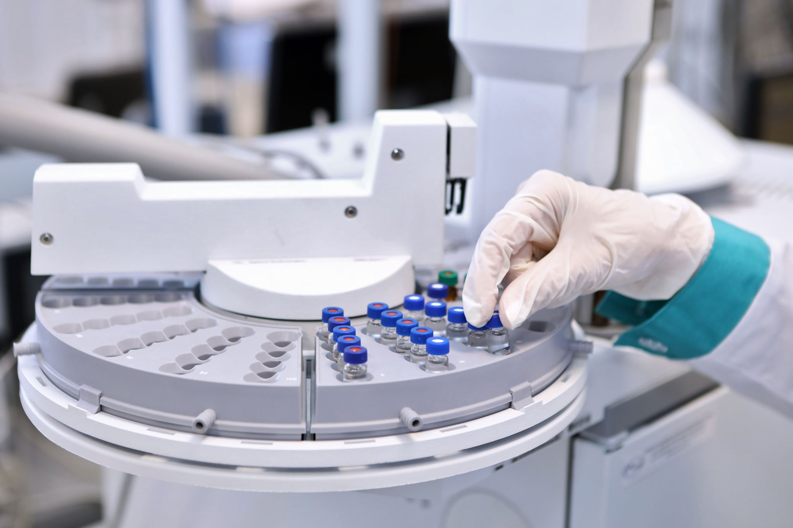
INTRODUCTION TO GOOD MANUFACTURING PRACTICE (GMP)
From Molecule to Drug
PROF. DR. AYSEGUL TAYLAN ÖZKAN
Notes:
Hello
This session will take you through Good Manufacturing Practices or GMP for short.
These international rules were developed by industry and regulators to ensure quality and safety in Manufacturing.

Slide 2
Learning Objectives
Identify
the importance of the GMP
Recall
the key principles of the GMP
Explain
the purpose and key activities of GMP in the pathway from molecule to drug.
Interpret
the importance of GMP in the drug development process.
Notes:
Welcome to our basic session on Good Manufacturing Practices (GMP), the cornerstone of quality in the pharmaceutical industry.
In this module, we begin by defining why GMP is not just a regulatory requirement, but also the backbone of our entire pharmaceutical manufacturing process. We will delve into the essence of GMP, understanding its critical role in protecting patient safety and ensuring the efficacy of our products.
As we move forward, we will recall the fundamental principles that underpin GMP. These principles are not just guidelines, they are the pillars that support every step from the laboratory bench to the patient’s bedside, ensuring that every medicine we manufacture is safe.
We will then explain the purpose and core activities of GMP. Here, we will bridge theory and practice by examining how GMP guides the transformation of a molecule into a life-saving medicine. We will explore the activities that will ensure that this pathway supports the highest standards of quality and safety.
Finally, we will comment on the vital importance of GMP in the drug development process. It is a framework that not only ensures compliance, but also promotes excellence and reliability in the pharmaceutical industry. Through this understanding, we will appreciate how GMP is inherently linked to our daily work and the well-being of global health. By the end of this module, you will have a clear understanding of the integral role of GMP in the drug development journey and be ready to apply these principles in your own fields.

Slide 3
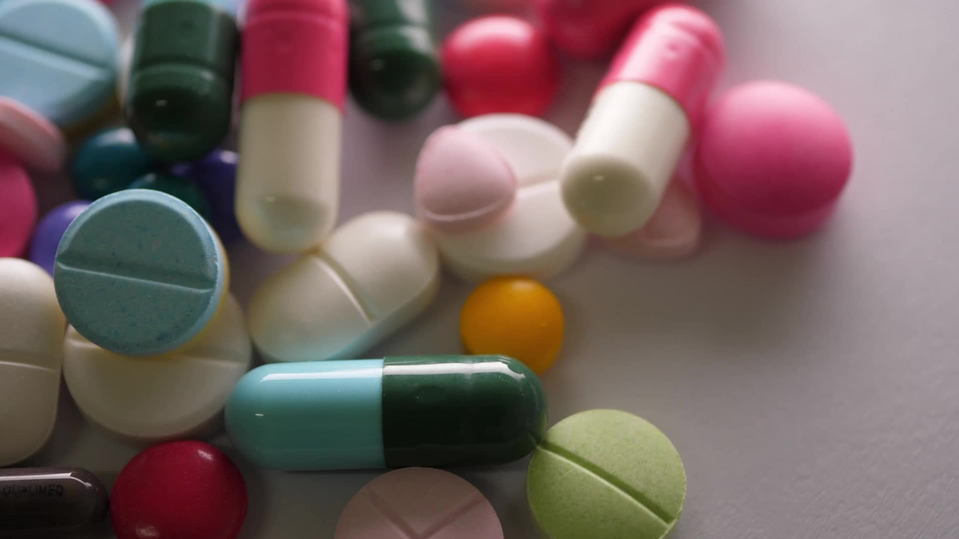
Agenda
Introduction
Historical Background
Key Principles of GMP
Importance of GMP
GMP Regulations
GMP in Different Industries
Compliance and Audits
Conclusion
Notes:
Let’s take a moment to orient ourselves on the roadmap of our Good Manufacturing Practice journey. Since this is the subject of the course, we will focus primarily on pharmaceuticals. Please note that GMP in other industries may include different elements.
We will start with an Introduction to set the stage for why we are here and what we aim to achieve through our collective learning.
We will then delve into the Historical Background of GMP, where we will trace the origins of these critical guidelines and understand how past events paved the way for today’s standards.
Moving on, we will examine the Fundamental Principles of GMP, the fundamental elements that ensure quality and safety in every product we bring to market, not by chance but by design.
We will then delve deeper into the importance of GMP, reflecting on its important role in not only meeting regulatory expectations, but also in instilling consumer confidence and protecting our end users.
Our attention will then shift to the GMP Regulations, where we will navigate the complex landscape of international standards and directives that govern our industry.
We will examine GMP in Different Industries, emphasizing the versatility and adaptability of these applications, whether pharmaceutical, biotech, food or cosmetics.
We will then examine Compliance and Audits, the mechanisms we use to ensure that we are not only complying with the rules but also continually improving and supporting the spirit of excellence.
We will conclude with a Conclusion that synthesizes our discussions and thoughts, ensuring that you leave with a solid understanding of the value of GMP.
Finally, we will open the floor to your thoughts, questions and insights in our Q&A session, where your participation will enrich our learning experience together.

Slide 4
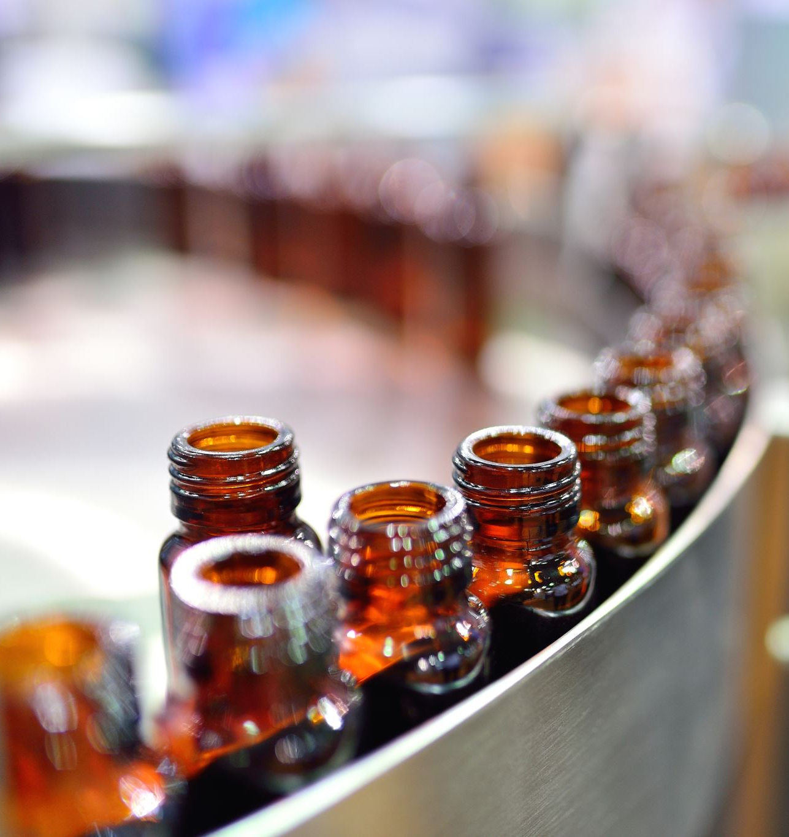
Introduction to Good Manufacturing Practice
Guidelines and principles to ensure
Quality
Safety
Consistency
In various Industries
Pharmaceuticals
Food
Cosmetics
Biotechnology
Notes:
Good Manufacturing Practice (GMP) is a set of guidelines and principles that are essential for ensuring the quality, safety, and consistency of products in various industries, including pharmaceuticals, food, cosmetics, and biotechnology. GMP standards provide a framework for manufacturing processes, emphasizing quality control, documentation, and adherence to regulatory requirements. In this chapter, we will explore the key aspects of GMP, its historical context, and its significance in today's manufacturing landscape.

Slide 5
Historical Background: Several 20th century high-profile incidents
1950s-1960s
Stricter drug regulation, including the GMP principle of validation
triggered by the Thalidomide Disaster
1963
In 1963, publishing of GMP guidelines for pharmaceutical manufacturing by WHO
1938
Federal Food, Drug, and Cosmetic Act
Result of the Sulfanilamide Diseaster
1906
Pure Food and Drug Act in the United States
aimed to regulate the labeling of food and drugs
1970s
GMP principles of documentation and traceability
Due to increased complexity pharma manufacturing
Notes:
Early developments of GMP go back to the start of the 20th century when concerns arose about the safety and quality of pharmaceuticals and food products. At that time, there were no standardized practices to ensure product integrity, leading to numerous public health issues.
Several high-profile incidents, such as the use of toxic preservatives in medicines and the distribution of adulterated food, prompted governments and industry stakeholders to take action.
One of the first significant steps towards GMP was the passage of the 1906 Pure Food and Drug Act in the United States. This act addressed the purity and labeling of products and laid the groundwork for manufacturing oversight. Although it didn't fully address manufacturing practices, it established the precedent that government can and should regulate drug and food safety, thus leading to the principle of regulatory compliance that is central to GMP.
Sulfanilamide Disaster of 1937 was a tragedy, where over 100 people died due to a toxic solvent used in a sulfanilamide medication. This led directly to the establishment of the 1938 Federal Food, Drug, and Cosmetic Act. This act required drug manufacturers to provide proof of safety before a drug could be marketed, setting the stage for GMP principles that ensure safety and efficacy through rigorous testing and quality control measures.
Thalidomide Tragedy of the late 1950s and early 1960s were the next trigger for shaping GMP. Fetal deformations caused by the drug thalidomide, which had not been properly tested for teratogenic effects, resulted in stricter drug regulation and the demand for thorough drug evaluation for safety and efficacy before approval. This event influenced the GMP principle of validation - that all aspects of the manufacturing process must be scientifically validated to produce a product of consistent quality and reliability.
In 1963, the World Health Organization (WHO) published its first set of GMP guidelines for pharmaceutical manufacturing, setting a global precedent
The 1970s and Beyond: Increasing complexity in pharmaceutical manufacturing and more sophisticated technologies led to more detailed GMP regulations. For instance, the need for detailed documentation and clear protocols came from historical issues of cross-contamination and mix-ups in drug manufacturing. This resulted in the GMP principles of documentation and traceability.
This overview highlights only a selection of milestones in GMP development. We must be aware that the evolution of the process still continues.
From the perspective of your own professional discipline, ask yourself how your work relates directly or indirectly on GMP, and what you need to know about new developments

Slide 6
Key Principles of GMP
Documentation and Record-keeping
Personnel Training and Hygiene
Facility and Equipment Maintenance
Raw Material Handling
Process Validation
Quality Control and Testing
Packaging and Labeling
Complaints and Recall Procedures
Risk Management
Notes:
GMP is founded on several fundamental principles that are applicable across industries. These principles include:
Documentation and Record-keeping: Ensuring all manufacturing processes are written down, and batch records are maintained to trace the history of each product.
Personnel Training and Hygiene: Providing continuous training to staff on GMP standards and ensuring personal hygiene to prevent product contamination.
Facility and Equipment Maintenance: Regularly inspecting and servicing machinery and facilities to comply with product safety standards and prevent cross-contamination.
Raw Material Handling: Implementing strict controls on the storage, handling, and use of raw materials to ensure their quality and integrity.
Process Validation: Demonstrating that each aspect of the manufacturing process consistently produces a product meeting its predetermined specifications and quality attributes.
Quality Control and Testing: Conducting systematic tests on products at different stages of production to ensure they meet quality and safety standards.
Packaging and Labeling: Ensuring that packaging materials are suitable to protect products from contamination, and that labeling provides accurate product information.
Complaints and Recall Procedures: Establishing a system to handle customer complaints and to effectively recall any products from the market if necessary.
Risk Management: Proactively identifying, assessing, and controlling potential quality risks throughout the manufacturing process.

Slide 7
Documentation and Record-keeping
For all aspects of operations, including
manufacturing processes
quality control
personnel training
equipment maintenance.
Proper documentation ensures
transparency
traceability,
accountability
throughout the product's lifecycle.
Notes:
Documentation and Record Keeping: The principle of ensuring that all manufacturing processes are in writing and that batch records are kept to track the history of each product. Comprehensive documentation is at the core of GMP. Manufacturers are required to keep records of all aspects of their operations, from manufacturing processes and quality control to personnel training and equipment maintenance. Proper documentation ensures transparency, traceability and accountability throughout the product lifecycle.

Slide 8
Personnel Training and Hygiene
Personnel involved in manufacturing:
Are appropriately trained
Adhere to strict hygiene practices.
Examples:
Wear suitable protective clothing
Maintain personal cleanliness,
Demonstrate risk awareness
Notes:
GMP mandates that personnel involved in manufacturing undergo appropriate training and adhere to strict hygiene practices. This includes wearing suitable protective clothing, maintaining personal cleanliness, and being aware of potential contamination risks.

Slide 9
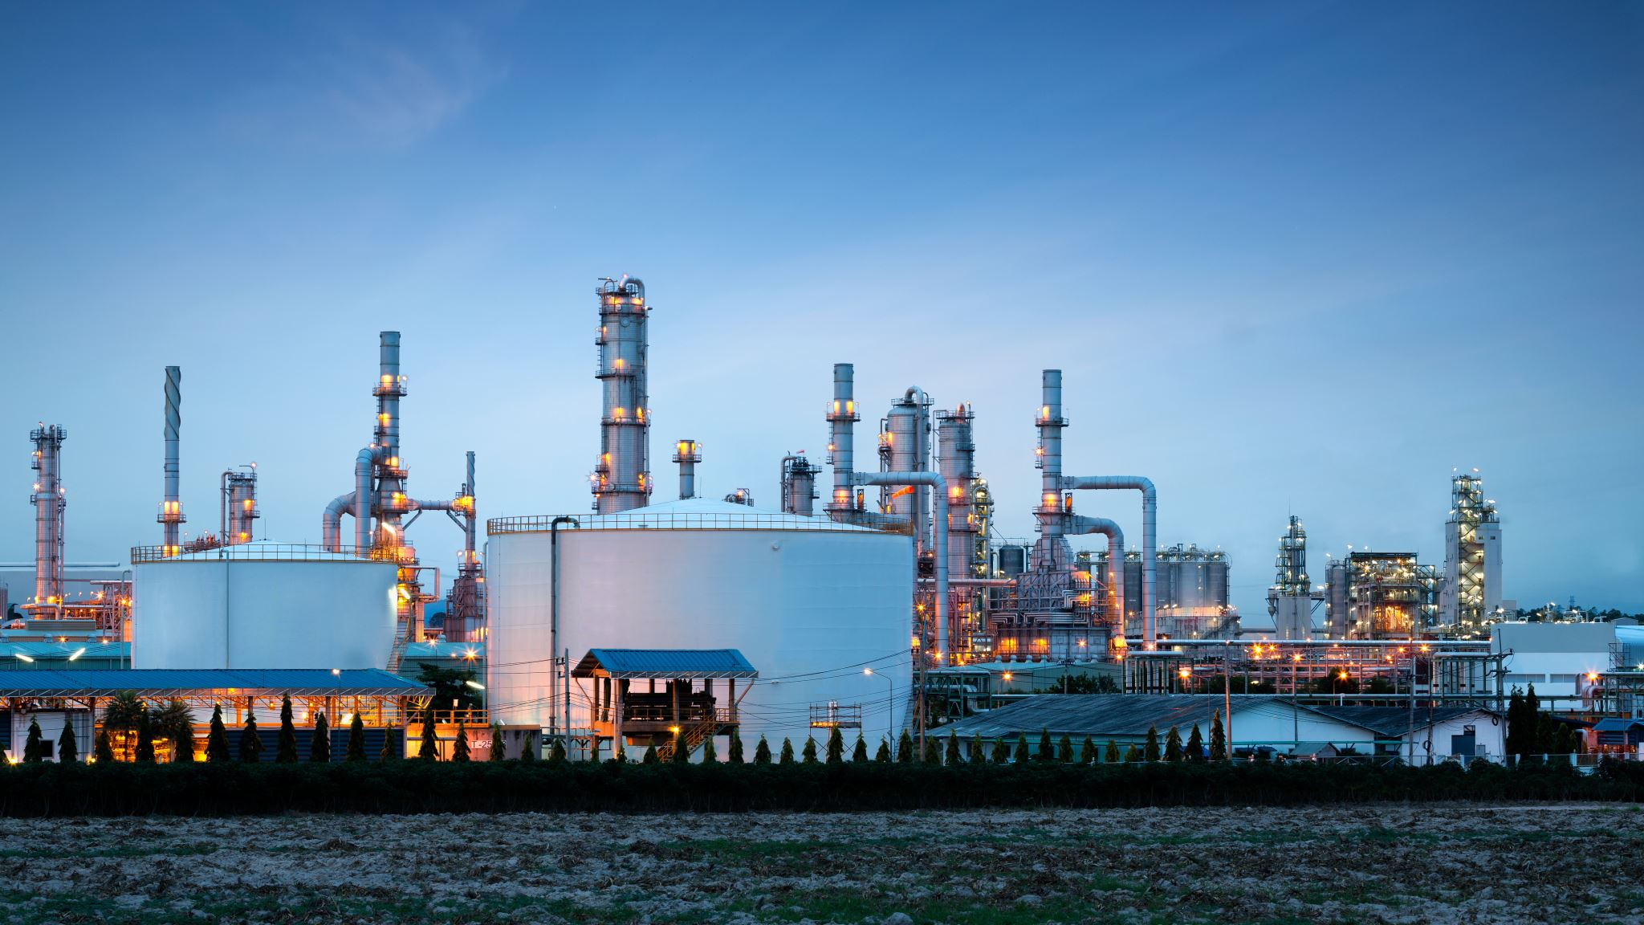
Facility and Equipment Maintenance
Facility design, construction, and maintainance
Routine maintenance and calibration
prevent contamination
critical to prevent equipment-related issues.
ensure product quality
Notes:
Facility and Equipment Maintenance «The principle of regularly inspecting and maintaining machinery and facilities to comply with product safety standards and prevent cross-contamination».
Production facilities and equipment must be designed, constructed and maintained to prevent contamination and ensure product quality. Routine maintenance and calibration are critical to preventing equipment problems.

Slide 10
Raw Material Handling
Proper procedures for
Receipt
İdentification
Storage
Handling
This aims to
prevent contamination
ensure their quality.
Notes:
Raw Material Handling The principle of «Implementing strict controls over the storage, handling and use of raw materials to ensure their quality and integrity». Appropriate procedures must be in place for the reception, identification, storage and handling of raw materials to prevent contamination and ensure their quality.

Slide 11
Process Validation
Demonstrate that production
İs consistent
meets predetermined quality standards
This includes
testing
monitoring
Notes:
Process Validation is the principle of «Demonstrating that every aspect of the manufacturing process consistently produces a product that meets predetermined specifications and quality attributes.» Manufacturers need to validate their manufacturing processes to demonstrate that they can consistently produce products that meet predetermined quality standards. This includes testing and monitoring at various stages of production.

Slide 12
Quality Control and Testing
Specification Compliance:
Ensuring all materials meet predefined standards.
Sampling Procedures:
Systematic selection of samples for testing.
Analytical Testing:
Using validated methods to assess quality attributes.
In-process Controls:
Monitoring critical parameters during manufacturing.
Validation of Test Methods:
Confirming the accuracy and reliability of testing procedures.
Record of Testing:
Documenting all quality control results for traceability.
Data Review:
Critical assessment of test data against specifications.
Out-of-Specification (OOS) Handling:
Procedures for investigating and addressing non-compliant results.
Notes:
Quality Control and Testing is the principle of «systematic testing of products at different stages of production to ensure that they meet quality and safety standards».
Being vigilant is essential in Good Manufacturing Practices. Every material, whether raw or part of a finished product, is subject to rigorous and ongoing quality assessments to ensure compliance with established standards. This requires a robust quality control system where every step, from careful sampling to comprehensive analytical testing, is performed in state-of-the-art laboratories. GMP protocols ensure that every test method is rigorously validated, every result is meticulously recorded, and every data point is critically examined. When results do not meet specifications, precise Out of Specification procedures guide investigation and resolution, ensuring that products under management are consistently of the highest quality and safety.

Slide 13
Packaging and Labeling
Labels must
accurately reflect the product's contents, usage instructions
İnclude any necessary warnings.
Notes:
Packaging and Labeling «Ensuring that packaging materials are suitable to protect products from contamination and that labeling contains accurate product information» is the principle.
Proper labeling and packaging of products are important elements of GMP compliance. Labels must accurately reflect the product content, instructions for use, and necessary warnings.

Slide 14
Complaints and Recall Procedures
Handling
handling customer complaints
Initiating
initiating product recalls if necessary
Notes:
Complaint and Recall Procedures The principle of "establishing a system for handling customer complaints and, if necessary, effectively withdrawing products from the market" is as follows.
Manufacturers must establish procedures for handling customer complaints and, if necessary, initiating product recalls. This will ensure that prompt action is taken in the event of safety or quality concerns.
All complaints regarding product quality will be carefully reviewed and recorded according to written procedures. Each complaint will be investigated/assessed by personnel designated by the company, and records of the investigation and actions taken will be kept. Reports of serious adverse drug reactions resulting from the use of a medicine will be reported immediately to the relevant Licensing Authority, together with comments and documentation. There will be written procedures explaining the recall and recall procedures to be carried out for the defective product. A system for prompt and effective recall of defective products will be established so that all relevant stockists, wholesalers and suppliers up to the retail level are informed in a timely manner. The licensee can use both printed and electronic media in this regard. Distribution records will be made available to the persons designated for the preliminary recall. The effectiveness of the recall arrangements will be evaluated from time to time. Recalled products will be stored separately in a secure, designated area until a final decision is made on the recalled products.

Slide 15
Risk Management
GMP emphasises:
risk assessment
risk management
Purpose:
identify and mitigate potential hazards.
Notes:
Risk Management is the principle of «Proactively identifying, assessing and controlling potential quality risks throughout the manufacturing process».
GMP emphasizes the importance of risk assessment and management throughout the manufacturing process to identify and reduce potential hazards.

Slide 16
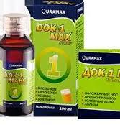
Case Study: Uzbekistan Cough Syrup Scandal
December 2022: The Uzbekistan Ministry of Health announced that 18 children in Samarkand died after consuming Dok-1 Max.
December 2022: Analysis of Dok-1 Max revealed that it was contaminated with ethylene glycol, a toxic substance used in antifreeze.
December 29, 2022: Marion Biotech halts production of Dok-1 Max.
January 2023: Two more children in Uzbekistan died after consuming AMBRONOL, which was also found to be contaminated with ethylene glycol.
January 2023: The World Health Organization (WHO) issued a global alert about contaminated cough syrups.
Currently: Investigations are ongoing and Marion Biotech is facing legal action.
Notes:
Case Study: Uzbekistan Cough Syrup Scandal: A Tragic Event
The Uzbekistan cough syrup scandal was a devastating incident that occurred in December 2022 and January 2023 and resulted in the deaths of 20 children. The scandal involved two cough syrups, Dok-1 Max and AMBRONOL, manufactured by the Indian pharmaceutical company Marion Biotech.
Here is a timeline of key events:
December 2022: The Uzbekistan Ministry of Health announced that 18 children in Samarkand died after consuming Dok-1 Max.
December 2022: Analysis of Dok-1 Max reveals it was contaminated with ethylene glycol, a toxic substance used in antifreeze.
December 29, 2022: Marion Biotech halts production of Dok-1 Max.
January 2023: Two more children in Uzbekistan died after consuming AMBRONOL, which was also found to be contaminated with ethylene glycol.
January 2023: The World Health Organization (WHO) issued a global alert regarding contaminated cough syrups.
To date: Investigations are ongoing and Marion Biotech is facing legal action.

Slide 17
Case Study: Uzbekistan Cough Syrup Scandal
What were the GMP errors?
What were the consequences?
What should be done?
Notes:
Think about this case
What were the GMP failures?
What was the impact?
And what should be done?

Slide 18
What were the GMP errors? Uzbekistan Cough Syrup Scandal
Inadequate Quality Control
No testing for ethylene glycol Defective testing procedures Documentation fraud
Poor Manufacturing Practices
Contamination of raw materials Inadequate hygiene and sanitation Improper storage and handling
Deficiencies in Regulatory Oversight
Weak regulatory enforcement Limited access to information Lack of international cooperation
Ethical Violations
Corporate negligence
Alleged bribery
Alleged bribery
Corporate negligence
Notes:
The Uzbekistan cough syrup scandal has exposed several critical failures in Good Manufacturing Practices (GMP) throughout the manufacturing process of contaminated Dok-1 Max and AMBRONOL syrups. Some of the identified GMP failures include:
Inadequate Quality Control:
No testing for ethylene glycol: Marion Biotech failed to test for ethylene glycol, a toxic contaminant, during the manufacturing process.
Flawed testing procedures: Reports suggest inconsistencies and inaccuracies in the testing procedures used by Marion Biotech, leading to unreliable results.
Fraud in documentation: Investigations have revealed that quality control data may have been falsified to mask inconsistencies and maintain product approvals.
2. Poor Manufacturing Practices:
Contamination of raw materials: The ethylene glycol contamination likely resulted from the use of contaminated raw materials during the manufacturing process.
Inadequate hygiene and sanitation: Poor hygiene practices at the manufacturing facility may have facilitated contamination of cough syrups with ethylene glycol or other harmful substances.
Improper storage and handling: Storage and handling of raw materials and finished products may not have been in compliance with GMP guidelines, potentially contributing to contamination.
3. Lack of Regulatory Oversight: Weak regulatory enforcement: Indian regulatory authorities responsible for overseeing Marion Biotech’s operations may not have implemented sufficiently stringent controls and inspections.
Limited access to information: Transparency and information sharing between regulatory agencies in Uzbekistan and India were initially limited, preventing timely identification and investigation of contamination.
Lack of international cooperation: Stronger communication and coordination between international regulatory agencies could have facilitated faster response and prevented further harm.
4. Ethical Violations:
Bribery allegations: Investigations suggest Marion Biotech may have bribed officials to bypass quality control procedures and expedite product approvals.
Corporate negligence: The company’s leadership potentially prioritized profits over patient safety, leading to the devastating consequences of contaminated cough syrups.
Collectively, these GMP failures contributed to the deaths of 20 children in Uzbekistan, highlighting the critical importance of robust quality control measures and ethical practices in the pharmaceutical industry.

Slide 19
Consequences of GMP failures?
Loss of life
20 children tragically lost their lives.
Widespread panic and fear among the public
Economic and Social Costs
Negative impact on pharmaceutical industries in both Uzbekistan and India
Global Impacts
Need for international cooperation to improve quality and safety
Many other children suffered serious health problems
Public Health Crisis
Importance of ensuring the vulnerability of children and the safety and quality of medicines
International damage to the reputation of the Indian pharmaceutical industry
Importance of information sharing and rapid response mechanisms
Notes:
Loss of Life:
Twenty children tragically lost their lives after consuming contaminated cough syrups Dok-1 Max and AMBRONOL. This huge loss has left families and communities in great pain and trauma.
Several other children suffered serious health complications from the poisoning, requiring long-term medical care and rehabilitation.
Public Health Crisis:
The scandal has caused widespread panic and fear among the public in Uzbekistan, leading to a serious loss of confidence in the healthcare system and medicine safety.
The incident highlighted the vulnerability of children and the importance of ensuring the safety and quality of medicines provided to them.
Economic and Social Costs:
The scandal had a negative impact on the pharmaceutical industries in both Uzbekistan and India, requiring significant economic resources for investigations, recalls and compensation.
The incident damaged the reputation of the Indian pharmaceutical industry internationally and raised concerns about the quality control measures implemented.
Global Implications:
The scandal has highlighted the potential risks of inadequate safety regulations and the need for international collaboration to improve the quality and safety of pharmaceuticals worldwide.
The WHO has issued a global alert on contaminated cough syrups, highlighting the importance of information sharing and rapid response mechanisms.
Public Health Crisis:
The scandal triggered widespread panic and fear among the public in Uzbekistan, leading to a significant loss of trust in the healthcare system and medication safety.
The incident highlighted the vulnerability of children and the importance of ensuring the safety and quality of medicines available to them.
Economic and Social Costs:
The scandal had a negative impact on the pharmaceutical industry in both Uzbekistan and India, requiring significant economic resources for investigations, recalls, and compensation.
The incident tarnished the reputation of the Indian pharmaceutical industry internationally, raising concerns about the quality control measures in place.
Global Implications:
The scandal exposed the potential risks of inadequate safety regulations and the need for international collaboration to improve the quality and safety of pharmaceuticals worldwide.
The WHO issued a global alert regarding the contaminated cough syrups, highlighting the importance of information sharing and rapid response mechanisms.

Slide 20
What should be done?
Rigorous testing and analysis
Implementation and enforcement of strong GMP standards
Raising awareness
Pre-marketing testing Monitoring adverse events Market surveillance
Notes:
Lessons Learned:
The Uzbekistan cough syrup scandal is a stark reminder of the importance of strong GMP compliance throughout the pharmaceutical lifecycle.
The incident highlights the need for strong regulatory oversight and effective enforcement mechanisms to ensure the safety and quality of medicines.
Transparency and open communication between manufacturers, regulators and the public are crucial to preventing future tragedies.
What’s Next:
The Uzbekistan cough syrup scandal has sparked significant debate about global drug safety and quality control.
International organizations such as the WHO are playing a key role in developing and implementing stricter regulations and standards.
Technological advances such as blockchain technology are being explored to provide greater traceability and transparency in the pharmaceutical supply chain.
Remember:
The impact of the GMP failures in the Uzbekistan cough syrup scandal goes far beyond the tragedy itself. It underscores the importance of collective responsibility and ongoing efforts to ensure the safety and well-being of individuals worldwide.
This case underscores the critical importance of GMP in the pharmaceutical industry and beyond:
Rigorous testing and documentation are essential to assessing the safety and efficacy of products.
Regulatory agencies must implement and enforce strong GMP standards to protect public health.
The tragedy has raised awareness of the need for extensive pre-market testing, monitoring for adverse events, and robust post-market surveillance.

Slide 21
Importance of GMP
Ensuring Product Quality
Protecting Public Health
Regulatory Compliance
Reputation Management
Notes:
The importance of GMP in today’s manufacturing environment cannot be overstated. It plays a key role in ensuring product quality, protecting public health, regulatory compliance, and reputation management.
GMP ensures that products are consistently manufactured to meet quality standards, reducing the risk of defects and ensuring customer satisfaction.
GMP guidelines are especially critical in industries such as pharmaceuticals and food, where product quality can directly impact public health.
GMP compliance is often a legal requirement, and violations can result in serious penalties, including product recalls and facility closures.
Adherence to GMP standards enhances a company’s reputation and instills confidence in consumers and regulators.

Slide 22
GMP Regulations
Regulatory Authorities
Food and Drug Administration (FDA)
International GMP Guidelines
International Council for Harmonisation of Technical Requirements for Pharmaceuticals for Human Use (ICH)
Legal Requirements and Standards
European Medicines Agency (EMA)
Notes:
Various regulatory authorities, such as the Food and Drug Administration (FDA) in the United States and the European Medicines Agency (EMA) in Europe, oversee GMP compliance in their respective regions. Additionally, international organizations such as the International Council for Harmonization of Technical Requirements for Pharmaceuticals for Human Use (ICH) provide global guidelines for pharmaceutical GMP.
How do different countries' GMPs compare?
At a high level, GMPs from different countries are very similar and require things like:
• Proper design, maintenance, and cleaning of equipment and facilities
• Writing and approving Standard Operating Procedures (SOPs)
• An independent Quality Control and Control (QC)/or Quality Assurance)
• Well-trained personnel and management
The World Health Organization (WHO) version of GMP is used by drug regulators and the pharmaceutical industry in over a hundred countries worldwide, especially in developing countries.
The European Union's GMP (EU-GMP), like the US version of the Food and Drug Administration, imposes more compliance requirements than the WHO GMP.
Similar GMPs are also used in Australia, Canada, Japan, Singapore and other countries with more sophisticated GMP requirements.
In the United Kingdom, the Medicines Act (1968), commonly referred to as the "Orange Guide" because of the color of its cover, and officially known as the Rules and Guidance for Manufacturers and Distributors of Medicines, covers many aspects of GMP.
Implementation of GMP in different countries
GMPs are implemented in the United States by the FDA;
In the European Union, GMP inspections are carried out by National Regulatory Authorities (for example, GMP inspections are carried out by the Medicines and Healthcare products Regulatory Agency (MHRA) in the United Kingdom);
In Australia, by the Therapeutic Goods Administration (TGA);
In India and Pakistan, by the Ministry of Health

Slide 23
GMP in Different Industries
Pharmaceutical Industry
Food and Beverage Industry
Cosmetics Industry
Biotechnology Industry
Notes:
GMP principles are applied in a wide range of industries such as the Pharmaceutical Industry, Food and Beverage Industry, Cosmetic Industry, Biotechnology Industry.
GMP is very important to ensure the safety and effectiveness of drugs.
GMP protects the quality of food and beverages.
GMP ensures the safety and consistency of cosmetic products.
GMP is essential in the production of biopharmaceuticals and other biotechnological products.

Slide 24
Compliance and Audits
Internal Audits
Regulatory Inspections
Non-Compliance Consequences
Notes:
Manufacturers are subject to both internal audits and regulatory inspections to ensure GMP compliance.
Non-compliance can result in serious consequences, including product recalls and legal action.

Slide 25
Questions and Discussion
QUESTION AND ANSWER
SHARING EXPERIENCES
LET'S SUMMARIZE
Notes:
Please review the books and other documents on our website to obtain more detailed information on the subject. You can use our social media accounts for any questions or concerns you may have.

Slide 26
Conclusion for GMP
GMP is a cornerstone of quality assurance in various industries
Manufacturers can ensure the consistent production of safe, high-quality products, ultimately benefiting consumers and their own reputation
Notes:
Good Manufacturing Practice is a cornerstone of quality assurance in various industries. By adhering to GMP principles, manufacturers can ensure the consistent production of safe, high-quality products, ultimately benefiting consumers and their own reputation.

Slide 27
Additional Resources
EMA. https://www.ema.europa.eu/en/human-regulatory-overview/research-development/compliance-research-development/good-manufacturing-practice
FDA. GMP International Master Reference Guide: https://www.gmppublications.com/
Documents required by EU GMP - a detailed list with references: https://www.inspiredpharma.com/gmp-training/
Guidance on good manufacturing practice and good distribution practice: Questions and answers: https://www.ema.europa.eu/en/human-regulatory-overview/research-and-development/compliance-research-and-development/good-manufacturing-practice/guidance-good-manufacturing-practice-and-good-distribution-practice-questions-and-answers
World Health Organization (WHO): https://www.who.int/teams/health-product-and-policy-standards/standards-and-specifications/norms-and-standards-for-pharmaceuticals/guidelines/production

Slide 28
Project Partners

Slide 29
This document was prepared for the Erasmus Project "2022-1-TR01-KA220-VET-000088373
A UNIVERSAL STRATEGIC NECESSITY: FROM MOLECULE TO DRUG»
"”Supported by the European Commission within the scope of the Erasmus+ Programme. However, the European Commission and the Turkish National Agency cannot be held responsible for the opinions expressed here."
Notes:
A universal necessity: From Molecule to Drug Project
"Supported by the European Commission within the Erasmus+ Programme.
However, the European Commission and the Turkish National Agency cannot be held responsible for the views expressed here."

Slide 30
THANK YOU
Notes:
Projemize desteklerinden ötürü Avrupa Komisyonu’na ve proje ekibinde yer alarak katkıda bulunan tüm üyelerimize ve proje kapsamındaki etkinliklere katılan herkese teşekkür ederiz.

