Slide 1
REGISTRATION: Technical requirements, pharmacopoeia, licensing and patenting
From Molecule to Drug
PROF. DR. KURSAT DERICI
Notes:
Hello
On the path from molecule to drug, we have reached the registration stage after the discovery, pre-clinical and post-clinical research, manufacturing processes.
The drug registration process is a complex and multifaceted journey that pharmaceutical products must go through to ensure that they meet the highest standards of safety, efficacy and quality before reaching the market. This section aims to provide an in-depth understanding of the various stages involved in the drug registration process, from the early stages of drug discovery to post-marketing activities.

Slide 2
Learning Objectives
Identify
Recall
Interpret
Explain
drug licensing rules and requirements
the Common Technical Document (CTD) and content required headers in the licensing file.
the concept of pharmacopoeia and its importance
drug patenting process and the types of patents
Notes:
This section provides a brief overview of these learning objectives in drug licensing. At the end of this presentation, you will be able to define drug licensing rules and requirements, recall the necessary headings for content in the Common Technical Document (CTD) and licensing dossier, interpret the concept and importance of Pharmacopoeia, and explain the drug patenting process and patent types.

Slide 3
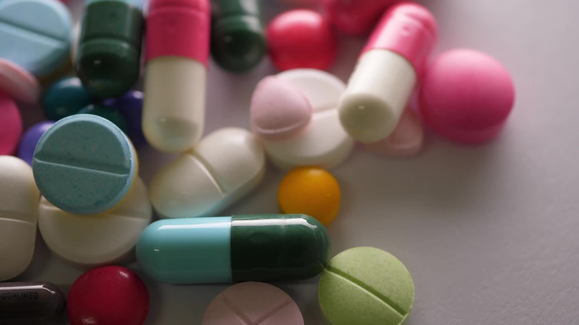
Agenda
Overview of Drug Licensing Processes
CTD (Common Technical Document)
Types of Drug Licenses
Importance of Pharmacopoeias
Importance of Patents and Data Protection in Pharmaceuticals
Notes:
The presentation content includes an Overview of Drug Licensing Processes, the content of the Common Technical Document known as CTD, Types of Drug Licensing, the Importance of Pharmacopoeias and the Importance of Patents and Data Protection in the Pharmaceutical Industry.

Slide 4
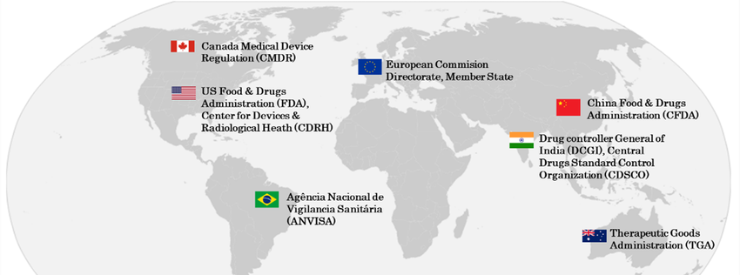
I. Overview of Drug Licensing Processes
Regulatory Authorities
Notes:
Regulatory agencies play a critical role in overseeing the drug development and licensing process to ensure that drugs are safe, effective, and of high quality before they reach the market. Regulatory agencies set standards and guidelines that pharmaceutical companies must follow during the drug development process. This includes safety, efficacy, manufacturing practices, and labeling criteria.

Slide 5
The role of regulatory bodies in overseeing drug development and licensing
Setting Standards and Guidelines
Preclinical Evaluation
Clinical Trials Oversight
Risk-Benefit Assessment
Review of Marketing Authorization Applications (MAAs)
Post-Market Surveillance
Labeling and Packaging Oversight
Inspecting Manufacturing Facilities
Post-Market Studies and Commitments
Regulatory Science and Research
International Collaboration
Notes:
Regulatory bodies play a critical role in overseeing drug development and licensing to ensure that pharmaceuticals are safe, effective, and of high quality before they reach the market. Their primary responsibilities include:
Setting Standards and Guidelines
Preclinical Evaluation
Clinical Trials Oversight
Risk-Benefit Assessment
Review of Marketing Authorization Applications (MAAs)
Post-Market Surveillance
Labeling and Packaging Oversight
Inspecting Manufacturing Facilities
Post-Market Studies and Commitments
Regulatory Science and Research
International Collaboration
By performing these functions, regulatory bodies aim to strike a balance between promoting innovation and safeguarding public health, ensuring that only safe, effective, and high-quality drugs reach the market. This process is vital in maintaining public trust in the pharmaceutical industry and safeguarding the health of patients worldwide.

Slide 6
1. Setting Standards and Guidelines
Key steps and considerations of Regulatory bodies:
Scientific Expertise and Research
Risk Assessment and Benefit Analysis
Public Input and Consultation
Collaboration with International Standards Organizations
Legislation and Legal Framework
Risk-Based Approach
Periodic Review and Updates
Documentation and Transparency
Consensus Building
Enforcement and Compliance
Training and Capacity Building
Emerging Technologies and Trends
Notes:
The process of setting standards by regulatory agencies is a complex, dynamic, and collaborative effort aimed at protecting public health, ensuring product quality, and encouraging innovation in the industry within the framework of safety and ethical considerations.
Setting Standards and Guidelines: Regulatory bodies establish the standards and guidelines that pharmaceutical companies must adhere to during the drug development process. This includes criteria for safety, efficacy, manufacturing practices, and labeling. The process involves several key steps and considerations:
Regulatory bodies play a crucial role in setting standards and guidelines for various industries, including pharmaceuticals. The process involves several key steps and considerations:
Scientific Expertise and Research:
Regulatory bodies typically consist of experts in various scientific fields relevant to the industry they oversee. These experts conduct research and review existing scientific literature to stay informed about the latest developments.
Risk Assessment and Benefit Analysis:
Before setting standards, regulatory bodies assess the risks and benefits associated with products or processes. This involves evaluating potential harm to public health or the environment and comparing it with the expected benefits.
Public Input and Consultation:
Many regulatory bodies seek input from the public, stakeholders, and industry experts during the standard-setting process. This ensures a more comprehensive understanding of different perspectives and potential impacts.
Collaboration with International Standards Organizations:
Regulatory bodies often collaborate with international standards organizations to harmonize standards globally. This collaboration ensures consistency and facilitates trade across borders.
Legislation and Legal Framework:
Regulatory bodies derive their authority from legislation. The legal framework empowers them to establish and enforce standards. The regulatory process must align with national and international laws.
Risk-Based Approach:
Standards are often set based on a risk-based approach. Higher-risk products or processes may have more stringent standards to ensure public safety, while lower-risk ones may have more flexible requirements.
Periodic Review and Updates:
Standards are not static; they need to evolve with scientific advancements and changes in industry practices. Regulatory bodies periodically review and update standards to reflect the latest knowledge and technologies.
Documentation and Transparency:
The standard-setting process involves documenting the rationale behind each standard. This documentation ensures transparency and accountability. It allows stakeholders to understand the basis for regulatory decisions.
Consensus Building:
Regulatory bodies aim to build consensus among stakeholders. This involves engaging in discussions, addressing concerns, and working towards standards that are acceptable and feasible for all parties involved.
Enforcement and Compliance:
Once standards are set, regulatory bodies establish mechanisms for enforcement and compliance monitoring. This may involve inspections, audits, and penalties for non-compliance.
Training and Capacity Building:
Regulatory bodies may provide training and capacity-building initiatives to industry professionals to ensure understanding and adherence to the established standards.
Emerging Technologies and Trends:
Regulatory bodies stay attuned to emerging technologies and industry trends. They adapt standards to address challenges posed by new developments and ensure that regulations remain relevant.
Overall, the standard-setting process by regulatory bodies is a complex, dynamic, and collaborative effort aimed at safeguarding public health, ensuring product quality, and promoting industry innovation within the bounds of safety and ethical considerations.

Slide 7
2. Preclinical Evaluation:
Discovery and Preclinical Testing
Target Identification and Validation
In vitro and In vivo Testing
Animal Testing
Animal Models and Ethical Considerations
Safety and Toxicology Studies
Notes:
Preclinical Evaluation: Before a new drug can be tested in humans, it undergoes extensive preclinical testing in the laboratory and on animals. Regulatory agencies review this data to determine if there is a reasonable expectation of safety and efficacy for humans.
In the initial phase, drug discovery involves identifying potential targets and screening compounds. Preclinical testing follows, encompassing in vitro and in vivo experiments, as well as toxicology studies to assess safety over various exposure durations.
Before a new drug can be tested in humans, it undergoes extensive preclinical testing in the laboratory and on animals. Regulatory agencies review this data to determine if there is a reasonable expectation of safety and efficacy for humans.
Once potential drug candidates are identified, preclinical testing begins. In vitro experiments provide insights into a drug's behavior in controlled environments, while in vivo studies involve testing on animals. This phase also includes rigorous toxicology studies to evaluate the potential toxicity of the drug, covering acute, sub-acute, and chronic exposures.
Toxicology studies are a critical component of preclinical testing. These studies assess the safety of the drug candidate by investigating its impact on living organisms over different exposure durations. They include acute toxicity studies to evaluate immediate adverse effects, sub-acute studies for short-term exposure, and chronic toxicity studies to assess long-term effects.

Slide 8
3. Clinical Trials Oversight:
Phase I
Phase I
Objectives and Participants
Safety and Dosing Studies
Phase II
Phase II
Efficacy and Dosage Optimization
Expanding Safety Data
Phase III
Phase III
Large-Scale Efficacy Studies
Randomized Controlled Trials (RCTs)
Phase IV
Phase IV
Post-Marketing Surveillance
Long-Term Safety and Efficacy
Notes:
Clinical Trials Oversight: Regulatory bodies oversee the design, conduct, and reporting of clinical trials. They evaluate the study protocols, ensuring that trials are well-designed, adequately powered, and scientifically sound. This is crucial to gather reliable data on a drug's safety and effectiveness.
Clinical trials progress through phases. Phase I focuses on safety in small groups, while Phases II and III involve larger patient populations to establish efficacy and safety profiles. Post-marketing surveillance (Phase IV) ensures ongoing safety monitoring and reporting.

Slide 9
4. Risk-Benefit Assessment:
Compilation and Documentation
Clinical Data
Preclinical Data
Manufacturing and Quality Control
Regulatory Review Process
Evaluation Criteria
Advisory Committees
Notes:
Risk-Benefit Assessment: Regulatory agencies assess the balance between the potential benefits of a drug and its associated risks. They evaluate whether the benefits outweigh the potential harms, taking into account the severity of the condition being treated and the availability of alternative treatments.
.

Slide 10
5. Review of Marketing Authorization Applications (MAAs):
Pharmaceutical companies submit comprehensive dossiers, known as Marketing Authorization Applications (MAAs), to regulatory bodies for approval to market a drug.
These applications include data from preclinical and clinical studies, as well as information about manufacturing processes and labeling.
Notes:
Review of Marketing Authorization Applications (MAAs): Pharmaceutical companies submit comprehensive dossiers, known as Marketing Authorization Applications (MAAs), to regulatory bodies for approval to market a drug. These applications include data from preclinical and clinical studies, as well as information about manufacturing processes and labeling.

Slide 11
6. Post-Market Surveillance:
Regulatory agencies monitor drugs after they have been approved and are available to the public.
They collect and analyze reports of adverse events, side effects, and other safety concerns.
If unexpected issues arise, they may take corrective actions, including modifying labeling or even withdrawing the drug from the market.
Notes:
Post-Market Surveillance: Regulatory agencies monitor drugs after they have been approved and are available to the public. They collect and analyze reports of adverse events, side effects, and other safety concerns. If unexpected issues arise, they may take corrective actions, including modifying labeling or even withdrawing the drug from the market.

Slide 12
7. Labeling and Packaging Oversight:
Regulatory bodies review and approve the labeling and packaging of pharmaceuticals.
This includes ensuring that the information provided is accurate, comprehensive, and understandable to healthcare professionals and patients.
Notes:
Labeling and Packaging Oversight: Regulatory bodies review and approve the labeling and packaging of pharmaceuticals. This includes ensuring that the information provided is accurate, comprehensive, and understandable to healthcare professionals and patients.

Slide 13
8. Inspecting Manufacturing Facilities:
Regulatory agencies conduct inspections of pharmaceutical manufacturing facilities to ensure they meet Good Manufacturing Practices (GMP) standards.
This helps ensure that drugs are consistently produced to the highest quality standards.
Notes:
Inspecting Manufacturing Facilities: Regulatory agencies conduct inspections of pharmaceutical manufacturing facilities to ensure they meet Good Manufacturing Practices (GMP) standards. This helps ensure that drugs are consistently produced to the highest quality standards.

Slide 14
9. Post-Market Studies and Commitments:
In some cases, regulatory bodies may require additional studies or commitments from pharmaceutical companies after a drug is approved.
These may be related to specific safety concerns or to gather more data on long-term effects.
Notes:
Post-Market Studies and Commitments: In some cases, regulatory bodies may require additional studies or commitments from pharmaceutical companies after a drug is approved. These may be related to specific safety concerns or to gather more data on long-term effects.

Slide 15
10. Regulatory Science and Research
Regulatory agencies often engage in research and development of new methodologies, technologies, and standards for evaluating drugs.
They work to stay at the forefront of scientific advancements to enhance their oversight capabilities.
Notes:
Regulatory Science and Research: Regulatory agencies often engage in research and development of new methodologies, technologies, and standards for evaluating drugs. They work to stay at the forefront of scientific advancements to enhance their oversight capabilities.

Slide 16
11. International Collaboration
Regulatory bodies often collaborate with their counterparts in other countries to share information and best practices.
This helps ensure a global perspective on drug safety and effectiveness.
Notes:
International Collaboration: Regulatory bodies often collaborate with their counterparts in other countries to share information and best practices. This helps ensure a global perspective on drug safety and effectiveness

Slide 17
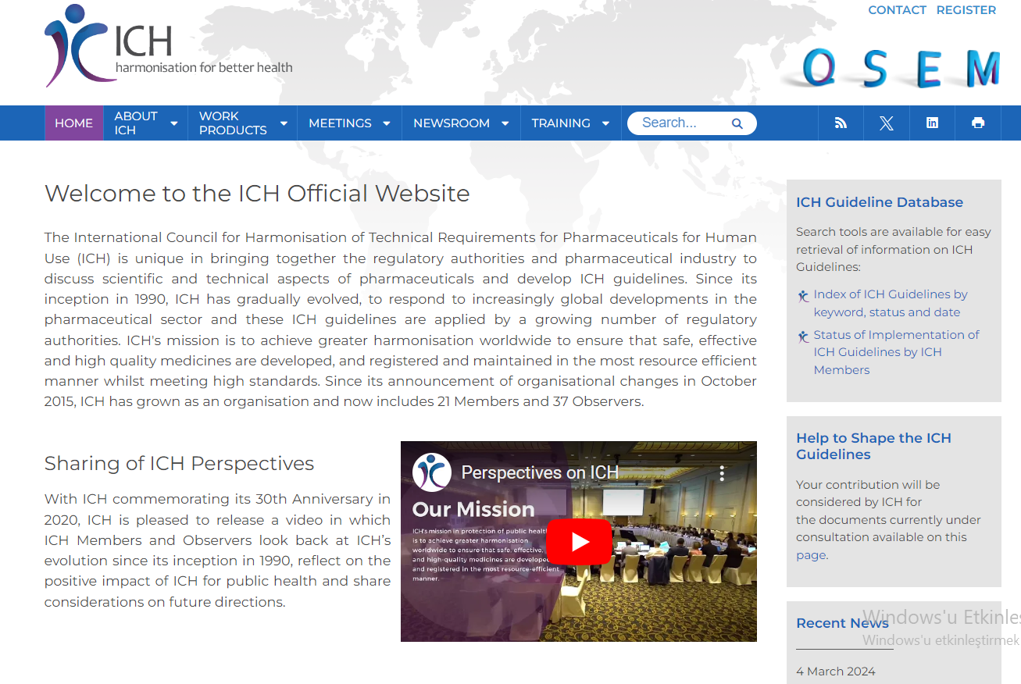
II. The Common Technical Document (CTD)
The Common Technical Document (CTD) is a standardized format for the preparation of regulatory submissions for the approval of pharmaceuticals.
It's accepted internationally and includes comprehensive information about a drug.
Notes:
The CTD serves as a standardized way for pharmaceutical companies to present information to regulatory authorities, streamlining the review and approval process. It helps ensure that all necessary data is included and organized in a consistent format, making it easier for regulatory agencies to evaluate the safety, efficacy, and quality of a pharmaceutical product.

Slide 18
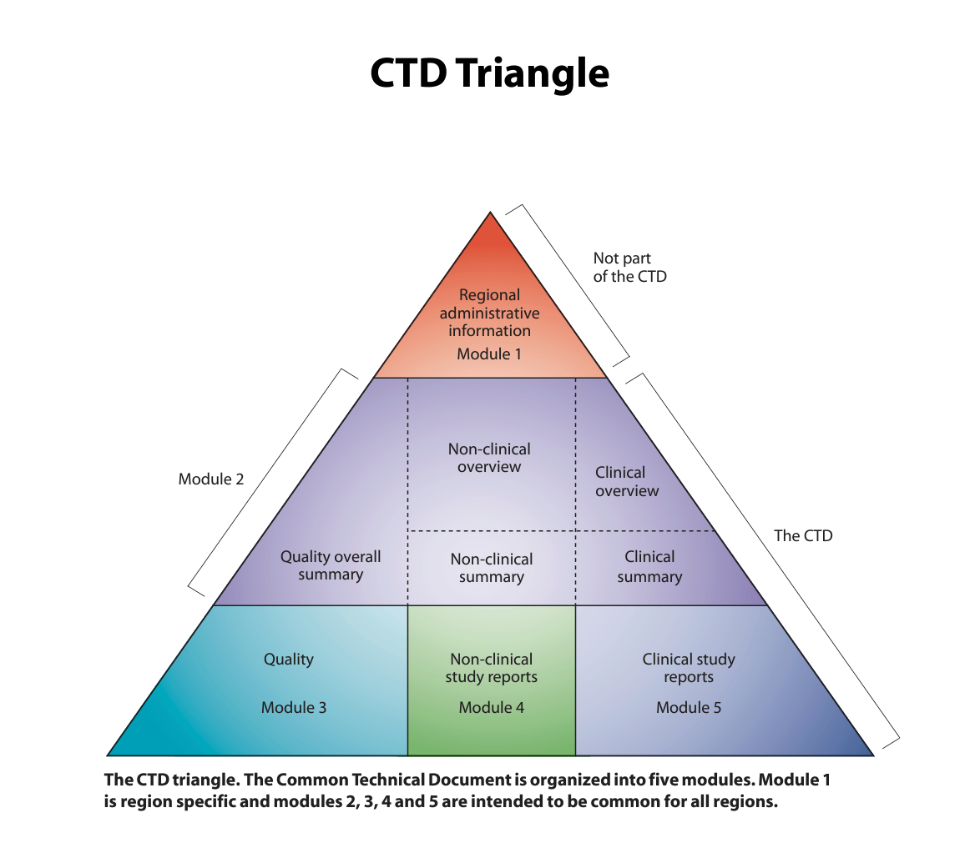
The Modules of CTD
Module 1: Administrative Information
Module 2: Common Technical Document Summaries
Module 3: Quality
Module 4: Nonclinical Study Reports
Module 5: Clinical Study Reports
Module 6: Overall Summary
Module 7: Appendices
Module 8: Post-Approval Information
Notes:
Module 1: Administrative Information:
Covers administrative details such as application form, region-specific administrative documents, and summaries of the submission.
Module 2: Common Technical Document Summaries:
Provides high-level overviews, including the Quality Overall Summary (Module 2.3), Nonclinical Overview (Module 2.4), and Clinical Overview (Module 2.5).
Module 3: Quality:
Details the pharmaceutical, chemical, and manufacturing aspects of the drug. It includes information on drug substance (Module 3.2.S), drug product (Module 3.2.P), and manufacturing processes (Module 3.2.S.2).
Module 4: Nonclinical Study Reports:
Contains summaries and detailed reports of nonclinical studies, covering pharmacology, pharmacokinetics, toxicology, and other relevant nonclinical data.
Module 5: Clinical Study Reports:
Contains summaries and detailed reports of clinical studies, including data from Phase I to Phase IV trials, as well as any pharmacovigilance data.
Module 6: Overall Summary:
Provides an integrated overview of the entire submission, including summaries of nonclinical and clinical data, conclusions, and recommendations.
Module 7: Appendices:
Contains additional supporting information such as raw data, reference documents, and detailed information on specific topics.
Module 8: Post-Approval Information:
Contains post-approval commitments, updates, variations, and other relevant information following the initial approval.

Slide 19
III. Types of Drug Licenses
Investigational New Drug (IND) License
New Drug Application (NDA) or Marketing Authorization Application (MAA)
Abbreviated New Drug Application (ANDA)
Biologics License Application (BLA)
Conditional Approval or Accelerated Approval
Orphan Drug Designation
Post-Market Licenses and Approvals
Notes:
Investigational New Drug (IND) License:
This license is granted by regulatory authorities to allow pharmaceutical companies to conduct clinical trials and test a new drug's safety and efficacy in humans. It allows researchers to gather data on a drug's effects, dosage, and potential risks before seeking approval for wider use.
New Drug Application (NDA) or Marketing Authorization Application (MAA):
This is a formal request submitted by a pharmaceutical company to a regulatory agency for approval to market and sell a new drug. It provides comprehensive data on a drug's safety, efficacy, manufacturing, and labeling, supporting its commercialization.
Abbreviated New Drug Application (ANDA):
This application is used for generic drugs. It demonstrates that the generic version is equivalent to the innovator drug in terms of active ingredients, strength, dosage form, and route of administration. It allows generic drug manufacturers to seek approval to market a version of a previously approved brand-name drug.
Biologics License Application (BLA):
Similar to an NDA, a BLA is a request to market and sell a biological product, which is a complex molecule derived from living organisms. It provides data on the safety, efficacy, and quality of the biological product, supporting its approval for use in patients.
Conditional Approval or Accelerated Approval:
These are special pathways provided by some regulatory agencies for certain drugs addressing serious or life-threatening conditions. They allow for earlier approval based on promising but incomplete data. It expedites the availability of drugs for patients who have limited treatment options.
Orphan Drug Designation:
This designation is granted to drugs developed for rare diseases or conditions. It provides incentives to encourage the development of treatments for these often-neglected conditions. It may include benefits like extended market exclusivity, tax credits, and waived application fees.
Post-Market Licenses and Approvals:
After a drug is on the market, regulatory agencies may issue additional licenses or approvals for new indications, dosage forms, or patient populations. It allows for the expansion of a drug's approved uses based on additional evidence or studies.
These different types of licenses and applications serve to ensure that drugs are thoroughly evaluated for safety, efficacy, and quality before they are made available to the public. Each type has its specific requirements and serves a unique role in the drug approval process.

Slide 20
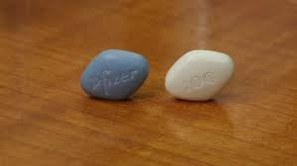
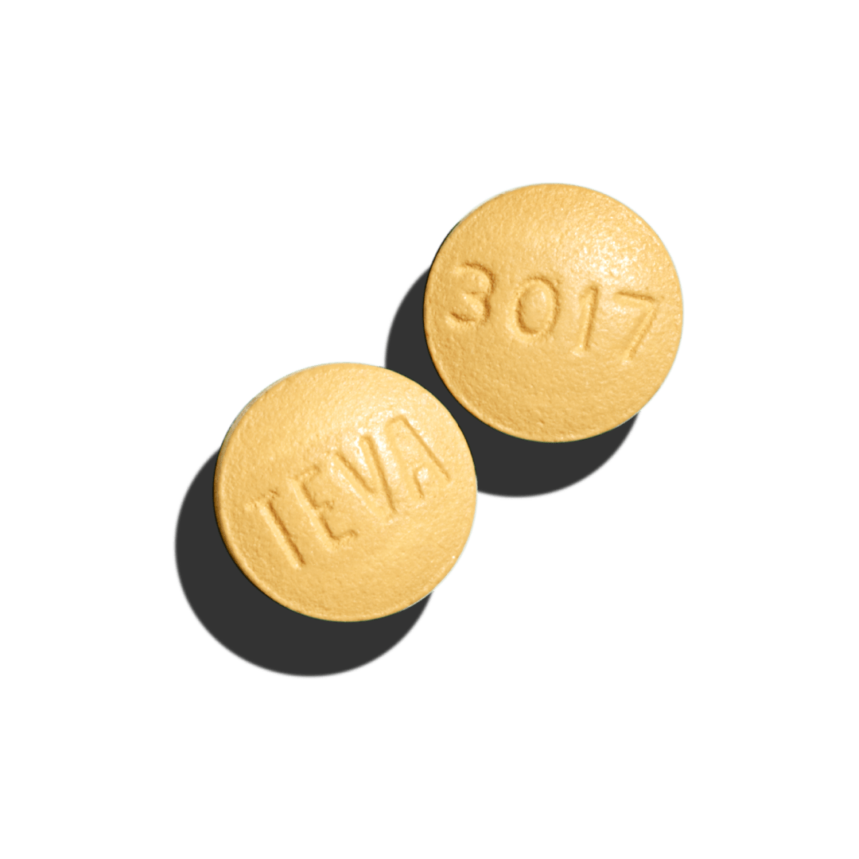
Generic Drugs:
A generic drug is a medication that is equivalent to a brand-name product in terms of active ingredient, dosage form, strength, route of administration, and intended use.
These drugs are typically produced after the patent for the original brand-name drug has expired.
Generic drugs are subject to rigorous regulatory standards to ensure they are as safe and effective as their brand-name counterparts.
Notes:
Generic drugs have the same active ingredients as brand-name drugs and work the same way, but they may look different and contain different inactive ingredients.
Generic drugs are often less expensive than brand-name drugs because the manufacturers of generics do not have the same research and development costs as the original innovator company. However, they must still meet strict quality and safety standards set by regulatory authorities.
Module 8: Post-Approval Information:
Contains post-approval commitments, updates, variations, and other relevant information following the initial approval.

Slide 21
Equivalent Drugs:
Equivalent drugs refer to pharmaceutical products that have the same active ingredient(s), dosage form, strength, and route of administration as another drug, but they may be produced by different manufacturers. They are essentially interchangeable with each other in terms of their therapeutic effects.
For example, if two drugs have the same active ingredient, same dosage form (e.g., tablet, capsule), same strength (e.g., 50 mg), and are intended for oral administration, they can be considered equivalent. This means a patient can switch from one to the other without any significant change in therapeutic outcome.
Notes:
It's important to note that while generic drugs are a type of equivalent drug, not all equivalent drugs are generics. Equivalent drugs can also refer to different brand-name versions of the same active ingredient, produced by different companies.
In summary, generic drugs are a specific category of equivalent drugs, where a non-patented version of a brand-name drug is produced by a different manufacturer. Equivalent drugs, more broadly, refer to different products that have the same active ingredient, strength, dosage form, and route of administration, regardless of brand or manufacturer.

Slide 22
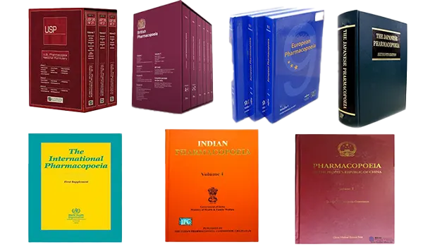
IV. Importance of Pharmacopoeias
Ensuring Drug Quality
Facilitating Interchangeability
Regulatory Compliance
Promoting Public Safety
Supporting Research and Development
Notes:
Pharmacopoeia serves as a reference guide for healthcare professionals, pharmacists, manufacturers, and regulatory authorities in the pharmaceutical industry.
In summary, pharmacopoeias are essential tools in the pharmaceutical industry that establish and maintain standards for drug quality, safety, and efficacy.
They serve as a foundation for regulatory compliance, quality assurance, and the production of reliable medicines.
Ensuring Drug Quality: Pharmacopoeias play a crucial role in maintaining the quality of pharmaceutical products. They provide clear guidelines and standards that manufacturers must meet to produce safe and effective medicines.
Facilitating Interchangeability: Healthcare professionals and pharmacists rely on pharmacopoeias to ensure that different products containing the same active ingredient are interchangeable, thus enhancing treatment consistency.
Regulatory Compliance: Adhering to pharmacopoeial standards is a legal requirement for pharmaceutical manufacturers. It helps ensure that medicines on the market are of high quality and meet regulatory expectations.
Promoting Public Safety: By setting stringent quality standards, pharmacopoeias protect the health and safety of patients by minimizing the risks associated with substandard or adulterated pharmaceutical products.
Supporting Research and Development: Pharmacopoeias provide researchers and developers with valuable information on established standards, analytical methods, and formulations, aiding in the creation of new and improved pharmaceutical products.

Slide 23
Key aspects of a pharmacopoeia
Standards and Specifications:
Formulation Guidelines:
Analytical Methods
Reference Materials
Monographs
Dosage Forms and Routes of Administration
Regulatory Compliance
Global Relevance
Notes:
A pharmacopoeia is a comprehensive and authoritative compilation of standards and specifications for the quality, safety, and efficacy of pharmaceuticals, including drugs, formulations, and medicinal substances. It serves as a reference guide for healthcare professionals, pharmacists, manufacturers, and regulatory authorities in the pharmaceutical industry.
Standards and Specifications: A pharmacopoeia provides detailed standards and specifications for the identity, purity, strength, and quality of pharmaceutical products. These standards ensure consistency and uniformity in the production and quality control of medicines.
Formulation Guidelines: It includes recipes and procedures for preparing various pharmaceutical dosage forms (e.g., tablets, capsules, syrups) to ensure they meet specific quality criteria
Analytical Methods: Pharmacopoeias contain validated methods for testing and analyzing pharmaceutical substances and products. These methods are used to verify compliance with the established standards.
Reference Materials: It lists reference substances that are used for comparison in analytical testing. These substances are well-characterized and serve as benchmarks for the quality of pharmaceutical products.
Monographs: These are detailed descriptions of individual drugs or pharmaceutical substances, including their physical characteristics, chemical structure, identification tests, and quality specifications.
Dosage Forms and Routes of Administration: Pharmacopoeias cover a wide range of dosage forms (e.g., tablets, injections, ointments) and provide guidelines for their proper preparation and administration.
Regulatory Compliance: Manufacturers must comply with the standards set forth in the pharmacopoeia to ensure that their products meet the regulatory requirements for safety and efficacy.
Global Relevance: Many countries have their own pharmacopoeias (e.g., United States Pharmacopeia, British Pharmacopoeia), and there are also international pharmacopoeias (e.g., European Pharmacopoeia) that set standards recognized worldwide.

Slide 24
V. Patents in Pharmaceuticals
Key steps in Patenting of a drug
Invention and Discovery
Pre-Patent Research and Development
Patent Search and Evaluation
Filing a Patent Application
Patent Examination
Patent Grant
Maintenance Fees
Enforcement and Defense
Generic Drug Challenges
Patent Expiration
Notes:
A patent grants inventors exclusive rights to their inventions for a specified period. In pharmaceuticals, patents are crucial for protecting the substantial investments made in research and development The drug patenting process is a legal mechanism that grants inventors exclusive rights to manufacture, sell, and distribute a newly developed pharmaceutical product for a specified period. Here are the key steps involved:
Invention and Discovery: The drug patenting process begins with the discovery or invention of a new chemical compound or biological entity that has potential therapeutic effects.
Pre-Patent Research and Development: Before filing for a patent, extensive research and development activities are conducted to understand the compound's properties, conduct preclinical studies, and initiate clinical trials.
Patent Search and Evaluation: A thorough search is conducted to ensure that the compound or entity is novel, non-obvious, and meets the criteria for patentability. This involves reviewing existing patents and scientific literature.
Filing a Patent Application: Once it's established that the invention is patentable, a formal patent application is prepared and submitted to the relevant patent office. The application includes detailed descriptions, claims defining the scope of the invention, and often supporting data.
Patent Examination: The patent office reviews the application to ensure it meets all legal requirements. This process may involve correspondence between the applicant and the patent office, addressing any issues or questions raised during the examination.
Patent Grant: If the patent office is satisfied with the application, it issues a patent grant, providing the inventor with exclusive rights to the invention for a specified period (typically 20 years from the filing date).
Maintenance Fees: To keep the patent in force, the inventor must pay periodic maintenance fees to the patent office. Failure to do so may result in the patent expiring before its full term.
Enforcement and Defense: With a granted patent, the inventor has the legal right to enforce their exclusive rights. This means they can take legal action against individuals or companies infringing on the patent.
Generic Drug Challenges: As a patent approaches its expiration date, generic drug manufacturers may file Abbreviated New Drug Applications (ANDAs) or similar applications to produce generic versions of the drug, which can lead to legal disputes.
Patent Expiration: After the patent term expires, the drug enters the public domain, allowing other companies to manufacture and sell generic versions of the drug without restrictions.
The drug patenting process is a crucial aspect of pharmaceutical development, providing inventors with an incentive for investment in research and development. It allows them to recoup their expenses and potentially profit from their discoveries before generic competition enters the market.
.

Slide 25
Drug Patent Lifecycle &Patent Challenges and Generics
A drug's lifecycle begins with the filing of a compound's patent during the early stages of development. The patent provides a period of exclusivity, typically 20 years, during which the developer has the sole right to produce and sell the drug.
As patents approach expiration, generic drug manufacturers can seek approval to produce and sell equivalent versions. This competition can lead to reduced drug prices and increased accessibility.
Notes:
A drug's lifecycle begins with the filing of a compound's patent during the early stages of development. The patent provides a period of exclusivity, typically 20 years, during which the developer has the sole right to produce and sell the drug.
As patents approach expiration, generic drug manufacturers can seek approval to produce and sell equivalent versions. This competition can lead to reduced drug prices and increased accessibility.

Slide 26
Data Protection and Regulatory Exclusivity
Data Exclusivity
Data exclusivity provides protection to the clinical trial data submitted by a drug developer.
Regulatory Exclusivity
Regulatory exclusivity refers to the period during which a regulatory agency refrains from approving a generic version of a drug, even after a patent has expired.
Balancing Innovation and Accessibility
Notes:
Data exclusivity provides protection to the clinical trial data submitted by a drug developer. This shields the investment in data generation from being used by competitors seeking market approval for equivalent products.
Regulatory exclusivity refers to the period during which a regulatory agency refrains from approving a generic version of a drug, even after a patent has expired. This ensures that the original developer has a fair chance to recoup investments.
The challenge lies in finding a balance between incentivizing innovation through patents and data protection, and ensuring affordability and accessibility for patients.

Slide 27
Questions and Discussion
QUESTION AND ANSWER
SHARING EXPERIENCES
LET'S SUMMARIZE
Notes:
Please review the books and other documents on our website to obtain more detailed information on the subject. You can use our social media accounts for any questions or concerns you may have.

Slide 28
Conclusion
The drug licensing process, intertwined with patent and data protection concepts, is instrumental in fostering pharmaceutical innovation.
The CTD serves as a standardized way for pharmaceutical companies to present information to regulatory authorities, streamlining the review and approval process.
Pharmacopoeias are essential tools in the pharmaceutical industry that establish and maintain standards for drug quality, safety, and efficacy.
The drug patenting process is a crucial aspect of pharmaceutical development, providing inventors with an incentive for investment in research and development.
Notes:
The drug licensing process, intertwined with patent and data protection concepts, is instrumental in fostering pharmaceutical innovation. By striking a balance between protecting investments and ensuring accessibility, society can benefit from both groundbreaking treatments and affordable healthcare options. As the pharmaceutical landscape continues to evolve, ongoing discussions and adaptations in regulatory frameworks will play a pivotal role in shaping the future of healthcare.
The CTD serves as a standardized way for pharmaceutical companies to present information to regulatory authorities, streamlining the review and approval process. It helps ensure that all necessary data is included and organized in a consistent format, making it easier for regulatory agencies to evaluate the safety, efficacy, and quality of a pharmaceutical product.
Pharmacopoeias are essential tools in the pharmaceutical industry that establish and maintain standards for drug quality, safety, and efficacy. They serve as a foundation for regulatory compliance, quality assurance, and the production of reliable medicines.
The drug patenting process is a crucial aspect of pharmaceutical development, providing inventors with an incentive for investment in research and development. It allows them to recoup their expenses and potentially profit from their discoveries before generic competition enters the market.

Slide 29
Additional Resources
https://titck.gov.tr/storage/legislation/QEv7VEBH.pdf
https://www.ema.europa.eu/en/human-regulatory-overview/post-authorisation/data-medicines-iso-idmp-standards-post-authorisation/registration
https://www.fda.gov/industry/fda-basics-industry/registration-and-listing
https://extranet.who.int/prequal/sites/default/files/document_files/02_Prequalification_general_fullPathway.pdf

Slide 30
Project Partners

Slide 31
This document was prepared for the Erasmus Project "2022-1-TR01-KA220-VET-000088373
A UNIVERSAL STRATEGIC NECESSITY: FROM MOLECULE TO DRUG»
"”Supported by the European Commission within the scope of the Erasmus+ Programme. However, the European Commission and the Turkish National Agency cannot be held responsible for the opinions expressed here."
Notes:
A universal necessity: From Molecule to Drug Project
"Supported by the European Commission within the Erasmus+ Programme.
However, the European Commission and the Turkish National Agency cannot be held responsible for the views expressed here."

Slide 32
THANK YOU
Notes:
Projemize desteklerinden ötürü Avrupa Komisyonu’na ve proje ekibinde yer alarak katkıda bulunan tüm üyelerimize ve proje kapsamındaki etkinliklere katılan herkese teşekkür ederiz.

