Slide 1
DELIVERY: WIDESPREAD USE OF DRUGS AND PHARMACOVIGILANCE
From Molecule to Drug
Dr. Mehmet Kürşat DERİCİ
Notes:
In recent decades, the use of pharmaceuticals has become an integral part of modern healthcare, offering relief and treatment for a myriad of ailments. However, with the widespread use of drugs comes the necessity for vigilant monitoring to ensure safety and efficacy. This chapter explores the growing landscape of drug consumption and the indispensable role of pharmacovigilance in safeguarding public health.

Slide 2
Learning Objectives
Identify
Recall
Interpret
Explain
the reasons for the use of drugs outside the license conditions
the types of side effects and importance of monitoring drug safety
the concept of pharmacovigilance
the pharmacovigilance systems and their operation
Notes:
The main purpose of this section is to explain the causes of adverse drug reactions and the importance of monitoring them. At the end of this session, you will be able to define the Factors Contributing to Widespread Drug Use, Recall the types of side effects and the importance of monitoring drug safety, Interpret the concept of Pharmacovigilance and Explain Pharmacovigilance systems and their functioning.

Slide 3
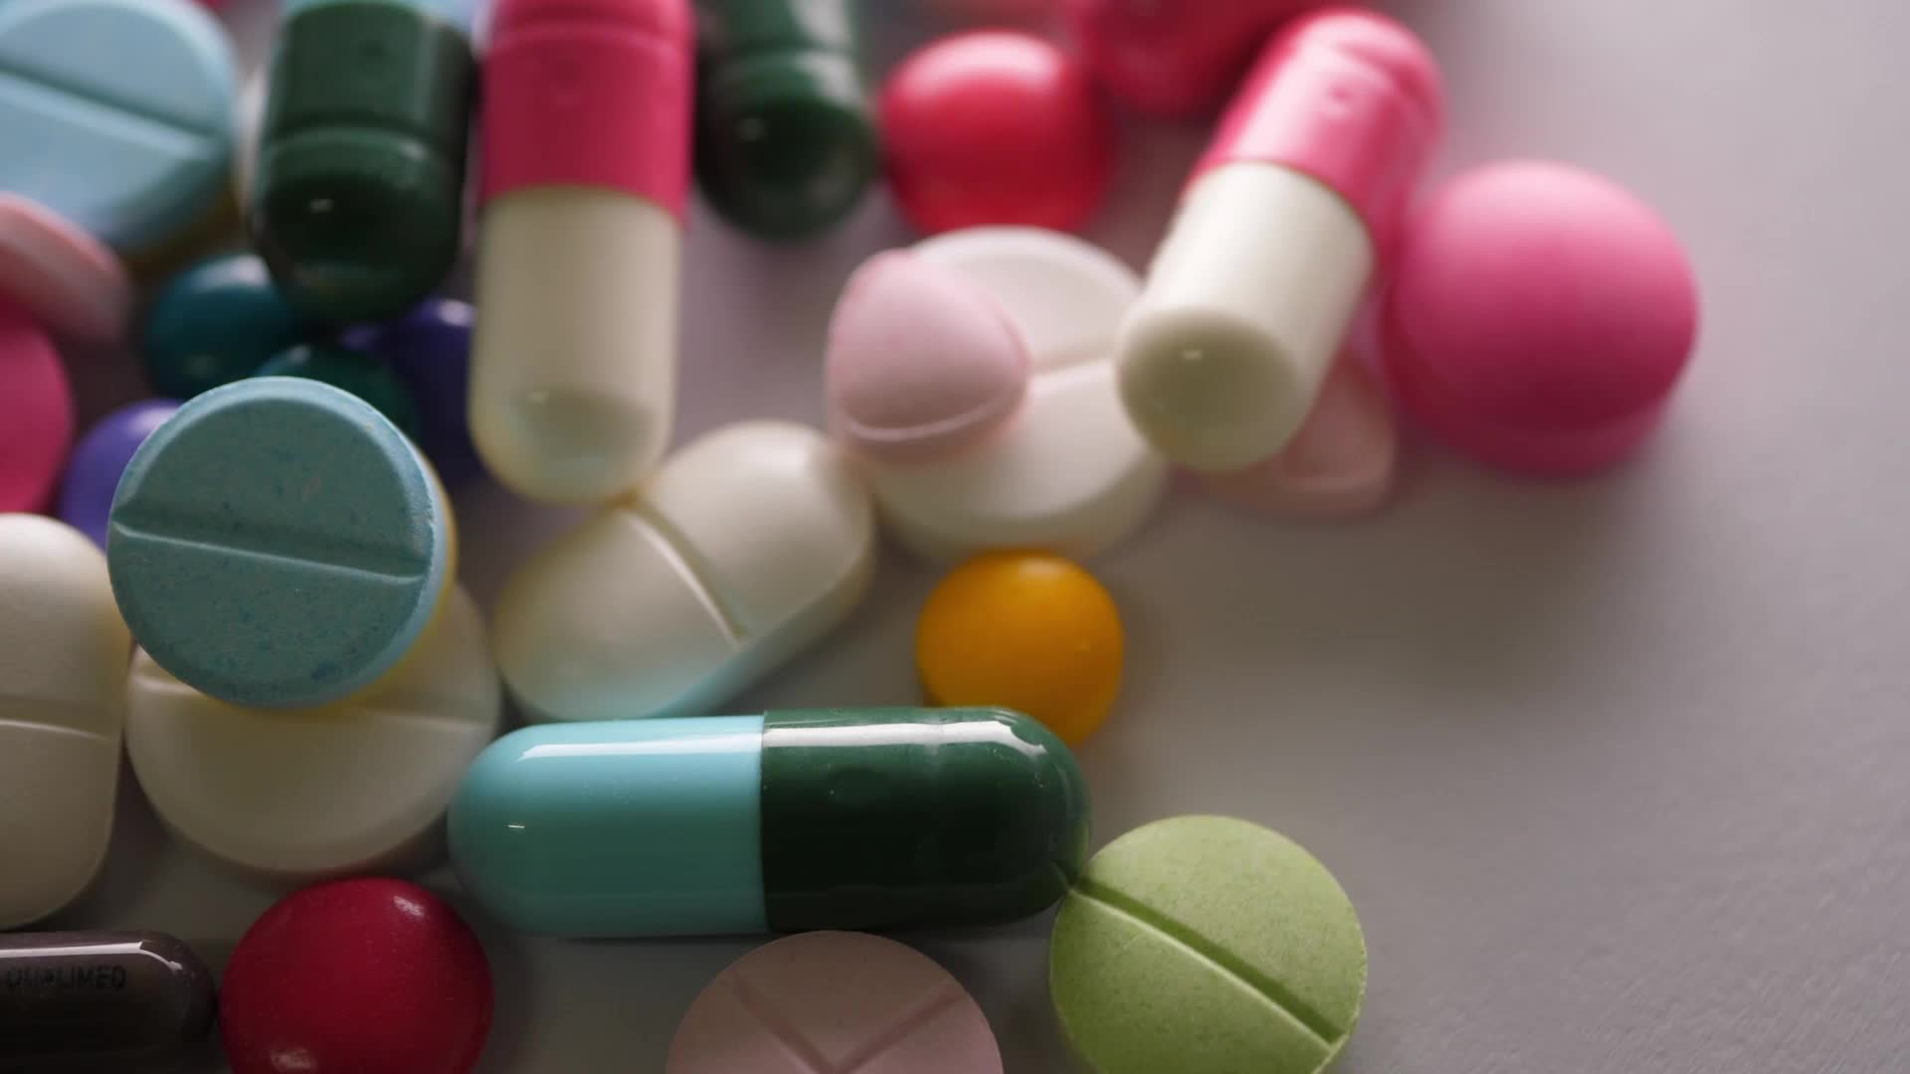
Agenda
Factors Contributing to Widespread Drug Use
The Importance of Pharmacovigilance
The Pharmacovigilance Process
Challenges in Pharmacovigilance
Conclusion
Notes:
In this presentation, the topics of Factors Contributing to Widespread Drug Use, Importance of Pharmacovigilance, Pharmacovigilance Process and Challenges in the Field of Pharmacovigilance will be discussed.

Slide 4
Factors Contributing to Widespread Drug Use
Increasing Disease Burden
Aging Population
Globalization and Urbanization
Notes:
Advancements in medical research and technology have led to the development of an extensive array of pharmaceuticals, ranging from antibiotics to complex biologics. As a result, drug utilization has surged globally, with millions of people relying on medications for managing chronic conditions, preventing diseases, and alleviating symptoms.
Factors Contributing to Widespread Drug Use:
Increasing Disease Burden: The rise in chronic diseases, infectious outbreaks, and lifestyle-related conditions has propelled the demand for pharmaceutical interventions.
Aging Population: As populations age, the prevalence of age-related conditions such as arthritis, cardiovascular diseases, and neurodegenerative disorders has increased, necessitating the use of medications for treatment and symptom management.
Globalization and Urbanization: Urbanization and globalization have exposed populations to diverse health challenges, leading to the need for a wide range of medications to address regional and lifestyle-specific health issues.

Slide 5
The Importance of Pharmacovigilance:
Pharmacovigilance
The key objectives
Science and activities related to
Detection
Assessment
Understanding
Prevention
of adverse effects or any other drug-related problems
Crucial for ensuring the safety of medications in real-world settings.
Early Detection of Adverse Events
Monitoring Drug Efficacy
Assessment and Understanding of Risks
Informing Regulatory Decision-Making
Enhancing Patient Safety
Notes:
Pharmacovigilance is a scientific and systematic process of monitoring, evaluating, and improving the safety of pharmaceutical products, particularly after they have been released into the market. The primary goal of pharmacovigilance is to detect, assess, understand, and prevent adverse effects or any other drug-related problems. It plays a crucial role in ensuring that the benefits of a medication outweigh its potential risks in real-world settings.
Early Detection of Adverse Events: Pharmacovigilance involves the continuous monitoring of data from various sources, including healthcare professionals, patients, and regulatory authorities, to identify any unexpected or harmful effects associated with the use of a drug. Early detection is essential for minimizing harm to patients.
Monitoring Drug Efficacy: Beyond safety, pharmacovigilance also assesses the effectiveness of medications in real-world conditions. It helps ensure that drugs deliver the intended therapeutic benefits as demonstrated in clinical trials.
Assessment and Understanding of Risks: When adverse events are identified, pharmacovigilance professionals conduct thorough assessments to understand the nature and extent of the risks associated with a particular drug. This information is crucial for making informed decisions about the continued use, modification, or withdrawal of the medication.
Informing Regulatory Decision-Making: Pharmacovigilance data play a central role in regulatory decision-making. Regulatory authorities, such as the U.S. Food and Drug Administration (FDA) or the European Medicines Agency (EMA), use this information to make decisions about drug approvals, label updates, and, in extreme cases, market withdrawals.
Enhancing Patient Safety: Patients are active participants in pharmacovigilance through reporting their experiences with medications. Encouraging patients to report any adverse effects or issues with drugs contributes to a more comprehensive understanding of a drug's safety profile and helps protect the broader population.
Pharmacovigilance is a dynamic and collaborative field that involves healthcare professionals, pharmaceutical companies, regulatory agencies, and patients. The continuous monitoring and analysis of drug safety data contribute to the ongoing improvement of healthcare practices and the protection of public health.

Slide 6
The Pharmacovigilance Process
1. Data Collection:
2. Data Analysis:
The process begins with the systematic collection of data from various sources.
Spontaneous Reporting: Healthcare professionals and patients
Clinical Trials: Data from pre-marketing clinical trials
Statistical and analytical tools
Patterns, trends, and potential safety signals
Signal Detection: Advanced algorithms and data mining techniques assist in the detection of signals—patterns or associations that may indicate a potential safety concern.
Notes:
The pharmacovigilance process is a comprehensive system designed to monitor, assess, and enhance drug safety throughout its lifecycle. This chapter delves into the key components and stages of the pharmacovigilance process, shedding light on the systematic approach that ensures the ongoing safety of pharmaceutical products.
1. Data Collection: The process begins with the systematic collection of data from various sources. These sources include healthcare professionals, patients, regulatory authorities, clinical trials, literature reviews, and social media. The diverse nature of data collection allows for a holistic understanding of a drug's safety profile.
Spontaneous Reporting: Healthcare professionals and patients voluntarily report adverse events to pharmacovigilance databases. These spontaneous reports form a crucial part of early detection.
Clinical Trials: Data from pre-marketing clinical trials provide essential information about a drug's safety and efficacy. Post-marketing studies continue to contribute to the understanding of a drug's performance in real-world scenarios.
2. Data Analysis: Once the data is collected, pharmacovigilance professionals employ statistical and analytical tools to identify patterns, trends, and potential safety signals. Data analysis aims to distinguish between expected and unexpected adverse events and assess the frequency and severity of reported issues.
Signal Detection: Advanced algorithms and data mining techniques assist in the detection of signals—patterns or associations that may indicate a potential safety concern. These signals prompt further investigation.

Slide 7
The Pharmacovigilance Process
3. Signal Evaluation:
4. Risk Assessment:
Identified signals undergo a thorough evaluation to determine their clinical relevance and potential impact on public health.
Causality Assessment: Experts assess the likelihood that a drug is responsible for the observed adverse event.
Once a signal is validated, the next step involves assessing the associated risks.
Notes:
3. Signal Evaluation: Identified signals undergo a thorough evaluation to determine their clinical relevance and potential impact on public health. This evaluation involves a multidisciplinary approach, incorporating clinical expertise, epidemiological analysis, and an understanding of the drug's pharmacology.
Causality Assessment: Experts assess the likelihood that a drug is responsible for the observed adverse event. This assessment considers factors such as temporal relationships, known side effects, and alternative explanations.
4. Risk Assessment: Once a signal is validated, the next step involves assessing the associated risks. This includes an evaluation of the severity and frequency of the adverse event, as well as an examination of risk factors and patient populations that may be more susceptible

Slide 8
The Pharmacovigilance Process
5. Risk Management
updating product labeling,
implementing risk minimization measures
withdrawing the drug from the market
6. Communication and Reporting
Pharmacovigilance is a collaborative effort involving healthcare professionals, regulatory authorities, and the pharmaceutical industry.
Notes:
5. Risk Management: Based on the risk assessment, strategies for risk management are developed. This may involve updating product labeling, implementing risk minimization measures, or, in extreme cases, withdrawing the drug from the market. The aim is to optimize the benefit-risk balance for patient safety.
6. Communication and Reporting: Pharmacovigilance is a collaborative effort involving healthcare professionals, regulatory authorities, and the pharmaceutical industry. Communication channels are established to disseminate safety information and updates. Timely reporting to regulatory agencies ensures a coordinated and swift response to emerging safety concerns.
The pharmacovigilance process is dynamic and iterative, reflecting the ongoing commitment to ensuring the safety of pharmaceutical products. By systematically collecting, analyzing, and acting upon safety data, the pharmacovigilance process contributes significantly to the continuous improvement of drug safety standards and the protection of public health.
While pharmacovigilance has made significant strides, challenges persist. These include underreporting of adverse events, data quality issues, and the need for global collaboration to address emerging threats like antimicrobial resistance.
Looking ahead, advancements in technology, such as artificial intelligence and real-world evidence, promise to revolutionize pharmacovigilance, making it more proactive and comprehensive. As drug utilization continues to rise, the evolution and strengthening of pharmacovigilance systems are imperative to ensure the ongoing safety and effectiveness of pharmaceutical interventions on a global scale.

Slide 9
Challenges in Pharmacovigilance
 | Challenge | Impact
1. Underreporting of Adverse Events | One of the primary hurdles in pharmacovigilance is the underreporting of adverse events by healthcare professionals and patients | Underreporting hampers the ability to detect emerging safety signals early, leading to delayed responses and potentially putting patients at risk.
2. Data Quality and Completeness | Incomplete or inaccurate data pose significant challenges to the pharmacovigilance process | Poor data quality can lead to misinterpretation of safety signals, compromising the reliability of risk assessments and subsequent regulatory decisions.
3. Regulatory Variability | The lack of uniformity in pharmacovigilance regulations and reporting requirements globally poses challenges for multinational pharmaceutical companies. Differing standards and expectations create complexities in compliance | Regulatory variability can result in inefficiencies, increased costs, and delays in responding to safety concerns, affecting the timely dissemination of crucial information.
4. Emerging Threats and Global Collaboration | The rise of global health threats, such as antimicrobial resistance and emerging infectious diseases, demands collaborative efforts in pharmacovigilance. | Inadequate collaboration impedes the timely identification and management of global health threats, potentially leading to widespread health crises
5. Technology Implementation and Integration | While technology, including artificial intelligence and real-world evidence, holds great promise for advancing pharmacovigilance, integrating these technologies into existing systems poses challenges | Slow adoption of advanced technologies limits the efficiency and effectiveness of pharmacovigilance activities, hindering the realization of their full potential
Notes:
Pharmacovigilance, the science of monitoring and ensuring the safety of pharmaceutical products, is an indispensable component of modern healthcare. Despite its critical role, the field faces numerous challenges that impact its effectiveness.
1. Underreporting of Adverse Events: Challenge: One of the primary hurdles in pharmacovigilance is the underreporting of adverse events by healthcare professionals and patients. Many adverse events go unreported due to lack of awareness, time constraints, fear of legal consequences, or the perception that the event is not serious.
Impact: Underreporting hampers the ability to detect emerging safety signals early, leading to delayed responses and potentially putting patients at risk.
2. Data Quality and Completeness: Challenge: Incomplete or inaccurate data pose significant challenges to the pharmacovigilance process. Variability in data quality across different sources, including spontaneous reports and clinical trials, can hinder the accurate assessment of drug safety.
Impact: Poor data quality can lead to misinterpretation of safety signals, compromising the reliability of risk assessments and subsequent regulatory decisions.
3. Regulatory Variability: Challenge: The lack of uniformity in pharmacovigilance regulations and reporting requirements globally poses challenges for multinational pharmaceutical companies. Differing standards and expectations create complexities in compliance.
Impact: Regulatory variability can result in inefficiencies, increased costs, and delays in responding to safety concerns, affecting the timely dissemination of crucial information.
4. Emerging Threats and Global Collaboration: Challenge: The rise of global health threats, such as antimicrobial resistance and emerging infectious diseases, demands collaborative efforts in pharmacovigilance. However, achieving effective global collaboration remains a challenge due to differences in regulatory frameworks, data-sharing agreements, and resource disparities.
Impact: Inadequate collaboration impedes the timely identification and management of global health threats, potentially leading to widespread health crises.
5. Technology Implementation and Integration: Challenge: While technology, including artificial intelligence and real-world evidence, holds great promise for advancing pharmacovigilance, integrating these technologies into existing systems poses challenges. Issues related to data interoperability, privacy concerns, and the need for workforce upskilling must be addressed.
Impact: Slow adoption of advanced technologies limits the efficiency and effectiveness of pharmacovigilance activities, hindering the realization of their full potential.

Slide 10
Questions and Discussion
QUESTION AND ANSWER
SHARING EXPERIENCES
LET'S SUMMARIZE
Notes:
Please review the books and other documents on our website to obtain more detailed information on the subject. You can use our social media accounts for any questions or concerns you may have.

Slide 11
Conclusion
Pharmacovigilance is an evolving field facing multifaceted challenges that require concerted efforts from stakeholders across the healthcare spectrum.
Addressing underreporting, improving data quality, fostering global collaboration, and embracing technological advancements are essential steps to enhance the robustness and responsiveness of pharmacovigilance systems.
Overcoming these challenges is crucial to maintaining public trust, ensuring patient safety, and adapting to the evolving landscape of pharmaceutical innovation.
Notes:
Pharmacovigilance is an evolving field facing multifaceted challenges that require concerted efforts from stakeholders across the healthcare spectrum.
Addressing underreporting, improving data quality, fostering global collaboration, and embracing technological advancements are essential steps to enhance the robustness and responsiveness of pharmacovigilance systems.
Overcoming these challenges is crucial to maintaining public trust, ensuring patient safety, and adapting to the evolving landscape of pharmaceutical innovation.

Slide 12
Project Partners

Slide 13
This document was prepared for the Erasmus Project "2022-1-TR01-KA220-VET-000088373
A UNIVERSAL STRATEGIC NECESSITY: FROM MOLECULE TO DRUG»
"”Supported by the European Commission within the scope of the Erasmus+ Programme. However, the European Commission and the Turkish National Agency cannot be held responsible for the opinions expressed here."
Notes:
A universal necessity: From Molecule to Drug Project
"Supported by the European Commission within the Erasmus+ Programme.
However, the European Commission and the Turkish National Agency cannot be held responsible for the views expressed here."

Slide 14
THANK YOU
Notes:
Projemize desteklerinden ötürü Avrupa Komisyonu’na ve proje ekibinde yer alarak katkıda bulunan tüm üyelerimize ve proje kapsamındaki etkinliklere katılan herkese teşekkür ederiz.

