Slide 1
CASE STUDY: The Dangers in Pharmaceuticals
From Molecule to Drug
PROF. DR. KURSAT DERICI
Notes:
In recent years, the use of medicines has become an integral part of modern healthcare, providing relief and treatment for a myriad of ailments. However, the widespread use of medicines requires careful monitoring to ensure safety and efficacy. This chapter examines the expanding landscape of medicine consumption and the indispensable role of pharmacovigilance in protecting public health.

Slide 2
Learning Objectives
Identify
Recall
Interpret
Explain
the reasons for the possible toxicity of drugs and side effects
the importance of drug safety studies
relations between the structure and long term effects of the drug
the importance of holistic view to avoid side effects
Notes:
The main purpose of this section is to explain the reasons for unexpected effects in drugs and the importance of monitoring them. At the end of this session, you are expected to gain the ability to define possible toxicity causes and side effects of drugs, to remember the importance of drug safety studies, to interpret the relationships between the structure of the drug and its long-term effects, and to explain the importance of a holistic view to avoid side effects.

Slide 3
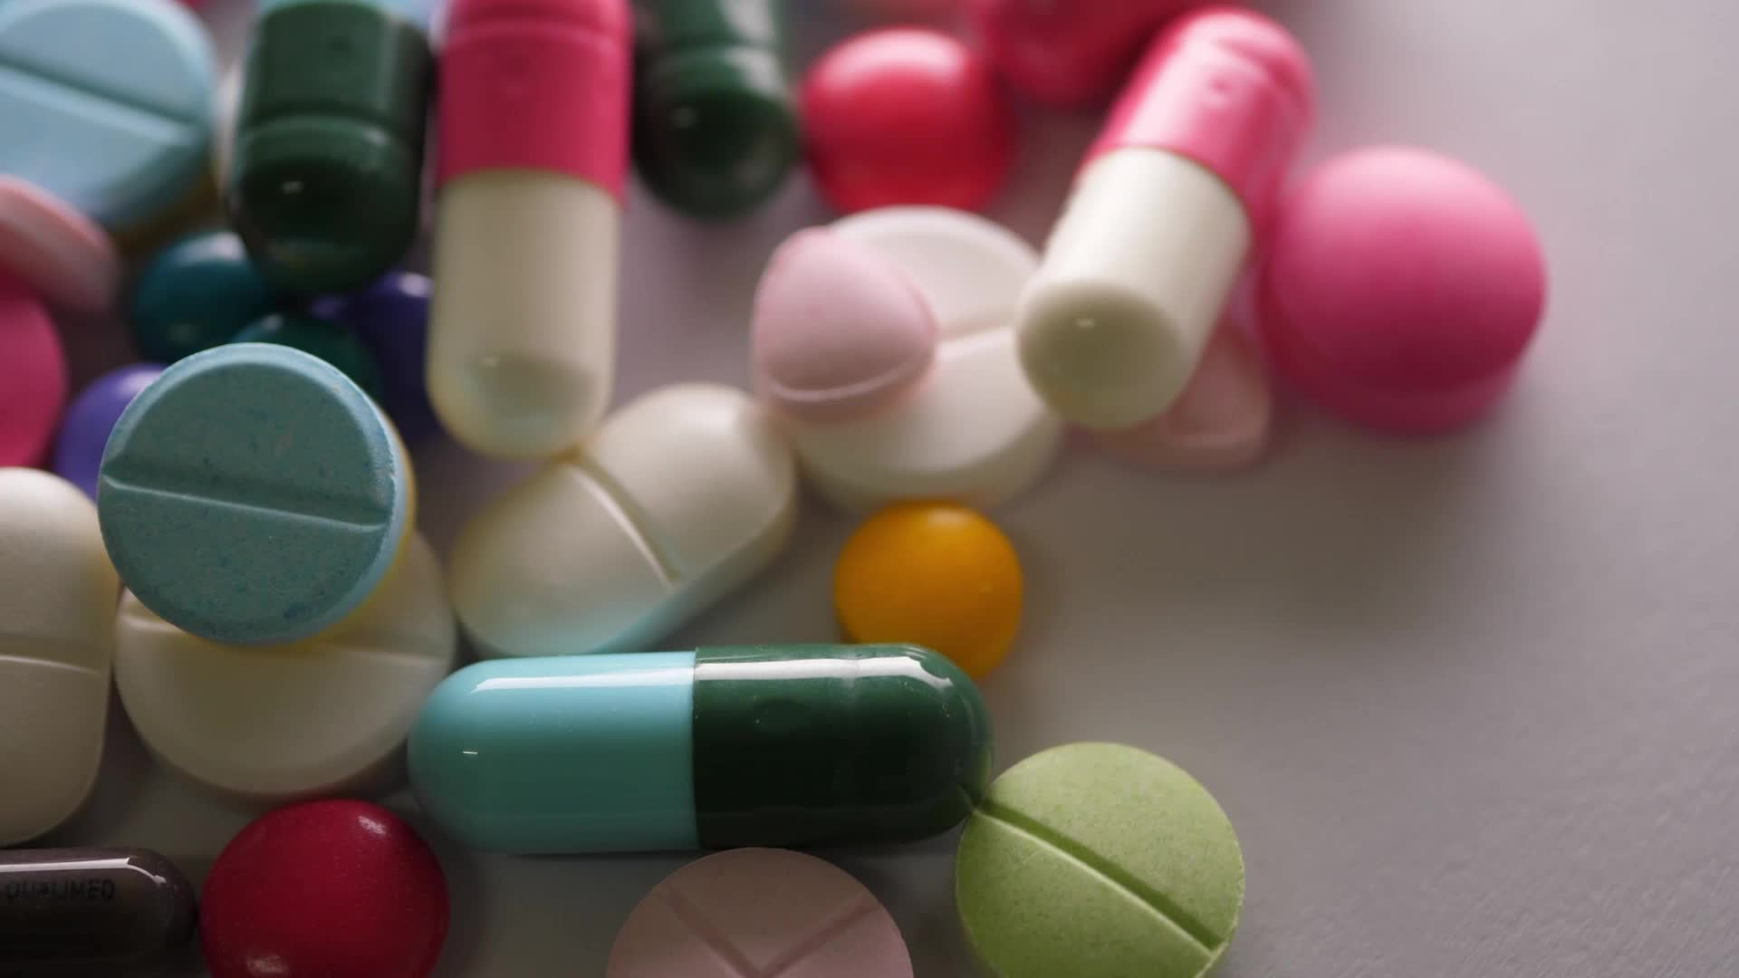
Agenda
Overview of the drug and case ( 5 min.)
Seting up the groups (5 min.)
Discovery&Research
Development
Registration
Delivery
Explanation of working style and expectations (5 min.)
Team work (10 min.)
Group Presentations (20 min.)
Conclusion and discussion (15. min.)

Slide 4
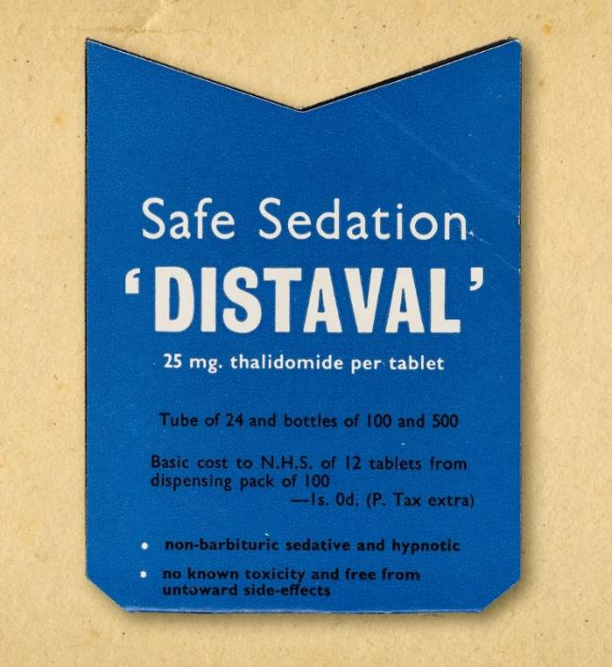
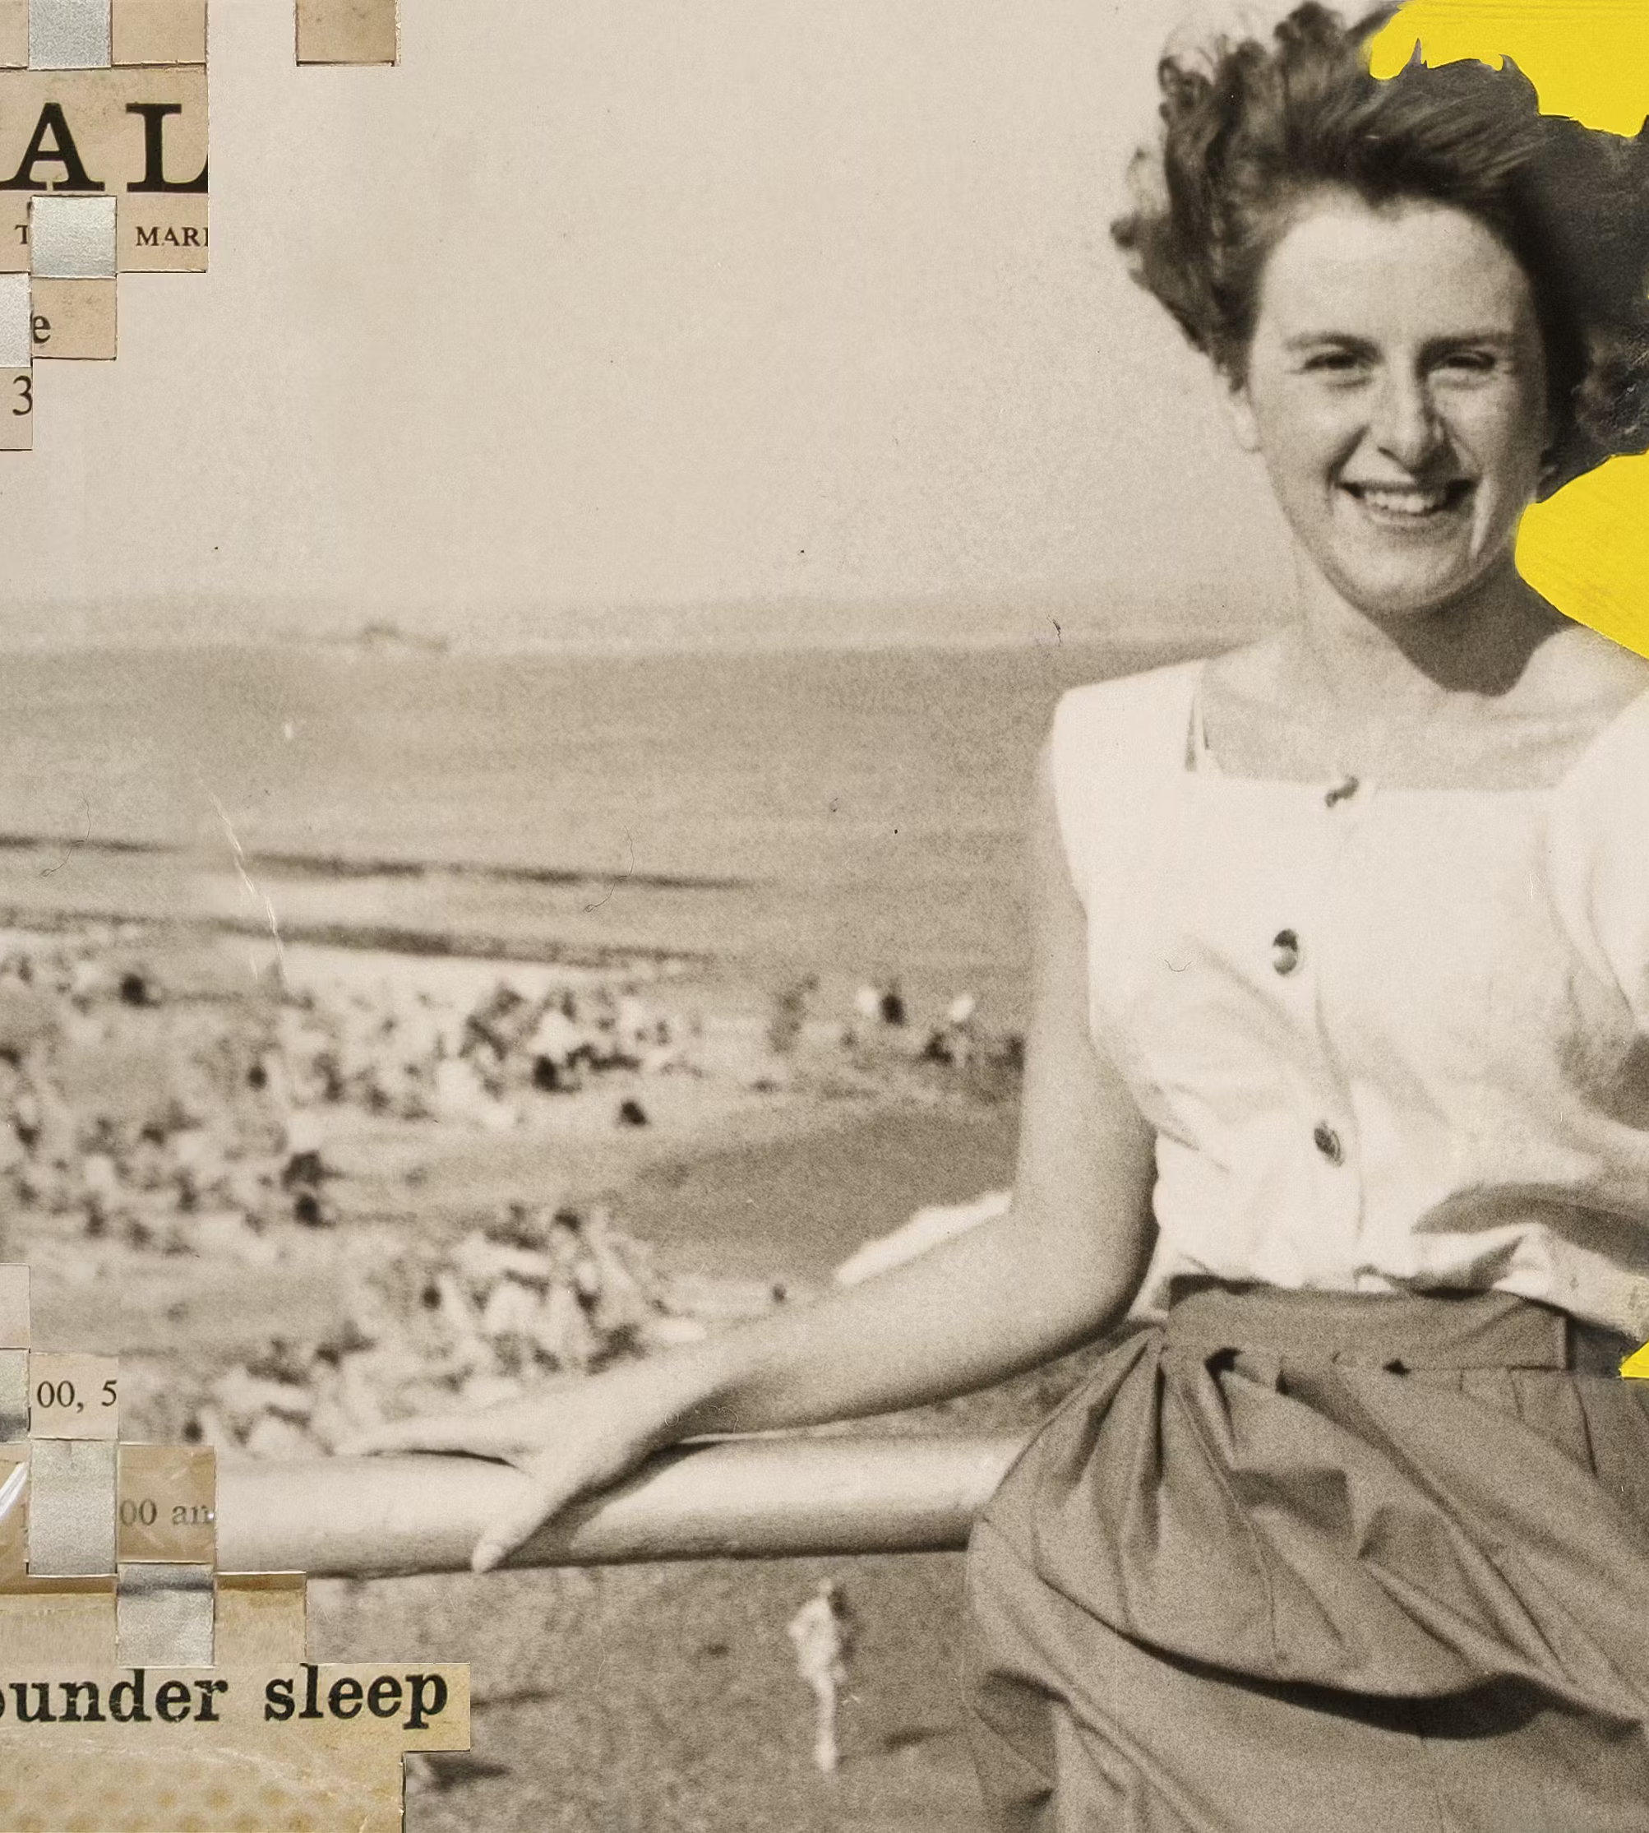
Case Study; Drug A
Drug A was a drug developed by the German pharmaceutical company in the late 1950s.
It was initially marketed as a sedative and anti-nausea medication, particularly for pregnant women suffering from morning sickness.
Notes:
Drug A was a drug developed by the German pharmaceutical company in the late 1950s. It was initially marketed as a sedative and anti-nausea medication, particularly for pregnant women suffering from morning sickness.
It was first officially released in 1957 in Germany for use as a non-addictive sedative which it was impossible to overdose on. Despite very limited clinical trials on humans and none on pregnant women, the drug A was marketed as suitable for treating morning sickness, anxiety and insomnia during early pregnancy.
The drug was licensed for distribution in the UK in April 1958, mostly under the trade name Distaval. By the end of November 1961, it had been officially withdrawn from use in both countries.

Slide 5
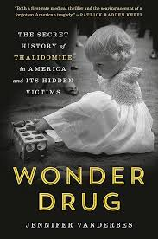
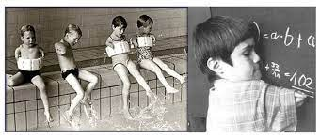
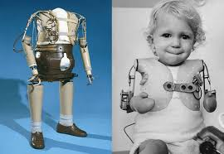
THALIDOMIDE …….. Results ☹
Notes:
Tragically, it was later discovered that Thalidomide caused severe birth defects in children born to mothers who had taken the drug during pregnancy. These deformities included limb abnormalities, heart defects, and other serious health issues.
We may never know exactly how many people were impacted by thalidomide, but conservative figures indicate that there were around 147,000 thalidomide-affected pregnancies worldwide and of those, only 24,600 resulted in live births. In the UK, out of the 12,000 recorded thalidomide pregnancies, only 2,000 resulted in live births. And most babies did not survive infancy.

Slide 6
Seting up the groups
Group I.
Group II.
Discovery & Research
Group III.
Development
Group IV.
Registration
Delivery
Notes:
Let's discuss this incident under four headings.

Slide 7
Questions………..
What are the GxP failures?
What are the possible mistakes made in step ….?
What should be done on ….. step ?
Was it possible to predict the effects of the drug on babies?
What precautions should be taken to avoid side effects of the drug?
Approximately 4 years have passed for the drug to be withdrawn from the field. How could we shorten this?
Notes:
Think about;
What were the GxP failures?
What was the impact?
What should be done?
Was it possible to predict the effects of the drug on babies?
What precautions should be taken to avoid side effects of the drug?
Approximately 4 years have passed for the drug to be withdrawn from the field. How could we shorten this?

Slide 8
Findings
Group I.
Discovery & Research

Slide 9
Findings
Group II.
Development

Slide 10
Findings
Group III.
Registration

Slide 11
Findings
Group IV.
Delivery

Slide 12
What were the failures?
Lack of Rigorous GLP and GCPTesting
Insufficient clinical testing
No studies for effects during pregnancy
Inadequate Documentation
No proper documentation
No proper record-keeping.
This hindered source tracing
Barrier to adverse effects investigation
Regulatory Oversight
No rigorous GMP standards in place
No adequate safety assessments.
Inadequate Pharmacovigilans
No rigorous GMP standards in place
No adequate safety assessments
Notes:
The Fallacies of the Thalidomide Tragedy
1. Lack of Rigorous Testing: Thalidomide was approved and marketed without adequate clinical testing to assess its safety, particularly its effects on pregnant women and their developing fetuses.
2. Inadequate Documentation: The manufacture and distribution of thalidomide lacked proper documentation and record keeping, making it difficult to trace the source of the drug or investigate adverse effects when they occurred.
3. Regulatory Oversight: Regulatory agencies did not have rigorous GMP standards to ensure the quality and safety of the drugs. Inadequate oversight allowed the drug to reach the market without adequate safety assessments.
4. Inadequate Pharmacovigilance: Inadequate and lack of assessment of pharmacovigilance notifications, inadequate monitoring, and risk-based systems

Slide 13
What should be done?
Rigorous testing and documentation
Implement and enforce strong GxP standards
Continued awareness for
pre-market testing
monitoring of adverse events,
post-market surveillance
Notes:
The Thalidomide case underscores the critical importance of GxP (GMP and GLP and GCP) in the pharmaceutical industry and beyond:
1. Rigorous testing and documentation are essential to assess the safety and efficacy of products.
2. Regulatory agencies must implement and enforce strong GxP standards to protect public health.
3. The tragedy led to increased awareness of the need for thorough pre-market testing, monitoring of adverse events, and robust post-market surveillance.
While the Thalidomide case is historical, it remains a powerful reminder of why GxP is crucial for ensuring the safety and quality of products in various industries, particularly the pharmaceutical industry. It serves as a cautionary tale and a catalyst for more stringent GxP regulations and practices globally.

Slide 14
Outcomes of Thalidomide Case
Strengthened Regulatory Oversight
Preclinical Testing Standards
Stringent Clinical Trial Requirements
Enhanced Monitoring of Adverse Events
Heightened Awareness of Teratogenicity
Patient Involvement in Drug Approval Process
Global Cooperation on Drug Safety
Notes:
The Thalidomide tragedy led to a significant reevaluation of drug safety protocols and regulatory processes worldwide. Here are some key outcomes and lessons learned from the Thalidomide case:
Strengthened Regulatory Oversight: The Thalidomide disaster prompted governments around the world to establish more rigorous regulatory agencies and processes for drug approval, with a heightened emphasis on safety and efficacy.
Preclinical Testing Standards: The case highlighted the need for thorough preclinical testing, including animal studies, to identify potential risks and side effects before human trials.
Stringent Clinical Trial Requirements: Regulatory agencies began requiring more extensive and well-designed clinical trials to assess the safety and effectiveness of new drugs before they could be marketed.
Enhanced Monitoring of Adverse Events: The Thalidomide case emphasized the importance of post-market surveillance systems to monitor and promptly respond to adverse events and side effects associated with pharmaceutical products.
Heightened Awareness of Teratogenicity: Thalidomide's teratogenic effects (causing birth defects) led to a greater understanding of the potential dangers of drug exposure during pregnancy and the need for specific precautions for pregnant women.
Patient Involvement in Drug Approval Process: The Thalidomide tragedy underscored the importance of involving patients and advocacy groups in the drug approval process to ensure that their perspectives and concerns are considered.
Global Cooperation on Drug Safety: The Thalidomide case spurred international collaboration on drug safety standards, leading to the establishment of organizations like the International Council for Harmonisation of Technical Requirements for Pharmaceuticals for Human Use (ICH).

Slide 15
Questions and Discussion
QUESTION AND ANSWER
SHARING EXPERIENCES
LET'S SUMMARIZE
Notes:
Please review the books and other documents on our website to obtain more detailed information on the subject. You can use our social media accounts for any questions or concerns you may have.

Slide 16
Conclusion
Every stage of a drug, from its discovery as a molecule to its post-distribution market monitoring, must be carried out with great care.
Notes:
The Thalidomide case remains a powerful reminder of the devastating consequences that can occur when drug safety is not rigorously assessed. It catalyzed significant changes in the pharmaceutical industry and regulatory practices, ultimately leading to safer and more effective medicines for patients worldwide.

Slide 17
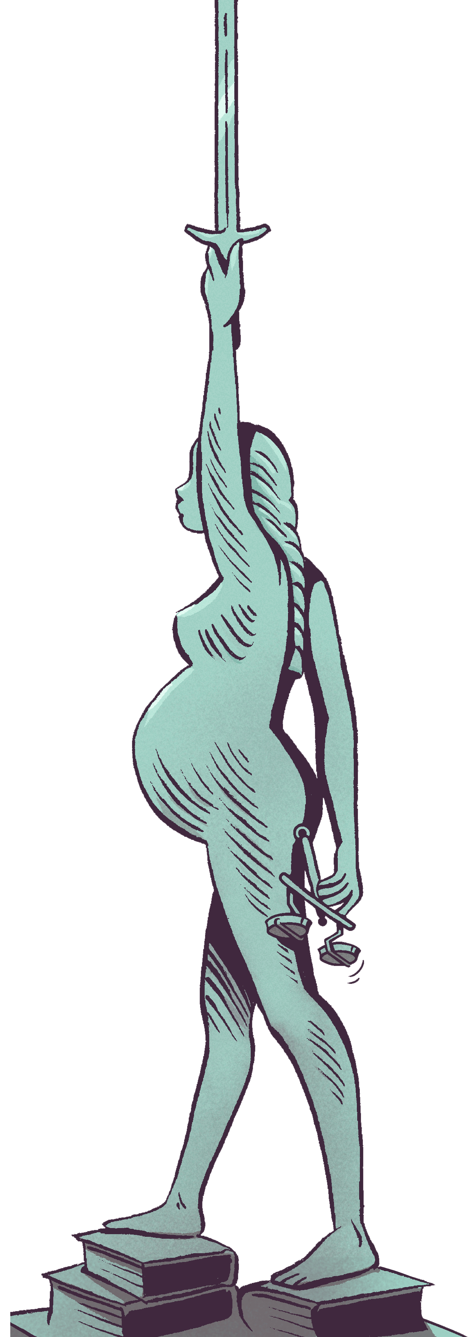
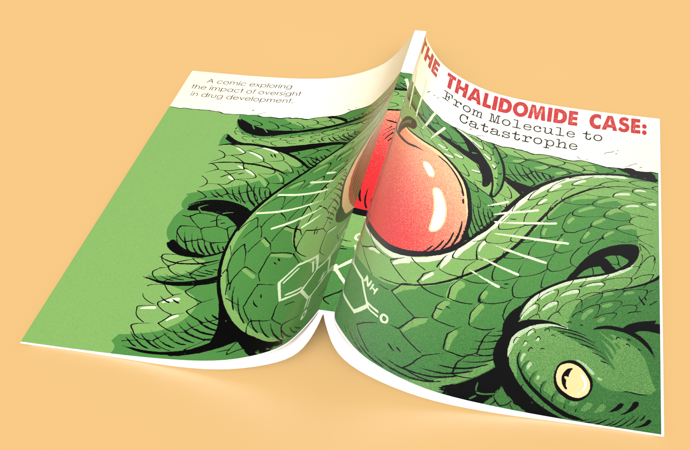
Additional Resources
https://pubmed.ncbi.nlm.nih.gov/21507989/#:~:text=Thalidomide%20was%20a%20widely%20used,defects%20in%20thousands%20of%20children.
https://www.thalidomidetrust.org/about-us/about-thalidomide/
https://academic.oup.com/toxsci/article/122/1/1/1672454
Worth R, Collver J, Watts O, Bosman A (ed). The Thalidomide Case: From Molecule to Catastrophe. Understanding the impact of oversight in drug development. Houten (Utrecht): Transmissible BV; 2024. ISBN 97-90-8346-790-0

Slide 18
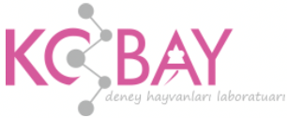
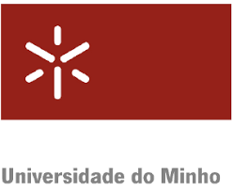
Project Partners

Slide 19
This document was prepared for the Erasmus Project "2022-1-TR01-KA220-VET-000088373
A UNIVERSAL STRATEGIC NECESSITY: FROM MOLECULE TO DRUG»
"”Supported by the European Commission within the scope of the Erasmus+ Programme. However, the European Commission and the Turkish National Agency cannot be held responsible for the opinions expressed here."
Notes:
A universal necessity: From Molecule to Drug Project
"Supported by the European Commission within the Erasmus+ Programme.
However, the European Commission and the Turkish National Agency cannot be held responsible for the views expressed here."

Slide 20
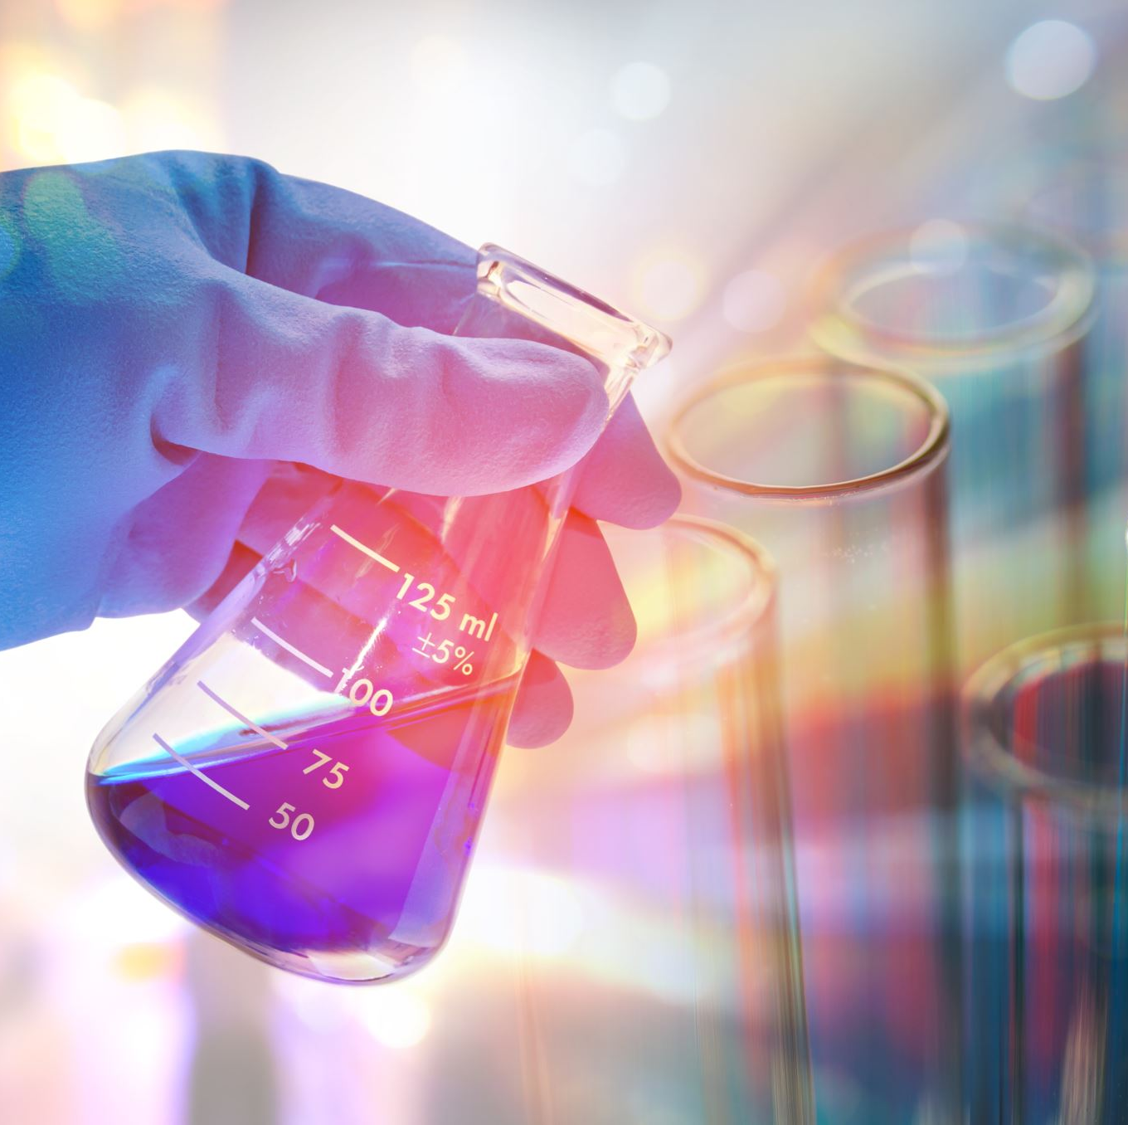
THANK YOU
Notes:
Projemize desteklerinden ötürü Avrupa Komisyonu’na ve proje ekibinde yer alarak katkıda bulunan tüm üyelerimize ve proje kapsamındaki etkinliklere katılan herkese teşekkür ederiz.

