Slide 1
DISCOVERY 2: Computer Aided Drug Discovery
From Molecule to Drug
Prof. Dr. Nuno S. OSORIO
Notes:
Hello everyone. We’re going to delve into the fascinating world of ‘Computer Aided Drug Discovery’, a field that is continuously evolving and revolutionizing how we approach the development of new therapeutic agents.

Slide 2
Learning Objectives
Describe
Define
Explain
the general pipeline to obtain a new drug, with an emphasis on how computer methodologies can increase the efficiency of drug discovery.
relevant terms in in the field, including ”target”, ”hit”, ”lead”, ”ADMET properties”, ”knowledge graphs” and ”SMILES”.
what ChEMBL is and how it can help understanding the interactions between molecules and their targets.
Notes:
By the end of this presentation, you’ll have a better understanding of the general pipeline to obtain a new drug, with an emphasis on how computer methodologies can increase the efficiency of drug discovery. We’ll also define some key terms in the field and discuss the role of databases like ChEMBL.

Slide 3
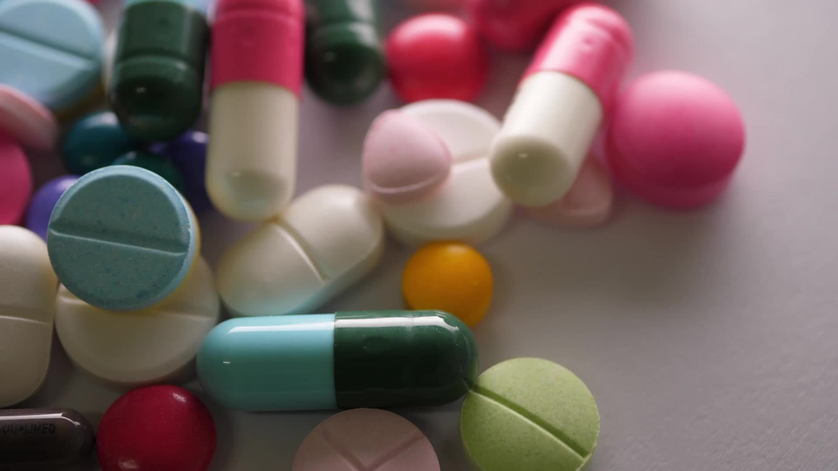
Agenda
The Drug Discovery Pipeline(s)
Target Identification
Knowledge Graphs
ADMET Properties
Role of Databases
Notes:
In this second session of the discovery phase, we will try to understand the role of bioinformatics. In this context, after making an introduction to understand the Holistic Process of Drug Discovery, we will focus on the topics of Target Identification, Identification Knowledge Graphs, ADMET Features and the Role of Databases.

Slide 4
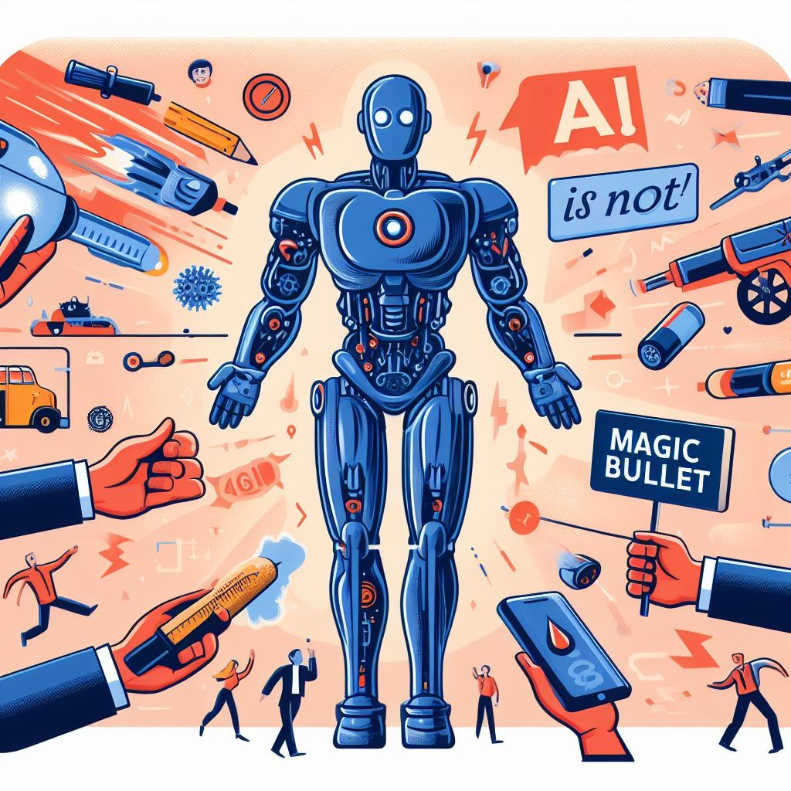
Introduction
Obtaining a new drug is complex and costly.
AI can assist in various aspects of drug discovery
AI is not a magic bullet!
Source: generated by DALL-E 3 from a text prompt.
Notes:
Drug discovery is a complex and costly process, often taking years and billions of dollars to bring a new drug to market. Artificial intelligence can assist in various aspects of drug discovery, although it’s not a magic bullet. It’s a tool that, when used correctly, can significantly aid in the identification and optimization of potential new drugs.

Slide 5
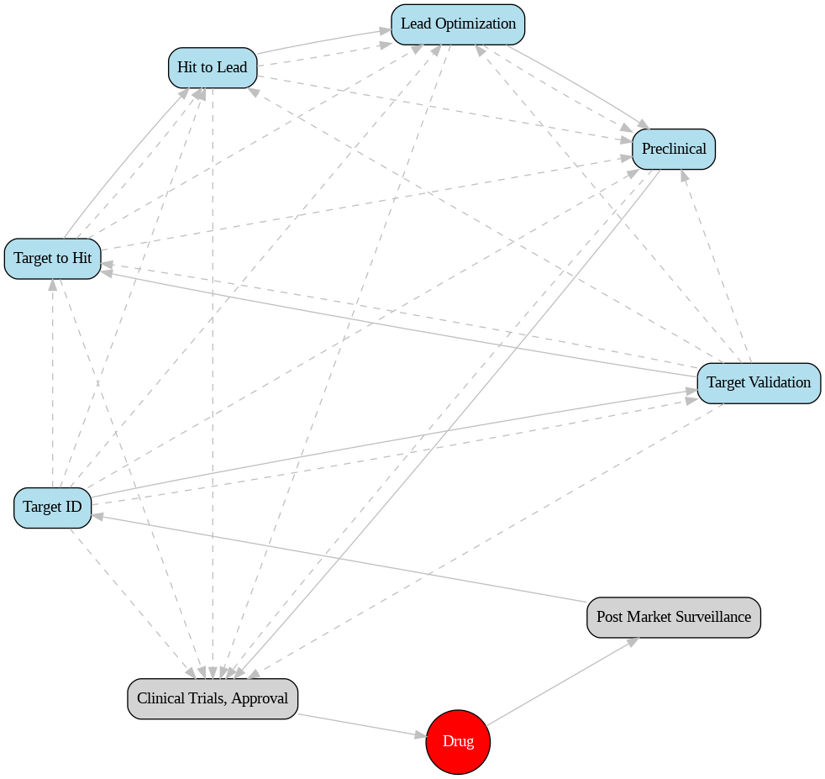
The Drug Discovery Pipeline(s)
Drug discovery is a complex and dynamic process
Different approaches:
target-based
phenotypic-based
serendipity-based
etc.
Diagram representing possible drug discovery pipelines. Source: Created by Nuno S.Osorio using Python.
Notes:
Drug discovery is a dynamic process. Each path has its own challenges and rewards. Let’s take a look at this diagram representing possible drug discovery pipelines. As you can see in the continuous lines, the typical pipeline starts with Target identification, proceeds to target validation, then to target-to-hit, hit-to-lead, lead-optimization and preclinical phases. However, there are different approaches to this target-based path like phenotypic-based or serendipity-based that have been shown to generate successful drugs.

Slide 6
The Drug Discovery Pipelines(s)
Drug discovery involves multiple stages, including
Target ID/validation
Target-to-Hit-to-Lead
Lead optimization
etc.
AI/ML are important in all steps of this process
Diagram representing possible drug discovery pipelines. Source: Created by Nuno S.Osorio using Python.
Notes:
Each stage of drug discovery, from Target ID/validation to Lead optimization, can benefit from AI/ML. These technologies can help to streamline the process, identify promising targets and candidates drugs more quickly, and reduce the risk of late-stage failures.

Slide 7
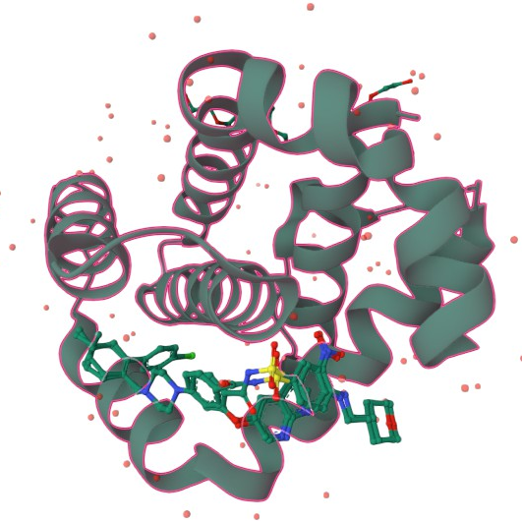
Target Identification
Target is a biomolecule (Protein, RNA, DNA, Lipid, etc) that is related with a disease in a group of individuals and the intended destination of the therapy
Finding the best target is critical to maximize success
PDB ID: 6O0K (Structure of BCL-2 with venetoclax). Source: Created by Nuno S. Osorio using Mol* Viewer
Notes:
A target is a biomolecule related to a disease in a group of individuals and is the intended destination of the therapy. Finding the best target is critical to maximize success. This process involves a deep understanding of the disease pathology and the role of different biomolecules in the disease process.

Slide 8
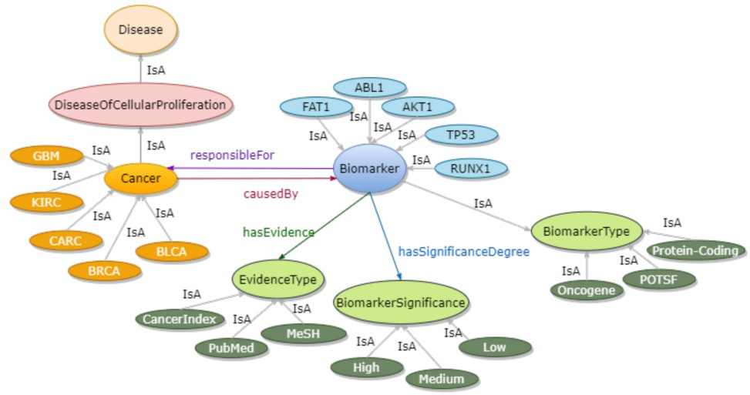
Target Identification Assisted by AI/ML
”Classical Target ID” was hypothesis-driven, often compartmentalized into silos.
Machine learning/AI integrates vast data for disease target identification.
Example of a Cancer Knowledge Graph. Source: arXiv:2302.04737
Notes:
Machine learning and AI can integrate vast data for disease target identification, moving away from the classical, hypothesis-driven approach. It’s like having a bird’s eye view of the entire treasure map.

Slide 9
KGs Integrate Multimodal Data
Knowledge Graphs (KGs) are structured data representations that capture entity relationships.
Facilitate data retrieval and knowledge inference, promoting the discovery of novel drug targets.
Example of a Cancer Knowledge Graph. Source: arXiv:2302.04737
Notes:
On this topic, let’s take a moment to discuss a powerful tool that aids in target identification - Knowledge Graphs, or KGs. KGs are structured data representations that capture relationships between entities. Imagine a web of interconnected nodes, where each node represents a piece of information and the connections between them represent the relationships. This structure facilitates data retrieval and knowledge inference, promoting the discovery of novel drug targets. Take a look at this example of a Cancer Knowledge Graph. Each point represents a piece of data, and the lines between them represent relationships. This interconnected web of information allows us to see patterns and connections that might otherwise be missed, aiding in the identification of potential drug targets. By integrating vast amounts of multimodal data, KGs provide a bird’s eye view of the entire landscape of potential targets, moving away from the classical, hypothesis-driven approach and towards a more holistic, data-driven methodology.

Slide 10
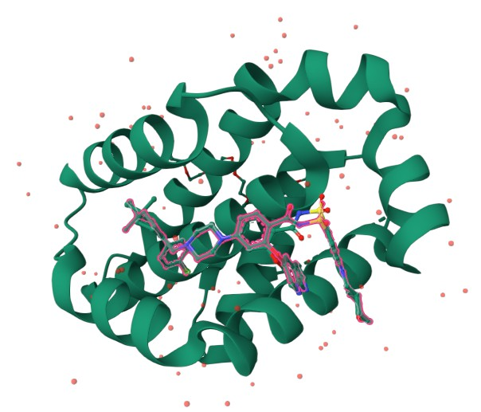
From Targets to Hits and Leads
After identifying a target, the next step is to find a hit.
A hit is a compound that shows activity against the target.
A hit with promising drug-like properties and potential for further optimization is called a lead.
PDB ID: 6O0K (Structure of BCL-2 with venetoclax). Source: Created by Nuno S. Osorio using Mol*Viewer
Notes:
Now, once we have identified a potential target using tools like KGs and AI, the next step in our journey is to find a hit that shows activity against the target. A hit with promising drug-like properties and potential for further optimization is called a lead. This process involves screening large libraries of compounds for activity against the target, followed by iterative cycles of design, synthesis, and testing to optimize the lead compound.

Slide 11
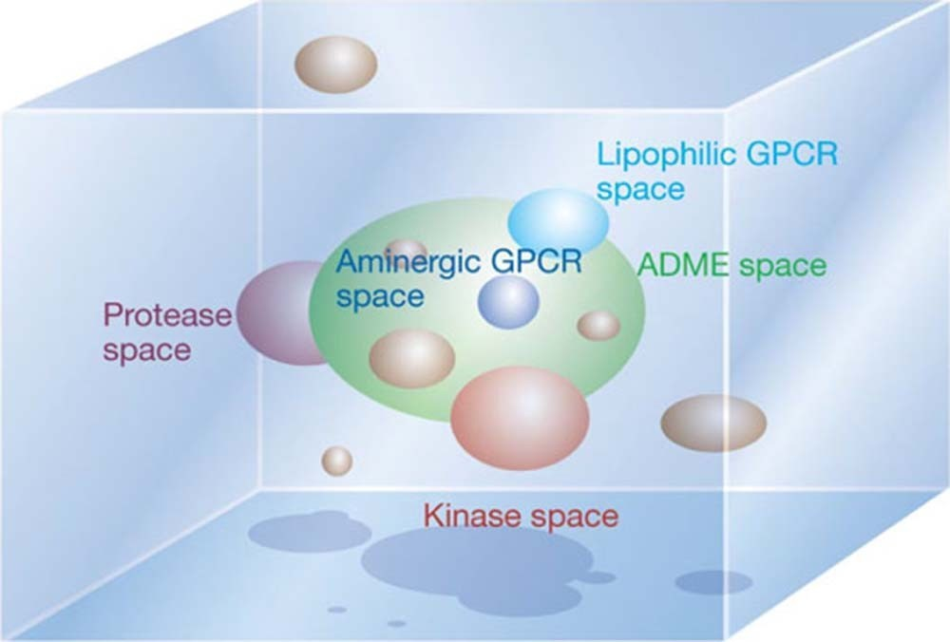
The Vast Chemical Space
The chemical space, a vast, multidimensional domain
Encompasses all conceivable chemical compounds
Serves as a conceptual framework in drug discovery
Representation of the chemical space. Source: 10.1038/nature03193
Notes:
The chemical space is a theoretical space that encompasses all possible chemical compounds. Navigating this space is a significant challenge in drug discovery. However, computational methods can help to explore this space more efficiently, identifying promising regions of the space to explore in more detail. The chemical space is vast but only a part of the compounds have properties that allowed them to be used as drugs.

Slide 12
The ADMET Properties
Absorption: Refers to how a drug enters the bloodstream after administration.
Distribution: Refers to how the drug is distributed throughout the body, including which tissues it reaches.
Metabolism: Refers to how the drug is broken down in the body for elimination.
Excretion: Refers to how the drug is removed from the body.
Toxicity: Refers to the potential harmful effects of the drug on the body.
Notes:
ADMET properties - Absorption, Distribution, Metabolism, Excretion, and Toxicity - are crucial considerations in drug discovery. These properties determine how a drug will be absorbed and distributed in the body, how it will be metabolized and excreted, and what toxic effects it might have. Computational methods can help to predict these properties early in the drug discovery process, helping to avoid costly failures in later stages of drug development.”

Slide 13
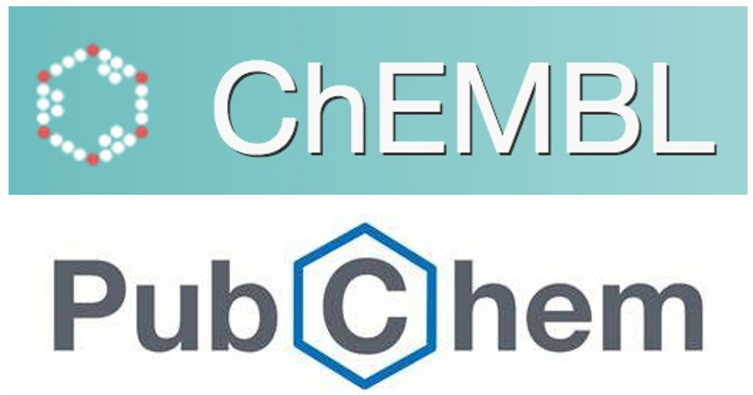
The Role of Databases
Databases play a crucial role in drug discovery providing vast amounts of data about compounds
ChEMBL: focused and curated
PubChem: quantity and diversity
Sources: https://www.ebi.ac.uk/chembl/; https://pubchem.ncbi.nlm.nih.gov/
Notes:
Databases like ChEMBL and PubChem provide vast amounts of data about compounds, including their structures, biological activities, and ADMET properties. These databases are invaluable resources in drug discovery, providing a wealth of information that can be used to guide the design and optimization of new drugs. Compounds are typically represented in DB by SMILES.

Slide 14
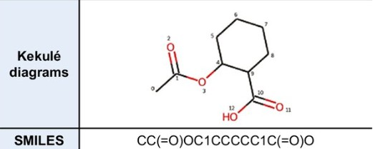
Compounds are represented in DB by SMILES
SMILES is a notation system that encodes the structure of a compound as a linear string of symbols.
It has the necessary information to generate other representations of the molecule.
Kekulé diagram and SMILES of Aspirin. Source: public domain
Notes:
SMILES is a notation system that encodes the structure of a compound as a linear string of symbols. This compact representation allows for efficient storage and retrieval of compound information, and can be easily converted into other representations for further analysis.
For instance, let’s consider Aspirin, a common medication used to treat pain and reduce fever or inflammation. You can see in the figure the SMILES notation for Aspirin. This string represents the structure of Aspirin in a simplified form. On the other hand, the Kekulé structure of Aspirin, which is also shown in the figure, provides a more detailed representation of the molecule, showing the arrangement of atoms and the bonds between them. Both SMILES and Kekulé structures provide valuable information about the compound, but in different formats. SMILES is particularly useful for computational analysis due to its simplicity and compactness, while Kekulé structures are more intuitive for humans to understand the molecular structure.

Slide 15
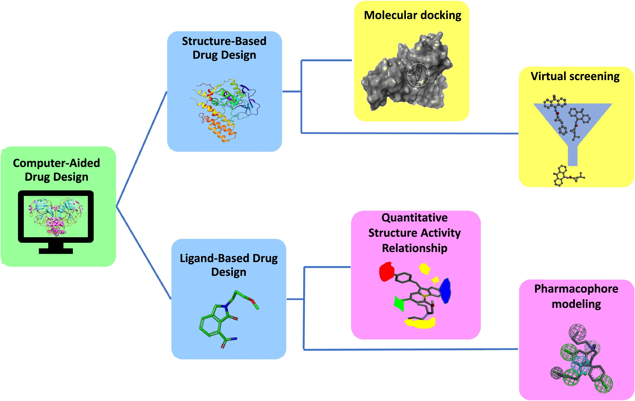
Hit Identification
High-throughput screening (HTS):
a common method for hit identification.
CADD methods complementing HTS include:
Virtual Screening
Quantitative Structure-Activity Relationship (QSAR) analysis
etc.
Overview of computer assisted hit identification. Source: 10.1016/j.ejps.2022.106324
Notes:
High-throughput screening is a common method for hit identification. It involves laboratorial testing of large libraries of compounds for activity against the target. Computer Aided Drug Discovery methods complementing HTS include Virtual Screening, which uses computational methods to predict the activity of compounds, and Quantitative Structure-Activity Relationship analysis, which uses statistical methods to relate the structure of compounds to their activity.

Slide 16
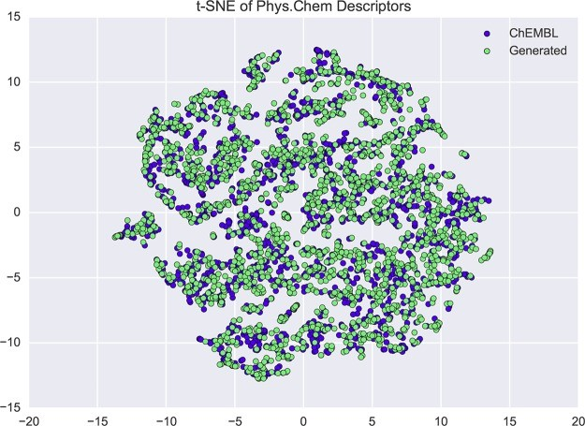
Lead Optimization
Lead optimization involves modifying the lead to improve its properties.
Chemoinformatics has been integrated with ML/AI methods to increase the efficiency of optimizing leads.
The t-SNE projection shows molecules from ChEMBL (blue) and AI generated molecules, based on 7 physicochemical descriptors. Source: 10.1021/acscentsci.7b00512
Notes:
Lead optimization involves modifying the lead compound to improve its properties. This can involve changes to improve potency, selectivity, and ADMET properties, among others. Chemoinformatics, the application of informatics methods to chemical data, has been integrated with ML/AI methods to increase the efficiency of this process.This figure shows a t-SNE projection, it visualizes the distribution of existing molecules from ChEMBL (blue) and AI-generated molecules (green), based on 7 physicochemical descriptors. This is a powerful way to compare and understand the chemical space covered by the original and generated molecules. The overlap of the distributions indicates that the AI model has learned to generate molecules that are similar to those in the ChEMBL database in terms of their physicochemical properties6 This is crucial in the lead optimization process as it allows for the generation of novel molecules with desired properties, thus expediting the drug discovery process.

Slide 17
Questions and Discussion
QUESTION AND ANSWER
SHARING EXPERIENCES
LET'S SUMMARIZE
Notes:
Please review the books and other documents on our website to obtain more detailed information on the subject. You can use our social media accounts for any questions or concerns you may have.

Slide 18
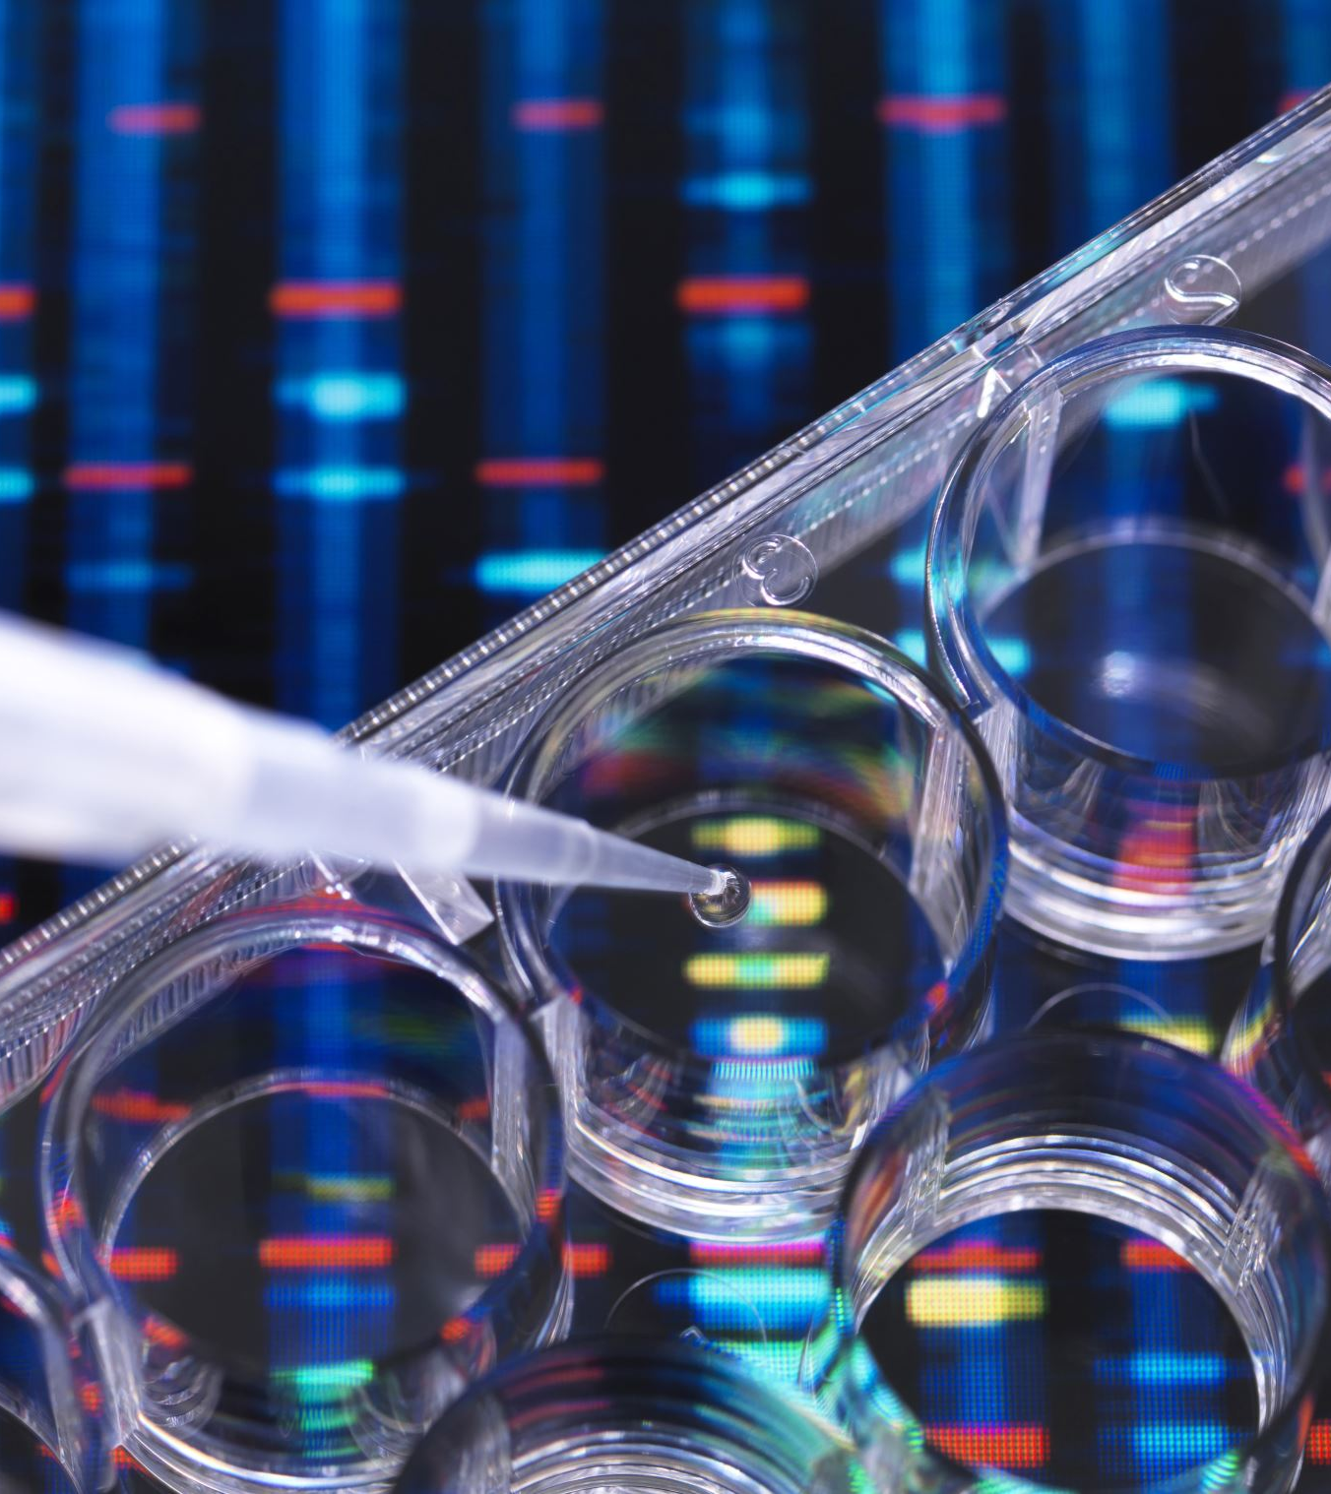
Conclusion
Computer-based methods like ML/AI can assist in various stages of drug discovery, from target identification to lead optimization.
ML/AI have limitations and cannot replace experimental validation.
The future of drug discovery will likely continue to involve a combination of computational and experimental laboratory methods.
Notes:
In conclusion, computer-based methods like ML/AI can assist in various stages of drug discovery, from target identification to lead optimization. However, they have limitations and cannot replace experimental validation. The future of drug discovery will likely continue to involve a combination of computational and experimental laboratory methods.

Slide 19
Additional Resources
Akshaya, Karthikeyan and Priyakumar U Deva (2022). “Artificial intelligence: machine learning for chemical sciences”. In: Journal of Chemical Sciences. url: https://link.springer.com/article/10. 1007/s12039-021-01995-2.
Biotechnology Information, National Center for (2023). PubChem Compound Database. https://pubchem. ncbi.nlm.nih.gov/. Accessed: 2023-11-02.
Consortium, The UniProt (Nov. 2022). “UniProt: the Universal Protein Knowledgebase in 2023”. In: Nucleic Acids Research 51.D1, pp. D523–D531. issn: 0305-1048. doi: 10.1093/nar/gkac1052. eprint: https://academic.oup.com/nar/article-pdf/51/D1/D523/48441158/gkac1052.pdf. url: https://doi.org/10.1093/nar/gkac1052.
Kim, Hyunho et al. (2020). “Artificial Intelligence in Drug Discovery: A Comprehensive Review of Data- driven and Machine Learning Approaches”. In: Biotechnology and Bioprocess Engineering 25.6, pp. 895– 930. doi: 10.1007/s12257-020-0049-y. url: https://doi.org/10.1007/s12257-020-0049-y.

Slide 20
Project Partners

Slide 21
This document was prepared for the Erasmus Project "2022-1-TR01-KA220-VET-000088373
A UNIVERSAL STRATEGIC NECESSITY: FROM MOLECULE TO DRUG»
"”Supported by the European Commission within the scope of the Erasmus+ Programme. However, the European Commission and the Turkish National Agency cannot be held responsible for the opinions expressed here."
Notes:
A universal necessity: From Molecule to Drug Project
"Supported by the European Commission within the Erasmus+ Programme.
However, the European Commission and the Turkish National Agency cannot be held responsible for the views expressed here."

Slide 22
Thank You
Notes:
Projemize desteklerinden ötürü Avrupa Komisyonu’na ve proje ekibinde yer alarak katkıda bulunan tüm üyelerimize ve proje kapsamındaki etkinliklere katılan herkese teşekkür ederiz.

