Slide 1
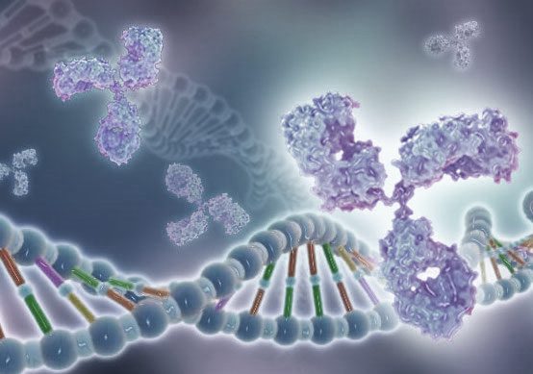
RESEARCH 3: RECOMBINANT PROTEIN PRODUCTION, PURIFICITATION AND CHARACTERIZATION
From Molecule to Drug
Prof. Dr. Hülya AYAR KAYALI
Notes:
Greetings esteemed colleagues and enthusiasts of molecular biology and biotechnology. I am Prof. Dr. Hülya Ayar Kayalı, and it is both an honor and a pleasure to guide you through the intricacies of our subject today. Our journey will revolve around the captivating realm of recombinant protein production, delving into the meticulous processes of purification and culminating in the critical aspect of characterization. As we embark on this academic odyssey, I invite you to join me in exploring the science and technology that underpin the fascinating world of recombinant proteins. Without further delay, let us delve into the heart of our discussion and unlock the secrets within the fascinating field of molecular engineering. Welcome, and let the exploration begin.

Slide 2
Learning Objectives
Identify
the importance of Recombinant protein production (RPP)
Recall
Explain
the RPP process from vector design to protein characterization
Interpret
various tools used for recombinant protein production
the key principles of RPP
Notes:
In our foundational session on biotechnological Recombinant Protein Production (RPP), which drives the large-scale synthesis of specific proteins and enzymes required in various sectors of life, we will explore the importance of using RPP methods, revealing its important role in various applications. Our journey will focus on key components such as gene cloning, expression systems and purification techniques in recombinant protein production. We will examine the complex steps of both upstream and downstream processing, emphasizing the optimization of upstream processes for protein yield and quality. The downstream processing section will demystify cell fractionation methods and explain purification techniques. Finally, we will examine protein characterization, including gel electrophoresis, chromatography, mass spectrometry and enzymatic assays. By the end of this module, you will have a comprehensive understanding of the integral role of RPP in the protein production journey, enabling you to effectively apply these methods to produce your desired proteins.

Slide 3
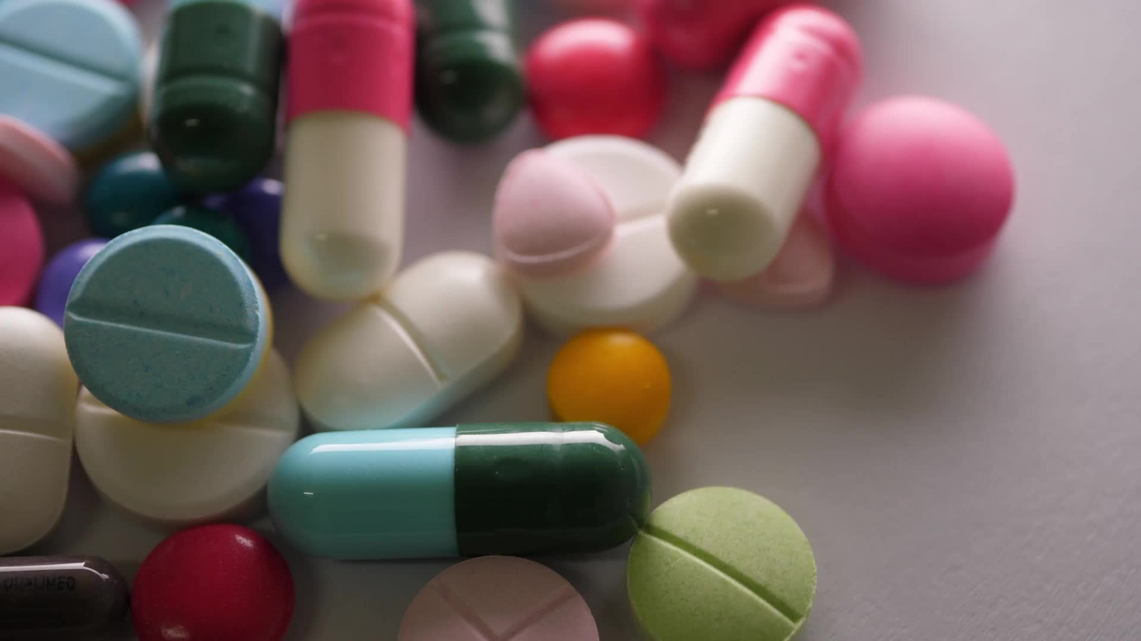
Agenda
Overview of recombinant protein production
Importance of recombinant enzymes in different sectors
Steps in molecular cloning
Upstream process of protein production
Downstream process of recombinant protein production
Characterization of produced protein
Notes:
Our agenda begins by uncovering the importance of recombinant enzymes in various sectors. Moving forward, we examine the Molecular Cloning Steps, a crucial step that unlocks the transformative potential of genetic modification. Moving up the production line, we explore the upstream process, laying the foundation for successful protein production through cell culture and growth condition optimization. Moving downstream, we witness the purification and refinement steps that are vital to meet quality and purity standards. Finally, our journey ends with the characterization of the produced protein, emphasizing the importance of understanding its structure, function and behavior to assess its efficacy and potential applications. This exploration offers a glimpse into the multifaceted world of recombinant protein production, inviting you to appreciate the importance and limitless potential of this dynamic field.

Slide 4
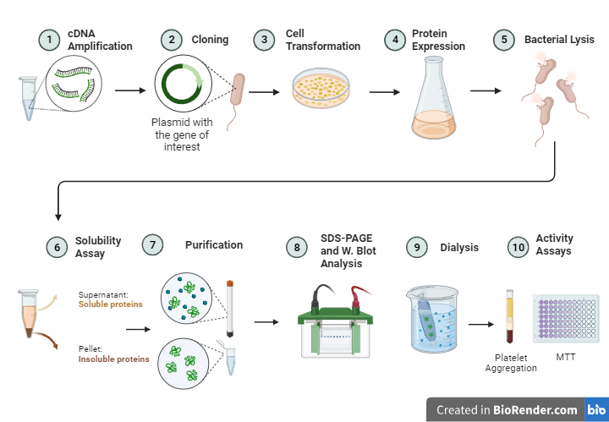
General View of Recombinant Protein Production
Notes:
Now we will embark on a journey into the realm of recombinant protein production. This intricate process involves the manipulation of genes to create proteins with precise traits. During cloning, specific genes are introduced into bacterial DNA, transforming the cells into efficient protein factories. In the expression stage, these modified bacteria generate the targeted proteins. Following a thorough purification process, we extract and refine the proteins, catering to a wide range of applications, spanning from pharmaceuticals to industrial use. This streamlined method has significantly transformed protein production, offering tailored solutions across diverse fields.

Slide 5
2. The Significance of the Production of Recombinant Proteins
The significance of RPP
Pharma-ceuticals
Diagnostic Testing
Food Industry
Bio-remediation
Stability
Notes:
The production of recombinant enzymes is of great importance in various fields such as biotechnology, medicine and industry.
Stability: Recombinant enzymes can be designed for improved stability and longer shelf life, reducing the need for frequent enzyme replacement in various applications.
Bioremediation: Recombinant enzymes play a very important role in environmental bioremediation. They can be designed to break down contaminants, contributing to the cleaning of polluted environments.
Medicines: Recombinant enzymes are used in the pharmaceutical industry to produce therapeutic proteins such as insulin and clotting factors for the treatment of various diseases.
Diagnostic tests: Enzymes produced by recombinant technology are used in diagnostic tests. For example, DNA polymerases are used in polymerase chain reaction (PCR) analyses for genetic testing.
Food Industry: Enzymes are used in various food-related processes such as baking, brewing and cheese production. Recombinant enzymes provide consistency and control in these processes.

Slide 6
Overview of Recombinant Protein Production
Notes:
We will now embark on a journey into the field of recombinant protein production. This complex process involves manipulating genes to create proteins with desired properties. During cloning, desired genes are introduced into bacterial DNA, making the cells efficient for protein production. During the expression phase, the modified bacteria produce the targeted proteins. After an extensive purification process, we extract and refine proteins that address a wide range of applications from pharmaceutical to industrial use. This streamlined method has significantly transformed protein production, offering specialized solutions in different areas.

Slide 7
Recombinant Protein Production Step
Notes:
In the schematic representation you see, we have summarized the recombinant enzyme production process. Let's examine each step in detail.
Plasmid Design, Amplification and Isolation
Our process begins with the careful design of a plasmid, a vital DNA structure that serves as the blueprint for our recombinant protein (metaphorically, plasmid refers to an important DNA structure that serves as the blueprint or template for the production of a recombinant protein). The plasmid then goes through amplification and isolation processes, providing a sufficient and pure genetic template for the next steps.
Optimizing Recombinant Protein Production
Moving to the second step, we focus on optimizing recombinant protein production. This requires optimizing various factors, such as culture conditions and inducer concentrations, to increase the yield and efficiency of the protein production process.
Purification of Recombinant Protein
Moving to the third step, we purify the recombinant protein. Using advanced techniques, we isolate the protein from other cellular components, ensuring a highly pure and bioactive final product.
Measurement and Characterization of Recombinant Protein Activity Our final goal in this journey is to measure and characterize the activity of the recombinant protein. This important step involves assessing the protein’s functionality, substrate specificity, and overall performance, providing valuable insight into its potential applications.

Slide 8
3. Molecular Cloning Steps-Plasmid
The components of a typical plasmid:
Origin of Replication (ori).
Selectable Marker.
Multiple Cloning Site (MCS).
Promoter.
Protein tags
Terminator.
Notes:
The components of a typical plasmid include:
1. Origin of Replication: This is a specific DNA sequence where the replication process begins. The ori is necessary for the plasmid to replicate independently of the host cell's chromosomal DNA.
Selectable Marker: This is a gene that gives the host cell a trait that allows it to be selected. Common selectable markers include genes that confer resistance to antibiotics such as ampicillin or kanamycin. Cells that take up the plasmid and express the selectable marker gene survive in the presence of the corresponding antibiotic, while untransformed cells die.
2.Multiple Cloning Site: Also known as a polylinker, the MCS is a region of the plasmid that contains more than one unique restriction enzyme recognition site. This allows foreign DNA fragments to be inserted into specific locations on the plasmid.
Promoter: A promoter is a DNA sequence that initiates the transcription of a gene. Plasmids typically have a promoter that directs the expression of genes that are inserted into the plasmid. The most commonly used promoters for protein synthesis are the T7 and IPTG-Inducible Promoters.
T7 Promoter: The T7 promoter is commonly used for protein expression in E. coli when combined with the T7 RNA polymerase. It is often used in the T7 expression system, where the gene of interest is placed downstream of the T7 promoter and the T7 RNA polymerase is provided separately.
IPTG-Inducible Promoters: Promoters such as the lac promoter can be induced in E. coli by isopropyl β-D-1-thiogalactopyranoside (IPTG). The lac promoter is part of the lac operon and is often used for controlled gene expression.
5. Tags are often used to simplify the purification of proteins. By attaching a tag to the target protein, researchers can use affinity chromatography to selectively isolate the tagged protein from a complex mixture. This simplifies the purification process and often results in higher purity and yield. A common tag used in plasmids to allow specific purification of proteins is the His-tag (histidine tag). The His-tag is a short amino acid sequence, typically containing six to ten histidine residues, that is genetically engineered into a protein expression vector. 6. Terminator: A sequence that signals the end of transcription. It helps ensure that the gene of interest is copied correctly.

Slide 9
3. Molecular Cloning Steps-Ligation
Notes:
The ligation step in molecular cloning is a critical process in which two DNA fragments, typically a plasmid vector and an insert DNA, are covalently joined together to form a recombinant DNA molecule. This step is facilitated by an enzyme called DNA ligase. The details of the ligation step in molecular cloning are given below:
Digestion of Plasmid and Insert DNA:
Restriction enzymes are used to cut both the plasmid and the insert DNA at specific recognition sites. This produces compatible ends that will allow the DNA fragments to be ligated together.
2. Ligation:
Mix the cut plasmid and add the DNA with the enzyme DNA ligase. The ligase seals the ends of the insert DNA to the plasmid vector by catalyzing the formation of phosphodiester bonds.
3. Transformation to clone the ligated plasmid:
Introduce the ligated DNA (now a recombinant plasmid) into bacterial cells in a process called transformation. This can be done using various methods such as heat shock, electroporation, or chemical methods to make the bacterial cells more permeable to foreign DNA.
4. Selection of Transformants:
Place the transformed bacteria on a selective medium containing antibiotics. The plasmid vector usually carries a gene for antibiotic resistance. Only bacteria that take up the plasmid will survive on the selective medium.
5. Screening of Recombinants:
Perform screening to identify bacterial colonies that contain the recombinant plasmid along with the insert. This may include PCR, restriction enzyme digestion, or other methods to verify the presence and size of the inserted DNA.
6. Propagation of Recombinant Plasmids:
Culture positive colonies to propagate the recombinant plasmids. This step ensures that there is sufficient plasmid for downstream applications.
7. Isolation of Plasmid DNA:
Extract plasmid DNA from bacterial cultures using a plasmid DNA isolation kit or other suitable methods. This purified plasmid DNA can then be used for further experiments or analyses.
8. Verify Insert DNA:
Verify the identity and integrity of the cloned insert by sequencing and agarose gel electrophoresis. This step ensures that the cloned DNA is correct and free of mutations.

Slide 10
3. Molecular Cloning Steps-Expression Systems for Recombinant Protein Production
Bacterial Protein Expression System
Yeast Expression System
Insect Expression System
Mammalian Expression Systems
Notes:
This is one of the critical decision-making processes in selecting a host expression system for recombinant IgG production. This important choice significantly impacts the efficiency and properties of the final product. Let’s examine the various expression systems with their advantages and disadvantages to better understand the key points.
1. Bacterial Protein Expression System
Our first competitor in the host expression systems field is the bacterial system. Known for its simplicity and cost-effectiveness, bacterial systems such as E. coli are widely used for recombinant IgG production. However, there are limitations in terms of post-translational modifications, potentially affecting the functionality and efficacy of the antibody.
2. Yeast Expression System
When we move on to yeast expression systems, especially Saccharomyces cerevisiae, we encounter a eukaryotic environment that allows for some post-translational modifications. Yeast systems offer advantages in terms of protein folding and secretion, but may fall short of providing the full spectrum of mammalian-specific modifications.
3. Insect Expression System
Insect cell expression systems using baculovirus vectors offer an attractive middle ground. They provide a eukaryotic environment that facilitates proper folding and post-translational modifications. However, the scalability of insect cell systems can pose challenges for large-scale production.
4. Mammalian Cell Expression System
Mammalian cell expression systems are superior at replicating the natural environment for IgG production. Mammalian cells, such as Chinese Hamster Ovary (CHO) cells, allow for the full spectrum of post-translational modifications that result in biologically active antibodies. However, the complexity and cost associated with mammalian cell systems must be carefully weighed. Ultimately, selection of a host expression system for recombinant IgG production requires careful consideration of the trade-offs between cost, simplicity, and the ability to achieve the desired product quality. Each system has its own advantages and disadvantages, and the most appropriate choice depends on the specific needs of the project.

Slide 11
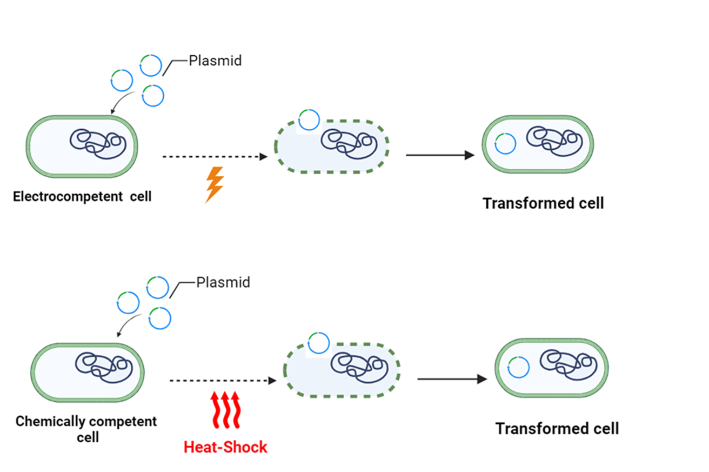
3.Molecular Cloning Steps-Transformation
Notes:
Transformation is the introduction of foreign or recombinant DNA (containing the gene of interest, such as a gene that codes for a protein) into a host organism.
A mixture of plasmids and competent cells is subjected to a heat shock. This involves rapidly exposing the cells to a higher temperature and then quickly returning them to ice. It is believed that the heat shock creates temporary pores in the bacterial cell membrane, facilitating the entry of plasmid DNA.
Electroporation is a technique used to introduce foreign DNA, such as plasmids, into cells by applying a short pulse of electricity. The electric field disrupts the cell membrane, creating temporary pores through which the DNA can pass.

Slide 12
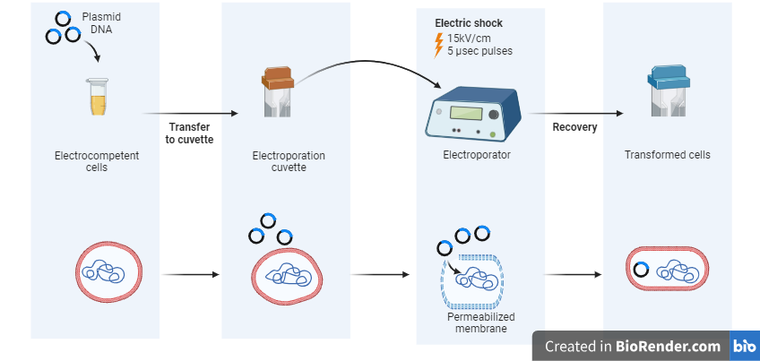
3.Molecular Cloning Steps-Transformation:Electroporation Procedure
Notes:
The electroporation procedure is a widely used technique for introducing foreign DNA into cells. This method involves several important steps, each of which is crucial for the successful transformation of cells. Let’s dive into the details of this process.
Cell Preparation: Harvest the cells and prepare a cell suspension.
Our journey begins with the collection of cells and the preparation of the cell suspension. This step ensures that the cells are in the most suitable condition for transformation by providing a receptive environment for the introduction of foreign DNA.
DNA Mixing: Combine the cells with the DNA of interest.
Moving forward, we come across the critical step of DNA mixing. Here, the cells combine with the DNA of interest to form a cell-DNA mixture. The precision and accuracy in this step is vital as it directly affects the success of the subsequent transformation process.
Cube Loading: Transfer the cell-DNA mixture into an electroporation cuvette.
As we proceed, the cell-DNA mixture is carefully transferred into an electroporation cuvette. This special container is designed to facilitate the application of an electric pulse to the cell-DNA complex, a key step in the electroporation process.
Electrical Pulse: Apply a precisely controlled electric pulse to the cuvette.
A defining moment in electroporation is the application of a precisely controlled electric pulse to the cuvette. This pulse creates temporary pores in the cell membrane, allowing the entry of foreign DNA. The accuracy of this electrical pulse is crucial for successful transformation.
Recovery: Allow the cells to recover and express the transfected DNA.
Our final step involves recovering the transformed cells. It is crucial to allow time for the cells to recover and express the transfected DNA after electroporation. This period is essential for the integration of the foreign genetic material and the subsequent emergence of the desired traits. The electroporation procedure is therefore a meticulously orchestrated series of steps, each contributing to the successful incorporation of foreign DNA into cells. The precision of cell preparation, DNA mixing, cuvette loading, electrical pulse application and recovery collectively determine the efficiency and effectiveness of this transformative technique.

Slide 13
3.Molecular Cloning Steps-Transformation -CRISPR
Paolo Petazzi et all., (2020)
Notes:
One of the most effective ways to transform genes in cells is through CRISPR. This cutting-edge technology enables precise genome editing and is changing the landscape of molecular biology. Let’s explore how the CRISPR system facilitates increased protein production in a seamless process.
Genome Editing with CRISPR: Introduction
At the heart of this transformative process lies genome editing with CRISPR. CRISPR, which stands for Clustered Regularly Interspaced Short Palindromic Repeats, enables targeted modifications within the cellular genome. This technology has revolutionized our approach to genetic manipulation by offering unprecedented accuracy and efficiency.
Designing sgRNA for Protein Overexpression
The first step in utilizing CRISPR for protein overexpression involves designing a guide RNA (sgRNA). This sgRNA is specifically designed to target and modify the genomic region responsible for editing the desired protein. Precision in sgRNA design is crucial to achieving the desired overexpression result.
CRISPR-Mediated Protein Overexpression
With the sgRNA in place, the CRISPR system triggers precise modifications in the cellular genome, leading to increased expression of the target protein. This controlled overexpression results in higher yields of the protein of interest and forms the basis for subsequent purification steps.
Advantages of CRISPR in Protein Production
The use of CRISPR in protein overexpression offers many advantages. These include unparalleled specificity, efficiency, and the ability to precisely control genetic modifications, ensuring that the target protein is produced with minimal off-target effects.
Therefore, the integration of the CRISPR system into the protein overexpression workflow represents a paradigm shift in molecular biology. This technology is paving the way for advances in a variety of fields by empowering researchers to achieve targeted and efficient protein production.

Slide 14
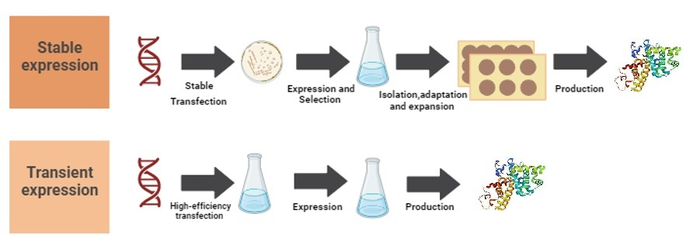
Transient and Stable Expression
Notes:
Transient Expression: Transient expression involves the temporary or short-term expression of a gene within a cell or organism. This can help researchers understand the function or effects of a particular gene over a short period of time. Common methods for achieving transient expression include introducing plasmid DNA or RNA into target cells, which can lead to temporary production of the gene product (e.g. protein) for experimental purposes.
Stable Expression: On the other hand, stable expression involves the long-term or permanent expression of a gene within a cell or organism. This is usually achieved by integrating the gene of interest into the host cell’s genome or by using other methods that provide stable, sustained expression of the gene.

Slide 15
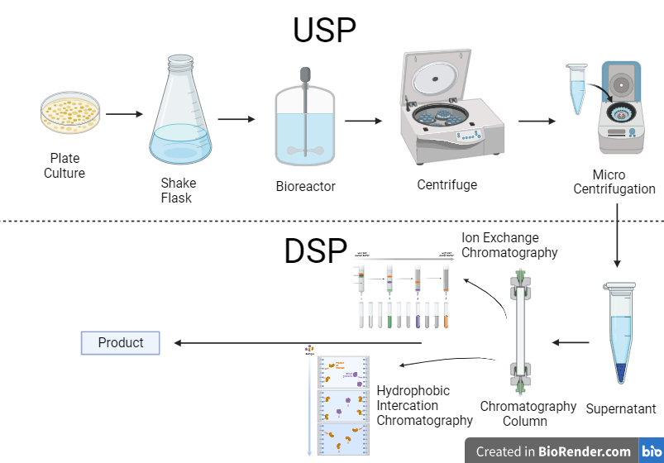
Overview of Upstream and Downstream Process
Notes:
In the field of recombinant protein production, the process occurs in two distinct but interconnected stages: upstream and downstream. The upstream process is the first stage where the foundations for successful protein production are laid. This stage includes tasks such as cell culture, where host cells are grown to express the desired protein, and optimization of growth conditions to maximize their productivity. The downstream process, on the other hand, follows the upstream stage and covers the steps required for purification and refining of the recombinant protein. This involves various purification techniques aimed at separating the target protein from cellular components and other impurities. Both upstream and downstream processes are crucial, working hand in hand to ensure efficient and high-quality production of recombinant proteins with various applications in fields such as medicine, agriculture, and industry.

Slide 16
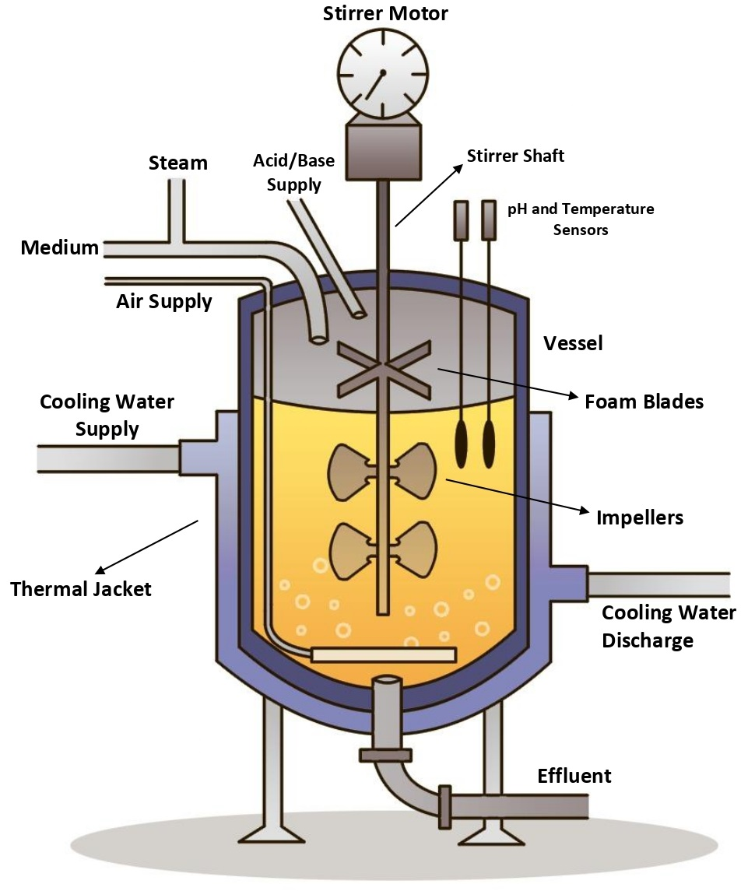
4. Bioreactors in Large-Scale Bio-Manufacturing
Cell Preparation
Bioreactor Fermentation
Bioreactor Functionality
Significance
Notes:
A key step in the process of preparing cells for fermentation involves transferring them into a special environment known as a bioreactor. Think of a bioreactor as a sophisticated culture vessel designed with meticulous attention to airflow and sterility. The main goal here is to facilitate the controlled and sterile production of significant quantities of biological material. As the prepared cells enter the bioreactor, they encounter a carefully orchestrated system where air is intelligently introduced and expelled. This deliberate airflow is instrumental in maintaining ideal conditions for large-scale fermentation. Essentially, bioreactors play a crucial role in providing a clean and controlled environment by promoting optimal conditions for the growth and production of various biological materials. This feature is of great importance in various industries, offering a modern and efficient approach to large-scale biomanufacturing processes. We will now look at the Types of Reactors Used Upstream.

Slide 17
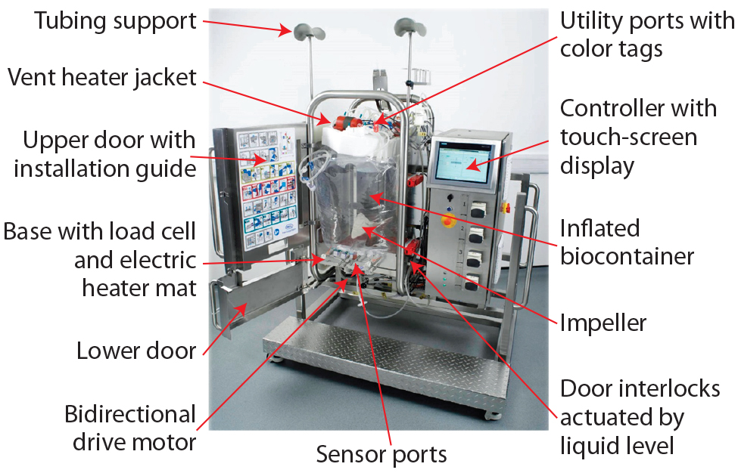
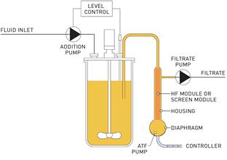
4. Types of Reactors Used In Upstream
Stirred-tank reactors
Airlift reactors
Packed-bed reactors
Notes:
In upstream bioprocessing, various reactor types play an important role in growing microorganisms or cells to produce biopharmaceuticals. The major types of reactors used include stirred tank reactors, airlift reactors, and packed bed reactors. Stirred tank reactors facilitate efficient mixing of nutrients and provide a homogeneous environment for cell growth. Airlift reactors provide an alternative method of aeration and mixing by utilizing the natural buoyancy of air bubbles to circulate the culture medium. Packed bed reactors involve immobilization of cells on a solid support and offer the advantages of increased cell density and simplified downstream processing. The choice of reactor type depends on factors such as the specific cell line, the nature of the bioprocess, and the desired product yield. Each reactor type has its own advantages and considerations and contributes to the versatility of upstream processing in biomanufacturing.

Slide 18
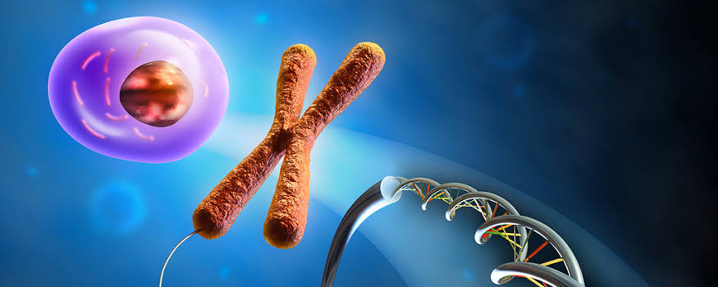
4. Optimization of upstream processing
Media
Production conditions
Scale-Up
Inoculum
Notes:
Media Optimization involves formulating a culture medium that contains the nutrients needed for cell growth and enzyme production, and significantly impacts yield. Further optimization involves adjusting pH and temperature for improved cell growth and enzyme activity, affecting stability and overall fermentation performance. Scale-up optimization involves developing models and configuring equipment for consistent and efficient production at larger scales. Inoculation optimization considers factors such as size and age, tailoring them to the desired cell density and growth characteristics to ensure high metabolic activity and productivity. Collectively, these optimization steps contribute to the success of large-scale enzyme production.

Slide 19
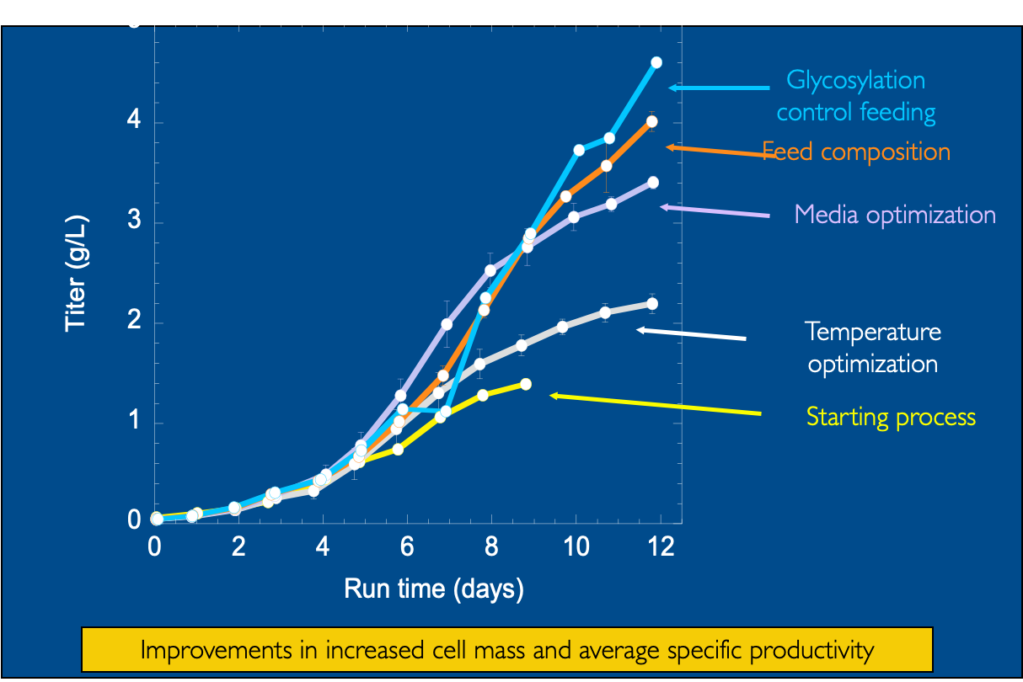
Impact of Upstream Development on Culture Productivity
Notes:
Process development and optimization studies include detailed experimental studies of the effects of environmental parameters on cellular behavior. Culture conditions such as temperature, pH, medium and feed composition, and feeding strategies can provide significant improvements in culture performance. For example, in this case, the new conditions resulted in both increased cell mass and average specific productivity, and the overall yield of the process increased by a factor of four.

Slide 20
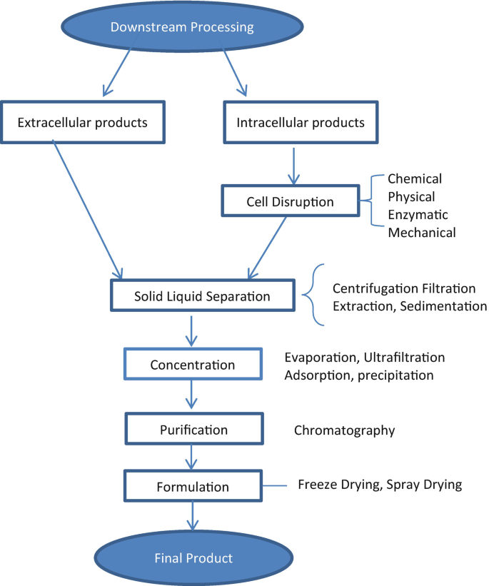
5. Downstream Processing Steps
Notes:
When we look at the downstream process and steps, it is a very important stage in bioprocessing that follows the cultivation of cells in bioreactors. It involves the separation, purification, and recovery of desired products that can be categorized as extracellular and intracellular products. Extracellular products are substances such as enzymes or secreted proteins that are released into the culture medium by cells during fermentation. In subsequent processes, these products are typically separated from the fermentation broth using techniques such as filtration or chromatography. On the other hand, intracellular products are biomolecules synthesized inside the cell, such as recombinant proteins or pharmaceuticals. Cell disruption methods are used to release these intracellular products, which are then purified using various separation techniques. Overall, downstream processing plays a very important role in obtaining high-quality and pure bio-products for pharmaceutical, industrial, or research purposes.

Slide 21
Downstream Process - Cell Disintegration
Mechanical
Physical
Chemical
Enzymatic
Notes:
Cell disruption methods are essential in bioprocessing to release cellular components for further processing.
Mechanical disruption involves the application of a non-specific force using methods such as cavitation, shearing, or impact, and is usually done using a high-pressure homogenizer or bead mill (?).
Physical disruption disrupts cell membranes through shear or external forces, and chemical disruption uses buffers or detergents to change the pH to solubilize the membranes. Enzymatic lysis uses enzymes such as lysozyme or protease for biodisintegration. Each method has its advantages and considerations that affect the quality of the lysates and the subsequent purification of intracellular products in biomanufacturing.

Slide 22
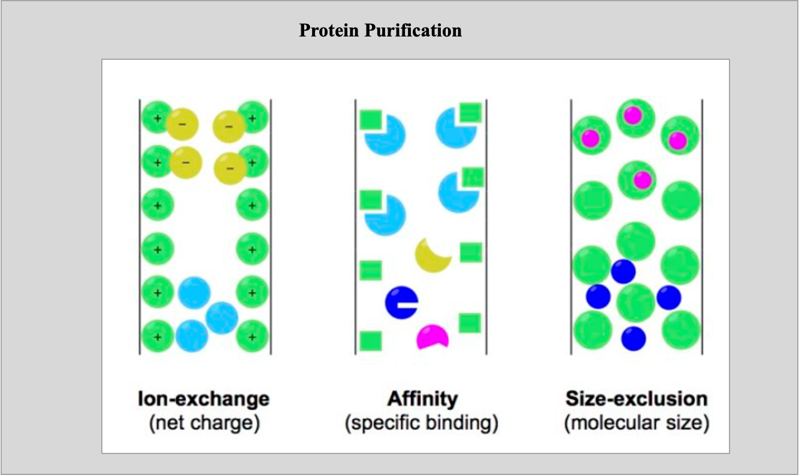
Downstream Process - Purification
Notes:
Once fractionation is complete, the next important step in bioprocessing is purification, which is usually achieved by chromatographic techniques. Ion Exchange Chromatography separates proteins based on their net charge, while the widely used Affinity Chromatography relies on specific interactions between proteins and a matrix-bound ligand and often adds a structure (tag) onto the protein for improved purification. Size Exclusion Chromatography or gel filtration chromatography separates proteins based on their size or molecular weight. These methods play a vital role in obtaining pure and high-quality proteins for various applications in biotechnology and research.

Slide 23
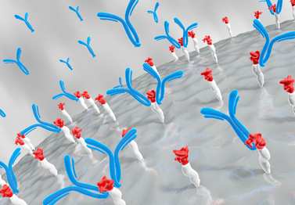
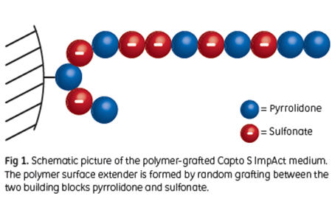
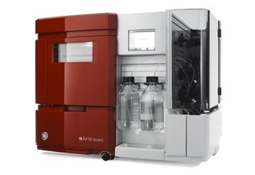
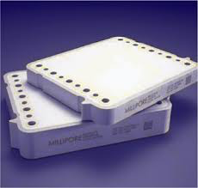
Downstream Process
Cell supernatant
Product
Capture- Affinity Chromatography/Optimization
Intermediate - IEX Chromatography/Optimization
Polishing – IEX Chromatography/Optimization
Virus inactivation / Filtration & UF/DF Optimization
ÄKTA avant 150
Notes:
Let's take a look at the downstream process

Slide 24
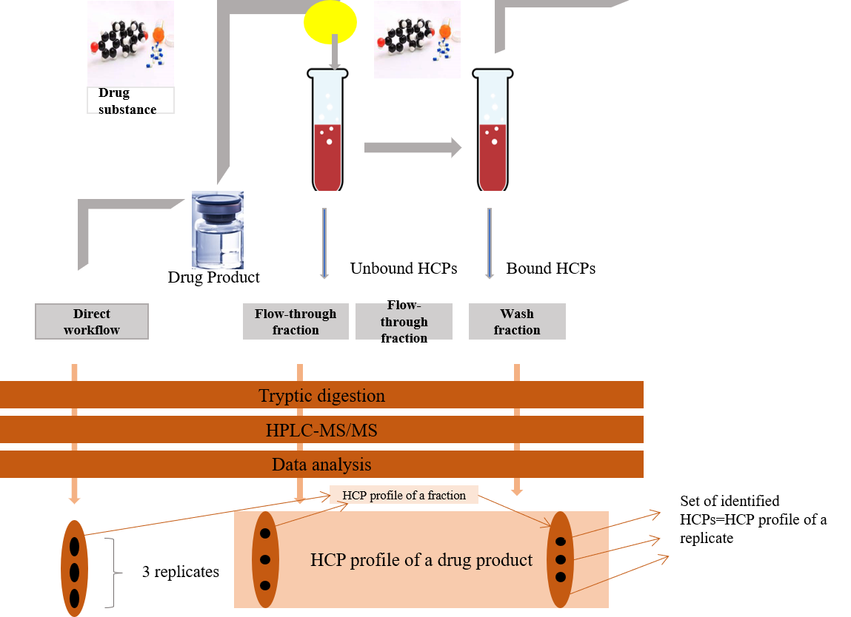
Downstream Process - Impurity Control
Notes:
What factors contribute to impurities in downstream processes during recombinant protein production?
In addition to product and process-related components, they also include contaminants. Host cell proteins (HCPs) are a significant source of impurities and their composition changes during fermentation.
Process-Related Impurities: Additives, equipment leaching, and other chemicals used in the process can become impurities in the final protein product. Early upstream optimization can reduce HCP production and improve DSP performance, leading to more efficient protein purification.
How can impurities be managed?
We can use SEC and IEC, which are important types of chromatographic methods.
SEC is used to separate molecules based on their size. It helps detect and quantify protein clumps, fragments, or other impurities that may be present in a protein sample.
IEC is used to separate proteins based on their charge characteristics. It is effective in identifying and removing HCPs, which are a significant source of impurities during the purification process.
We can also use biological tests to detect mycoplasma contamination.

Slide 25
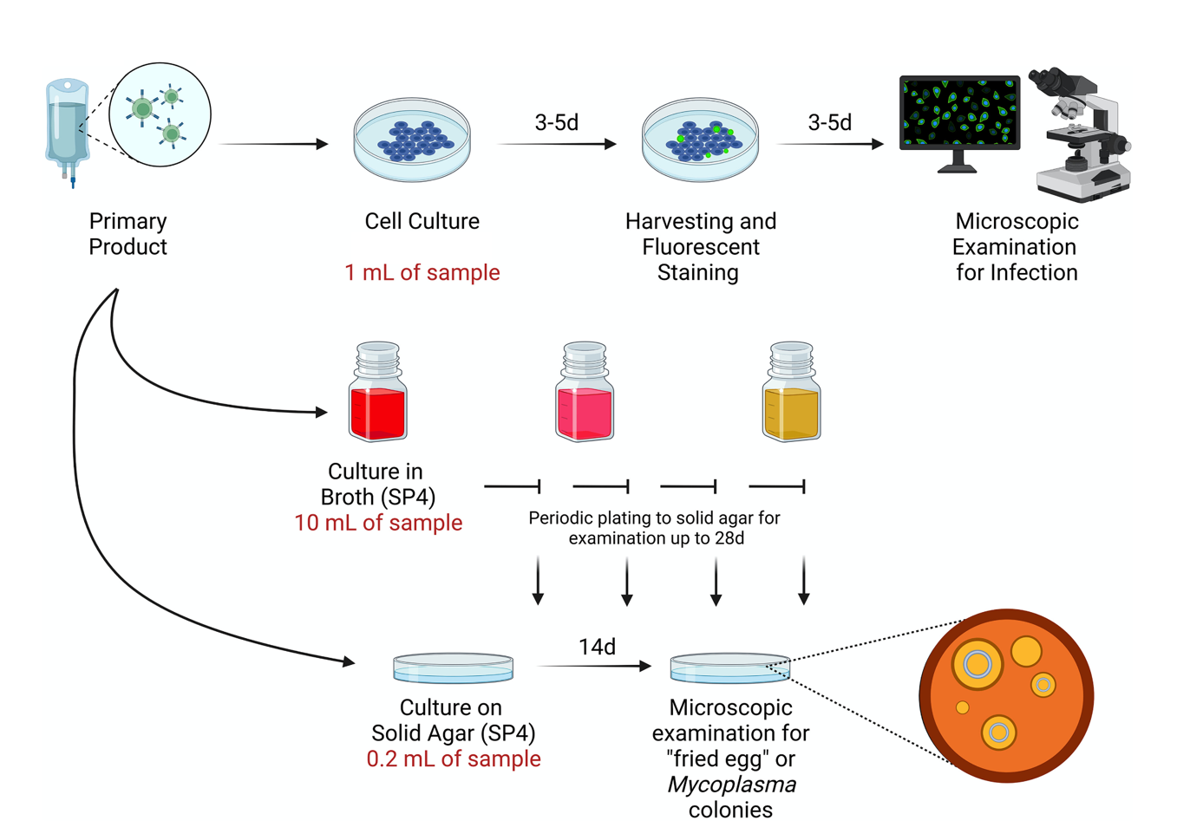
Downstream Process – Biological Tests for Impurity Control
(Arthur H. Totten et al., January 2023)
Notes:
Biological mycoplasma testing is a crucial technique in the impurity control process of recombinant protein production. This testing method is used to ensure that there is no mycoplasma contamination that could potentially compromise the quality and safety of recombinant protein. By performing rigorous biological mycoplasma testing, manufacturing facilities can maintain high standards and ensure the purity of the final recombinant protein product.

Slide 26
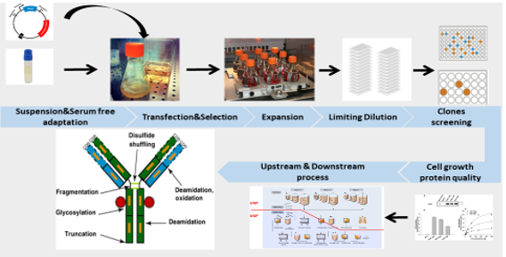
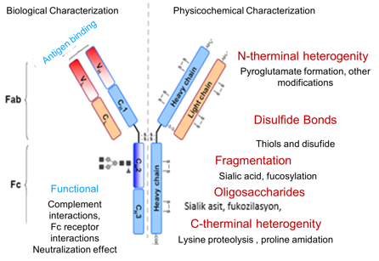
Monoclonal Antibody Production Strategies
Notes:
Animal cell culture technology has advanced significantly over the last few decades and is now generally accepted as a reliable, robust and relatively mature technology. The process of developing a stable cell line begins with expression vector construction and transfection. After transfection with plasmids carrying antibody light and heavy chain genes and a selectable marker or markers, the cells are screened for high productivity after recovery of growth, adaptation to serum-free suspension and amplification (if required) and clone selection. Screening and selecting a highly productive and stable clone from the transfectant population within a limited time frame is a major challenge.

Slide 27
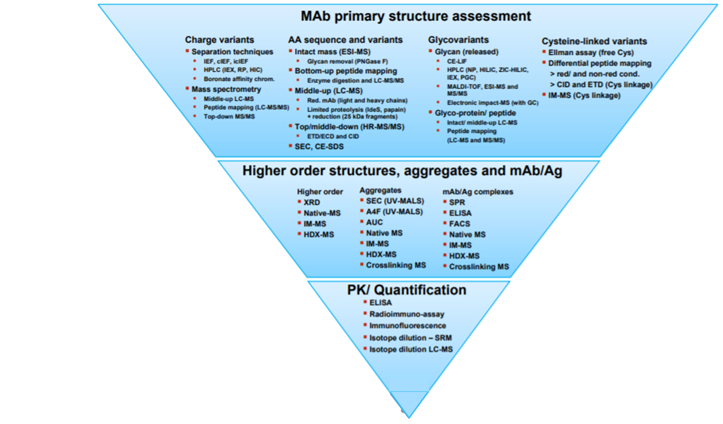
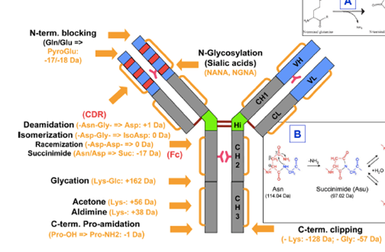
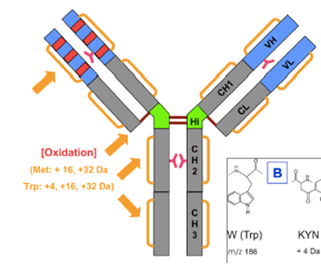
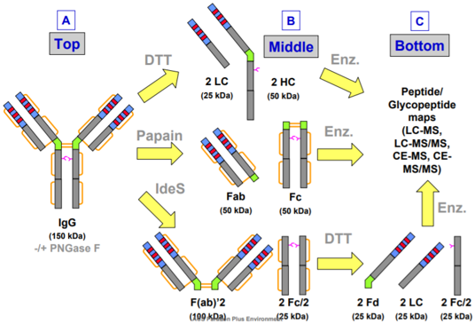
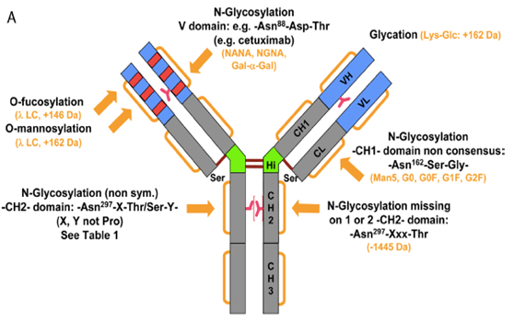
Beck et al. Anal Chem (2013) 85, 715-736
27
Notes:
Many separation techniques based on liquid chromatography and electrophoresis and MS are used for antibody characterization and homogeneity assessment. These analytical techniques help to select the best antibody producing clone with the right glycoprofile for full structural characterization of research leads and clinical candidates. Also orthogonal analytical methods aim to separate multiple isoforms of antibody from microvariants.
SDS-PAGE, SEC, intact mass for differences in mass
CEX, hydrophobic chromatography, cIEF for charge variants

Slide 28
Final Critical Steps in Recombinant Protein Production
Purification
Improving purification methods and chromotography techniques can increase protein purity and yield, resulting in higher overall production efficiency.
Process Robustness
Enhancing process robustness through optimized buffer systems and improved resin selection can lead more consistent and reproducible protein production.
Scale-Up
Developing effective scale-up strategies ensures smooth and efficient transition from small-scale to large-scale production, meeting the demand for commercial quantities of protein.
Process Economics
Identifying cost-effective approaches, such as reducing expensive reagents or improving pocess yield, can lead to more economically viable protein production.
Quality Control
Stringent quality control measures and analyticl techniques help monitor protein quality throughout the production process, ensuring the final product meets required standards.
Notes:
In the field of protein production, upgrading purification methods and utilizing chromatography techniques have the potential to increase both protein purity and yield, contributing to overall production efficiency. Strengthening process robustness achieved through refined buffer systems and optimum resin selection plays a crucial role in establishing a consistent and reproducible protein production process. Effective scale-up strategies are essential to smoothly transition from small-scale to large-scale production and meet the demand for commercial quantities of protein. Recognizing cost-effective approaches, such as minimizing the use of expensive reagents or increasing process efficiency, is key to achieving more economically viable protein production. Furthermore, stringent quality control measures and analytical techniques are used to monitor protein quality throughout the production process and ensure that the final product meets the required standards.

Slide 29
Characterization of Produced Recombinant Protein
SDS PAGE and Western Blot
Spectrophotometric Analysis
Chromatographic Analysis (Intac mass/Peptide mapping) pumla
Notes:
Some comprehensive analyses are required to characterize the produced recombinant protein and evaluate its structural, functional and biochemical properties.

Slide 30
Characterization of Produced Recombinant Protein - SDS Page and Western Blot
Notes:
SDS-PAGE and Western Blotting are crucial methods for characterizing Recombinant Protein Production (RPP). A cornerstone in protein production, SDS-PAGE separates proteins by size, confirming purity and molecular weight through distinct bands observed on the gel. Complementary to this, Western Blotting detects and quantifies specific proteins, confirming the presence of the target protein. After SDS-PAGE, proteins are transferred to a membrane where antibodies bind to the protein of interest, visually confirming successful expression and purification. Collectively, these techniques play a crucial role in the success of protein production efforts by ensuring the purity, integrity and presence of recombinant proteins.

Slide 31
Characterization of Produced Recombinant Protein - Spectrophotometric Analysis
Spectro-photometric analysis
Enzyme Activity Assay
pH and Temperature Optimum
Inhibition Studies
Enzyme Kinetics Assay
Stability Assays
Notes:
Spectrophotometry is a valuable tool for enzyme characterization and different assays can be performed to investigate different aspects of enzyme behavior.
Enzyme Activity Analysis measures enzyme activity by monitoring substrate concentration or product formation over time.
Kinetic experiments such as determination of Michaelis-Menten constants (Km and Vmax) provide information on substrate affinity and catalytic efficiency.
pH and Temperature Optimization experiments reveal the optimal conditions for enzyme activity and evaluate stability in different environments.
Stability experiments include thermal, pH and chemical stability tests and help optimize storage and handling conditions.
Inhibition Studies evaluate the effect of inhibitors on enzyme activity, distinguishing between competitive, uncompetitive or competitive inhibition. These spectrophotometric assays contribute to a comprehensive understanding of enzyme properties and behavior.

Slide 32
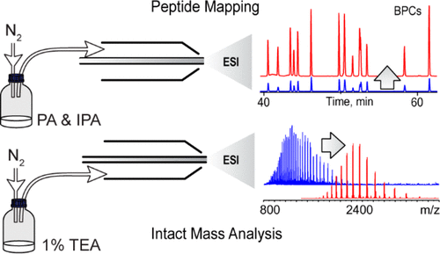
Chromatographic Analysis
Notes:
Chromatographic Analysis, particularly Intact Mass and Peptide Mapping, is a powerful technique in bioanalytical chemistry. Intact Mass Analysis involves determining the mass of whole proteins or large biomolecules and provides information about their structure and modifications. This method helps in verifying the integrity of target molecules. On the other hand, Peptide Mapping involves breaking down proteins into peptides and analyzing their sequences. This detailed mapping helps in identifying post-translational modifications and ensures the purity and authenticity of the protein. Intact Mass and Peptide Mapping together form a comprehensive approach to characterize and validate proteins in various biopharmaceutical and research applications.

Slide 33
Questions and Discussion
QUESTION AND ANSWER
SHARING EXPERIENCES
LET'S SUMMARIZE
Notes:
Please review the books and other documents on our website to obtain more detailed information on the subject. You can use our social media accounts for any questions or concerns you may have.

Slide 34
Recombinant protein production Summary
Versatile approach across applications
Enhanced production via advanced techniques
Characterization ensures functionality and safety
Notes:
Recombinant protein production offers a versatile approach to produce high-quality proteins across a variety of application areas
Advances in molecular biology techniques, expression systems, and protein purification methods have facilitated efficient and scalable production of recombinant proteins
Characterization of recombinant proteins is crucial to ensure their functionality, stability, and safety

Slide 35
Recombinant protein production Summary
Comprehensive assessment via analytical tools
Fosters innovation in healthcare and technology
Notes:
The use of analytical tools such as chromatography, mass spectrometry, and biophysical tests allows for comprehensive assessment of recombinant protein properties.
Successful recombinant protein production and characterization fosters innovation in drug development, biopharmaceuticals, industrial enzymes, and diagnostics, ultimately benefiting society through improved healthcare and technological advances.

Slide 36
Additional Resources
Remans, K., Lebendiker, M., Abreu, C. et al. Protein purification strategies must consider downstream applications and individual biological characteristics. Microb Cell Fact 21, 52 (2022).
Recent advances on protein separation and purification methods. Advances in Colloid and Interface Science, 284, 102254.
Tripathi, N. K. (2016). Production and purification of recombinant proteins from Escherichia Liu, S., Li, Z., Yu, B., Wang, S., Shen, Y., & Cong, H. (2020).

Slide 37
Project Partners

Slide 38
This document was prepared for the Erasmus Project "2022-1-TR01-KA220-VET-000088373
A UNIVERSAL STRATEGIC NECESSITY: FROM MOLECULE TO DRUG»
"”Supported by the European Commission within the scope of the Erasmus+ Programme. However, the European Commission and the Turkish National Agency cannot be held responsible for the opinions expressed here."
Notes:
A universal necessity: From Molecule to Drug Project
"Supported by the European Commission within the Erasmus+ Programme.
However, the European Commission and the Turkish National Agency cannot be held responsible for the views expressed here."

Slide 39
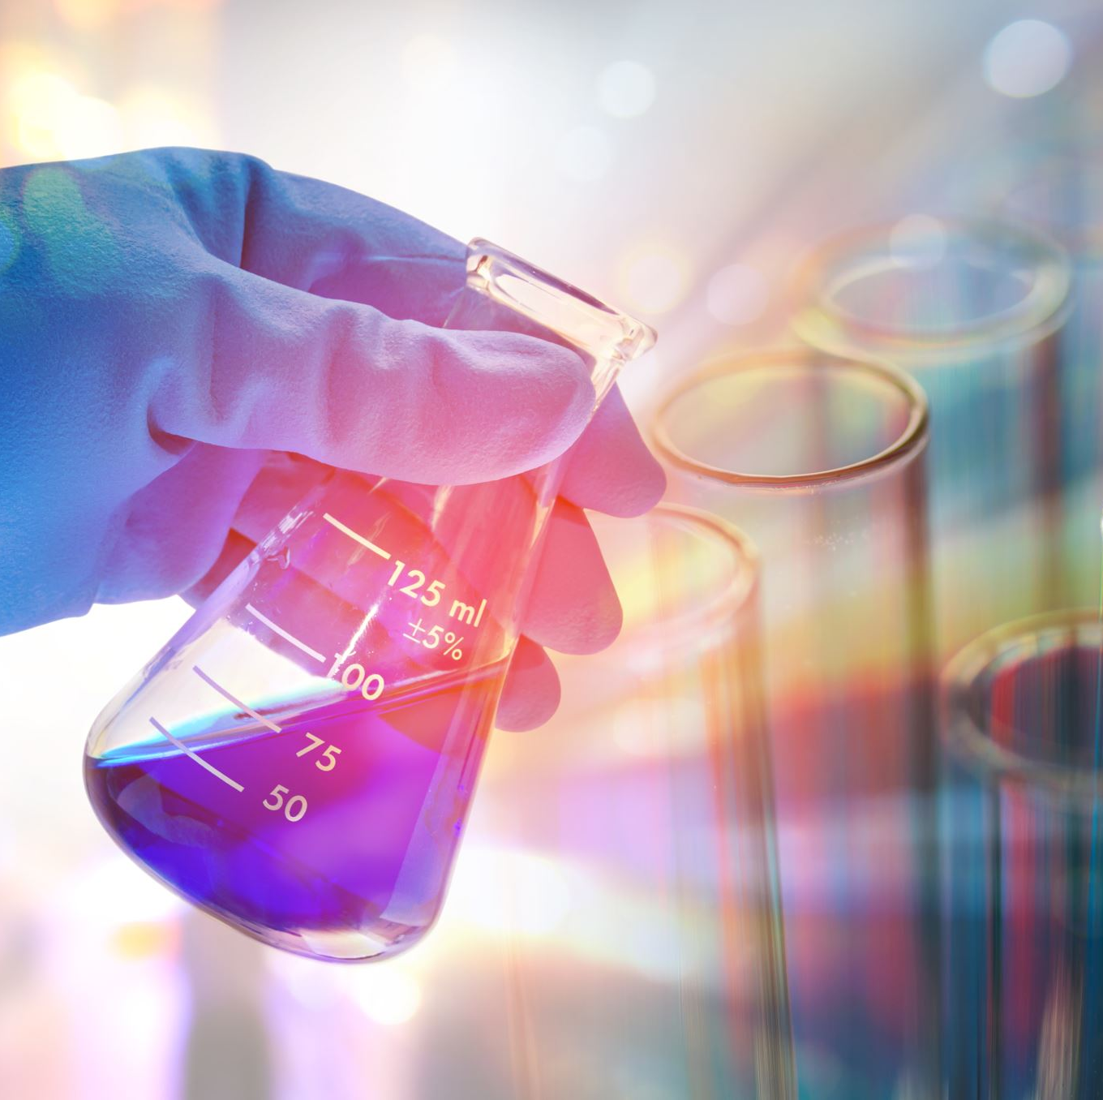
THANK YOU
Notes:
Projemize desteklerinden ötürü Avrupa Komisyonu’na ve proje ekibinde yer alarak katkıda bulunan tüm üyelerimize ve proje kapsamındaki etkinliklere katılan herkese teşekkür ederiz.

