Slide 1
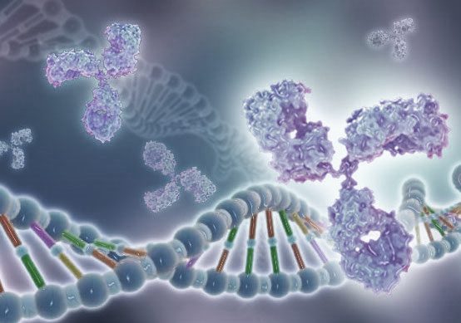
RESEARCH 5: Applications of Nanotechnology and Nanoparticles in Medicine
From Molecule to Drug
Dr. Lucia GEMMA DELOGU & Dr. Açelya YILMAZER
Notes:
Hello. In this session, we will touch upon the field of nanotechnology, another innovative drug research method. In this context, we will examine the meeting of high-dimensional analyses with immune cells, especially in 2-dimensional materials.

Slide 2
Learning Objectives
Recognize
The need for experiments to assess the biocompatibility of nanoparticles
Comprehend
technologies to assess the effect of nanoparticles on immune cells
Notes:
Learning objectives: First of all, it is defined as realizing that experiments are needed to evaluate the biocompatibility of Nanoparticles and also understanding the technologies that will evaluate the effect of Nanoparticles on immune cells.

Slide 3
Agenda
Introduction to nanoparticles and nanomedicine
The effect of nanoparticles on immune cells - How do we evaluate?
Conclusion
Notes:
We will start our presentation with the introduction and usage areas of Nanoparticles and nanomedicine. Then we will focus on the effects of Nanoparticles on immune cells. We will explain how we evaluate these effects. We will close our session by summarizing the topic.

Slide 4
Nanoparticles: nanomedicine
https://www.youtube.com/watch?v=2VcNpl8-PRI
Notes:
First, let's start with a brief introduction to nanomedicine and watch our video.

Slide 5
Notes:
https://etp-nanomedicine.eu/about-nanomedicine/what-is-nanomedicine/
https://www.youtube.com/watch?v=2VcNpl8-PRI&ab_channel=nanomedTV

Slide 6
Nanomedicine
A new and popular area of ​​research
A focus of attention for researchers worldwide
Interdisciplinary
Areas of application of nanotechnology in medicine
Therapeutics (drug delivery)
Diagnosis and imaging
Regenerative Medicine
Notes:
Nanomedicine is a very new field of research and has become the focus of scientists from all over the world and in many different disciplines. Nanomedicine is the application of nanotechnologies in medicine; especially in therapeutic approaches including drug delivery, diagnostic and imaging methods and regenerative medicine.

Slide 7
Notes:
Nanomedicine can also be called the future of medicine.
Nanomedicine works by injecting nanoparticles into the body.
Nanoparticles can be used to deliver drugs, find and treat diseases, and repair damaged cells.
Sources
https://commonfund.nih.gov/nanomedicine/overview.aspx
http://www.understandingnano.com/medicine.html
http://pubs.acs.org/doi/abs/10.1021/nn400630x
http://www.nature.com/nnano/journal/v6/n10/full/nnano.2011.147.html
http://www.dana.org /news/features/detail_bw.aspx?id=35592
http://pubs.rsc.org/en/Content/ArticleLanding/2011/AN/C1AN15303J
http://onlinelibrary.wiley.com/doi/10.1002/smll.201001642/abstract
http://www.clinam.org/benefits.html

Slide 8
Notes:
When it comes to nanomedicine applications, drug delivery can be considered among the most widely used applications.
Cancer diagnosis and treatment in particular is a good example of nanomedicine applications.

Slide 9
Notes:
Nanomedicine can also be used to test how cells respond to drugs. This provides immediate feedback on how cells are responding to the drug, which can save time and money spent on tests and clinical trials, and may be more effective than current drugs.
Finally, nanomedicine has several advantages, including faster diagnosis of many diseases, more precise treatment of conditions such as cancer, and targeting only diseased organs without destroying healthy tissue.

Slide 10
Rapid growth of indexed publications
37,813 results
Notes:
According to data collected from Pubmed on 27/12/2021, the continuous development of nanomedicine is also reflected in the rapid growth of indexed publications.

Slide 11
Ideal medicine
Well tolerated
Selective
Simple administration
Safe
Targeted distribution
Predictable bioavailability
Effective
Optimal delivery system
Simple metabolism and elimination
Notes:
An ideal drug, including nanoparticles, should have many characteristics:
It should be well tolerated
It should be selective
It should be easy to administer
It should be safe
It should have targeted drug distribution
It should have predictable bioavailability
It should be effective
It should have an ideal delivery system
It should be easy to metabolize and eliminate

Slide 12
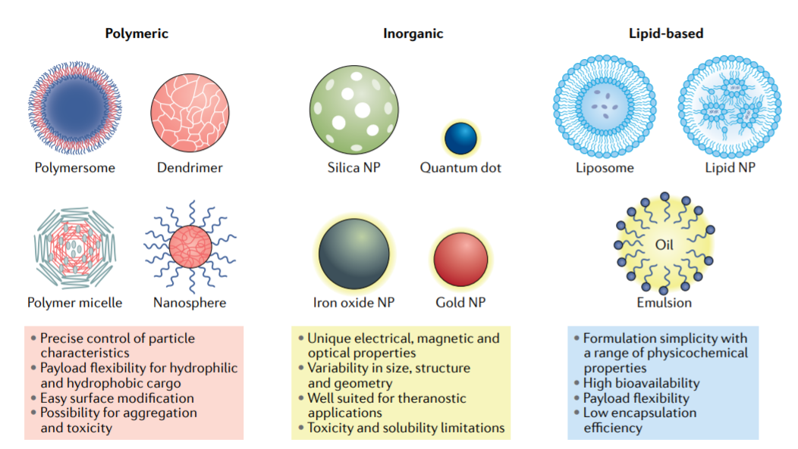
Classes of NPs
Notes:
Each class of nanoparticles is divided into multiple subclasses. Basically, we can classify them as polymeric, inorganic, and lipid-based.
The most common ones are shown here. Each class has many advantages and disadvantages in terms of content, distribution, and patient response.
Polymeric ones have features such as
Precise control of particle properties possible
Load carrying flexibility for hydrophilic and hydrophobic cargoes
Easy surface modification - Possibility of aggregation and toxicity
Inorganic nanoparticles have unique electrical, magnetic, and optical properties
They vary in size, structure, and geometry.
Well-suited for theranostic applications
Toxicity and solubility limitations
Lipid-based nanoparticles have
Ease of formulation with various physicochemical properties
High bioavailability
Load flexibility
Low encapsulation capacity

Slide 13
Impact of nanoparticles on immune cells - How do we assess?
Assessment
Applications
High-dimensional approaches: Imaging Mass Cytometry (IMC) and ion beam imaging by time-of-flight (MIBO-TOF)
High-dimensional analysis
High-dimensional approaches:Single-Cell Mass Cytometry (CyTOF)
Notes:
It is very important to consider and study the effect of nanoparticles on immune cells. But how do we evaluate this?
High-dimensional approaches can be used to evaluate this, especially innovative approaches such as single-cell mass cytometry (CyTOF) or imaging mass cytometry.

Slide 14
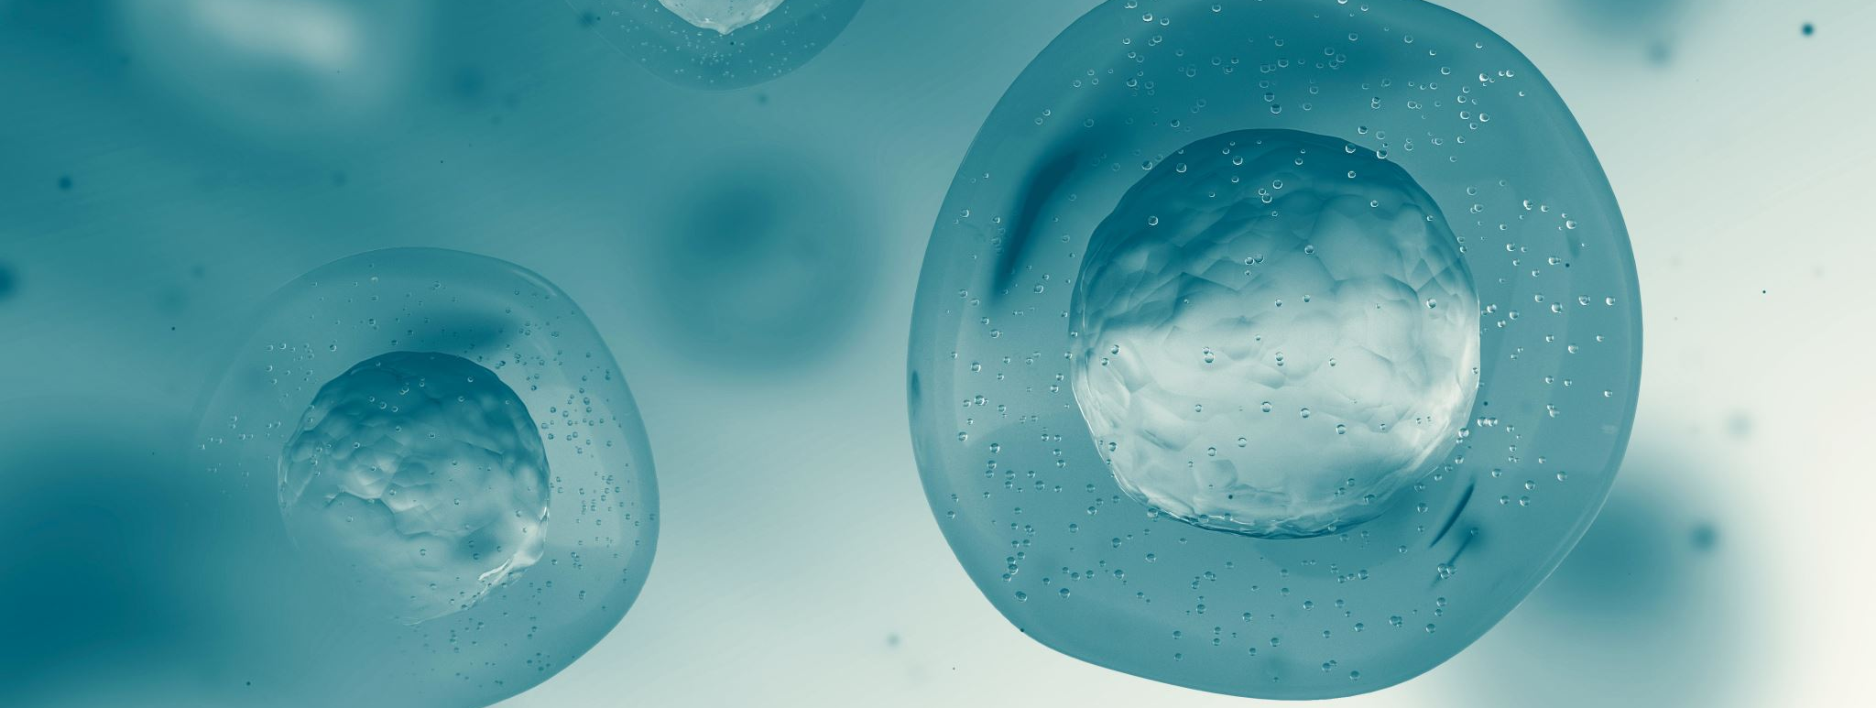
1. High-dimensional approaches: Single-Cell Mass Cytometry (CyTOF)
Notes:
Let’s first start with Single-cell mass cytometry (CyTOF)

Slide 15
High-dimensional approaches: SINGLE CELL-MASS CYTOMETRY
Notes:
Mass cytometry or CyTOF (Fluidigm) is a variant of flow cytometry in which antibodies are labeled with heavy metal ion labels instead of fluorochromes. After the cells are injected, they pass into a nebulizer, which ionizes the cells for mass spectrometry. An argon plasma then breaks all chemical bonds in the cells and atomizes the cells. The heavy metal ions are then separated and detected through time of flight based on their mass-to-charge ratios. Each isotope directly resembles the expression of its corresponding biological target.

Slide 16
SINGLE CELL-MASS CYTOMETRY (CYTOF)
FLOW CYTOMETRY VS MASS CYTOMETRY
Antibodies are labeled with heavy metal ion tags not with fluorophores
NO spectra overlap
No noise
No autofluorescence problems
Notes:
Additionally, since metal isotopes that are not typically found in vivo are used, there is almost no background noise. Therefore, the contrast between the markers of interest and the background is ideal for analyzing images. Since there is no noise, up to 50 markers can be imaged simultaneously from a single slide with a single tissue sample. This broad multiplexing capability means that complex research questions can be addressed and researchers can examine many immune cell types and subtypes along with spatial and cellular markers.

Slide 17
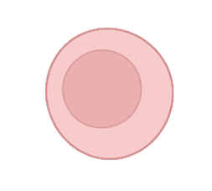
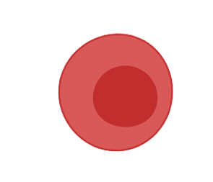
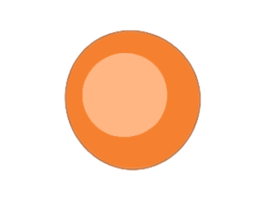
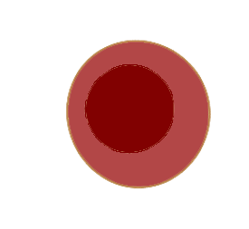
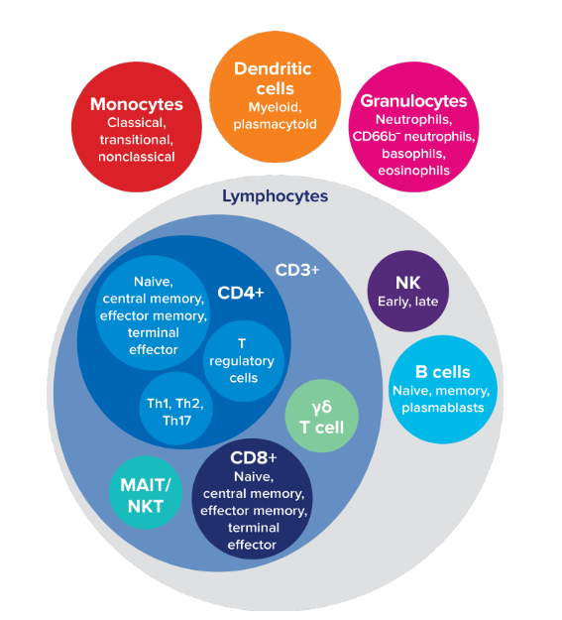
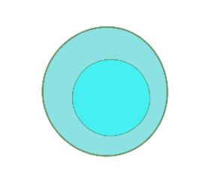
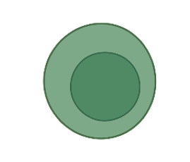
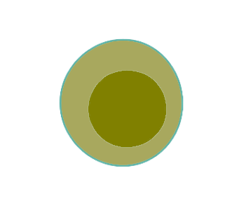
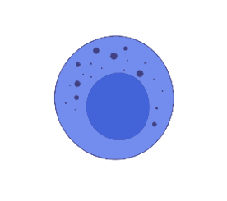
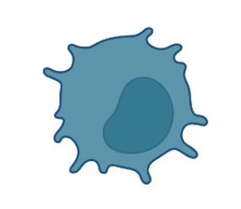
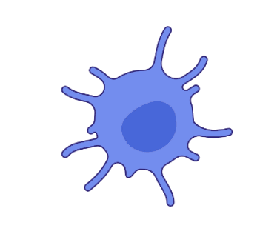
IMMUNE PROFILING BY SINGLE-CELL MASS CYTOMETRY
A HIGH-DIMENSIONAL APPROACH looking at more than 50 cell parameters at the same time
Notes:
The typical workflow of a CyTOF experiment is as follows:
1. Sample preparation
2. Treatment with nanomaterials
3. Staining with metal antibody labels
4. Reading samples with CyTOF
5. High dimensional analysis and data analysis

Slide 18
IMMUNE PROFILING BY SINGLE-CELL MASS CYTOMETRY
A HIGH-DIMENSIONAL APPROACH looking at more than 50 cell parameters at the same time
Notes:
With CyTOF we can distinguish more than 50 cell parameters at the same time. For example, we can distinguish T cell subpopulations T CD4 and T CD8 but also if their staging is naive, central memory, effector memory, and terminal effector.

Slide 19
Over 50 metal isotopes are commercially available for use in a wide variety of applications
>650 antibodies conjugated to 37 different isotopes
Secondary antibodies to biotin, GFP, FITC, APC, PE as well as mouse, rat and goat immunoglobins
Viability indicators
Nucleic acid intercalators
Notes:
There are various antibodies available on the market for different purposes. More than 50 metal isotopes are commercially available for use in various applications.
➤>650 antibodies conjugated to 37 different isotopes
➤Secondary antibodies against biotin, GFP, FITC, APC, PE as well as mouse, rat and goat immunoglobulins
➤Viability indicators
➤Nucleic acid intercalators

Slide 20
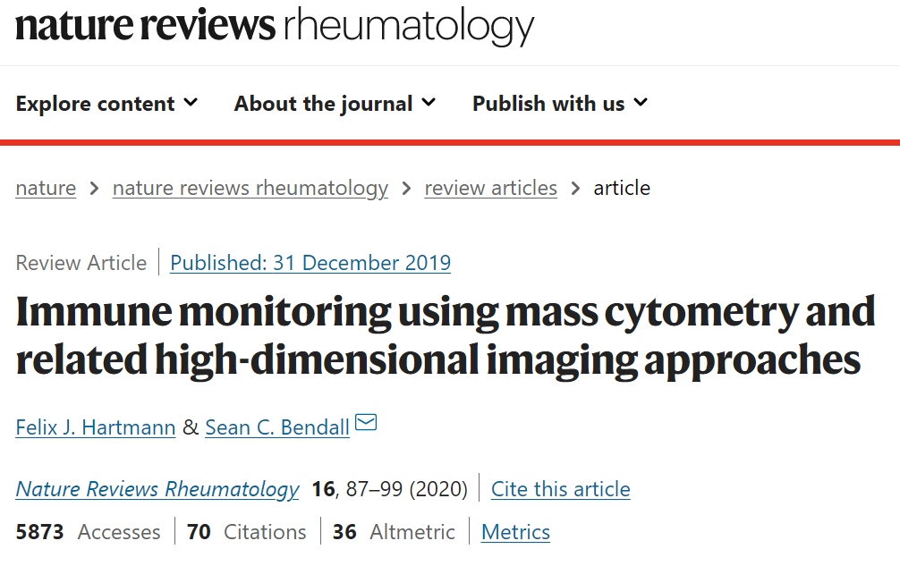
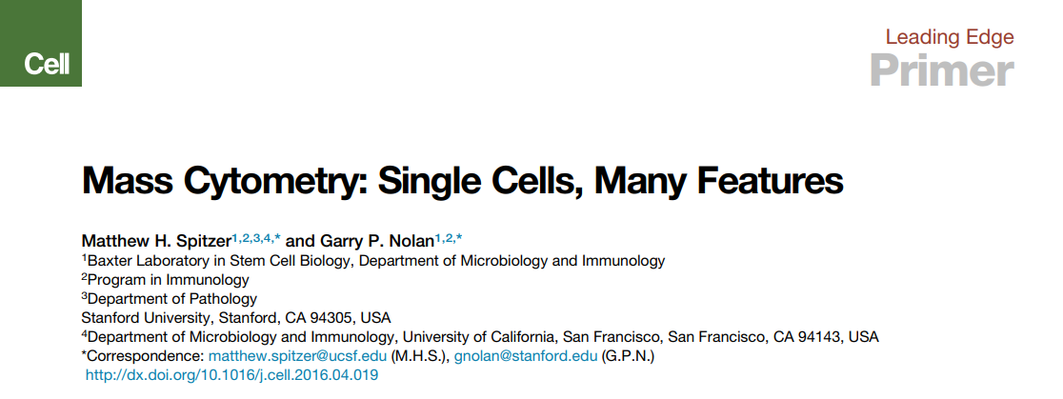
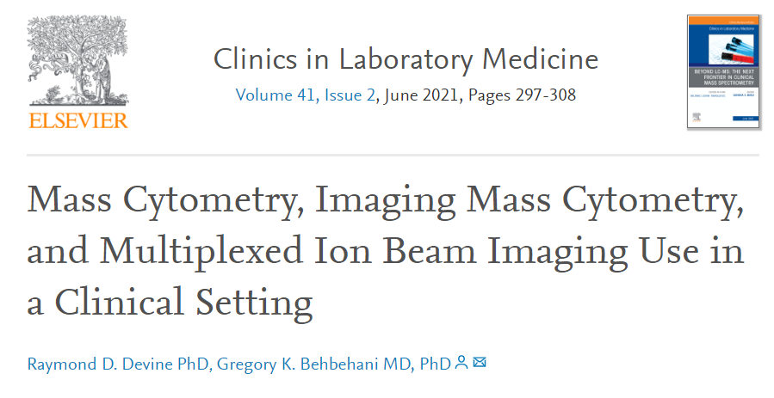
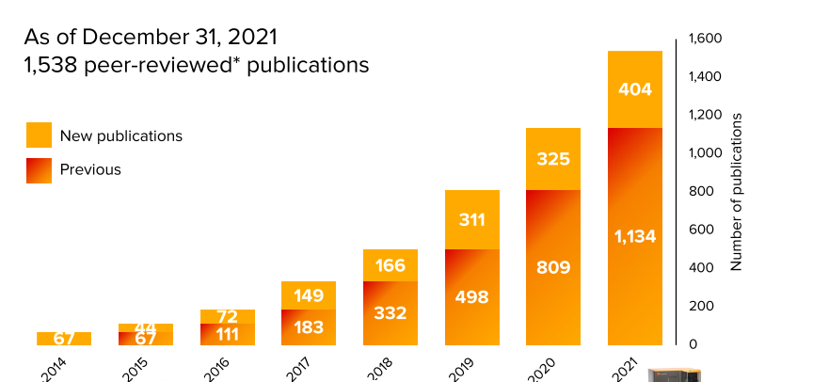
SINGLE CELL-MASS CYTOMETRY (CYTOF) IMPACT IN SCIENCE
Notes:
Given the potential of CyTOF in clinical studies, it is emerging as a widely used technique in large-scale studies, including those related to COVID-19 and its impact on the immune system.

Slide 21
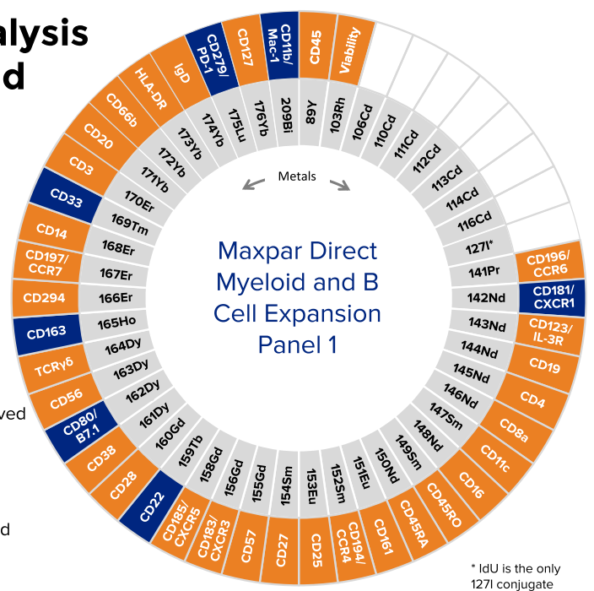
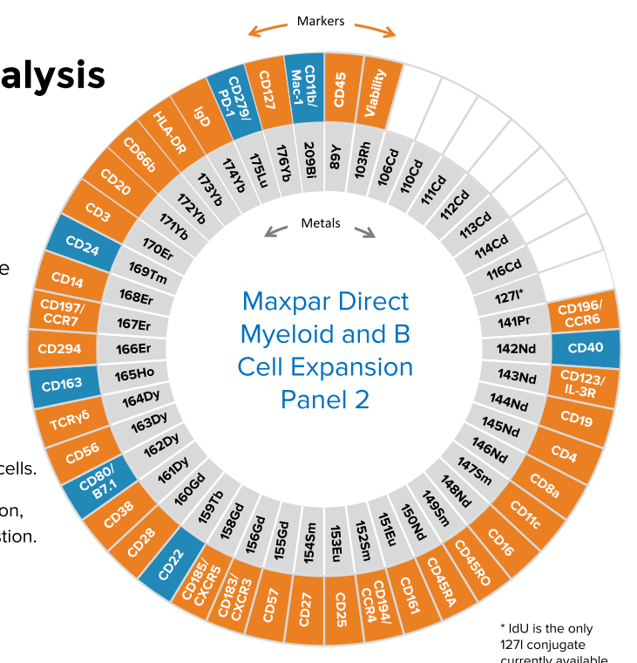
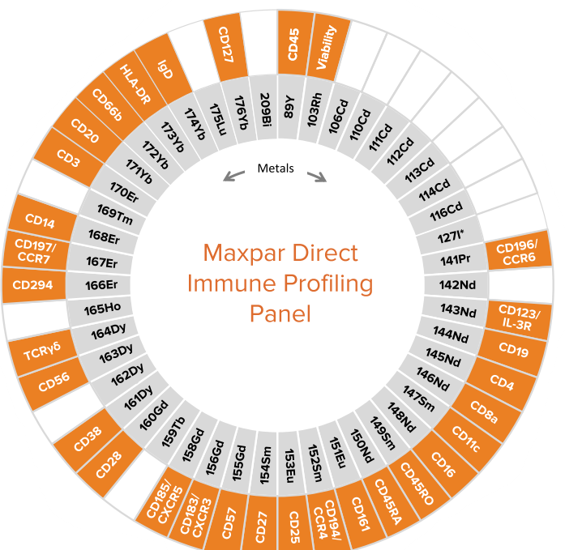
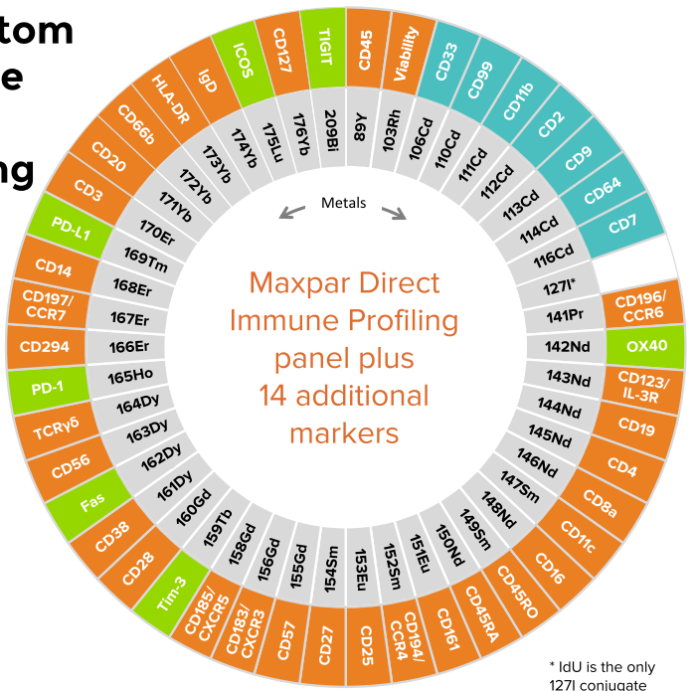
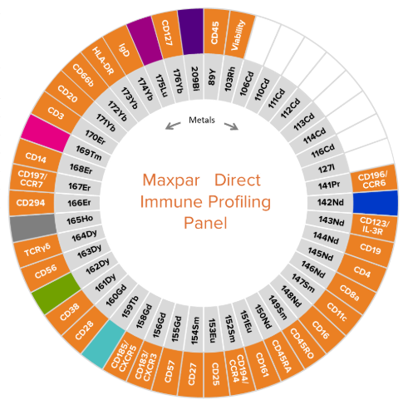

Slide 22
PANEL DESIGN
Notes:
One of the major advantages of CyTOF it is the design of antibodies panel. Pre-configured panels are easily accessible in the market, providing a solid starting point for panel customization, which offers ample flexibility to allocate these vacant channels for the inclusion of additional visible nanomaterials in CyTOF.

Slide 23
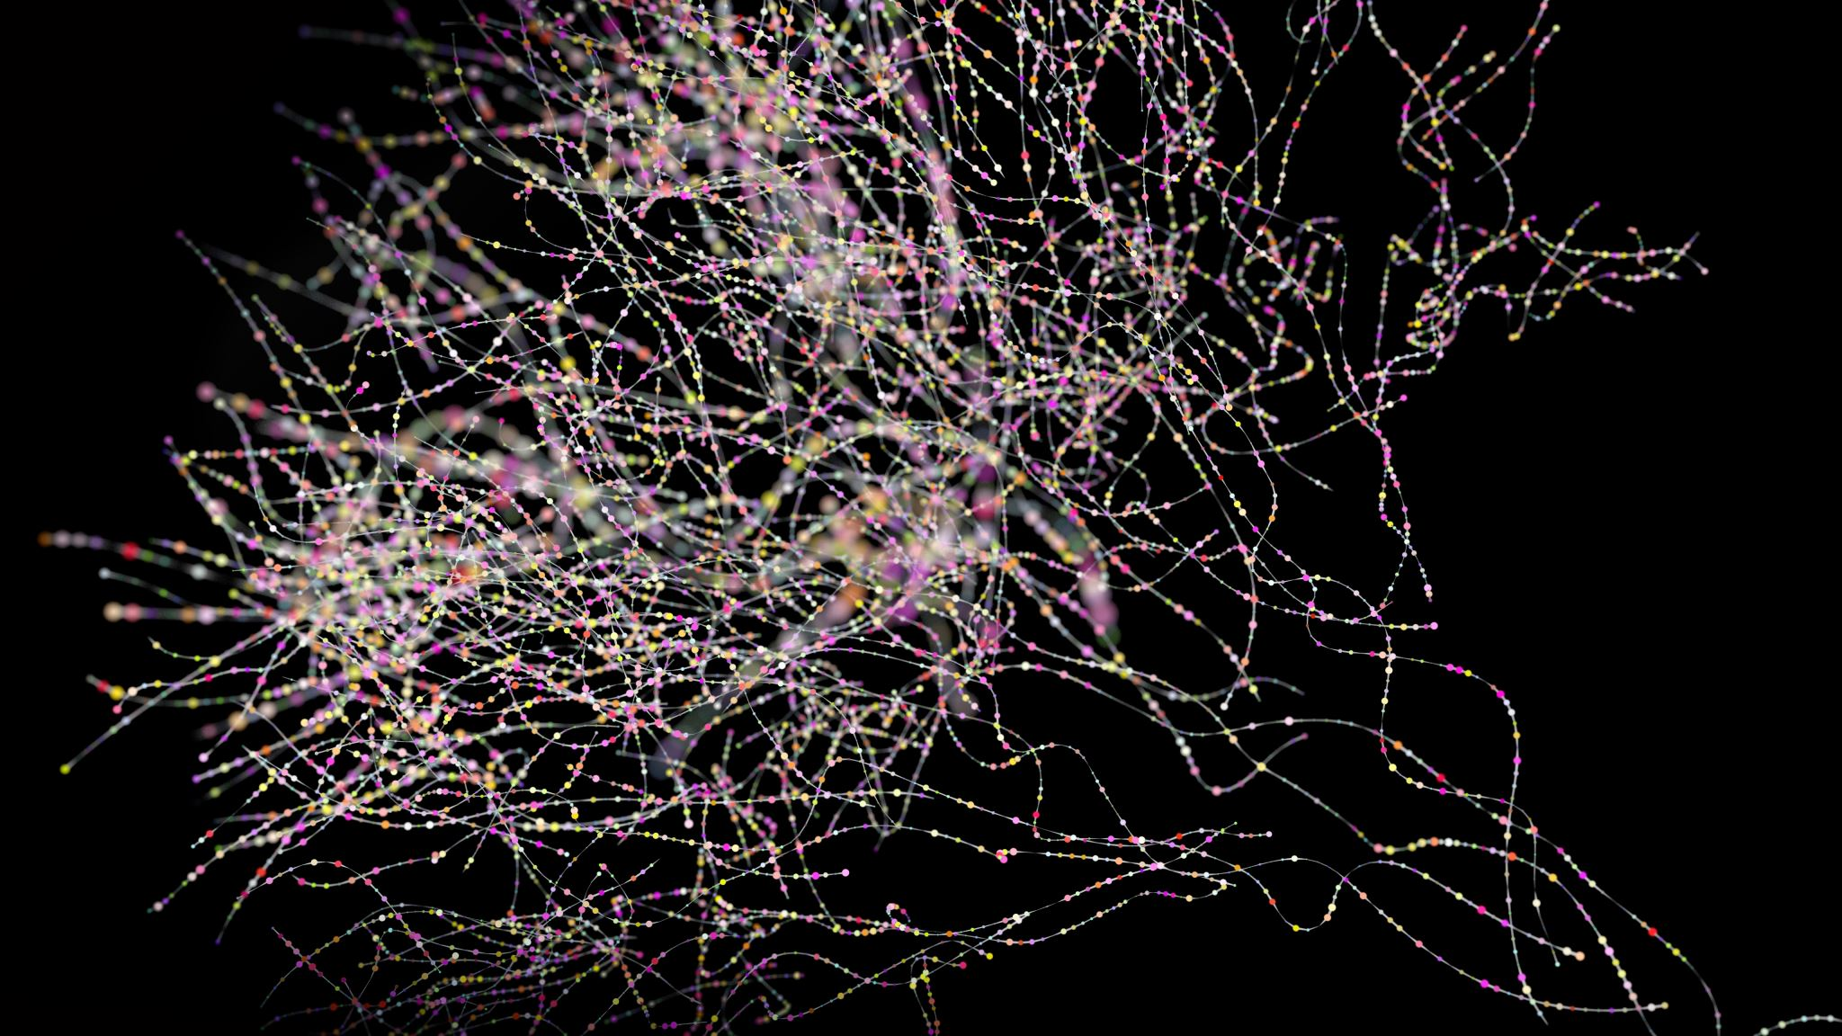
Multidimensional Approaches: Imaging mass cytometry (IMC) and time-of-flight ion beam imaging (MIBI-TOF)
Notes:
We have given general information about Single cell mass cytometry (CyTOF) from multidimensional approaches. Now let's talk about Imaging mass cytometry (IMC) and Time-of-Flight Ion Beam Imaging (MIBI-TOF) methods within the scope of the second multidimensional approach.

Slide 24
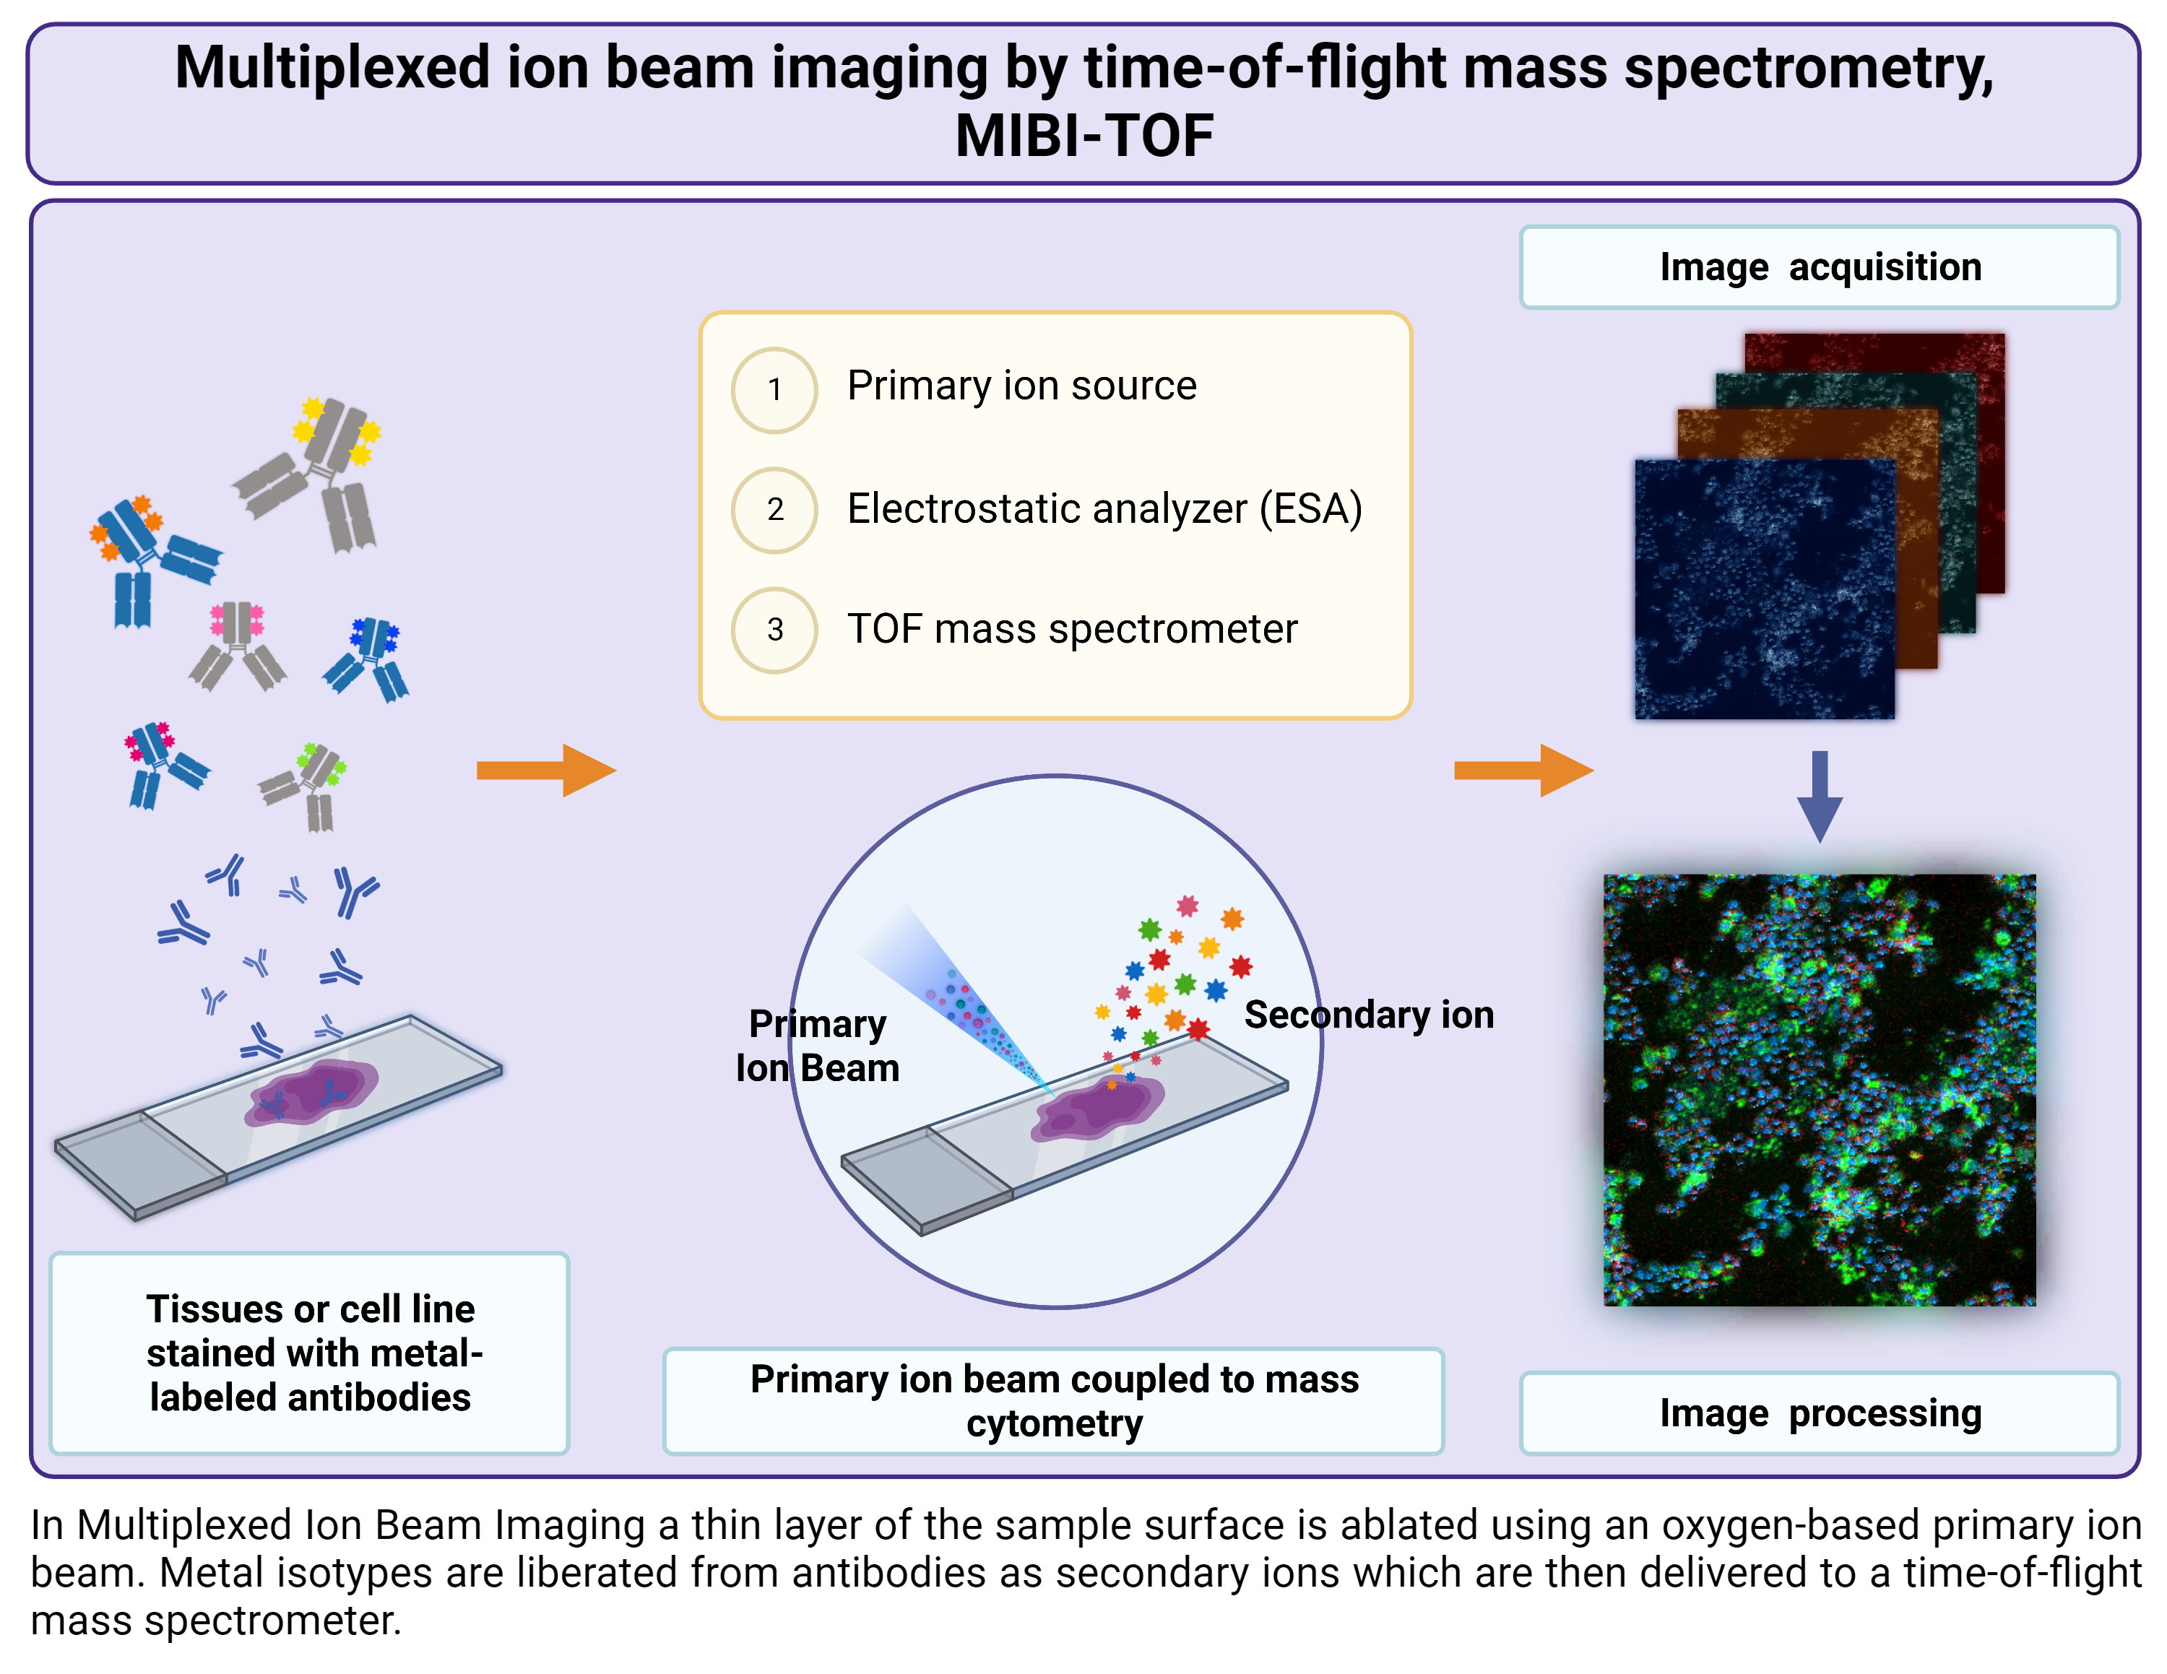
Notes:
Imaging mass cytometry (IMC) is a new immunohistochemical tool that resolves two-dimensional spatial orientation using direct laser ablation combined with time-of-flight cytometry, in addition to multiparametric analysis, which has powerful implications for investigating skin diseases or skin cancers.

Slide 25
Notes:
In immunology, researchers use time-of-flight ion beam imaging (MIBI-TOF) to study the distribution of antigens and antibodies in tissues. This can help localize specific immune cells or identify antigens associated with diseases or infections. MIBI-TOF uses ion beams, which are streams of charged particles, to image or analyze a target sample by measuring the time it takes for ions to travel from the source to a detector after interacting with the sample.

Slide 26
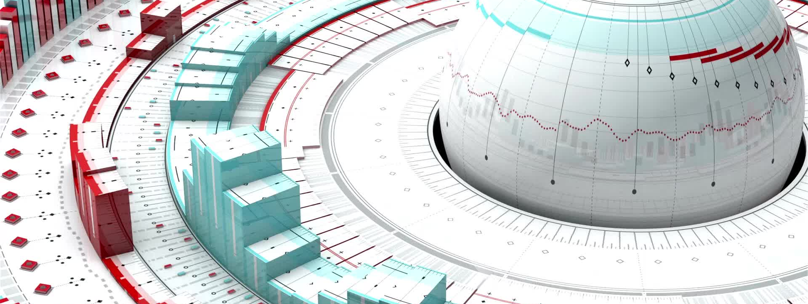
3. High Dimensional Analysis
Notes:
Finally, how do we analyze this high dimensional data?

Slide 27
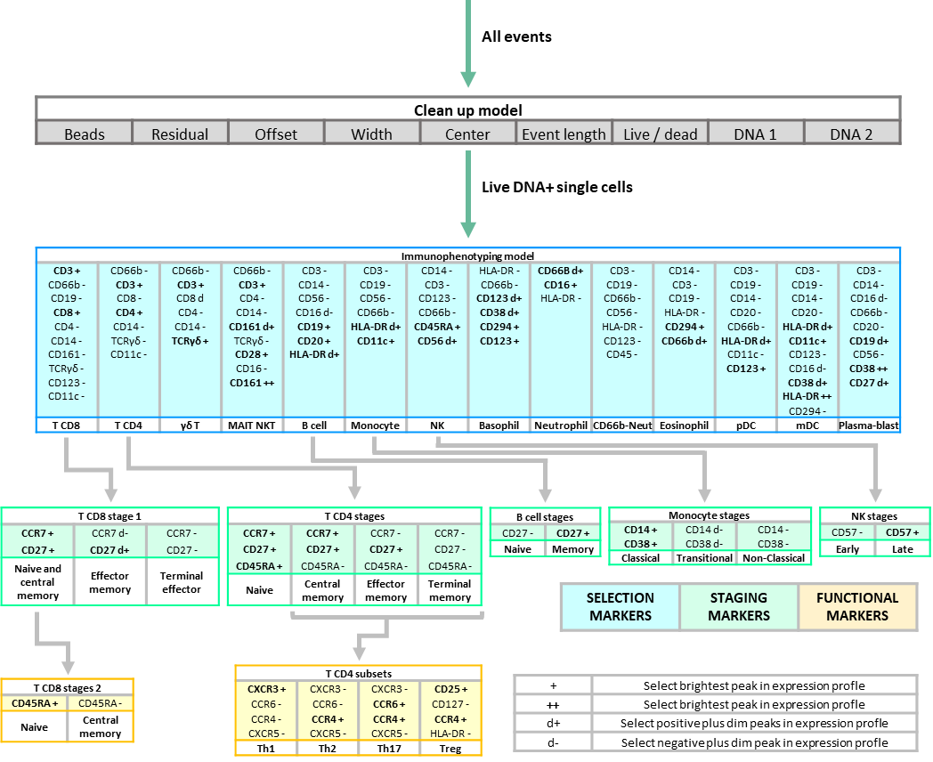
SETTING UP A NOVEL ANALYSIS METHOD
IN MASS CYTOMETRY:
2D MATERIALS PROFILING
Notes:
Here, we present a visual mass cytometry application involving a two-dimensional nanomaterial called bismuthene. Following blood collection, a whole blood sample was treated with bismuthene and then we performed single cell analysis using CyTOF to establish the analytical pipeline.

Slide 28
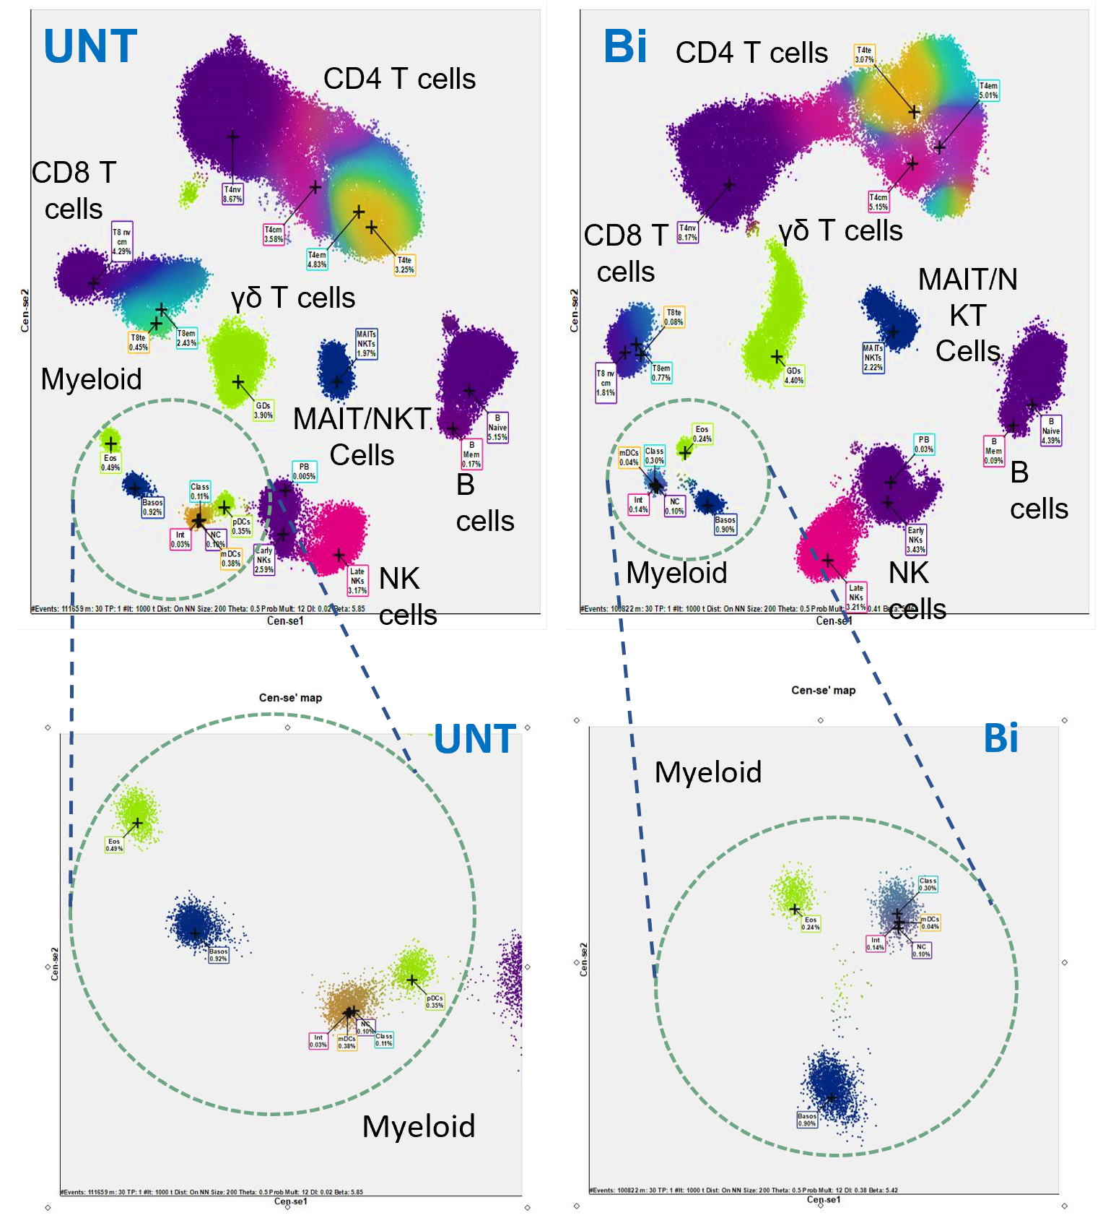
SETTING UP A NOVEL ANALYSIS METHOD
IN MASS CYTOMETRY:
2D MATERIALS PROFILING
UPTAKE
CEN-SE’ CLUSTERING
Giro L. et al. (in preparation)
Notes:
After establishing the analytical pipeline, we continued with high-dimensional analysis. The density heatmap reveals simultaneous uptake of bismuthene in 30 different immune subpopulations. Further analysis may provide insights into the percentage of uptake within each immune population.

Slide 29
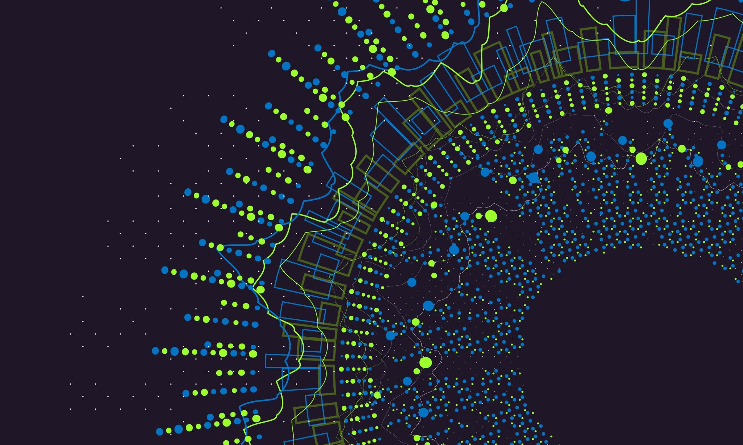
4. Applications
Notes:
Now, let’s look at the applications.

Slide 30
2020 publications topic areas (322 papers)
Notes:
The increasing number of articles referencing CyTOF underscores the important role of this technology in advancing scientific research, fostering multidisciplinary collaborations, and improving our understanding of complex biological systems at the single cell level. This trend is expected to continue as the technology evolves and new applications emerge.

Slide 31
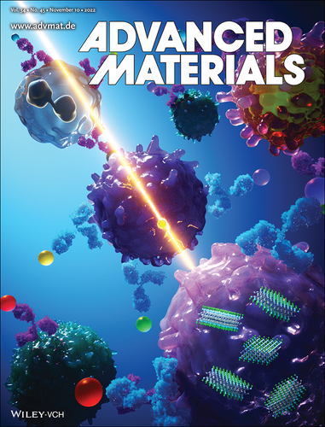
Notes:
In this publication, we described how Mxene can be detected by mass cytometry in multiple cells and tissues with a label-free strategy. Our approach is able to interrogate a wide range of cell parameters, the same ones that have been checked during various clinical trials.

Slide 32
2D materials -MXene
Two-dimensional (2D) transition metal carbides, carbonitrides and nitrides MXenes
Professor Yury Gogotsi
VahidMohammadi A. et al. The world of two-dimensional carbides and nitrides (MXenes). Science 2021. Doi: 10.1126/science.abf1581.
Notes:
In the field of materials science, a revolutionary class of ceramics called MXenes, pronounced ‘max-eens,’ emerged in 2011. A subset of the larger two-dimensional (2D) family, these materials are derived from a bulk crystal known as MAX.
Unlike traditional 2D ceramics, MXenes have extraordinary conductivity and volumetric capacity. Consisting of molecular layers derived from carbides and nitrides of early transition metals such as titanium, these materials have transcended disciplines, finding applications in fields ranging from energy storage to medicine and optoelectronics.
The formation of MXenes involves a unique process called exfoliation. Traditionally three-dimensional ceramics, such as titanium-aluminum carbide (Ti3AlC2), are exfoliated by treating them with hydrofluoric acid at room temperature. This chemical wizardry selectively removes aluminum, transforming the material into two-dimensional Ti3C2 nanosheets—the birth of graphene-like MXene.
In the MXene family nomenclature:
- M represents an early transition metal (Ti, V, Nb, etc.).
- X represents C and/or N.
- Tx represents surface terminations (usually -O, -OH, -Cl, and -F).
- n ranges from 1 to 4.
- x is a variable.
Important steps in MXene production include etching, breaking of strong metallic or covalent bonds, and delamination yielding colloidal solutions of single- or multilayer MXene flakes in water or polar organic solvents.
Biomedical applications have become a focus for MXenes, especially Ti-, Nb-, and Ta-based variants known for their non-toxicity. Biosensors, antibacterial materials, bioimaging agents, and therapeutics have emerged from the unique properties of MXene. A variety of biosensors have been developed that are adept at detecting small molecules ranging from NH3 to heavy metals. Moreover, MXenes exhibit the ability to inhibit bacterial growth.
Unlike their counterparts such as graphene, the high metallic conductivity of MXenes confers superior hydrophilicity, a very important property for biomedical purposes. Their ultra-thin nanostructures, combined with high photothermal conversion efficiency and localized surface plasmon resonance (LSPR) effect, open new horizons in photodynamic and photothermal therapy. The large surface area of ​​MXene nanosheets facilitates drug loading and delivery for disease treatment.
With over 30 stoichiometric compositions and a large number of predicted forms, MXenes have numerous applications promising a transformative impact on nanotechnology in daily life. Ti3C2, a well-known member of the MXen family, exhibits high bio- and immunocompatibility. Ongoing studies on the immune system point to the potential of MXenes in nanomaterial immunomodulation for autoimmune diseases.
In essence, MXenes are at the forefront of materials innovation, poised to reshape industries and healthcare with their versatile and unprecedented properties.

Slide 33
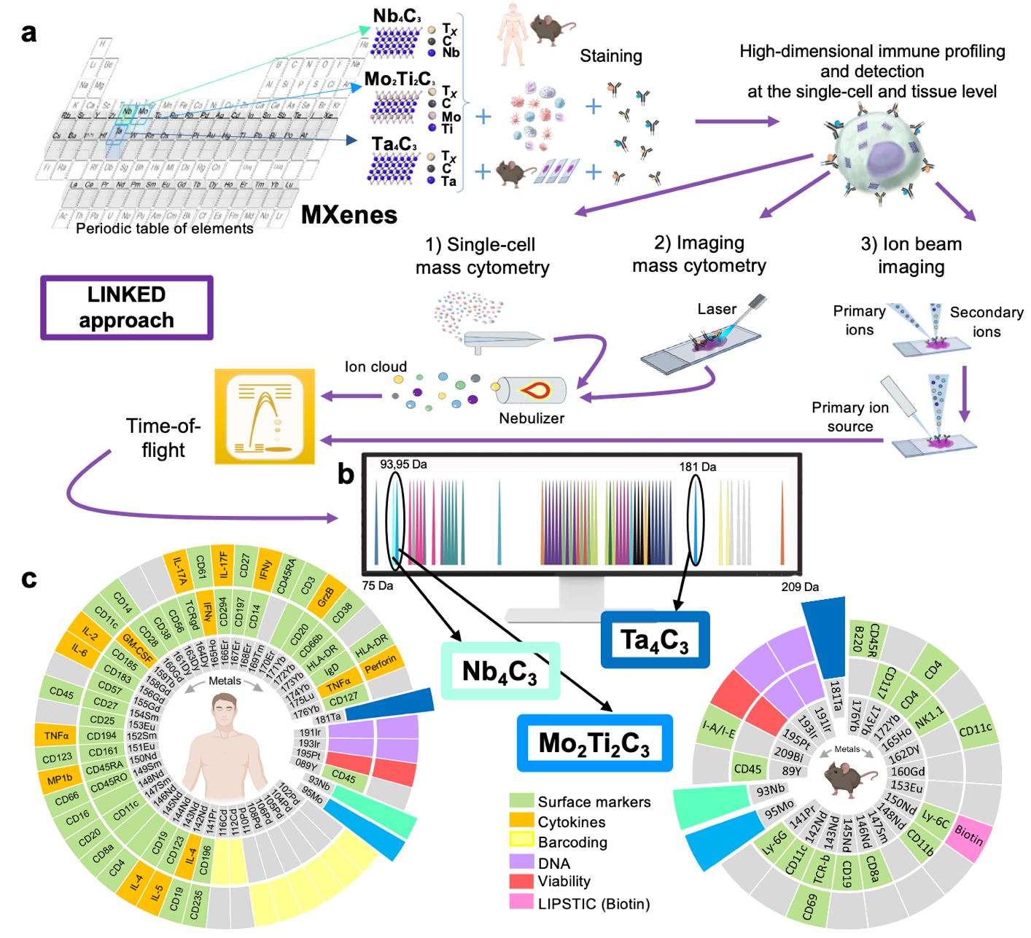
LINKED approach: Label-free sINgle-cell tracKing of 2D matErials by mass cytometry and MIBI-TOF Design
Notes:
There is a critical unmet need to detect and image 2D materials within single cells and tissues while collecting high-level information from single samples. Here, we propose a versatile, multiplexed, label-free single-cell detection strategy based on time-of-flight single-cell mass cytometry (CyTOF) and time-of-flight ion beam imaging (MIBI-TOF). This strategy, label-free single-cell tracking of 2D materials by mass cytometry and MIBI-TOF Design (LINKED), enables nanomaterial detection and simultaneous measurement of multiple cell and tissue properties. As a proof of concept, we selected MXenes, a set of 2D materials, to enable mass sensing in the cytometry range while avoiding overlap with the 70+ labels currently available, each capable of probing multiple biological parameters. We first demonstrated their detection and quantification in 15 primary human immune cell subpopulations. Along with detection, we used mass cytometry to capture various biological aspects of MXenes, such as their biocompatibility and cytokine production after uptake. We simultaneously assessed the mediation of cell-cell interactions by MXenes via enzymatic labeling. In vivo biodistribution experiments using a MXene mixture in mice confirmed the versatility of our detection strategy and revealed MXene accumulation in liver, blood, spleen, lungs, and relative immune cell subtypes. Finally, we applied MIBI-TOF to detect MXenes in different organs. Label-free detection of 2D materials by mass cytometry at the single-cell level, in multiple cell subpopulations, and in multiple organs simultaneously will enable exciting new opportunities in biomedicine.

Slide 34
Label-free sINgle-cell tracKing of 2D matErials by mass cytometry and MIBI-TOF Design (LINKED)
Fusco et al. Advanced Materials, (2022)
Notes:
Label-free tracking of 2D materials by mass cytometry and MIBI-TOF design" (LINKED) approach.
a Selection of CyTOF-visible elements shown in gray in the periodic table to synthesize biocompatible MXenes: Nb4C3, Mo2Ti2C3, and Ta4C3; a schematic representation is also shown for their detection in cells and tissues using three mass cytometry-based methods (single cell mass cytometry, imaging mass cytometry, and ion beam imaging).

Slide 35
Label-free sINgle-cell tracKing of 2D matErials by mass cytometry and MIBI-TOF Design (LINKED)
Fusco, Gazzi et al. Advanced Materials, (2022)
Notes:
Mass cytometry and label-free tracking of 2D materials with MIBI-TOF design (LINKED) approach.
b, Mass cytometry allows detection of stable isotope masses from 75 Da to 209 Da. Color images represent all current metal labels used on CyTOF. Here, MXenes designed by LINKED are placed in uncharted channels. Detection of Nb4C3, Mo2Ti2C3, and Ta4C3 is allowed in the 93Nb, 95Mo, and 180Ta channels, respectively.
c, MXene compatibility with current commercial labels used in this study: a total of 48 isotopes were used for human ex vivo, and ex vivo and in vivo mouse experiments. A total of 76 mass cytometry probes (56 for human and 21 for mouse) were used for assessment of viability, cytokine detection, cluster of differentiation (CD) markers, palladium and cadmium-based barcoding, DNA staining, and biotin detection. has been used.

Slide 36
MXene tracking in human immune cells
at the single-cell level
Fusco, Gazzi et al., Advanced Materials, (2022)
Notes:
Here are some of the results that reached up to 80% of Mxene uptake into cells at a very short time point.
MXenes can be detected at the single cell level without additional chemical functionalization
The tracking of 2D materials is critical to expanding the biomedical applications of these materials. Therefore, we investigated the possibility of detecting MXenes at the single cell level with CyTOF and interrogating multiple cellular parameters simultaneously. To this end, we selected the complex PBMC pool, consisting of a wide variety of immune cell subpopulations, as an ideal ex vivo model for a proof-of-concept study to develop LINKED.
We used CyTOF to investigate the potential detection of Nb4C3, Mo2Ti2C3, and Ta4C3 and to reveal their immunological effects on individual cells. In this study, the specific atomic masses of the selected 2D materials enabled the mass spectrometric detection of Nb4C3, Mo2Ti2C3, and Ta4C3 in the niobium (93Nb), molybdenum (95Mo), and tantalum (180-181Ta) channels, respectively. Using a panel of 61 metal-labeled antibodies, we identified 15 different immune cell types based on the expression profiles of various cluster of differentiation (CD) markers present on their cell surfaces.
Among the MXenes, Nb4C3 had the strongest signal and showed extensive interaction with all identified immune cell subpopulations. In particular, dendritic cells (DCs) showed the most prominent binding to Nb4C3. Mo2Ti2C3 and Ta4C3 showed similar single-cell signal levels and were similarly traceable across many immune subsets. However, compared to Ta4C3, Mo2Ti2C3 had a greater ability to interact with cells in general, especially DCs.
Tracking of MXene at the single cell level in human PBMCs.
a-f, PBMCs were incubated with 50 µg/mL Ti3C2, Nb4C3, Mo2Ti2C3, or Ta4C3 for 24 h and stained for mass cytometry analysis. Representative tSNE for each MXene showing single cell signal intensity compared to control (Ctrl); intensity is shown from blue (low interaction) to red (high interaction) (a). Heatmaps reporting the median intensity of MXene for each specific channel across all identified major immune cell subpopulations (b-d). Grouped bar graphs showing Nb4C3, Mo2Ti2C3 and Ta4C3 median intensity (e) and percentage of positive cells for all replicates in all identified PBMC subpopulations (f).

Slide 37
MXene detection in human PBMCs by imaging mass cytometry (IMC)
Fusco, Gazzi et al., Advanced Materials, (2022)
Notes:
Additionally, we evaluated the MXene interaction and detection by IMC on human PBMCs. All 2D materials were successfully identified by IMC and their signals were mutually exclusive of those of DNA, indicating that they do not localize to cell nuclei. Detection of MXene in human PBMCs by imaging mass cytometry (IMC). Panel I represents IMC images reporting single cell tracking of Nb4C3, Mo2Ti2C3, or Ta4C3 in green. Panel II represents IMC images reporting DNA signal in blue and light blue. Panel III represents IMC images reporting a combined image of DNA (blue) and Nb4C3, Mo2Ti2C3, or Ta4C3 (green). All experiments were performed in triplicate and are shown as mean±SD.

Slide 38
Questions and Discussion
QUESTION AND ANSWER
SHARING EXPERIENCES
LET'S SUMMARIZE
Notes:
Please review the books and other documents on our website to obtain more detailed information on the subject. You can use our social media accounts for any questions or concerns you may have.

Slide 39
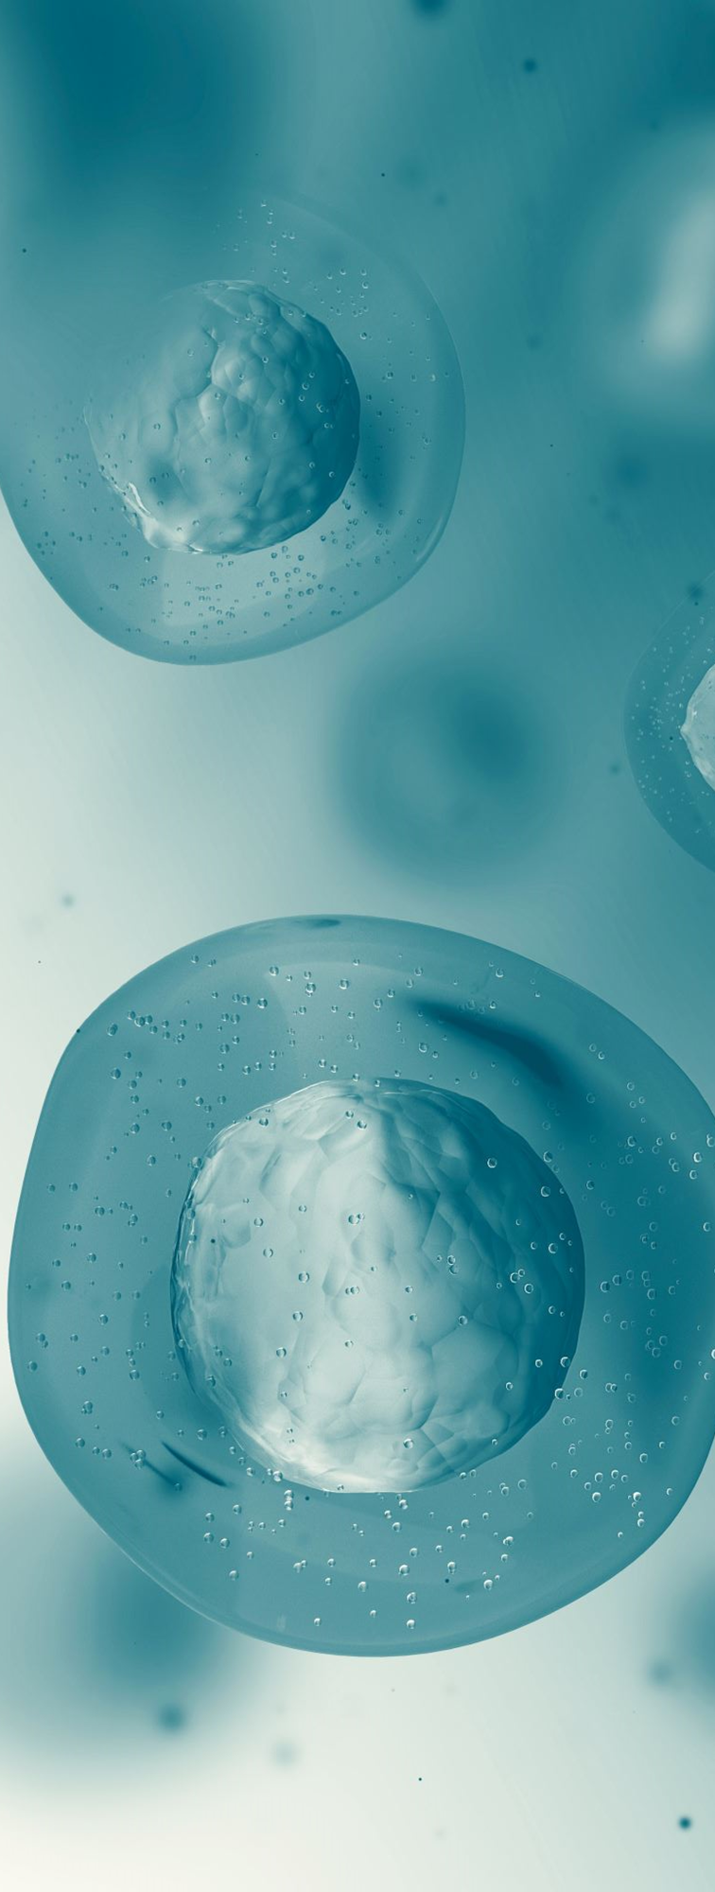
Xcelligence Analysis Nanotechnology and Applications of Nanoparticles in Medicine Summary
Nanomedicine: new, interdisciplinary research field
Focuses on drug delivery and diagnostics
Uses high-dimensional approaches on immune cells
Notes:
Let's summarize what we talked about and see how this course helps us achieve our learning objectives...
Nanomedicine is a very new field of research and has become the focus of scientists from all over the world and in many different disciplines.
Nanomedicine is the application of nanotechnologies in medicine; especially in therapeutic approaches including drug delivery, diagnostic and imaging methods, and regenerative medicine.
High-dimensional approaches, especially innovative approaches such as single-cell mass cytometry (CyTOF) or imaging mass cytometry, can be used to evaluate the effect of nanoparticles on immune cells.

Slide 40
Additional Resources
https://www.sciencedirect.com/journal/nanomedicine-nanotechnology-biology-and-medicine
https://nanohub.org/resources/36541

Slide 41
Project Partners

Slide 42
This document was prepared for the Erasmus Project "2022-1-TR01-KA220-VET-000088373
A UNIVERSAL STRATEGIC NECESSITY: FROM MOLECULE TO DRUG»
"”Supported by the European Commission within the scope of the Erasmus+ Programme. However, the European Commission and the Turkish National Agency cannot be held responsible for the opinions expressed here."
Notes:
A universal necessity: From Molecule to Drug Project
"Supported by the European Commission within the Erasmus+ Programme.
However, the European Commission and the Turkish National Agency cannot be held responsible for the views expressed here."

Slide 43
THANK YOU
Notes:
We would like to thank the European Commission for their support of our project, all our members who contributed to the project team, and everyone who participated in the activities within the scope of the project.

