Slide 1
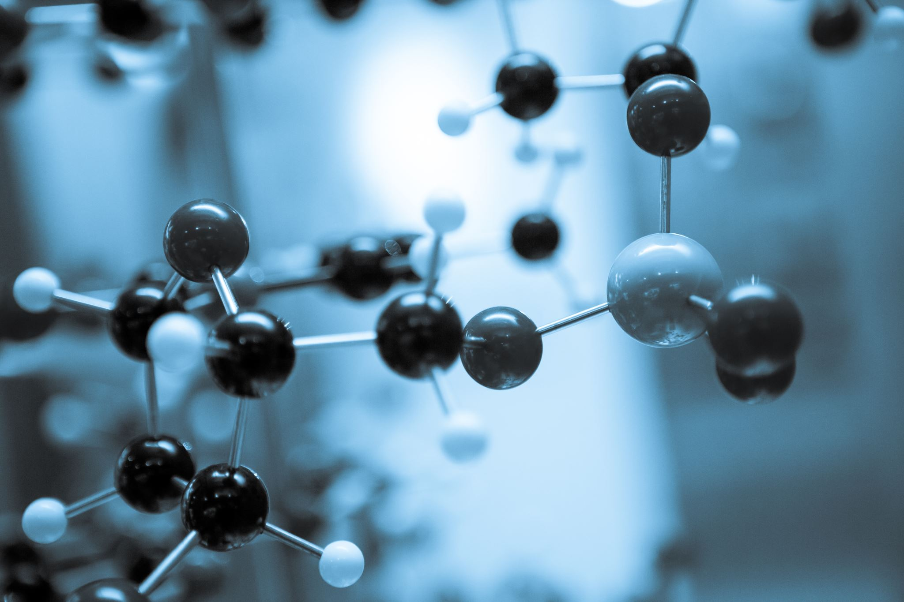
RESEARCH 4: Bioinformatics & Pharmaco-genomics
From Molecule to Drug
PROF. DR. NUNO OSORIO
Notes:
Hello, welcome to this presentation on the fascinating topics of Bioinformatics and Pharmacogenomics. In this presentation, we will see how bioinformatics and omics technologies are transforming drug development and embodying the concept of pharmacogenomics. We will also discuss the challenges and opportunities of these fields and introduce you to some possible solutions to overcome the challenges in the field.

Slide 2
Learning Objectives
Discuss
Recognize
Explore
how bioinformatics and omics technologies are transforming drug development and materializing the concept of pharmacogenomics.
the challenges faced by bioinformatics and omics related to data quality, volume, dimensionality, reproducibility, standardization, ethics, and privacy
web applications for bioinformatics analyses using Shiny and Streamlit frameworks, their potential and limitations.
Be able
to suggest strategies and methods to overcome these challenges
Notes:
By the end of this presentation, you’ll have a better understanding of how bioinformatics and omics technologies are revolutionizing the field of drug development, and you’ll be able to identify some of the limitations and challenges in the field and some of the best practices and techniques to overcome them.

Slide 3
Agenda
Overview of bioinformatics and omics technologies
Examples of pharmacogenetics
Challenges in bioinformatics
Directions to overcome challenges in bioinformatics
Conclusion

Slide 4
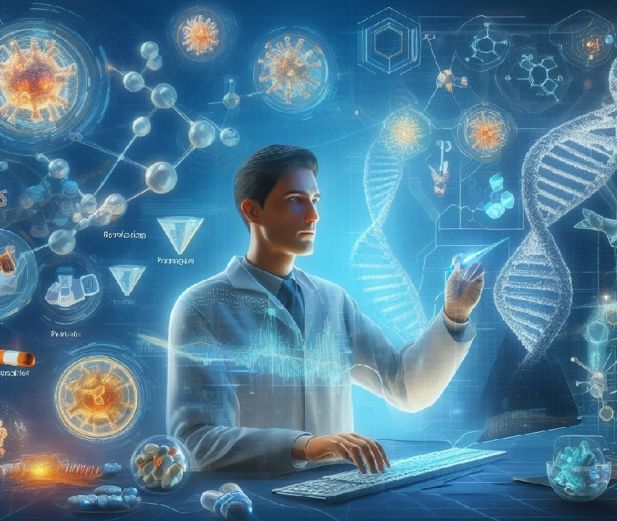
Introduction
Bioinformatics and Omics:
Revolutionizing drug development
Pharmacogenomics:
Personalizing drug therapies
Source: generated by DALL-E 3 from a text prompt.
Notes:
Bioinformatics uses computational methods to analyze large and complex biological data, such as DNA, RNA, proteins, and metabolites (Omics data). These data can reveal the molecular mechanisms of diseases, the effects of drugs, and the variations among individuals. Pharmacogenomics can help tailor drug therapies to each individual’s genetic profile, taking into account their metabolism, sensitivity, and resistance to drugs. Bioinformatics and omics technologies support pharmacogenomics by evaluating drug efficacy and safety, and optimize their dosage and delivery. They can also help identify new targets, biomarkers, and pathways for drug discovery and development. Bioinformatics, omics technologies and pharmacogenomics are revolutionizing the field of drug development, and can improve the effectiveness and safety of drugs, reduce adverse reactions and side effects. They can also help discover new drugs for rare or complex diseases that are difficult to treat with conventional drugs. In the next slides, I will explain these topics in more detail.

Slide 5
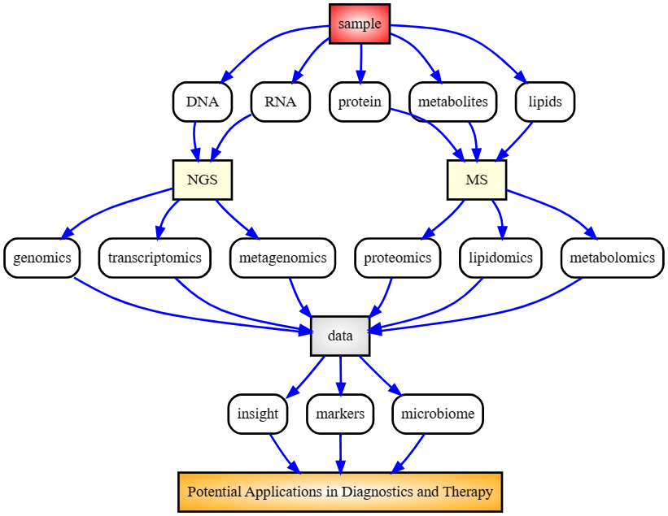
Bioinformatics and Omics Technologies
Overview of Bioinformatics and Omics. Source: Created by Nuno S. Osorio using DOT language.
Notes:
Let’s start by examining the workflow of bioinformatics analysis applied to various types of biological samples. Initially, we collect the biological sample, which could be from a patient, an animal model, or a cell line. The sample might be blood, tissue, saliva, or any other biological material. Depending on the sample type, we employ different protocols to extract molecules such as DNA, RNA, proteins, metabolites, or lipids. Subsequently, we quantify and characterize these molecules. For DNA and RNA, we utilize next-generation sequencing (NGS) platforms like Illumina or Nanopore. For proteins, metabolites, and lipids, we apply mass spectrometry (MS) methods. Following this, we analyze the data generated by these techniques using various bioinformatics tools. For DNA, we employ genomics tools to align the sequences to a reference genome, identify variants, or perform de novo assembly. For RNA, we use statistical methods to quantify gene expression levels at the transcript level. For both DNA and RNA, we can also use metagenomics tools, such as Blast, to characterize the microbiome composition. For proteins, metabolites, and lipids, we utilize proteomics, metabolomics, and lipidomics tools to identify and quantify the molecules. Finally, we analyze the data from different sources and extract biological insights. This analysis can be conducted separately for each sample type or integrated in a multiomics analysis. We employ visualization tools to explore the data and identify patterns and correlations. We also use statistical and machine learning tools to perform analysis and annotation, and to discover biomarkers that can distinguish between different conditions or groups. These results can then potentially be used for clinical applications, paving the way for pharmacogenomics.

Slide 6
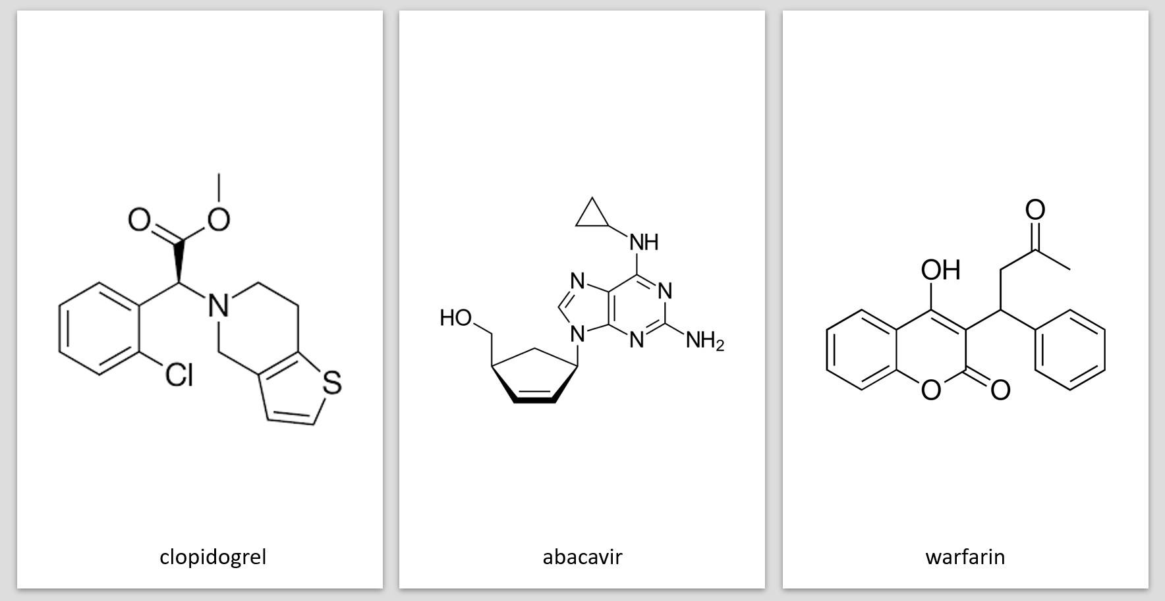
Pharmacogenomics: A New Era in Medicine
Source: public domain.
Clopidogrel activation by CYP2C19
Warfarin dosing based on VKORC1 and CYP2C9 genotypes
Abacavir hypersensitivity in HLA-B*5701
Cancer treatment targeting EGFR, KRAS, and BRCA mutations.
Notes:
Let’s explore some concrete examples of how pharmacogenomics can enhance and personalize drug development and the resulting treatment. The first two examples involve tailoring drug dosage. Clopidogrel and Warfarin are both blood thinners, but they work in different ways and their effectiveness can be influenced by an individual’s genetic makeup. Clopidogrel prevents blood clots and requires activation by an enzyme called CYP2C19 in the liver. However, certain individuals possess genetic variants that reduce the activity of CYP2C19, rendering Clopidogrel less effective. On the other hand, Warfarin functions by inhibiting an enzyme called VKORC1, which is involved in blood clotting, and its optimal dose varies widely among individuals, depending on their genetic variants of VKORC1 and CYP2C9, another enzyme that metabolizes Warfarin. Pharmacogenomics can help identify these genetic variants to adjust the dose or switch to another drug, enhancing the safety and efficacy of these treatments. The other examples relate to the evaluation of a drug’s safety and efficacy based on an individual’s genetic profile. Abacavir is an antiviral drug used to treat HIV infection. However, some people experience a severe allergic reaction to Abacavir, which can be life-threatening. This reaction is linked to a genetic marker called HLA-B*5701, present in about 5% of the population. This knowledge allows for screening of this HLA haplotype before prescribing Abacavir, thereby avoiding the risk of hypersensitivity. In the realm of cancer treatment, there are also remarkable examples of successful applications of pharmacogenomics. For instance, EGFR is a protein that stimulates cell growth and is mutated in some lung cancers. Drugs that inhibit EGFR can eliminate these tumors. However, some tumors also have mutations in KRAS, another protein that activates cell growth. These tumors are resistant to EGFR inhibitors. Pharmacogenomics can help test for EGFR and KRAS mutations and select the most effective treatment. Additionally, BRCA is a gene that repairs DNA damage and is mutated in some breast and ovarian cancers. Drugs that interfere with DNA repair can kill these cancer cells. Pharmacogenomics can help identify BRCA mutations and offer personalized therapy. Pharmacogenomics has also been applied to rare diseases such as Cystic Fibrosis.

Slide 7
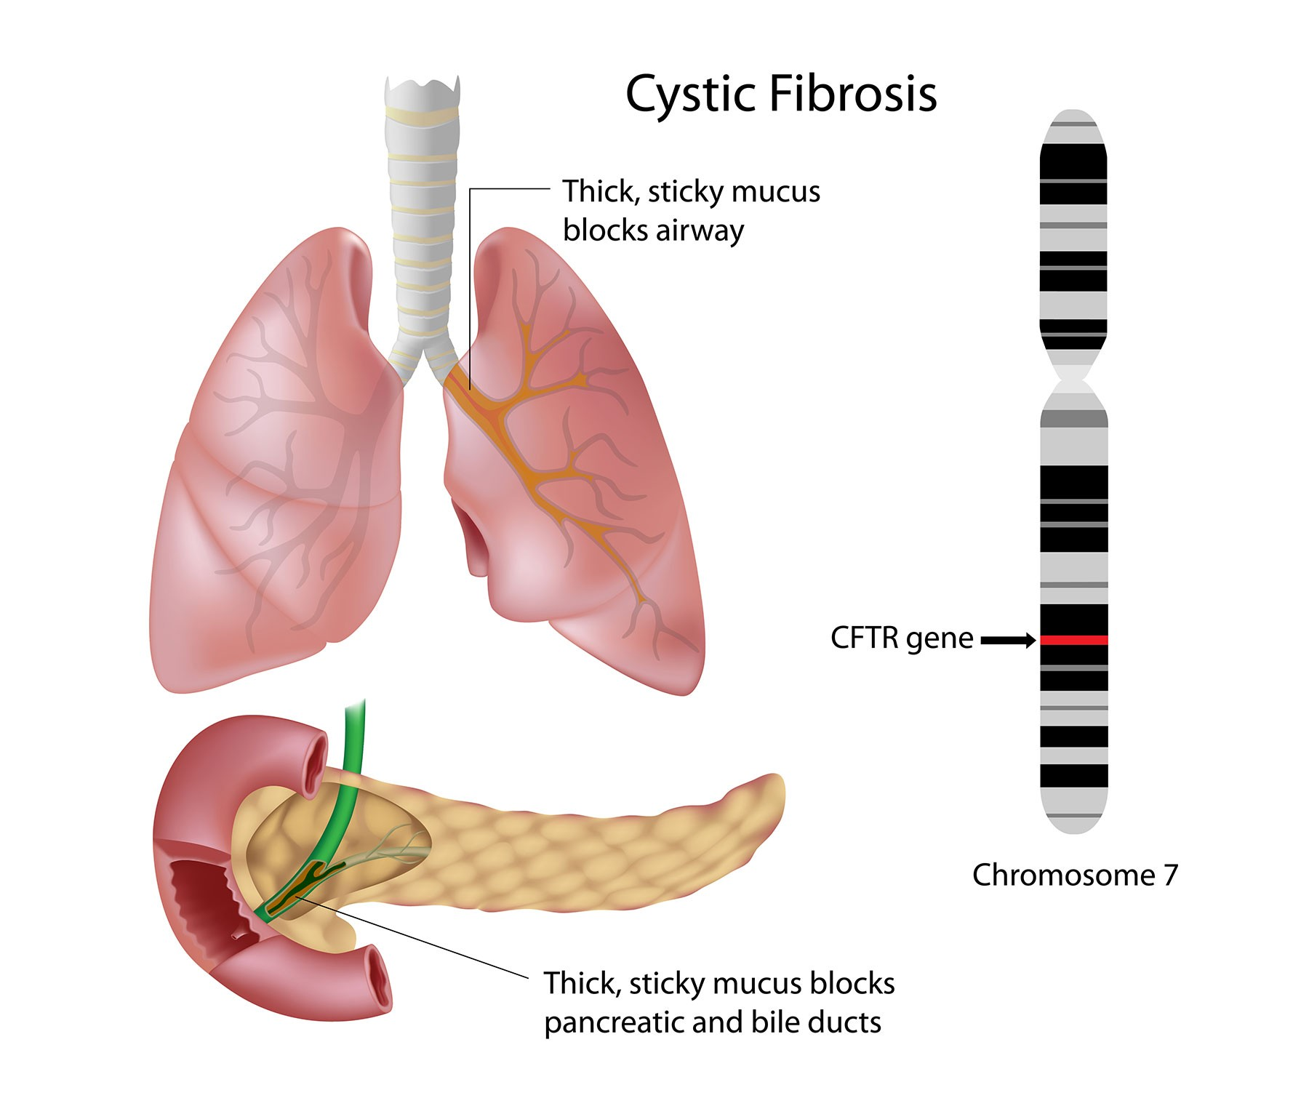
Pharmacogenomics: A New Era in Medicine
Ivacaftor: a bioinformatics and omics-driven drug for cystic fibrosis.
Genomics: screening of CFTR mutations in patients to select ivacaftor candidates.
Transcriptomics and Proteomics: assessment of CFTR expression and function in patient cells before and after ivacaftor treatment.
Causes of Cystic fibrosis. Source: https://www.cysticfibrosisdna.com/
Notes:
Cystic Fibrosis, a disease that affects the lungs and pancreas, is caused by mutations in the CFTR gene located on chromosome 7. These mutations disrupt the function of the protein deregulating the movement of chloride ions across cell membranes, resulting in thick and sticky mucus that clogs the airways and organs. Ivacaftor exemplifies a bioinformatics and omics-driven drug that restores the activity of the CFTR protein. It achieves this by binding to the protein and increasing its open probability. However, Ivacaftor is only effective for patients with specific mutations in the CFTR gene. Therefore, pharmacogenomics plays a crucial role in screening for CFTR mutations in patients to identify suitable candidates for Ivacaftor treatment. Furthermore, pharmacogenomics can assist in evaluating the expression and function of the CFTR protein in patient cells before and after Ivacaftor treatment, utilizing transcriptomics and proteomics techniques. Ivacaftor stands as a remarkable testament to how bioinformatics and omics can facilitate drug development and enable personalized medicine, even for rare diseases.
:

Slide 8
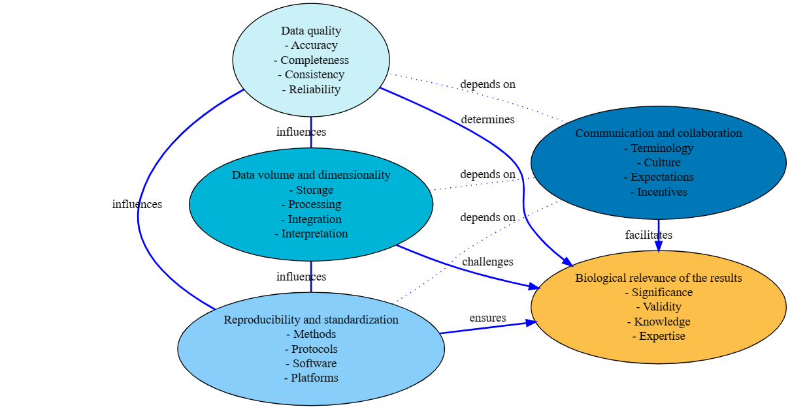
Challenges in Bioinformatics and Omics
Challenges in bioinformatics and omics. Source: Created by Nuno S. Osorio using DOT language.
Notes:
As we demonstrated, Bioinformatics and omics have revolutionized pharmacogenomics and personalized medicine, but they also face many challenges and limitations. Lets look at this diagram that illustrates some of these challenges, which are: Data Quality: How good is the data we use and generate? Poor data quality can lead to wrong conclusions and wasted resources. Data Volume and Dimensionality: How much and how complex is the data we deal with? High-throughput technologies produce huge amounts of data, which require efficient storage, processing, integration, and interpretation. Reproducibility and Standardization: How reliable and consistent are our results? We need to use the same or equivalent methods, protocols, software, and platforms to ensure the reproducibility of our results. Communication and Collaboration: How well do we share and integrate information and knowledge? We need to work together with different stakeholders, such as biologists, chemists, clinicians, computer scientists, statisticians, and engineers, etc to make the most of bioinformatics and omics. This is one of the most innovative aspects of this diagram being a very relevant but often overllooked. Biological Relevance of the Results: How meaningful and applicable are our results? We need to validate and translate our results into real-world applications. These challenges are interrelated and affect the biological relevance of the results. For example, the quality and volume of data can influence the reproducibility of results, while effective communication and collaboration can improve data quality and ensure the biological relevance of the results.”

Slide 9
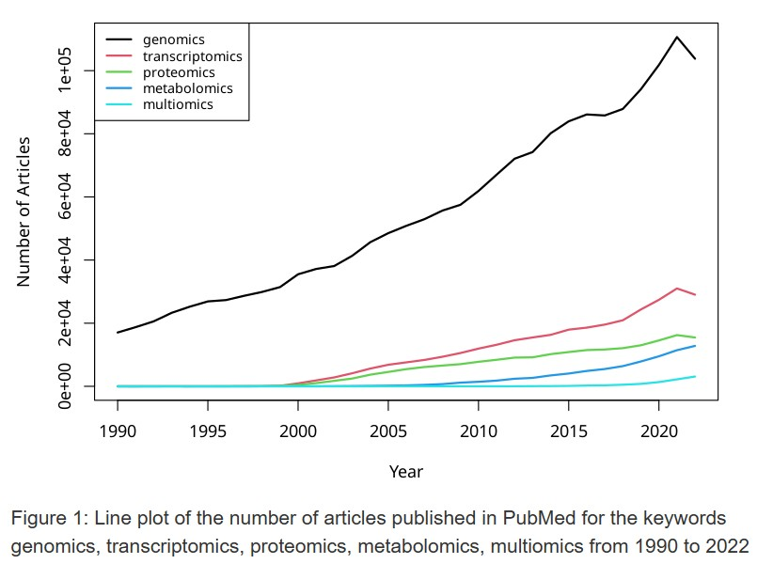
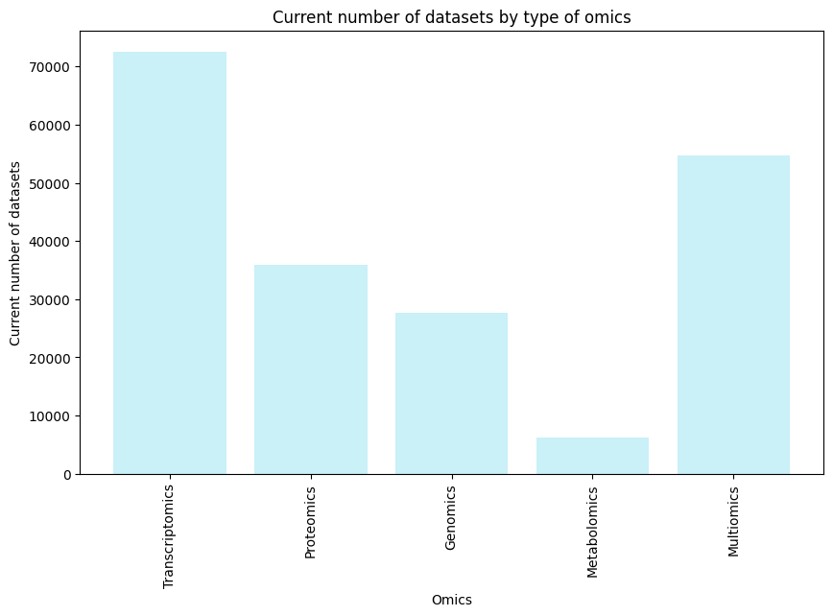
Large Volume of Data
Trends in NCBI of omics kewords. Created by NS. Osorio using R.
Datasets in OmicsDI (Nov.23). Created by NS. Osorio using Python
Notes:
Indeed, the challenge of handling large data volumes in bioinformatics and omics remains a significant hurdle. This challenge is likely to continue to expand as we can observe in the first plot, the trends of publication keywords in PubMed on the omics have continued to increase in recent years. To gain a sense of the number of datasets that these works generate, we can look at the second plot to view the data from OmicsDI. This platform provides a unique infrastructure to integrate datasets coming from multiple omics studies, including genomics, proteomics, transcriptomics, and metabolomics. Presently, they are cataloging several thousands of datasets, for instance, more than 70,000 transcriptomics datasets. However, the vast majority of these datasets were only explored by the original authors and are still to be re-analyzed and integrated. This highlights the untapped potential of these datasets and the need for computational techniques and tools for efficient omics data analysis.

Slide 10
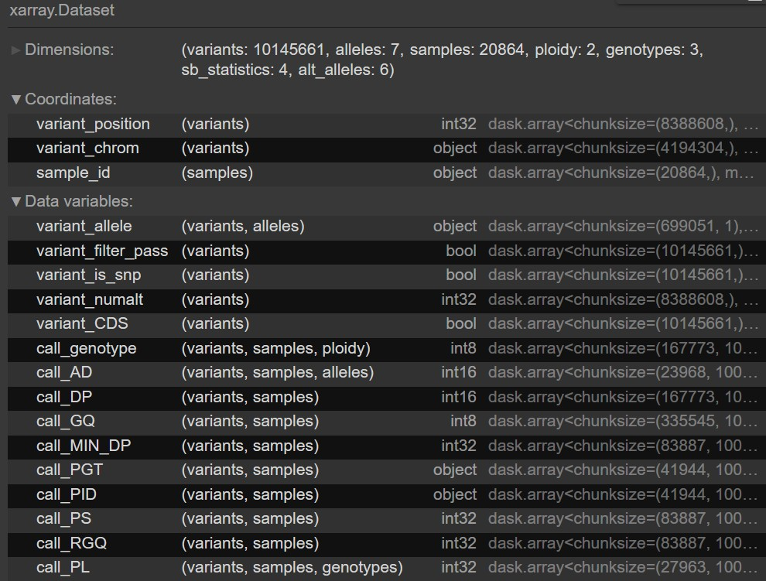
High Dimensionality
Omics data have many dimensions (genes, variants, proteins, metabolites, cells...)
Some dimensions are not meaningful and might obscure the analysis
Visualization of the xarray of MalariaGen release 7
Notes:
Another significant challenge affecting the field of bioinformatics and omics is the “curse of dimensionality”. This term refers to the phenomena that arise when analyzing and organizing data in high-dimensional spaces, such as those encountered in omics data, which do not occur in low-dimensional settings. Omics data have many dimensions, including genes, variants, proteins, metabolites, cells, tissues, populations, and more.An example of the complexity and high dimensionality of omics data is depicted in the image showing part of the data array from the MalariaGEN Pf7 data release. This release contains genome variation data on over 20,000 worldwide samples of Plasmodium falciparum, the parasite responsible for the most severe form of human malaria. The data includes millions of genetic variants in the parasite genome, representing a vast and complex multidimensional dataset.However, meaningful analysis of this data requires the removal of dimensions that are redundant or non-informative.

Slide 11
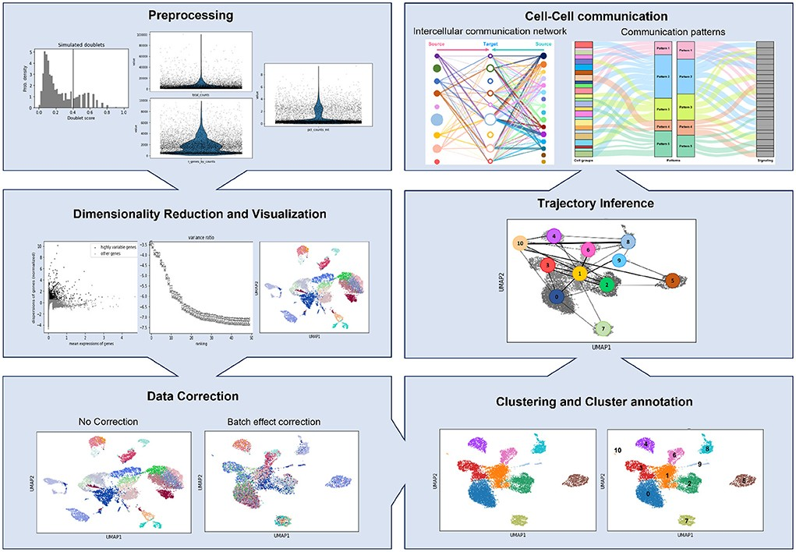
Standardization and Data Quality
Omics datasets are noisy, heterogeneous and complex (technical noise, batch effect, data stored in different formats, with different structures, etc.)
Example of scRNA-seq Analysis in Python. Source: 10.3389/fmicb.2022.989464
Notes:
Furthermore, omics datasets are noisy, heterogeneous and complex: Omics data come from different sources, platforms, and experimental designs and models, which introduce technical noise, batch effects, and overall data heterogeneity. These factors can affect the quality and reliability of the data and the analysis results. The slide shows an example of a single-cell RNA sequencing analysis pipeline, which includes several preprocessing and normalization steps, such as cell filtering, gene filtering, log transformation, scaling, batch correction, and dimensionality reduction. These steps help to improve the quality and interpretability of the scRNA-seq data.

Slide 12
Collaboration, Reproducibility and Privacy
Working in an open and highly collaborative environment.
Sharing data, code and containerized bioinformatics pipelines.
While, handling sensitive data, such as genomic data, ethically and ensuring its privacy.
Created by Nuno S. Osorio using Microsoft Designer.
Notes:
Various platforms such as Shiny, Streamlit, Docker, Nextflow, Galaxy, Github, among others, have revolutionized the field of bioinformatics. These platforms, meticulously designed to enhance accessibility, foster collaboration, and encourage scrutiny within the scientific community, provide an intuitive interface for sharing knowledge and perspectives as omics analysis unfolds. This promotes an open, highly collaborative, and reproducible environment. However, they also present new challenges related to privacy and ethical treatment of sensitive omics data. As we move towards a more open and collaborative scientific world, it is crucial to strike a balance between the utility of shared data and the privacy rights of individuals. Sensitive Omics data, which can include personal or identifiable information, must be handled with the utmost care. Current data-sharing policies are not uniform internationally and may not always have the needed safeguards to protect the rights of participants. Moreover, transparency in data collection, storage, and use is paramount. In the next slides, we will focus on how to overcome or at least mitigate some of the major challenges. Let's start by addressing the elephant in the room: Data size and dimensionality.
:

Slide 13
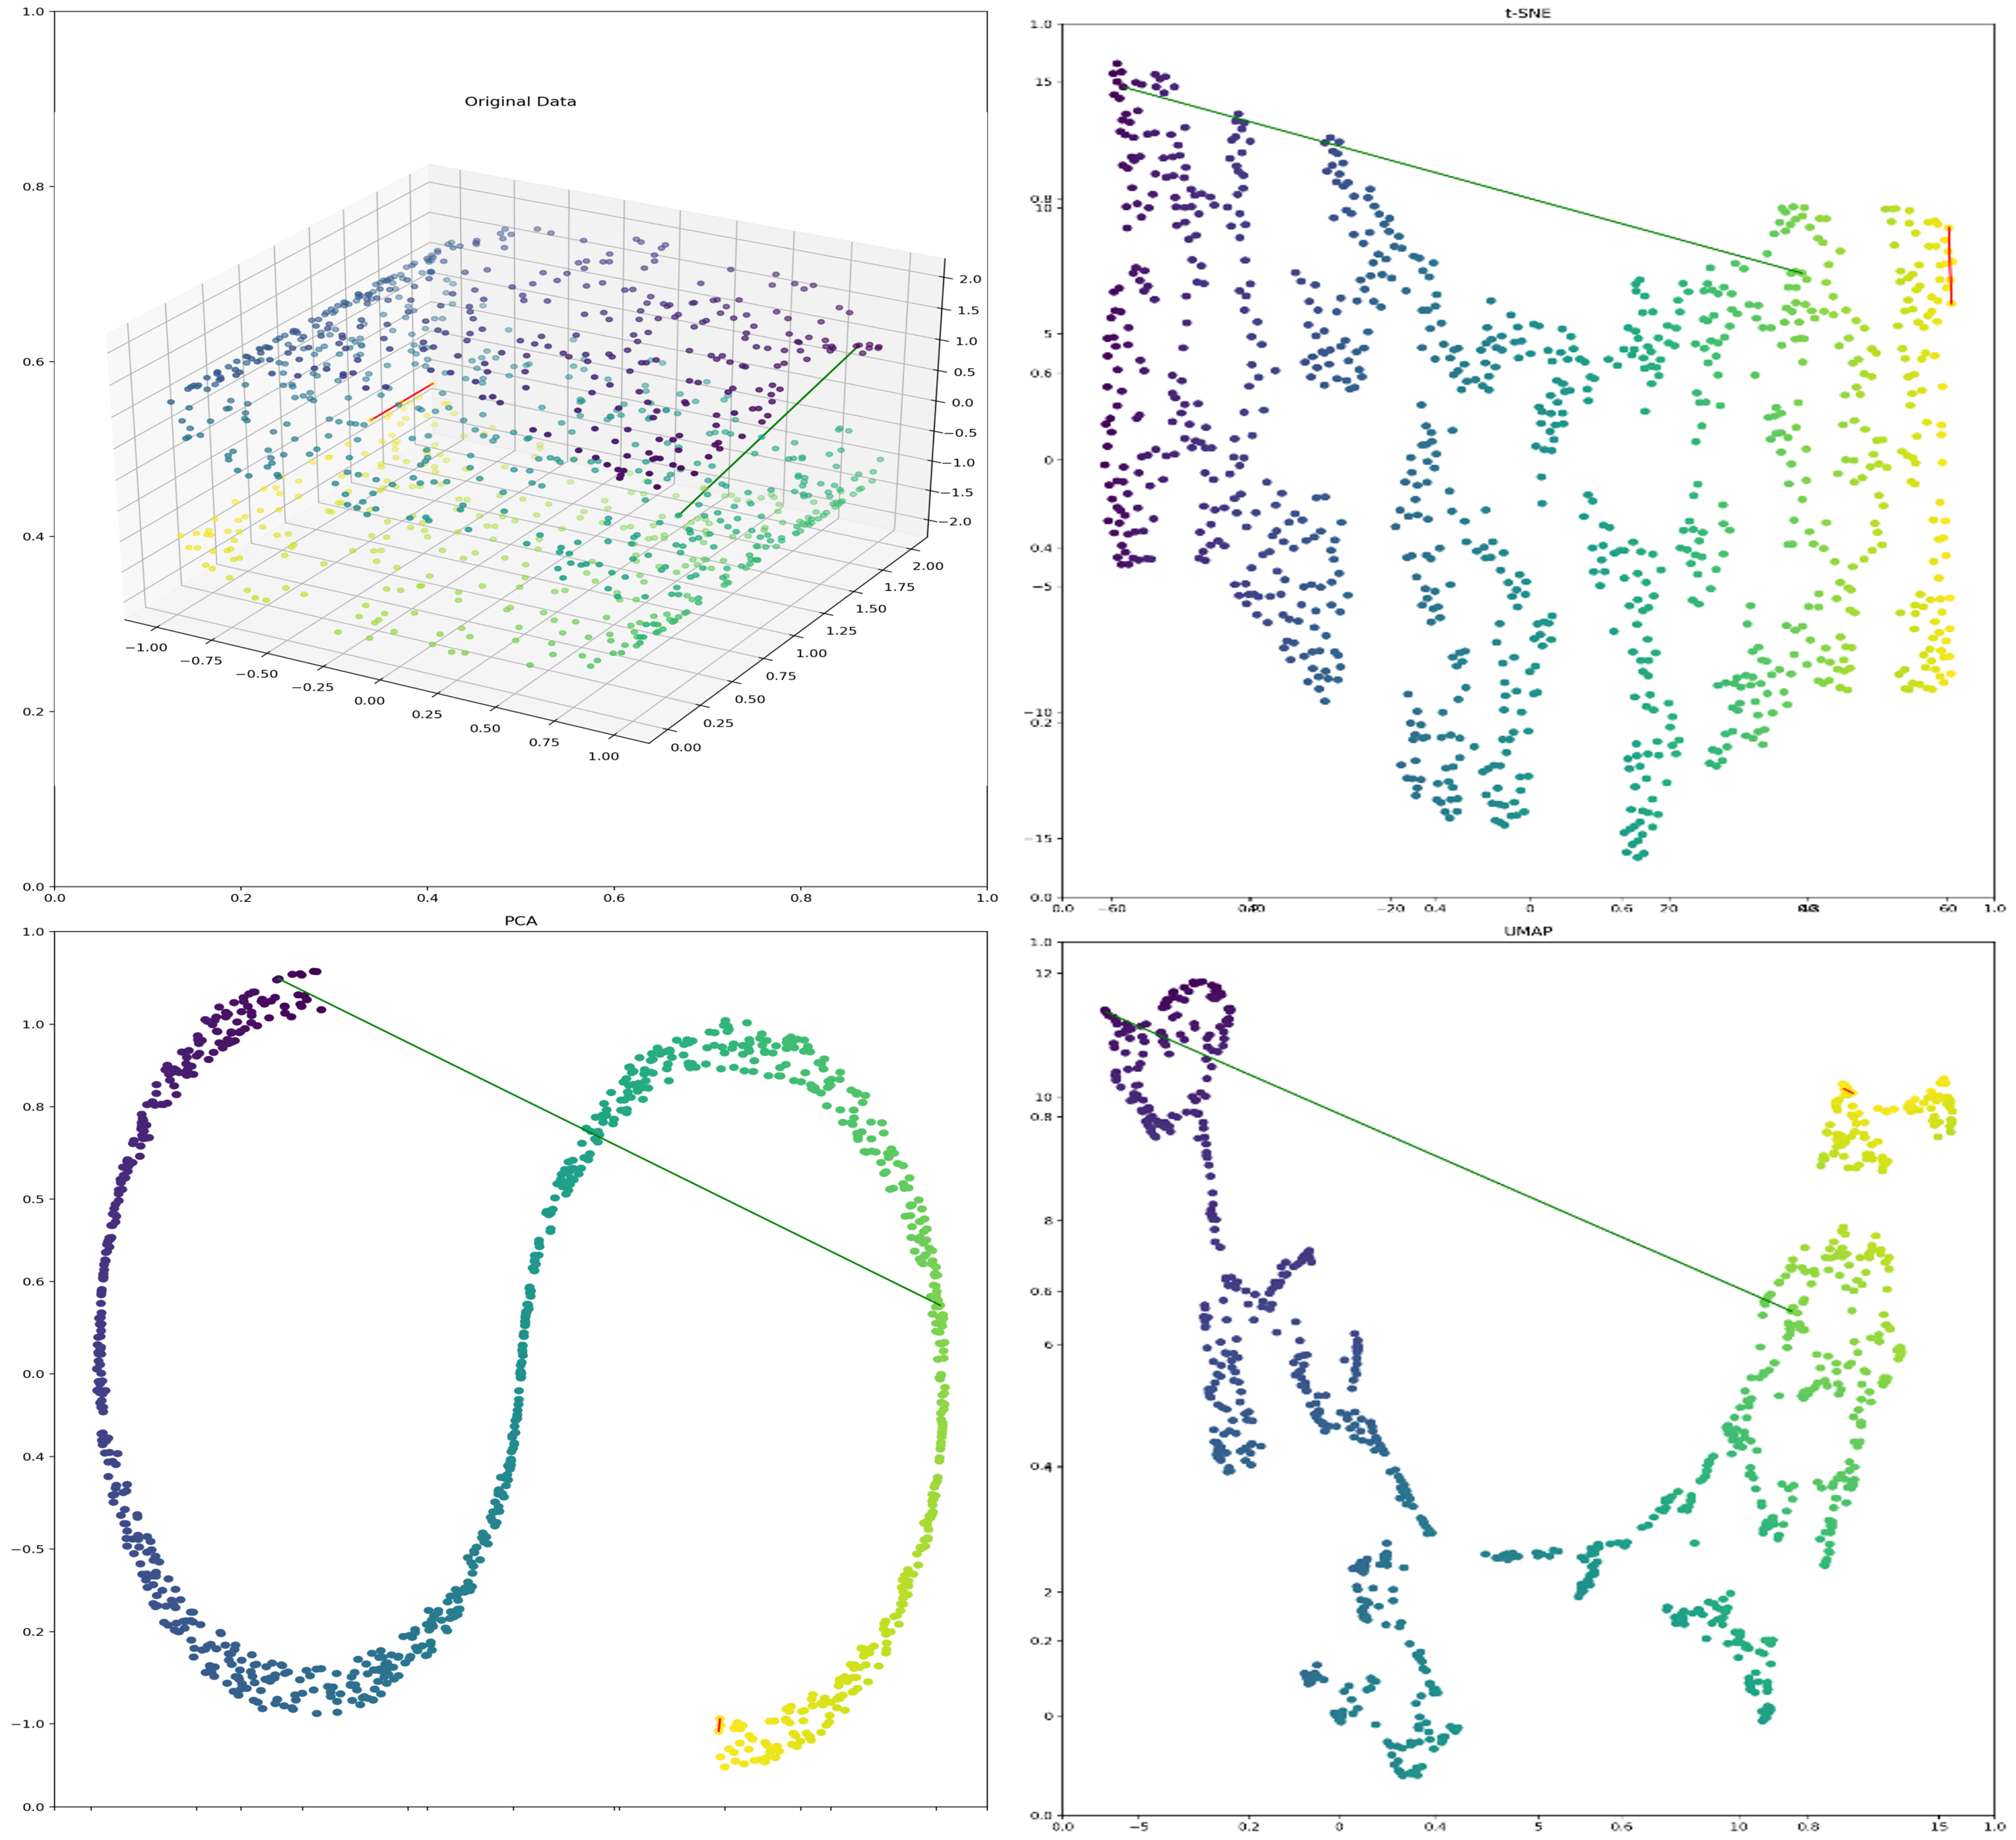
Overcoming Challenges: Size & Dimensionality
Memory efficient data objects for storage and manipulation (xarray, netCDF, HDF5, etc).
Dimensionality reduction techniques (PCA, UMAP, t-SNE, etc).
Dimensionality Reduction. Source: 10.1002/bmb.21800. Interactive version: http://reduce.streamlit.app
Notes:
While the size and dimensionality of omics data may seem overwhelming, we have a variety of tools and techniques at our disposal to manage this aspect. We can utilize memory-efficient data objects for storage and manipulation. Tools such as xarray, netCDF, HDF5 and others enable us to store large datasets efficiently and manipulate them easily. These tools allow us to handle substantial volumes of data without exhausting computational resources. However, managing the data is just the initial step. We also need to interpret it. This is where dimensionality reduction techniques prove invaluable. Techniques like PCA (Principal Component Analysis), UMAP (Uniform Manifold Approximation and Projection), and t-SNE (t-Distributed Stochastic Neighbor Embedding) assist us in distilling the essence of our data. They reduce the dimensionality of our data, thereby simplifying visualization and interpretation. It's important to note that these methods are based on different mathematical algorithms, each with its strengths and limitations. The reduction space is not a faithful reflection of the original multidimensional setting, but it provides a useful approximation for data exploration and pattern recognition. The image shows an example where the linear method PCA effectively reveals the general structure of the data. However, in some cases, it might not retain the distance between points as well as the non-linear methods UMAP and t-SNE. These nuances highlight the importance of understanding the underlying assumptions and characteristics of different dimensionality reduction techniques.
:

Slide 14
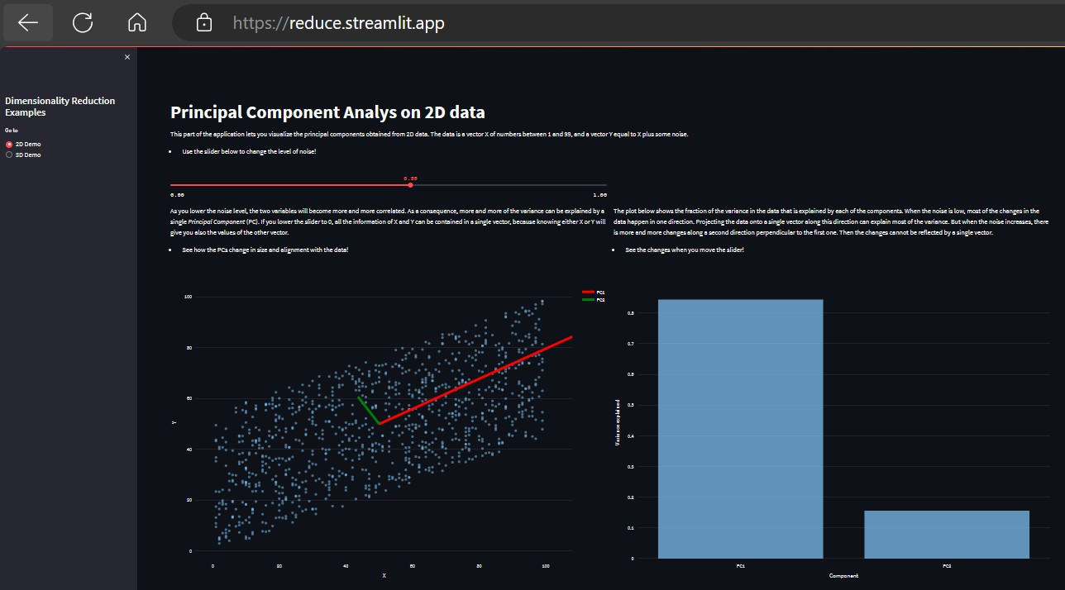
Overcoming Challenges: Collaboration
Streamlit and Shiny are tools for building data apps with Python and R, respectively.
These apps help teams explore different analyses and tools interactively.
Source: 10.1002/bmb.21800. Interactive version: http://reduce.streamlit.app
Notes:
We now move to a rapidly evolving and exciting aspect of bioinformatics: developing ways to enhance collaboration. Bioinformatics platforms have been developed to make the analysis more accessible and encourage collaboration between multidisciplinary teams of researchers and bioinformaticians. This is very relevant in complex fields such as drug discovery and development. These platforms allow the sharing of knowledge and views more intuitively as the omics analysis is taking place, enabling multidisciplinary research teams to influence in "live-mode" the path of bioinformatics analysis. Streamlit and Shiny are tools for building data apps with Python and R, respectively. Here you can see an example of an app developed using Python and Streamlit you can visit the app and see it allows the user to interact in real time and adjust parameters in the analysis.
:

Slide 15
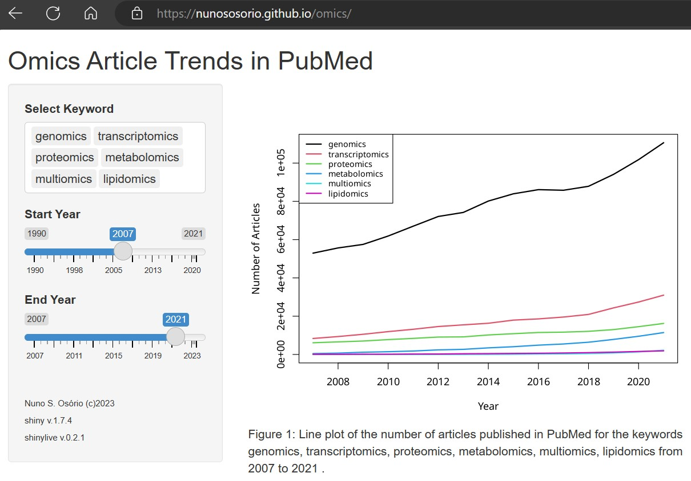
Overcoming Challenges: Collaboration
Shiny and Streamlit apps need a web server with R or Python.
ShinyLive apps can run on a static web server, which can be more flexible and private.
ShinyLive apps may load slowly and lack some packages.
Interactive data app build with Shinylive: https://nunososorio.github.io/omics/
Notes:
Shiny and Streamlit apps need a web server with R or Python. Contrastingly, ShinyLive apps can run on a static web server, which can be more flexible and private. However, ShinyLive apps may load slowly and lack some packages. Here you can see an example of an interactive data app built with ShinyLive. If you visit the URL, you'll see that the app takes around 30 seconds to load, but once loaded it has good performance and allows easily customizing the data analysis parameters. With this note, we end this presentation.
:

Slide 16
Questions and Discussion
QUESTION AND ANSWER
SHARING EXPERIENCES
LET'S SUMMARIZE
Notes:
Please review the books and other documents on our website to obtain more detailed information on the subject. You can use our social media accounts for any questions or concerns you may have.

Slide 17
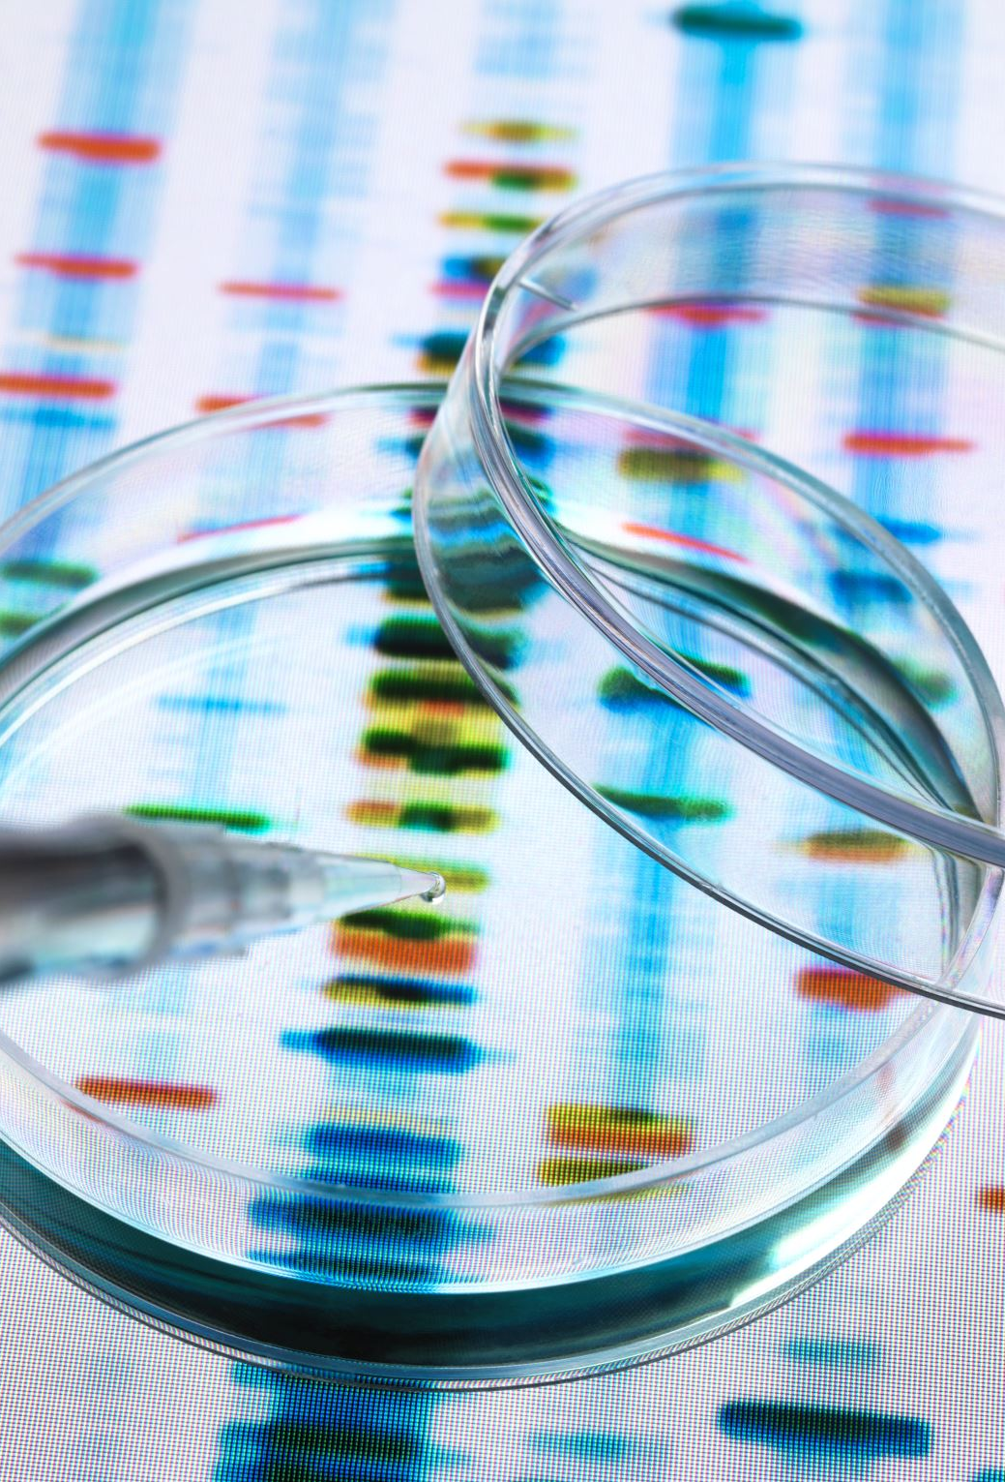
Conclusion
Bioinformatics and omics help us develop and personalize drugs based on molecular data.
Challenges of bioinformatics and omics, include data quality, reproducibility, ethics, and privacy.
The potential and risks of bioinformatics and omics for medicine and health care include improving drug efficacy, safety, and personalization, as well as addressing ethical, legal, and social issues.
Notes:
We learned how bioinformatics and omics help us develop and personalize drugs based on molecular data. We saw examples like ivacaftor and warfarin. We discussed the challenges of bioinformatics and omics, such as data quality, reproducibility, ethics, and privacy. We suggested strategies and methods to overcome them. We highlighted the potential and risks of bioinformatics and omics for medicine and health care, such as improving drug efficacy, safety, and personalization, as well as addressing ethical, legal, and social issues. We how this was interesting and useful. Thank you for your attention.

Slide 18
Additional Resources
Afgan, Enis et al. (May 2018). “The Galaxy platform for accessible, reproducible and collaborative biomed- ical analyses: 2018 update”. In: Nucleic Acids Research 46.W1, W537–w544. issn: 0305-1048. doi: 10.1093/nar/gky379. eprint: https://academic.oup.com/nar/article-pdf/46/W1/W537/ 25110642/gky379.pdf. url: https://doi.org/10.1093/nar/gky379.
Argelaguet, Ricard et al. (June 2018). “Multi-Omics Factor Analysis—a framework for unsupervised inte- gration of multi-omics data sets”. In: Molecular Systems Biology 14.6. issn: 1744-4292. doi: 10.15252/ msb.20178124. url: http://dx.doi.org/10.15252/msb.20178124.
Armitage, Emily G. and Andrew D. Southam (Aug. 2016). “Monitoring cancer prognosis, diagnosis and treatment efficacy using metabolomics and lipidomics”. In: Metabolomics 12.9. issn: 1573-3890. doi: 10.1007/s11306-016-1093-7. url: http://dx.doi.org/10.1007/s11306-016-1093-7.

Slide 19
Project Partners

Slide 20
This document was prepared for the Erasmus Project "2022-1-TR01-KA220-VET-000088373
A UNIVERSAL STRATEGIC NECESSITY: FROM MOLECULE TO DRUG»
"”Supported by the European Commission within the scope of the Erasmus+ Programme. However, the European Commission and the Turkish National Agency cannot be held responsible for the opinions expressed here."
Notes:
A universal necessity: From Molecule to Drug Project
"Supported by the European Commission within the Erasmus+ Programme.
However, the European Commission and the Turkish National Agency cannot be held responsible for the views expressed here."

Slide 21
THANK YOU
Notes:
Projemize desteklerinden ötürü Avrupa Komisyonu’na ve proje ekibinde yer alarak katkıda bulunan tüm üyelerimize ve proje kapsamındaki etkinliklere katılan herkese teşekkür ederiz.

