Slide 1
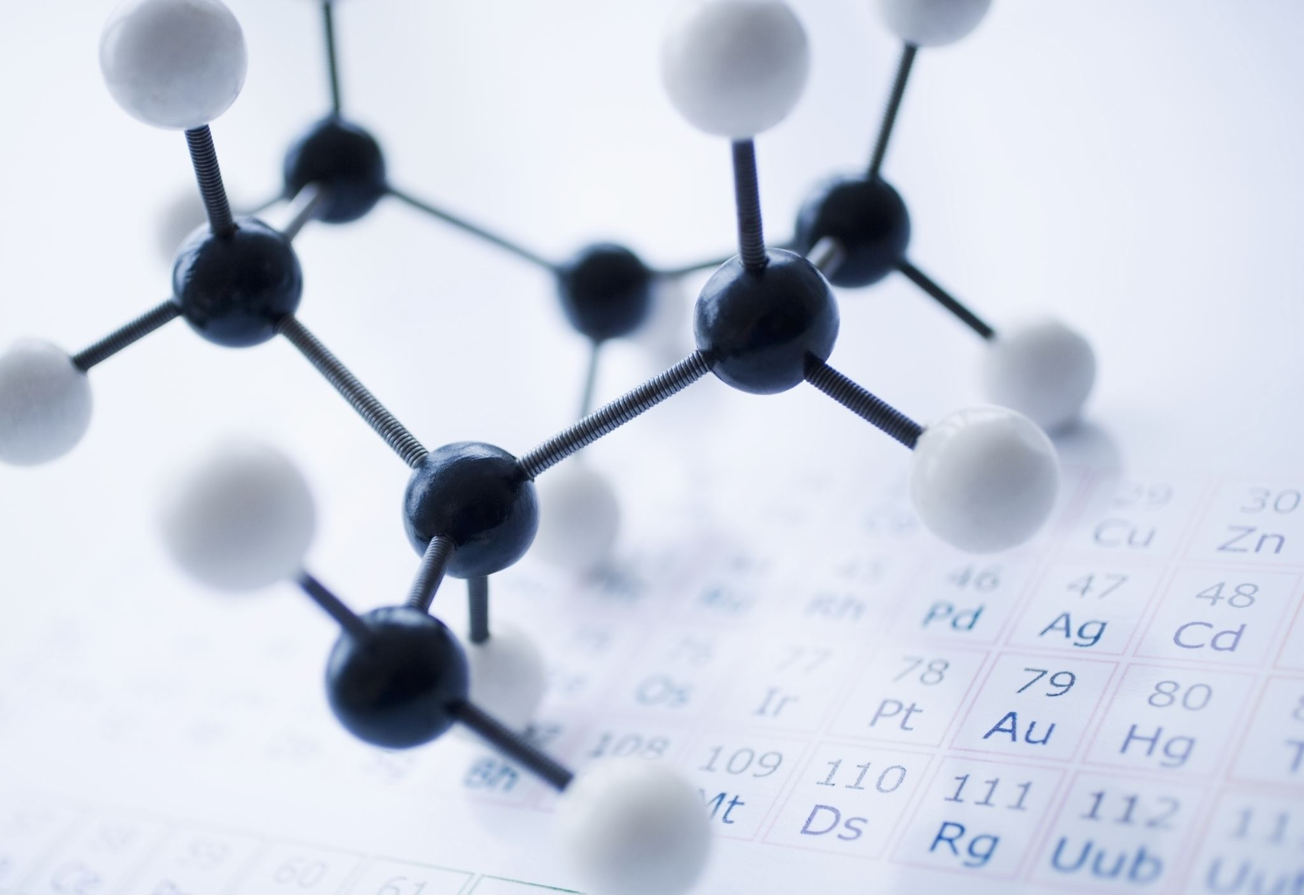
RESEARCH 6: INVIVO TESTS AND GOOD LABORATORY PRACTICE
From Molecule to Drug
PROF. AYŞE BEGÜM BUĞDAYCI
Notes:
During the research phase, drug candidates must be applied to experimental animals before being tested on humans. All these studies must be carried out under Good Laboratory Practice conditions. In this session, we will focus on in vivo tests and GLP.

Slide 2
Learning Objectives
Identify
Recall
Interpret
Explain
the Good Laboratory Practice (GLP)
the importance of animal tests for drug safety and areas is GLP applied
the importance of GLP in Drug Research Studies
the pre-clinical Stages and the types Invivo Tests
Notes:
The main objectives of this section are;
To define Good Laboratory Practices (GLP)
To remember the importance of animal testing in terms of drug safety and the areas where GLP is applied
To be able to interpret the importance of GLP in Drug Research Studies
To explain Preclinical Stages and Invivo Test types

Slide 3
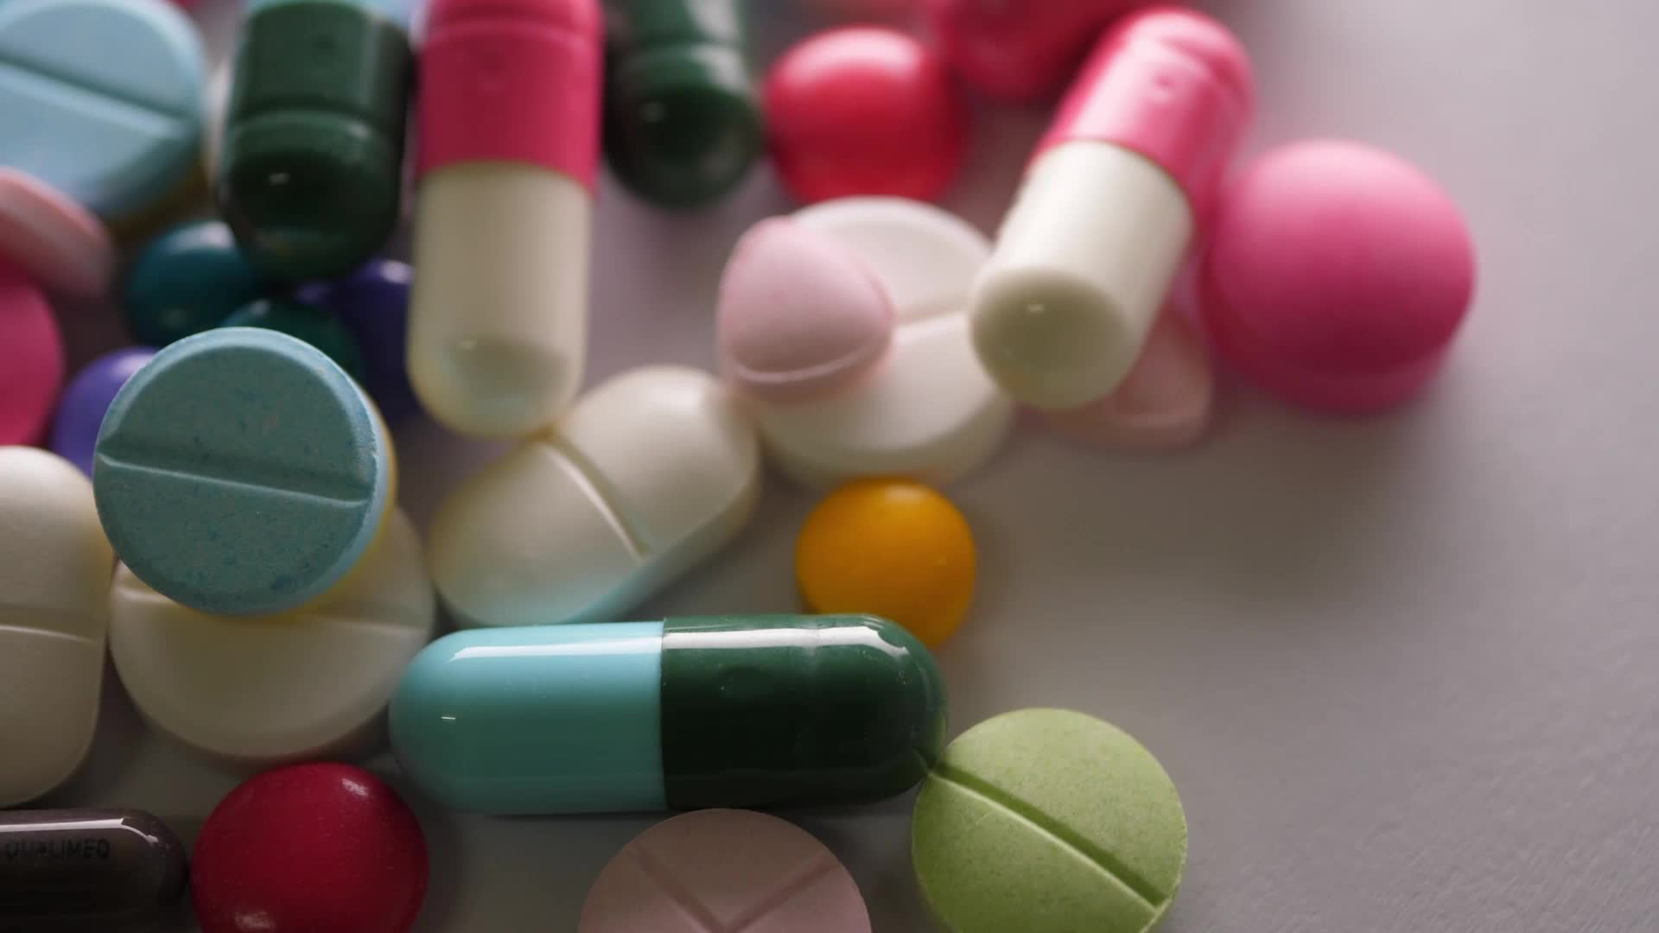
Agenda
Overview of the GLP standarts
The basic principles of GLP
GLP applied areas
GLP in Drug Research Studies
Pre-clinical Stages and Invivo Tests in GLP
Notes:
In this session, we will provide information about an overview of GLP standards, basic principles of GLP, areas where GLP is applied, GLP in Drug Research Studies and Preclinical Stages and Invivo Testing in GLP.

Slide 4
GxP Standarts in pharmaceutical development
Notes:
As can be understood from the visual in the presentation, different quality systems are applied in the process from basic research to the registration stage. These quality systems, generally called GxP, are called by different names depending on the stage and field of work they are applied. The Good Laboratory Practices quality system, known as GLP, is the one we will examine in detail in this presentation.

Slide 5
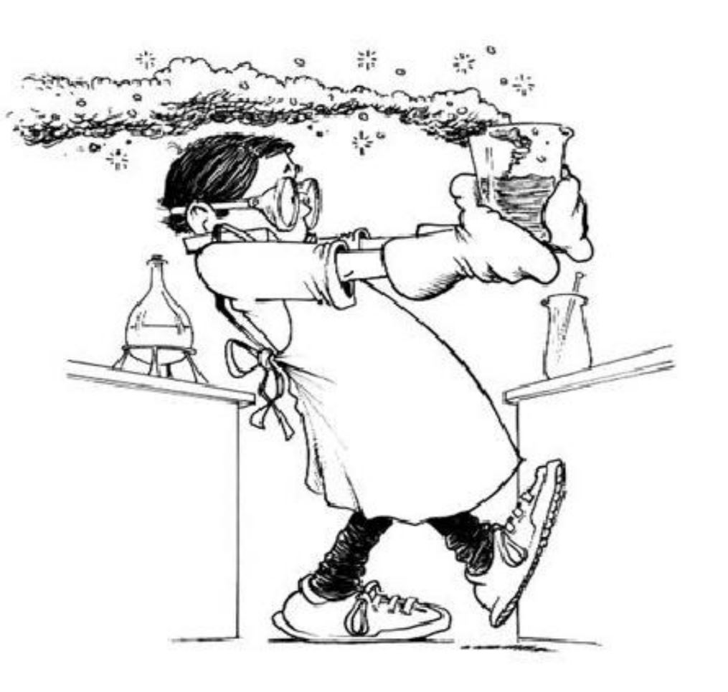
Good Laboratory Practice- GLP
In the early 70s, the FDA was aware of poor laboratory practices throughout the United States.
The FDA decided to conduct an in-depth investigation of 40 toxicology laboratories.
They found there was a lot of fraudulent activity and a lot of poor laboratory practices.
Notes:
In the early 70s, the FDA was aware of poor laboratory practices throughout the United States.
The FDA decided to conduct an in-depth investigation of 40 toxicology laboratories.
They found there was a lot of fraudulent activity and a lot of poor laboratory practices.

Slide 6
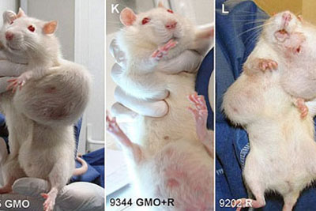
FDA's Research Findings
A laboratory that conducted experiments for a famous chemical manufacturer was found to be committing fraud.
The mice they used to test cosmetic products such as lotions and deodorants were discovered to have cancer and died.
The lab threw away dead mice and hid the actual results, giving results that qualified them as products fit for human consumption.
Notes:
FDA's Research Findings
A laboratory that conducted experiments for a famous chemical manufacturer was found to be committing fraud.
The mice they used to test cosmetic products such as lotions and deodorants were discovered to have cancer and died.
The lab threw away dead mice and hid the actual results, giving results that qualified them as products fit for human consumption.

Slide 7
FDA's Research Findings
Inadequately qualified managers and personnel
Poorly designed and planned work plans
Non-compliance with protocols, non-implementation of procedures, and lack of standard operating procedures
Inadequate collection of raw data, incorrect identification, lack of traceability, incorrectly validated or unvalidated
Inadequate characterization of test materials and systems
Inadequate validation of reports, inaccurate raw data records
Inadequate archiving and reuse processes
Notes:
The FDA’s Investigation Findings summarized the following:
Unqualified study directors and personnel
Poorly designed and planned work plans
Protocols were not followed, procedures were not performed as described, and standard operating procedures were not in place.
Raw data were inadequately collected, incorrectly defined, lacked traceability, were approved by inappropriate personnel, or were not approved.
Inadequate characterization of test materials and systems
Reports were not adequately validated, raw data records were inaccurate
Archiving and reuse processes were inadequate.

Slide 8
FDA's Research Findings
These findings were encountered in US FDA investigations at a company responsible for approximately 325 insecticide-herbicide drugs associated with 35-40% of all toxicological studies in the US.
Many decisions regarding the safety of chemicals have been found to be questionable.
Notes:
FDA's Research Findings
These findings were encountered in US FDA investigations at a company responsible for approximately 325 insecticide-herbicide drugs associated with 35-40% of all toxicological studies in the US.
Many decisions regarding the safety of chemicals have been found to be questionable.

Slide 9
History of GLP
GLP is an official regulation created by the FDA (United States Food and Drug Administration) in 1978.Although GLP originated in the United States, it has had a worldwide impact.
Non-U.S. companies that wanted to do business with the United States or register their production in the United States had to comply with United States GLP regulations.
They eventually started making GLP regulations in their own countries.
In 1981, the organization called OECD (Organization for Economic Co-operation and Development) produced the GLP principles, which are international standards.
Notes:
History of GLP
GLP is a government regulation established by the FDA (United States Food and Drug Administration) in 1978. Although GLP originated in the United States, it has a worldwide impact.
Companies outside the United States that wanted to do business with the United States or register their products in the United States were required to comply with the United States GLP regulations.
They eventually began to regulate GLP in their own countries.
In 1981, an organization called the OECD (Organization for Economic Co-operation and Development) produced the GLP principles, which are international standards.

Slide 10
History of GLP Regulations
1978 ABD-FDA Establishment of US-FDA GLP Regulation
1979 ABD-FDA US-FDA GLP Regulation Goes into Force
1981 OECD OECD Council Decision on Mutual Acceptance of Data (MAD)
1982 OECD GLP Principles
1989 OECD OECD Council Decision (For Non-OECD Countries)
1997 OECD OECD GLP Principles Revision (OECD document No. 1)
2004 EC EC directive 2004/9/EC and 2004/10/EC
Notes:
History of GLPThis slide contains the regulations made in the field of GLP from past to present. This process, which started in the United States in 1978, is now mandatory in OECD and European Union countries.

Slide 11
Target of regulations is to get results;
Trustworthy
Repeatable
Auditable
Acceptable by everyone
Notes:
The GLP Guidelines were developed to improve the quality and validity of test data used to ensure the safety of chemical products and chemicals.
GLP principles must be followed by test facilities conducting studies to be submitted to national authorities for the assessment of chemicals used for the protection of humans and the environment.
The aim of the regulations is to get results;
To ensure that studies are reliable, repeatable, auditable and acceptable to all.

Slide 12
Good Laboratory Practice (GLP)
The entire process of planning, implementing, monitoring, recording, archiving and reporting preclinical studies of health, chemical and environmental safety studies
In vivo or in vitro experiments in which test substances are studied prospectively under laboratory conditions to determine the safety of the analysis
Notes:
Good Laboratory Practice (GLP)
GLP is the entire process of planning, implementing, monitoring, recording, archiving and reporting health and environmental safety studies other than clinical studies.
Non-clinical laboratory studies refer to in vivo or in vitro experiments in which test substances are studied prospectively under laboratory conditions to determine the safety of the test.

Slide 13
Good Laboratory Practice (GLP)
Good laboratory practices are a quality system concerned with the organizational processes and conditions under which they are planned, implemented, monitored, recorded, archived and reported.
Planned: Study plan (protocol) and planned changes made during the studies
Implemented: Refers to Standard Operating Procedures, which are GLP requirements.
Monitored: Performed by study staff, quality assurance personnel and national monitoring authority auditors to ensure GLP compliance.
Recorded: Collecting raw data and recording deviations if they occur during the study
Archived: Study data, samples, samples and reports should be archived appropriately.
Reported: Because study reports in previous years did not always accurately reflect study data, it has now become a GLP mandate to ensure accuracy in reports.
Notes:
Good Laboratory Practice (GLP)
Good laboratory practice is a quality system that relates to the organizational processes and conditions under which it is planned, implemented, monitored, recorded, archived and reported.
Planned: Study plan (protocol) and planned changes during the study
Implemented: Refers to the Standard Operating Procedures that are GLP requirements.
Monitored: Performed by study personnel, quality assurance personnel and national monitoring authority auditors to ensure GLP compliance.
Recorded: Collection of raw data and recording of deviations that occur during the study
Archived: Study data, samples, specimens and reports should be archived appropriately.
Reported: Since study reports from previous years do not always accurately reflect study data, it is now a GLP task to ensure the accuracy of the reports.

Slide 14
Why GLP?
Advantages of GLP
Recognizes that the data are a true reflection of the results obtained from the studies.
Enables the development of quality test data
Provides pre-clinical safety and residue safety.
Preventing duplication of data
It ensures the production of high quality and reliable test data.
Ensures data is traceable.
It provides mutual acceptance of data.
It increases public trust.
It shortens the time required to launch a new product.
It enables the removal of technical barriers to trade.
It ensures the protection of human health and the environment.
It improves animal welfare.
Notes:
Why GLP and what are the advantages of GLP?
Aware that data is a true reflection of the results obtained from studies.
Enables the development of quality test data
Provides preclinical safety and residual safety.
Prevents duplication of data
Enables the production of quality and reliable test data.
Ensures traceability of data.
Ensures mutual acceptance of data.
Increases public confidence. Shortens the time required for a new product to be launched.
Removes technical barriers to trade.
Protects human health and the environment.
Improves animal welfare.

Slide 15
What Does GLP Not Deal With?
It is not related to the technical validity of the studies.
It is not concerned with measuring scientific value.
How important is the question asked?
How appropriate is the study design?
How scientific is the evaluation?
It is not concerned with ensuring approval of the data or product.
Notes:
What GLP Does Not Concern:
It is not concerned with the technical validity of studies.
It is not concerned with measuring scientific value.
It is not concerned with how important is the question asked?
How appropriate is the study design?
How scientific is the evaluation?
It is not concerned with validating the data or the product.

Slide 16
Good Laboratory Practice (GLP)
Provides a standard basis for improving the quality and integrity of data from studies evaluating the safety and efficacy of new drug applications
GLP is not required for early development stages such as concept evaluation and screening
GLP is only required for safety studies that include biocompatibility, metabolism, toxicology and pharmacology in vivo measurements prior to application of an investigational new drug
Notes:
GLP provides a standard basis for improving the quality and integrity of data from studies evaluating the safety and efficacy of new drug applications;
GLP is not required for early development stages such as concept evaluation and screening;
GLP is only required for safety studies before application for an investigational new drug. Such safety studies may include in vivo measurements of biocompatibility, metabolism, toxicology and pharmacology. GLP will be required for an in vivo preclinical animal safety test if regulatory submission is planned.
Provides a standard basis for improving the quality and integrity of data from studies evaluating the safety and efficacy of new drug applications
GLP is not required for early development stages such as concept evaluation and screening
GLP is only required for safety studies that include biocompatibility, metabolism, toxicology and pharmacology in vivo measurements prior to application of an investigational new drug

Slide 17
When is GLP Required?
It is necessary for studies carried out to support a research, R&D on issues such as the properties and safety information of chemical products, and studies carried out for the marketing of these products.
GLP is required to define and approve all non-clinical health and environmental safety tests.
The scope of GLP is non-clinical safety testing of test substances contained in the following products:
Pharmaceutical products
Pesticide products
Food and feed additives
Cosmetics
Veterinary medicines and similar products
Industrial chemicals
Notes:
When is GLP Necessary?
Studies conducted to support research, R&D on issues such as the properties and safety information of chemical products and studies conducted for the marketing of these products are necessary.
GLP is required to define and approve all non-clinical health and environmental safety tests.
The scope of GLP includes pre-clinical safety tests of substances such as
Pharmaceutical products
Pesticide products
Food and feed additives
Make-up materials
Veterinary drugs and similar products
Industrial chemicals.

Slide 18
Good Laboratory Practice (GLP)
Single dose toxicity
Repeated dose toxicity (sub-acute and chronic)
Reproductive toxicity (fertility, embryo-fetal toxicity and teratogenicity, peri-/post-natal toxicity)
Mutagenic potential
Carcinogenic potential
Toxicokinetics (above studies providing systemic exposure data for pharmacokinetic studies)
Pharmacodynamic studies designed to test the potential for adverse effects (Safety pharmacology)
Local tolerance studies, including phototoxicity, irritation and sensitivity studies, or testing for suspected dependence and/or withdrawal effects of drugs
Notes:
The test groups performed in the GLP area are as follows
Single dose toxicity
Repeated dose toxicity (sub-acute and chronic)
Reproductive toxicity (fertility, embryo-fetal toxicity and teratogenicity, peri-/post-natal toxicity)
Mutagenic potential
Carcinogenic potential
Toxicokinetics (the above studies providing systemic exposure data for pharmacokinetic studies)
Pharmacodynamic studies designed to test the potential for adverse effects (Safety pharmacology)
Local tolerance studies including phototoxicity, irritation and sensitization studies or tests for suspected dependence and/or withdrawal effects of drugs

Slide 19
Good Laboratory Practice (GLP)
Physical-chemical tests;
Toxicity studies;
Mutagenicity studies;
Environmental toxicity studies on aquatic and terrestrial organisms
Studies on behavior in water, soil and air; bioaccumulation
Studies to determine pesticide residues in food or animal feed
Studies on effects on mesocosms and natural ecosystems;
Analytical and clinical chemistry tests
Notes:
Physical-chemical tests;
Toxicity studies;
Mutagenicity studies;
Environmental toxicity studies on aquatic and terrestrial organisms
Studies on behavior in water, soil and air; bioaccumulation
Studies to determine pesticide residues in food or animal feed
Studies on effects on mesocosms and natural ecosystems;
Analytical and clinical chemistry tests

Slide 20
Essential Requirements of GLP
Resources: Organization, personnel, facilities and equipment;
Characterization: Test items and test systems;
Rules: Protocols, standard operating procedures (SOPs);
Results: Raw data, final report and archives;
Quality Assurance: Independent monitoring of research processes.
Notes:
The Basic Requirements of GLP can be grouped into five main groups: source, characterization, rules, results and quality assurance.
Resources refer to issues such as organization, personnel, facilities and equipment.
Characterization: Includes test items and test systems
Rules: Includes protocols, standard operating procedures.
Results refer to raw data, final reports and archives.
In order to ensure quality assurance, research processes must be monitored independently.

Slide 21
Drug Development Stages
There are two important stages in drug development:
Finding the precursor compound: The precursor compound is a model (prototype) molecule for a certain pharmacological activity.
Natural resources
Finding by chance
Clinical observations
Pharmacological screening tests
Drug metabolism studies
Mimicking the structures of active endogenous molecules
Rational drug design
Combinatorial chemistry
Notes:
Drug Development Stages
There are two important stages in drug development:
The first of these is the discovery of the lead compound.
A lead compound is a model (prototype) molecule for a specific pharmacological activity.
Natural Sources
Chance Finding
Clinical Observations
Pharmacological Screening Tests
Drug Metabolism Studies
Mimicking the Structures of Active Endogenous Molecules
Rational Drug Design
It is possible to find lead substances with combinatorial chemistry

Slide 22
Drug Development Stages
2) Optimization of the precursor compound:
The aim is to target the precursor molecule;
Changing the strength of the activity
Specificity
Changing the duration of effect
Ease of application
Increasing stability
It is the making of molecular modifications that will improve undesirable effects or properties such as toxicity.
Notes:
The second main stage in drug development is optimization of the lead compound.
The aim here is to target the lead molecule.
Studies conducted within this scope include
Changing the strength of the activity
specificity
Changing the duration of effect
Ease of application
Increasing stability
Making molecular modifications that will improve properties such as undesirable effects or toxicity.

Slide 23
Notes:
Developing new, innovative drugs takes time; a very long time. On average, the journey from discovery to market takes 12 years, but in newer areas of medicine, such as gene therapy, this can be as long as 30 years. Many players in drug development would consider 12 years to be optimistic, especially considering that only about one in 5,000 new compounds is approved as a pharmaceutical drug by regulatory bodies such as the FDA in the US or the European Medicines Agency (EMA) in the European Union.

Slide 24
The GLP in Drug Research Studies
GLP principles must be applied in preclinical studies of the following products for the evaluation of new adjuvants and adjuvanted vaccines:
unlicensed adjuvant vaccines;
antigens and adjuvants that have been included in licensed vaccines but have undergone significant changes during the manufacturing process;
previously licensed products that have undergone major formulation changes (for example, a change in the excipient or the addition or removal of one of the ingredients);
previously licensed products delivered through a new management pathway.
Notes:
GLP in Drug Research Studies
GLP principles should be applied to preclinical studies of the following products for the evaluation of new adjuvants and adjuvanted vaccines:
unlicensed adjuvanted vaccines;
antigens and adjuvants that are included in licensed vaccines but have undergone significant changes during the manufacturing process;
pre-licensed products that have undergone major changes in formulation (e.g., changes in the excipient or addition or removal of one of the components);
previously licensed products delivered via a new administration route.

Slide 25
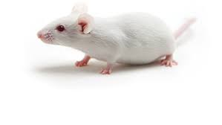
Pre-clinical In-vivo Toxicity
It is carried out on healthy animals.
For small molecules, rodent species or non-rodent species are used.
Biotech compounds should be tested on a species in which they will be pharmacologically active.
Behavior, appearance, food consumption, weight, necropsy
Doses;
Ineffective dose
Threshold dose
Highest allowed dose
Therapeutic index TD50, ED50
Notes:
Preclinical In-vivo Toxicity analyses are performed on healthy animals.
Rodent species or non-rodent species are used for small molecules.
Biotechnological compounds should be tested on a species in which they will be pharmacologically active.
Behavior, appearance, food consumption, weight status are monitored. If necessary, autopsy is performed.
Doses;
Non-effective dose
Threshold dose
Highest allowed dose
Parameters such as therapeutic index TD50, ED50 are examined.

Slide 26
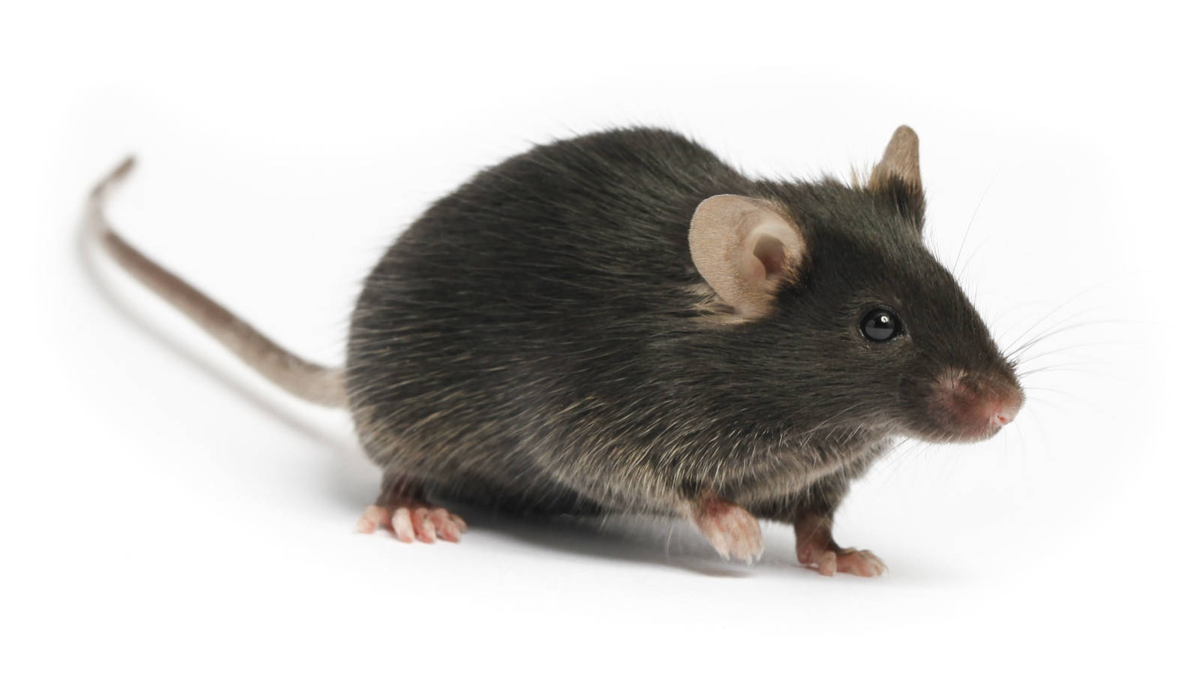
Pre-Clinical Stages
The goal of preclinical development is to meet all the requirements that must be met before a new compound is considered ready for initial testing in humans.
It is mainly done on mice, rabbits, rats and monkeys.
It basically consists of 4 main parts.
Pharmacological Safety Studies
Pharmacological tests to check that the drug does not produce obvious dangerous acute effects such as bronchoconstriction, cardiac arrhythmias, blood pressure changes and ataxia
Notes:
Preclinical Stages
The goal of preclinical development is to meet all the parameters that a new compound must meet before it is considered ready for human testing.
It is mainly done on mice, rabbits, rats and monkeys.
It basically consists of 4 main parts. These are
Pharmacological Safety Studies
Preliminary toxicological tests
Pharmacokinetic and pharmacodynamic (PK/PD) tests
Chemical and pharmaceutical development.
Preclinical Stages
1. Pharmacological Safety Studies - Pharmacological tests are performed to check that the drug does not produce obvious dangerous acute effects such as bronchoconstriction, cardiac arrhythmias, blood pressure changes and ataxia.

Slide 27
Pre-Clinical Stages
Preliminary toxicological tests
Preliminary toxicological tests to exclude genotoxicity and determine the maximum non-toxic dose of the drug
Autopsy to look for histological and biochemical evidence of tissue damage at the end of the trial in cases of major changes in treated animals
Pharmacokinetic and pharmacodynamic (PK/PD) tests
Chemical and pharmaceutical development
To assess the feasibility of large-scale synthesis and purification, to assess the stability of the compound under various conditions and to develop a formulation suitable for clinical studies
Notes:
2. Preliminary toxicological tests: These are preliminary toxicological tests performed to exclude genotoxicity and to determine the maximum non-toxic dose of the drug. These tests are usually performed daily for 28 days and in two species. In case of major changes in the treated animals, the collected material is meticulously examined at the end of the experiment by performing an autopsy to look for histological and biochemical evidence of tissue damage.
3. Pharmacokinetic and pharmacodynamic tests Pharmacological analyses, also called PK/PD, are performed
4. Chemical and pharmaceutical development: Chemical and pharmaceutical development studies are conducted to assess the feasibility of large-scale synthesis and purification, to evaluate the stability of the compound under various conditions and to develop a formulation suitable for clinical studies

Slide 28
Questions and Discussion
QUESTION AND ANSWER
SHARING EXPERIENCES
LET'S SUMMARIZE
Notes:
Please review the books and other documents on our website to obtain more detailed information on the subject. You can use our social media accounts for any questions or concerns you may have.

Slide 29
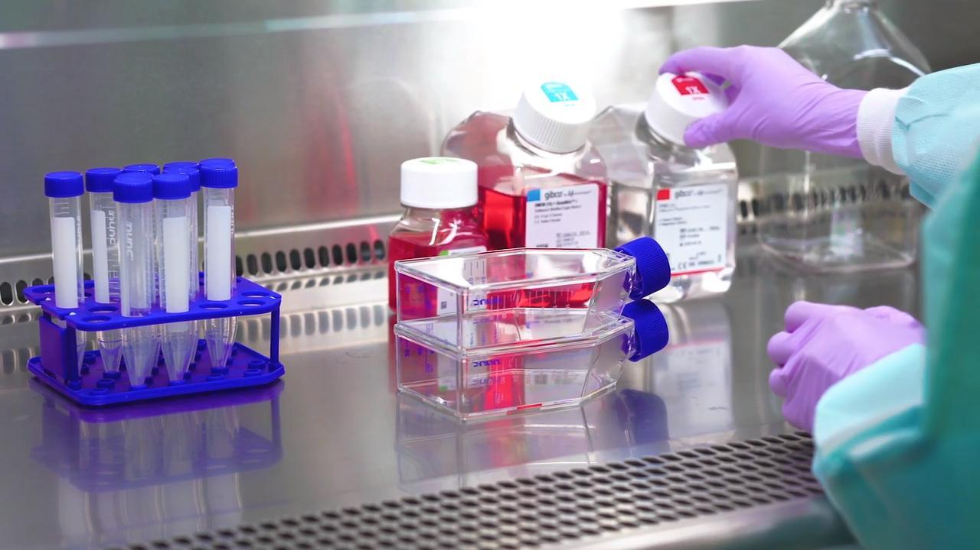
GLP and In vivo Testing Summary
- Preclinical studies follow Good Laboratory Practices (GLP)
- GLP aims to ensure reliable data for regulators
- Preclinical tests in mice, rabbits, rats, monkeys
Notes:
To summarize our session:
Most preclinical development studies, especially those related to safety issues, are conducted under formal operating rules known as Good Laboratory Practices (GLP), which cover record keeping procedures, data analysis, instrument calibration, and staff training.
The aim of GLP is to eliminate human error as much as possible and to ensure the reliability of data submitted to regulatory authorities, and laboratories are regularly monitored for compliance with GLP standards.
The aim of preclinical development is to meet all the parameters that a new compound must meet before it is considered ready for human testing. It is primarily done in mice, rabbits, rats, and monkeys.

Slide 30
Additional Resources
OECD, 1999..GLP. http://www.oecd.org/chemicalsafety/testing/oecdseriesonprinciplesofgoodlaboratorypracticeglpandcompliancemonitoring.htm
ILAC, 2007. G24. https://ilac.org/publications-and-resources/ilac-guidance-series/
WHO, 2009. Handbook: Good Laboratory Practice (GLP). Quality Practices for Regulated Non-clinical Research and Development. 2nd ed. Geneva..
Resmi Gazete, 2010. İyi Laboratuvar Uygulamaları Prensipleri, Test Birimlerinin Uyumlaştırılması, İyi Laboratuvar Uygulamalarının ve Çalışmaların Denetlenmesi Hakkında Yönetmelik. https://www.resmigazete.gov.tr/eskiler/2010/03/20100309-10.htm

Slide 31
Project Partners

Slide 32
This document was prepared for the Erasmus Project "2022-1-TR01-KA220-VET-000088373
A UNIVERSAL STRATEGIC NECESSITY: FROM MOLECULE TO DRUG»
"”Supported by the European Commission within the scope of the Erasmus+ Programme. However, the European Commission and the Turkish National Agency cannot be held responsible for the opinions expressed here."
Notes:
A universal necessity: From Molecule to Drug Project
"Supported by the European Commission within the Erasmus+ Programme.
However, the European Commission and the Turkish National Agency cannot be held responsible for the views expressed here."

Slide 33
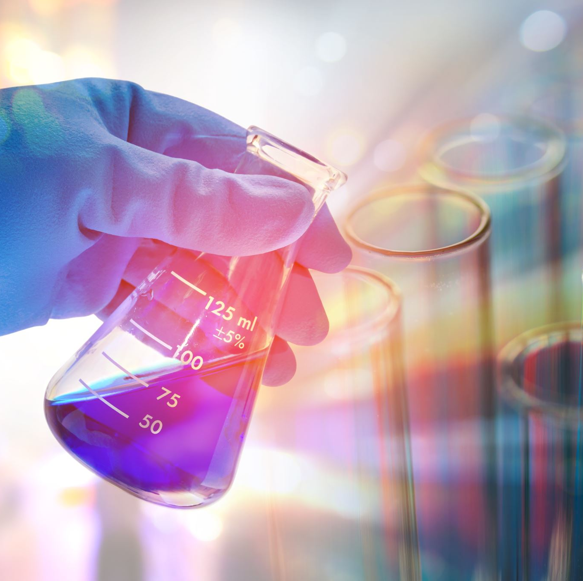
THANK YOU
Notes:
Projemize desteklerinden ötürü Avrupa Komisyonu’na ve proje ekibinde yer alarak katkıda bulunan tüm üyelerimize ve proje kapsamındaki etkinliklere katılan herkese teşekkür ederiz.

