Slide 1
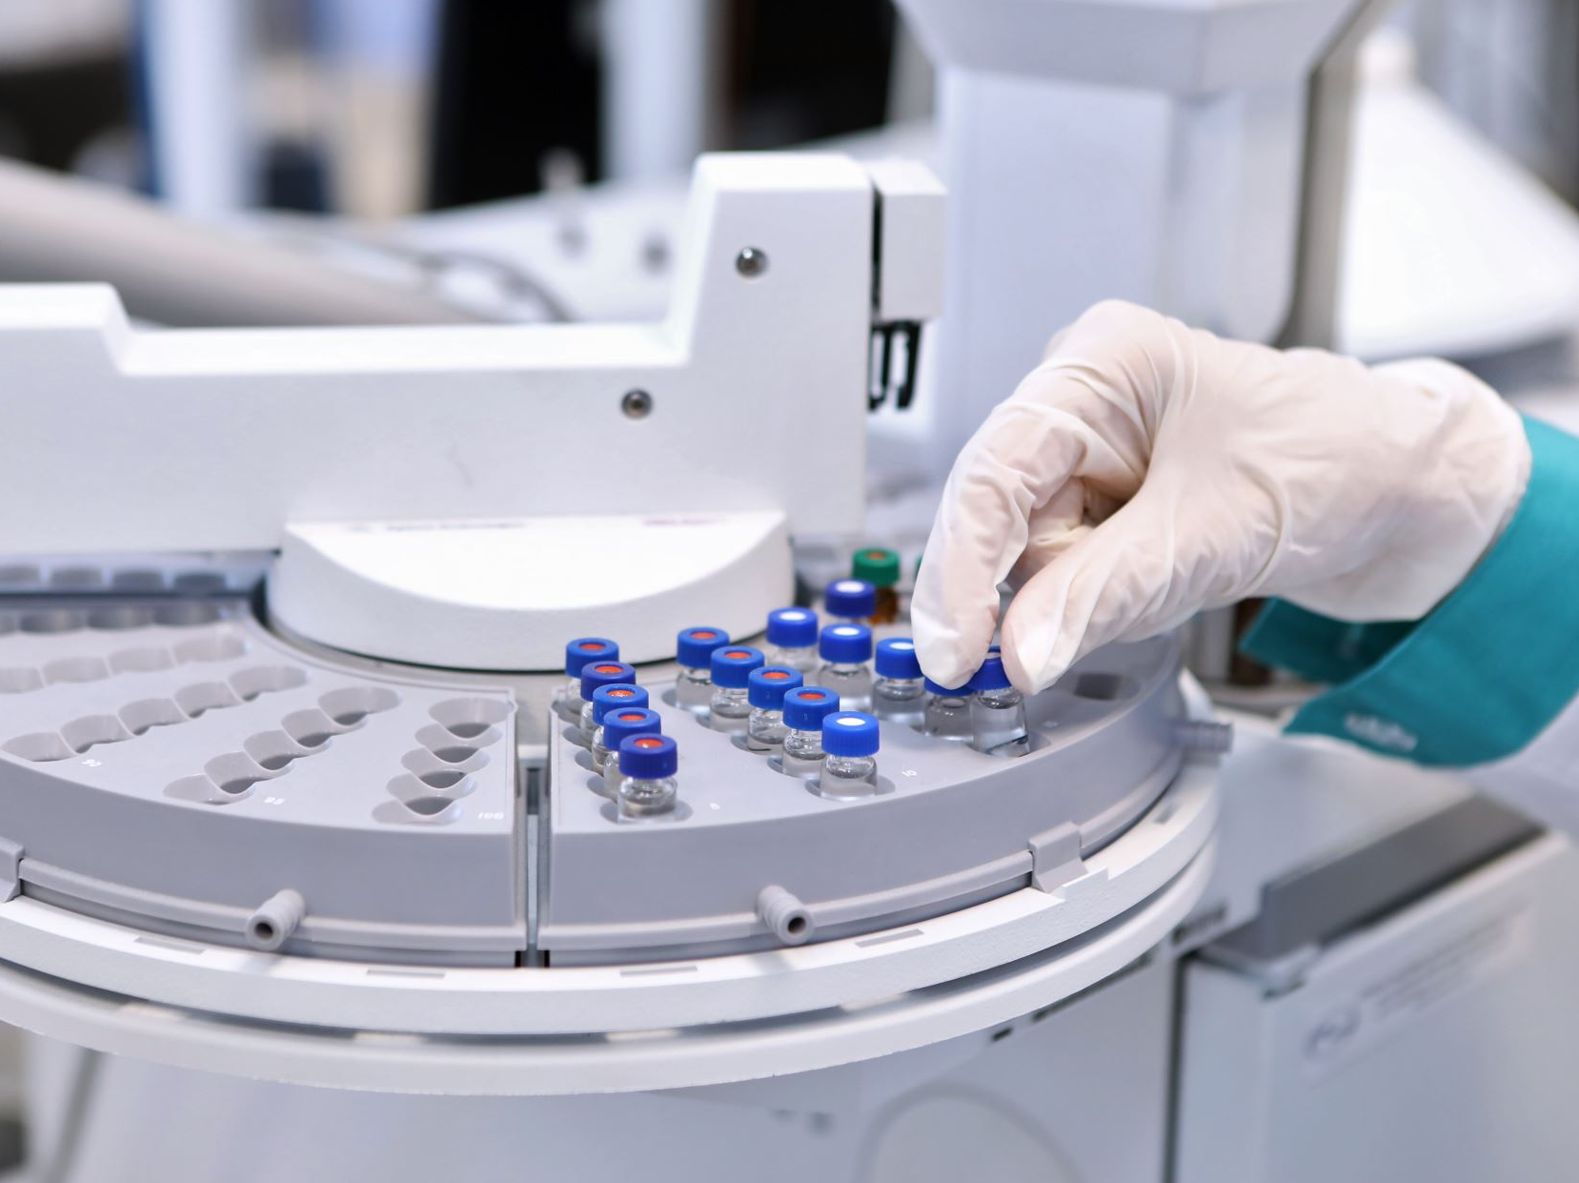
Development: Introduction to
Laboratory Safety
From Molecule to Drug
PROF. DR. AYSEGUL TAYLAN ÖZKAN
Notes:
Welcome to the session. This module aims to introduce laboratory safety and ensure that each experiment advances knowledge without compromising our health. Biosafety will also be briefly discussed.

Slide 2

Learning Objectives for Lab Safety
Identify
Identify the importance of Laboratory Safety
Recall
Recall the key principles of Laboratory Safety
Explain
Explain the purpose and key activities of Lab Safety in the pathway from molecule to drug.
Interpret
Discover the Cross-Disciplinary Relevance of Lab Safety.
Notes:
As we review today’s Lab Safety lesson, it is important to understand that this topic is not just a checklist or a set of rules, but a fundamental aspect of our work in the biomedical field. The goals we will cover today are critical for everyone involved in the pharmaceutical manufacturing pipeline from discovery to delivery.
First, we will Identify the Importance of Lab Safety. This is not just about compliance, but also about understanding the impact of safety practices on our business, our health, and the integrity of research and product development.
Next, we will Recall the Fundamental Principles of Lab Safety. We will review basic safety protocols and procedures from chemical handling to emergency response.
Our third goal is to Explain the Purpose and Core Activities of Lab Safety from Molecule to Drug. Here, we will connect the dots between lab safety practices and the entire drug development process.
Finally, we will Explore the Interdisciplinary Connection of Lab Safety. Safety in the lab is not the responsibility of just one discipline; it is a collaborative effort. We will examine how laboratory safety principles are complementary and useful in a variety of fields, including bioengineering, bioinformatics, pharmacology, and more.

Slide 3
Lab Safety
Why Laboratory Safety
The Lab Environment
Key Principles of Laboratory Safety
Risk Assessment
Safety Training
Personal Protective Equipment (PPE)
Emergency Procedures
Types of lab safety
Chemical Safety
Biological Safety
Equipment Safety
Housekeeping
Laboratory Etiquette
Reporting Incidents
Institutional Resources
Notes:
In this module, we will embark on a comprehensive journey covering the various aspects of Laboratory Safety. Our exploration will begin with understanding why Laboratory Safety is essential to our work and its impact on the entire scientific process.
We will then move on to discuss the Laboratory Environment, which is a critical backdrop to all our activities and safety practices. Laboratories are environments that contain many potential hazards. Many researchers have been left in the crosshairs of death due to accidents that have occurred.
Our focus will shift to the Fundamental Principles of Laboratory Safety, where we will cover important topics such as:
Risk Assessment to understand and reduce potential hazards.
Safety Training, which emphasizes the importance of continuous learning and awareness.
Personal Protective Equipment (PPE), details the correct use and importance of protective equipment.
Emergency Procedures will prepare us for unforeseen events and how to respond effectively.
We will then examine the Types of Laboratory Safety, which include:
Chemical Safety, which deals with the handling and storage of hazardous materials.
Biological Safety, which focuses on safe practices when working with biological materials.
Equipment Safety is ensuring that laboratory equipment operates correctly and safely.
Environmental Cleanliness emphasizes the importance of a clean and orderly work area.
Laboratory Rules, which include respectful and safe behavior in a common area, must be followed.
Incident Reporting outlines protocols for reporting accidents and near-misses.
Institutional Resources directs you to available support and additional safety resources within our institution.
Each topic is designed to provide you with a comprehensive understanding of Laboratory Safety and equip you with the knowledge and skills necessary for excellence in the biomedical field.

Slide 4
Why Laboratory Safety Matters ?
Safety First: Protecting your well-being
Responsible Research: Ensuring the integrity of experiments
Legal Compliance: Meeting regulatory requirements
Notes:
Laboratories are dynamic environments where scientists and researchers conduct experiments, analyze data, and make discoveries. While laboratories are essential for advancing scientific knowledge, they can also be potentially dangerous places if safety precautions are not followed carefully.
We will take a three-focused approach to laboratory safety: Safety First, which is about protecting your personal health; Responsible Research, which must ensure the integrity of experiments; and Legal Compliance, which is about meeting regulatory requirements.

Slide 5

The Lab Environment
Lab Types: Different types of labs
chemistry, biology, physics, ...
Hazards: Potential dangers
chemicals, equipment, biological agents, …
Notes:
It is important to be familiar with the various laboratory environments you may encounter.
Each type of laboratory (chemistry, biology, physics, or any other) has its own practices, equipment, and risks.
In addition, each laboratory encompassing these diverse scientific fields also has its own unique potential hazards. These can range from volatile chemicals in a chemistry lab to pathogenic biological agents in a biosafety facility to high-powered equipment in a physics lab. Recognizing these hazards is the first step to reducing risk and protecting our health.
Our goal is not only to make you aware of these hazards, but also to equip you with the knowledge to navigate these hazards with confidence, ensuring that safety is an integral part of your scientific practice.

Slide 6

The Importance of Laboratory Safety
Personal Safety
Environmental Protection
Equipment and Infrastructure Preservation
Reputation and Funding
Notes:
Why is Laboratory Safety Important?
Laboratory safety is not just a set of rules and regulations; it is a fundamental responsibility that every individual working in a laboratory must fulfill. The importance of laboratory safety can be summarized under several headings:
Personal Safety: The primary concern of laboratory safety is the protection of individuals working in the laboratory. This includes researchers, technicians, and even visitors. Accidents and injuries can have serious consequences, both physically and emotionally, and can disrupt the progress of research.
Environmental Protection: Laboratories often work with hazardous chemicals, materials, and equipment. Proper safety practices help prevent spills, leaks, and releases that can harm the environment. Environmental damage can lead to legal and financial consequences for institutions.
Equipment and Infrastructure Protection: Carelessness can damage expensive laboratory equipment and infrastructure. Proper use and maintenance of equipment is important to avoid costly repairs or replacements.
Reputation and Funding: Laboratory accidents that cause serious consequences can damage an institution's reputation and hinder its ability to secure research funding. A commitment to safety demonstrates professionalism and responsibility, attracting collaborators and funding opportunities.

Slide 7
The Hierarchy of Laboratory Safety
1. Elimination/Substitution
2. Engineering Controls
3. Administrative Controls
4. Personal Protective Equipment (PPE)
Notes:
Laboratory safety is organized into a hierarchy of controls that represent different levels of protection. These controls are ranked from most effective to least effective:
Elimination/Substitution: The most effective way to prevent hazards is to eliminate them completely or replace them with less hazardous alternatives. This approach may not always be possible, but should be considered when possible. For example, substituting a toxic chemical for a nontoxic one can significantly reduce risks.
Engineering Controls: Engineering controls involve the design and implementation of safety features and equipment that minimize exposure to hazards. Examples include fume hoods, safety showers, and eyewash stations. The goal of these controls is to isolate the hazard from the worker.
Administrative Controls: Administrative controls are policies, procedures, and training that guide safe laboratory practices. Examples include safety protocols, access restrictions, and training programs. These controls rely on individuals to follow established guidelines.
Personal Protective Equipment (PPE): When hazards cannot be eliminated or controlled by other means, PPE becomes the last line of defense. This includes items such as lab coats, gloves, safety glasses, and breathing masks. Using the right PPE is essential to minimize exposure to hazards.

Slide 8
General Laboratory Safety Practices
Risk Assessment
Emergency Procedures
Reporting Incidents
Safety Training
Institutional Resources
Chemical Safety
Biological Safety
Equipment Safety
Personal Hygiene
Laboratory Etiquette
Housekeeping
Notes:
General Laboratory Safety Practices
Here are some basic laboratory safety practices that should be followed in every laboratory environment: These can be grouped into three.

Slide 9
General Laboratory Safety Practices
Risk Assessment
Emergency Procedures
Reporting Incidents
Safety Training
Institutional Resources
Chemical Safety
Biological Safety
Equipment Safety
Personal Hygiene
Laboratory Etiquette
Housekeeping
Notes:
Risk assessment
Before beginning any experiment, researchers should conduct a thorough risk assessment to identify potential hazards and develop strategies to mitigate them.
Emergency procedures
Learn the location and proper use of safety equipment, such as fire extinguishers, eye wash stations, and safety showers. Learn evacuation routes and emergency contact information.
Incident reporting
Laboratory workers should be encouraged to report near-misses and incidents. Important for risk assessmentLaboratory workers should be informed of who to contact in an emergency. A culture of non-punitive reporting needs to be established in the laboratory.
Safety training
All individuals working in the laboratory should receive appropriate safety training, including instructions on the safe use of chemicals, equipment, and emergency procedures.
Institutional resources
Available resources such as safety guards, first aid, and safety manuals should be emphasized. Laboratory workers should be encouraged to seek help and guidance. Laboratory safety and security manuals should be prepared and shared with laboratory workers at all levels and in all roles.

Slide 10
General Laboratory Safety Practices
Risk Assessment
Emergency Procedures
Reporting Incidents
Safety Training
Institutional Resources
Chemical Safety
Biological Safety
Equipment Safety
Personal Hygiene
Laboratory Etiquette
Housekeeping
Notes:
Chemical safety
Chemical safety is a critical aspect of laboratory safety. This includes the proper labeling of chemicals, their safe application, storage, handling and disposal. Safety data sheets (SDS) should be readily available. Each chemical should be labeled.
Biological Safety
Working with microorganisms and biological materials can always have harmful consequences. The laboratory should be designed to Biosafety Levels (BSL). It is essential that it is stored and disposed of properly.
Equipment Safety
Laboratory equipment must be operated safely. Maintenance and calibration of equipment is essential. Equipment malfunctions should be reported immediately.
These are the minimum safety requirements that must be observed in every laboratory. In addition, laboratories may have different safety requirements depending on the material being worked on. For example, laboratories that work with radioactive agents should have specific safety precautions in place.

Slide 11
General Laboratory Safety Practices
Risk Assessment
Emergency Procedures
Reporting Incidents
Safety Training
Institutional Resources
Chemical Safety
Biological Safety
Equipment Safety
Personal Hygiene
Laboratory Etiquette
Housekeeping
Notes:
Personal hygiene
It is very important to maintain good personal hygiene. Wash your hands regularly, especially after contact with chemicals, and avoid touching your face, mouth or eyes while in the laboratory.
Laboratory Rules
Proper behavior and conduct in the laboratory are essential. Respect for other workers and their work areas must be shown. Good communication skills and teamwork are essential.
Environmental Cleanliness
Keep the laboratory work area clean and tidy. This is directly linked to safety and efficiency. Clutter can cause accidents and hinder emergency response efforts. It is essential to follow common cleaning rules.

Slide 12
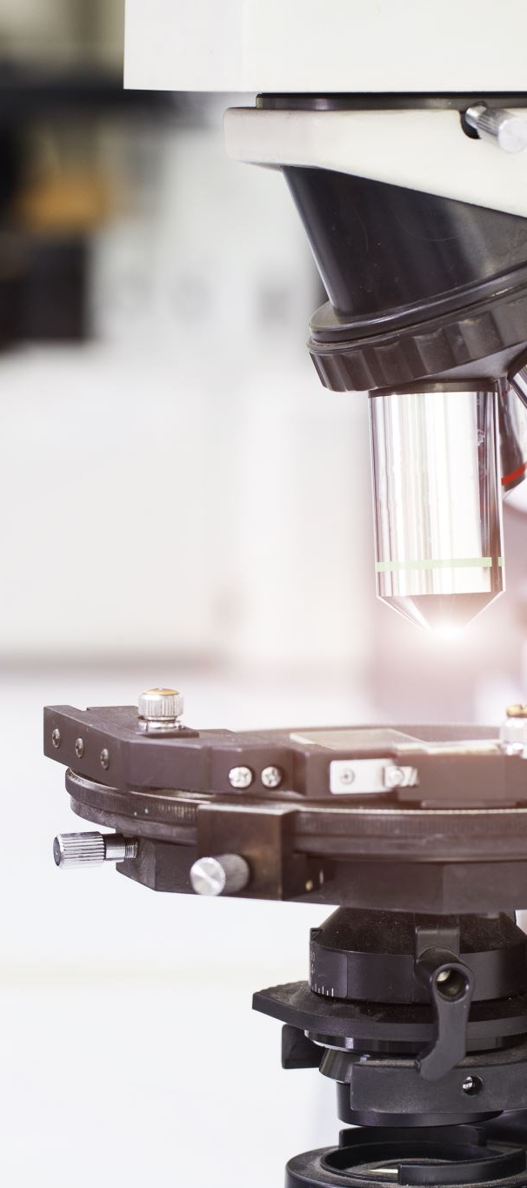
Case Study: The Texas Tech University Chemistry Laboratory Explosion (2010)
In January 2010, a tragic incident occurred in a chemistry laboratory at Texas Tech University, highlighting the critical importance of laboratory safety protocols and procedures. The incident involved a chemical explosion that resulted in injuries and damage to the laboratory.
  Who could be responsible?
  How & why it happened?
Phifer, R., Case study – Incident investigation, J. Chem. Health Safety (2014), doi:http://dx.doi.org/ 10.1016/j.jchas.2014.04.001
Notes:
Case Study: The Texas Tech University Chemistry Laboratory Explosion (2010)
Background:
In January 2010, a tragic incident occurred in a chemistry laboratory at Texas Tech University, highlighting the critical importance of laboratory safety protocols and procedures. The incident involved a chemical explosion that resulted in injuries and damage to the laboratory.
Key Details:
The Experiment: A graduate student was conducting an experiment involving the synthesis of diethylzinc, a highly reactive and pyrophoric compound used in organic chemistry reactions. The experiment required the handling of a small quantity of diethylzinc.
Lack of Proper Training: The graduate student involved in the experiment had limited experience with highly reactive chemicals like diethylzinc and had not received sufficient training in handling such materials safely.
Inadequate Safety Precautions: Several safety precautions were not followed during the experiment. For example, the student did not work within a fume hood, which is designed to contain and vent hazardous fumes. Additionally, proper personal protective equipment (PPE), such as a lab coat and safety goggles, was not worn.
The Explosion: During the course of the experiment, a small fire ignited within the laboratory. In an attempt to extinguish the fire, the graduate student used a fire extinguisher, which expelled a fine powder. This powder came into contact with the diethylzinc, resulting in a violent explosion.
Consequences:
The explosion caused significant injuries to the graduate student, including burns and shrapnel wounds.
The laboratory sustained substantial damage.
The incident led to a temporary evacuation of the building and a subsequent investigation by safety authorities.

Slide 13
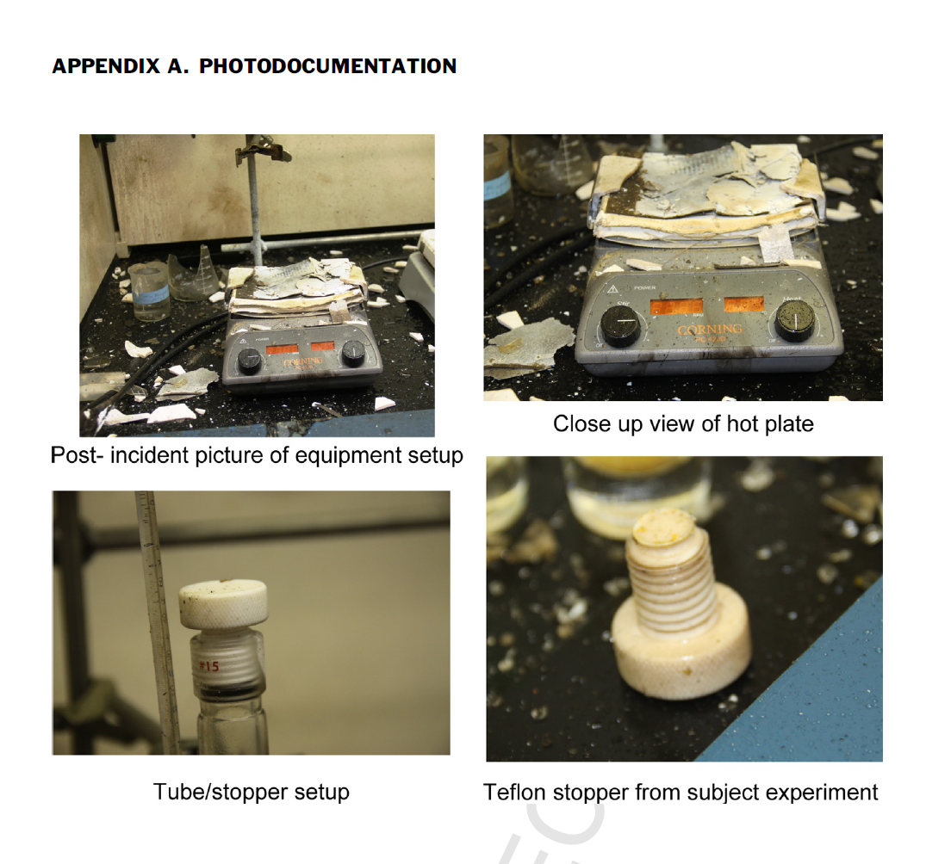
Notes:
You can see some frames from the damage in the laboratory after the explosion.

Slide 14
James Reason’s “Swiss cheese model”
U.S. Chemical Safety and Hazard Investigation Board. Case Study. Texas Tech University Laboratory Explosion No. 2010-05-I-TX
Notes:
This theory of accident causation can be explained in an academic context using James Reason’s aptly named “Swiss Cheese Model.” Reason uses his model to depict a series of security layers (or system defenses) that can prevent an incident. The holes represent gaps in each system where failure can occur. If a series of failures occur one on top of the other, an incident will occur.

Slide 15

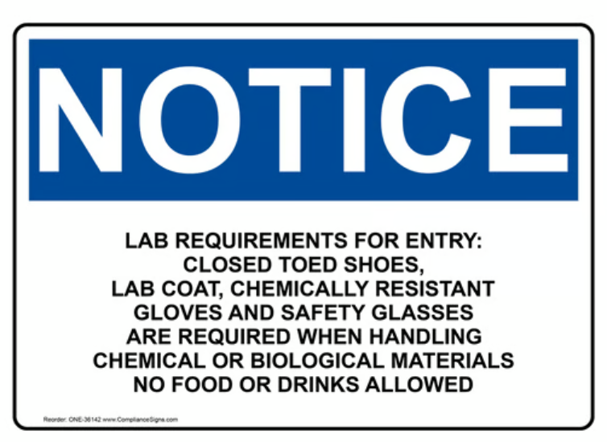
Vaka Çalışması:
Alınan Dersler
Proper Training
Use of Safety Equipment
Security Protocols
Security Culture
Investigation and Reporting
Notes:
This case study of a laboratory explosion is a stark reminder of the importance of laboratory safety:
Proper Training: Adequate training in the use of hazardous materials is essential. Researchers and students must understand the properties and risks of the chemicals they work with.
Use of Safety Equipment: Always wear appropriate safety equipment, including personal protective equipment (PPE) such as lab coats, safety glasses, and gloves.
Safety Protocols: Follow established laboratory safety protocols, including working in fume hoods when handling hazardous materials and knowing the location and proper use of safety equipment such as fire extinguishers.
Emergency Response: In an emergency, follow established emergency response procedures. Attempting to extinguish fires without proper training and equipment can be dangerous.
Safety Culture: Promote a strong safety culture in the laboratory environment by emphasizing the importance of safety awareness and compliance.
Investigation and Reporting: Thoroughly investigate laboratory incidents, no matter how minor. Reporting incidents and near-misses can lead to improvements in safety practices.
This case study highlights the need for ongoing education and vigilance in laboratory safety to prevent accidents and protect the health of laboratory personnel and the integrity of research environments.

Slide 16
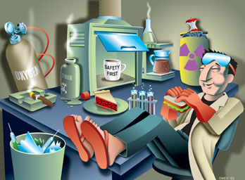
Notes:
Can you find the mistakes in this picture?

Slide 17
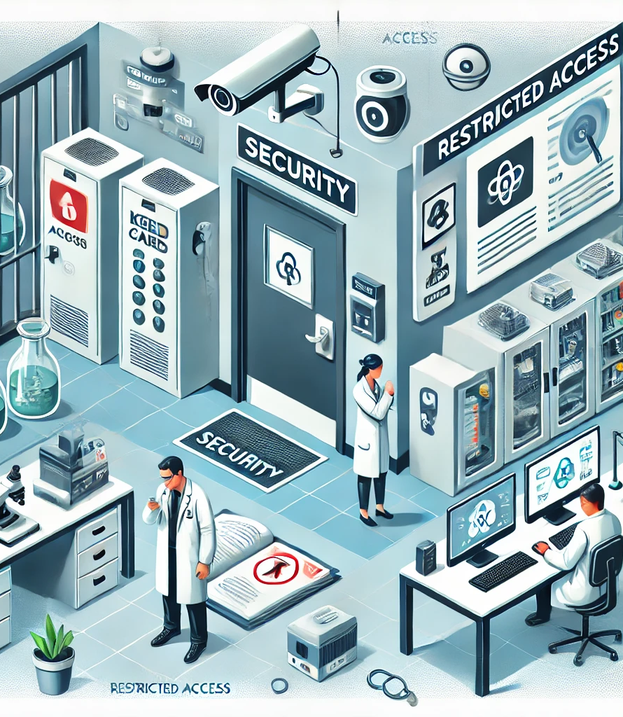
Laboratory Safety
It is critical to the integrity of research as well as to protect personnel, equipment and sensitive information.
Lab Security focuses on preventing accidents and injuries, while Lab Security emphasizes measures to prevent unauthorized access, theft, malicious damage or misuse of hazardous materials.
Created by ChatGPT
Notes:
I would also like to talk a little bit about the concept of laboratory safety. Although biosafety or laboratory safety is quite advanced, especially in laboratories where biological and microbiological products are worked on, the concept of laboratory safety is often either unknown or neglected.
Security in a laboratory is extremely important not only to preserve the integrity of research, but also to protect personnel, equipment, and sensitive information. Unlike general security practices that focus on preventing accidents and injuries, laboratory safety emphasizes measures to prevent unauthorized access, theft, malicious damage, or misuse of hazardous materials. However, laboratories contain both valuable and dangerous substances, materials, and information that can be used for criminal purposes.

Slide 18
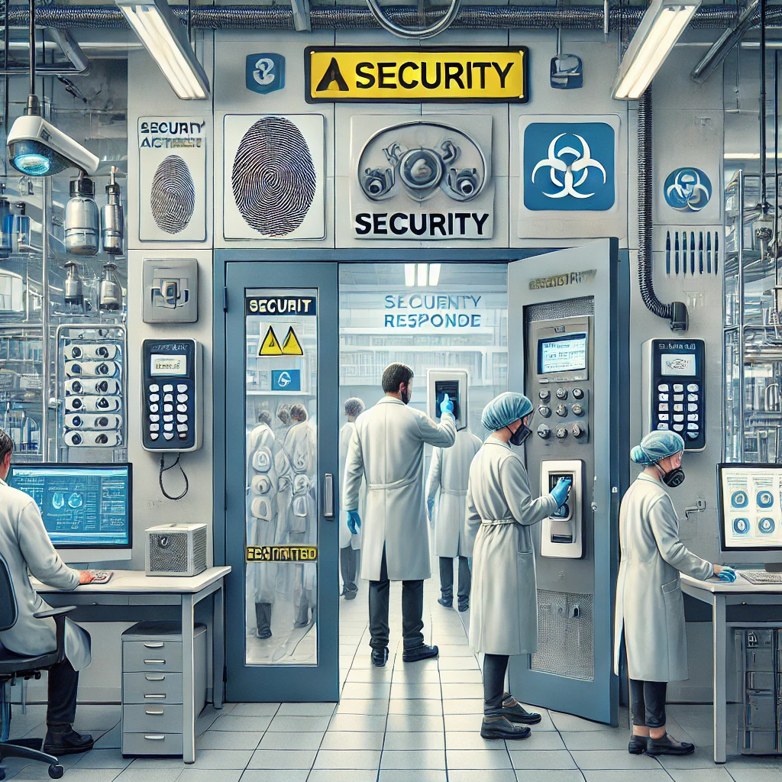
Laboratory Safety
1. Physical Security Measures
Access Control: Restricted Entry, Visitor Management, Surveillance Systems
Equipment and Material Security: Lockable Storage, Alarms and Sensors, Inventory Management
2. Cyber ​​Security and Information Security
Digital Data Protection: Data Encryption, Access Controls for Digital Systems, Regular Backups
Cyber ​​Threat Prevention: Software Security, Phishing Awareness, Secure Communications
Created by ChatGPT
Notes:
Physical Security Measures
Access Control
Restricted Access: Only authorized personnel should have access to certain areas in a laboratory. This can be accomplished using access control systems such as key cards, biometric scanners, or PIN codes.
Visitor Management: Maintain a visitor log and require all visitors to enter and exit. Visitors should be accompanied by authorized personnel at all times.
Surveillance Systems: Install security cameras at key entry and exit points to monitor and record activity. This prevents unauthorized access and provides a record in the event of incidents. 1.2
Securing Equipment and Materials:
Lockable Storage: Sensitive equipment, hazardous chemicals, and biological materials should be stored in restricted-access lockers or refrigerators.
Alarms and Sensors: Use alarms on doors, windows, and storage units to detect unauthorized access or breaches. Motion sensors can add an additional layer of security for high-risk areas.
Inventory Management: Maintain a detailed inventory of all equipment, chemicals, and biological materials. Regular audits should be conducted to ensure nothing is missing or misplaced.
Cybersecurity and Information Security
Protecting Digital Data
Data Encryption: Encrypt all sensitive data, including research data, personal information, and confidential communications. Use secure networks and VPNs for remote access.
Access Controls for Digital Systems: Implement multi-factor authentication (MFA) for access to lab computers, databases, and networks. Assign user privileges based on job roles and limit access to sensitive data to only those who need it.
Regular Backups: Back up data regularly to secure, off-site locations. Make sure backups are encrypted and protected from unauthorized access.
Preventing Cyber ​​Threats
Software Security: Keep all software and operating systems up to date with the latest security patches. Use reputable antivirus and antimalware programs.
Phishing Awareness: Train lab staff to recognize phishing emails and social engineering tactics. Encourage reporting of suspicious emails and potential security breaches.
Secure Communications: Use encrypted communication channels for sensitive information, such as secure email platforms with end-to-end encryption or private communication tools.

Slide 19
Laboratory Safety
3. Handling Hazardous Materials
Chemical Safety: Inventory Control, Proper Storage, Training and Awareness
Biological Materials Safety: Biosecurity Measures, Transportation Security, Incident Response Plan
4. Personnel Safety
Screening and Training: Background Checks; Security Training
Monitoring and Inspection: Continuous Monitoring, Buddy System
Created by ChatGPT
Notes:
Handling Hazardous Materials
Chemical Safety
Inventory Control: Maintain an up-to-date inventory of all chemicals, including quantities and storage locations. Any acquisition or disposal should be recorded immediately.
Proper Storage: Store chemicals according to their hazard classifications and ensure that incompatible materials are segregated. Flammable materials should be stored in fire-resistant cabinets.
Training and Awareness: Ensure that all personnel are trained on the hazards associated with the chemicals they handle and understand safety protocols for their storage and use.
Biological Material Safety
Biosecurity Precautions: Implement biosecurity protocols for handling and storing biological materials, especially pathogens or toxins. Access to these materials should be restricted and controlled.
Transportation Security: Use secure, tamper-resistant containers when transporting biological materials and comply with national and international regulations. Maintain chain of custody records.
Incident Response Plan: Develop and regularly update an incident response plan to address potential biosecurity breaches, such as theft, loss, or release of hazardous biological agents.
Personnel Security
Screening and Training
Background Checks: Conduct comprehensive background checks for all employees who will have access to sensitive materials or data, especially those who will have access to sensitive materials or data. This includes criminal history, employment verification, and reference checks.
Security Training: Regularly train all personnel on laboratory security protocols, including recognizing and responding to suspicious behavior, handling sensitive information, and complying with access control measures.
Monitoring and Auditing
Continuous Monitoring: Use surveillance and monitoring tools to detect and deter unauthorized activity. Regularly review access logs and surveillance recordings.
Buddy System: Implement a buddy system for high-security tasks or access to restricted areas. This ensures accountability and reduces the risk of theft or misuse.

Slide 20
Laboratory Safety
5. Emergency Response and Incident Management
Incident Reporting and Investigation: Reporting Protocols, Incident Investigation
Emergency Preparedness: Emergency Drills, Communication Plan
Created by ChatGPT
Notes:
Emergency Response and Incident Management
Incident Reporting and Investigation
Reporting Protocols: Develop clear procedures for reporting security incidents, including unauthorized access, theft, data breaches, or suspicious activity. Ensure that all personnel are aware of these protocols.
Incident Investigation: Designate a security team responsible for investigating incidents, determining their cause, and implementing corrective measures to prevent recurrence.
Emergency Preparedness
Emergency Drills: Conduct regular security drills to test the laboratory’s readiness to respond to a variety of security threats, such as intrusions, cyberattacks, or hazardous material leaks.
Communication Plan: Create an internal communication plan to ensure rapid dissemination of information in the event of an emergency. This may include email alerts, text messages, or public address systems.

Slide 21
Questions and Discussion
QUESTION AND ANSWER
SHARING EXPERIENCES
LET'S SUMMARIZE
Notes:
Please review the books and other documents on our website to obtain more detailed information on the subject. You can use our social media accounts for any questions or concerns you may have.

Slide 22
Laboratory Safety and Security Summary
Lab Safety
  Safety protocols
  Risk assessment
  Personal and environmental safety
Lab Safety
  Physical security measures
  Protection of sensitive information
  Responsible use of hazardous materials
  Emergency preparedness
SAFETY FIRST!!!
A center for innovation and discovery in a safe working environment
Notes:
In conclusion, laboratory safety and laboratory security are a shared responsibility that requires the vigilance, knowledge, and commitment of everyone working in the laboratory.
By following established safety protocols, conducting risk assessments, and prioritizing personal and environmental safety, laboratories can continue to be centers of innovation and discovery while minimizing the risks associated with scientific research.
By implementing robust physical security measures, protecting sensitive information, handling hazardous materials responsibly, and preparing for emergencies, laboratories can maintain a secure environment conducive to safe and effective research. Continuous evaluation and adaptation of safety protocols are essential to counter evolving threats and maintaining a safe work environment.
Always remember: safety first.

Slide 23

Additional Resources
T.C. Sağlık Bakanlığı Halk Sağlığı Genel Müdürlüğü, Ulusal Mikrobiyoloji Standartları, Laboratuvar Güvenliği Rehberi. Sağlık Bakanlığı Yayın No: 1204, Ankara, 2021
https://www.csb.gov/texas-tech-university-chemistry-lab-explosion/
Phifer, R., Case study – Incident investigation, J. Chem. Health Safety (2014), doi:http://dx.doi.org/ 10.1016/j.jchas.2014.04.001
https://www.osha.gov/laws-regs/regulations/standardnumber/1910/1910.1450
https://www.who.int/publications/i/item/9789240011311

Slide 24








Project Partners

Slide 25




This document was prepared for the Erasmus Project "2022-1-TR01-KA220-VET-000088373
A UNIVERSAL STRATEGIC NECESSITY: FROM MOLECULE TO DRUG»
"”Supported by the European Commission within the scope of the Erasmus+ Programme. However, the European Commission and the Turkish National Agency cannot be held responsible for the opinions expressed here."
Notes:
A universal necessity: From Molecule to Drug Project
"Supported by the European Commission within the Erasmus+ Programme.
However, the European Commission and the Turkish National Agency cannot be held responsible for the views expressed here."

Slide 26
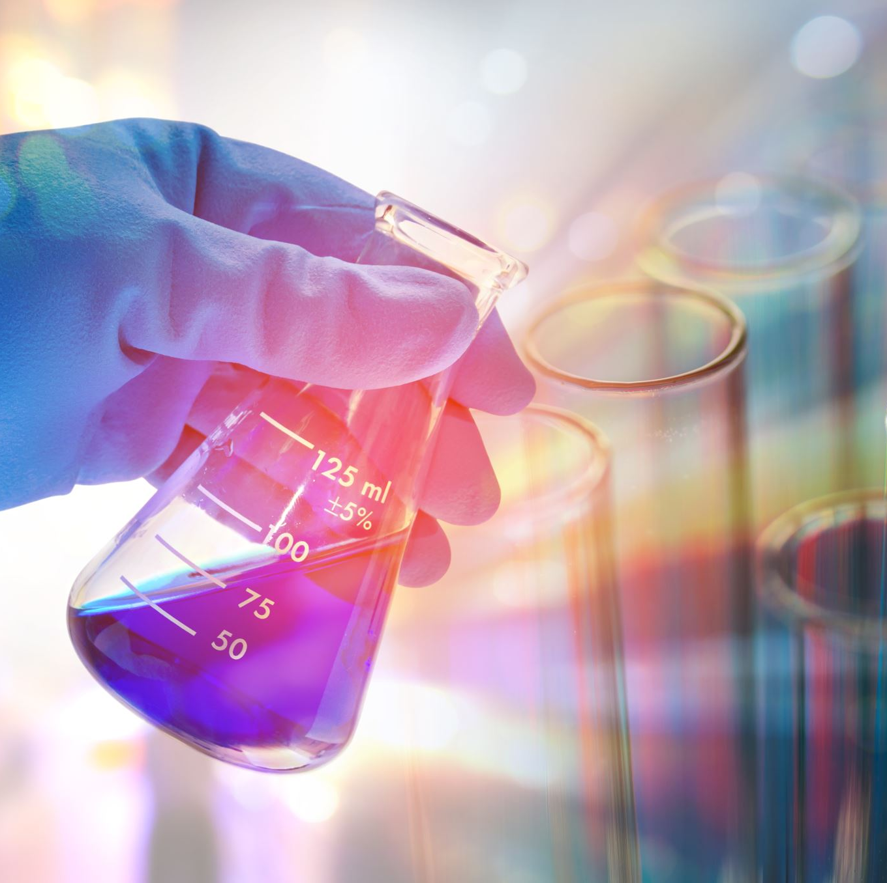

THANK YOU
Notes:
Projemize desteklerinden ötürü Avrupa Komisyonu’na ve proje ekibinde yer alarak katkıda bulunan tüm üyelerimize ve proje kapsamındaki etkinliklere katılan herkese teşekkür ederiz.

